Slide 1

bioinformatics.ca
bioinformaticsdotca.github.io

Slide 2


Slide 3

Module 3: Introduction to Neural Networks
David Wishart
Machine Learning
Apr 22-23, 2026
University of Alberta

Slide 4

Schedule (MT)
Day 1 (MT) | Wednesday Apr. 22 | Day 2 (MT) | Day 2
9:00 AM | Introductions and Technology Check | 9:00 AM | Module 5: Gene Finding with NNs (Lecture and Lab)
9:45 AM | Module 1: Introduction to Machine Learning (Lecture) | 11:00 AM | Break (30 min)
11:00 AM | Break (30 min) | 11:30 AM | Module 6: Machine Learning with Keras and Scikit-Learn (Lecture/Lab)
11:30 AM | Module 2: Decision Trees (Lecture and Lab) | 1:00 PM | Break (45 min)
1:00 PM | Break (1 hour) | 2:00 PM | Module 7: Machine Learning with Keras and Scikit-Learn (Cont'd)
2:00 PM | Module 3: Neural Networks (Lecture and Lab) | 3:00 PM | Break (30 min)
3:00 PM | Break (30 min) | 3:30 PM | Module 8: LLMs and agentic coding for bioinformatics
3:30 PM | Module 4: Neural Networks for 2º Structure (Lecture and Homework) | 4:45 PM | Survey and Closing Remarks
5:00 PM | End of Day 1 | 5:00 PM | End of Day 2
Canadian Bioinformatics Workshops | bioinformatics.ca

Slide 5
Schedule (PT)
Day 1 (PT) | Wednesday Apr. 22 | Day 2 (PT) | Thursday Apr. 23
8:00 AM | Introductions and Technology Check | 8:00 AM | Module 5: Gene Finding with NNs (Lecture and Lab)
8:45 AM | Module 1: Introduction to Machine Learning (Lecture) | 10:00 AM | Break (30 min)
10:00 AM | Break (30 min) | 10:30 AM | Module 6: Machine Learning with Keras and Scikit-Learn (Lecture/Lab)
10:30 AM | Module 2: Decision Trees (Lecture and Lab) | 12:00 PM | Break (45 min)
12:00 PM | Break (1 hour) | 1:00 PM | Module 7: Machine Learning with Keras and Scikit-Learn (Cont'd)
1:00 PM | Module 3: Neural Networks (Lecture and Lab) | 2:00 PM | Break (30 min)
2:00 PM | Break (30 min) | 2:30 PM | Module 8: LLMs and agentic coding for bioinformatics
2:30 PM | Module 4: Neural Networks for 2º Structure (Lecture and Homework) | 3:45 PM | Survey and Closing Remarks
4:00 PM | End of Day 1 | 4:00 PM | End of Day 2
Canadian Bioinformatics Workshops | bioinformatics.ca

Slide 6
Learning Objectives
To explain how biological systems learn
To introduce the concept of neural networks
To explain key concepts in neural network algorithms (one-hot encoding, back propagation, hidden layers)
To review and explain python code for an ANN for Iris classification
To compare performance of ANNs with DTs

Slide 7
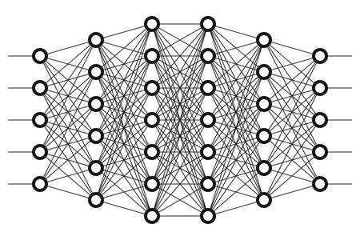
Artificial Neural Network
Input
Attempts to simulate the function and activity of the brain using inputs, outputs and neurons
ANNs are based on a collection of connected units or nodes called artificial neurons, which loosely model the neurons in a biological brain
Can be used for both classification and regression
Output

Slide 8
Explaining Neural Networks
ANNs can be used for supervised or unsupervised classification
First described in detail in 1986
Mimic the way the brain works
Layers of neurons connected to each other to perform pattern analysis and logic operations
Computer converts neuron locations and connections to tables or matrices

Slide 9
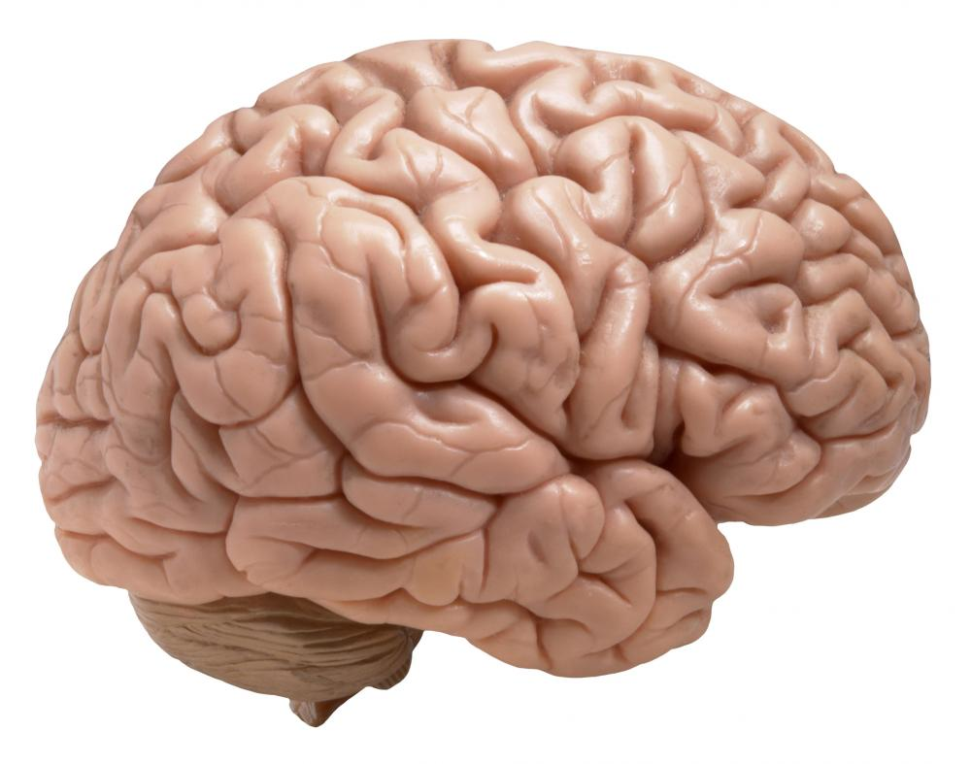


The Brain’s Neural Networks

Slide 10
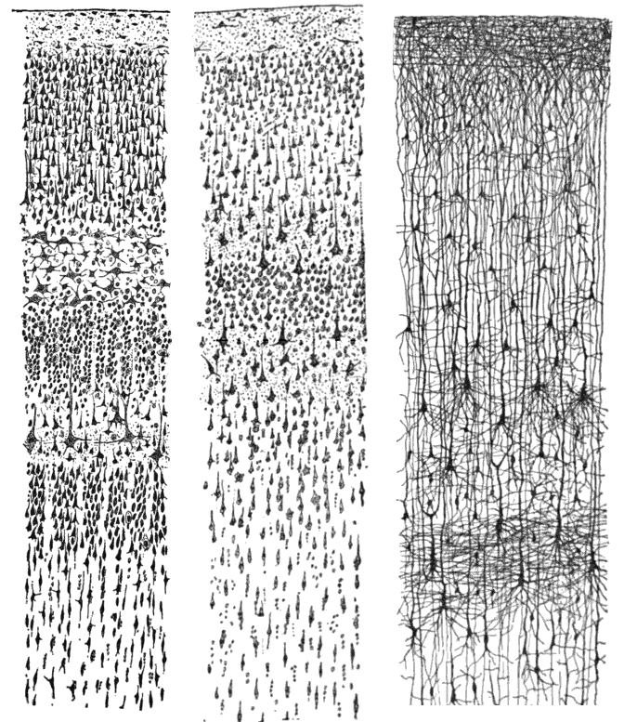
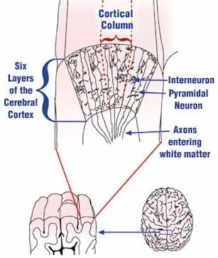
Neural Structure

Slide 11
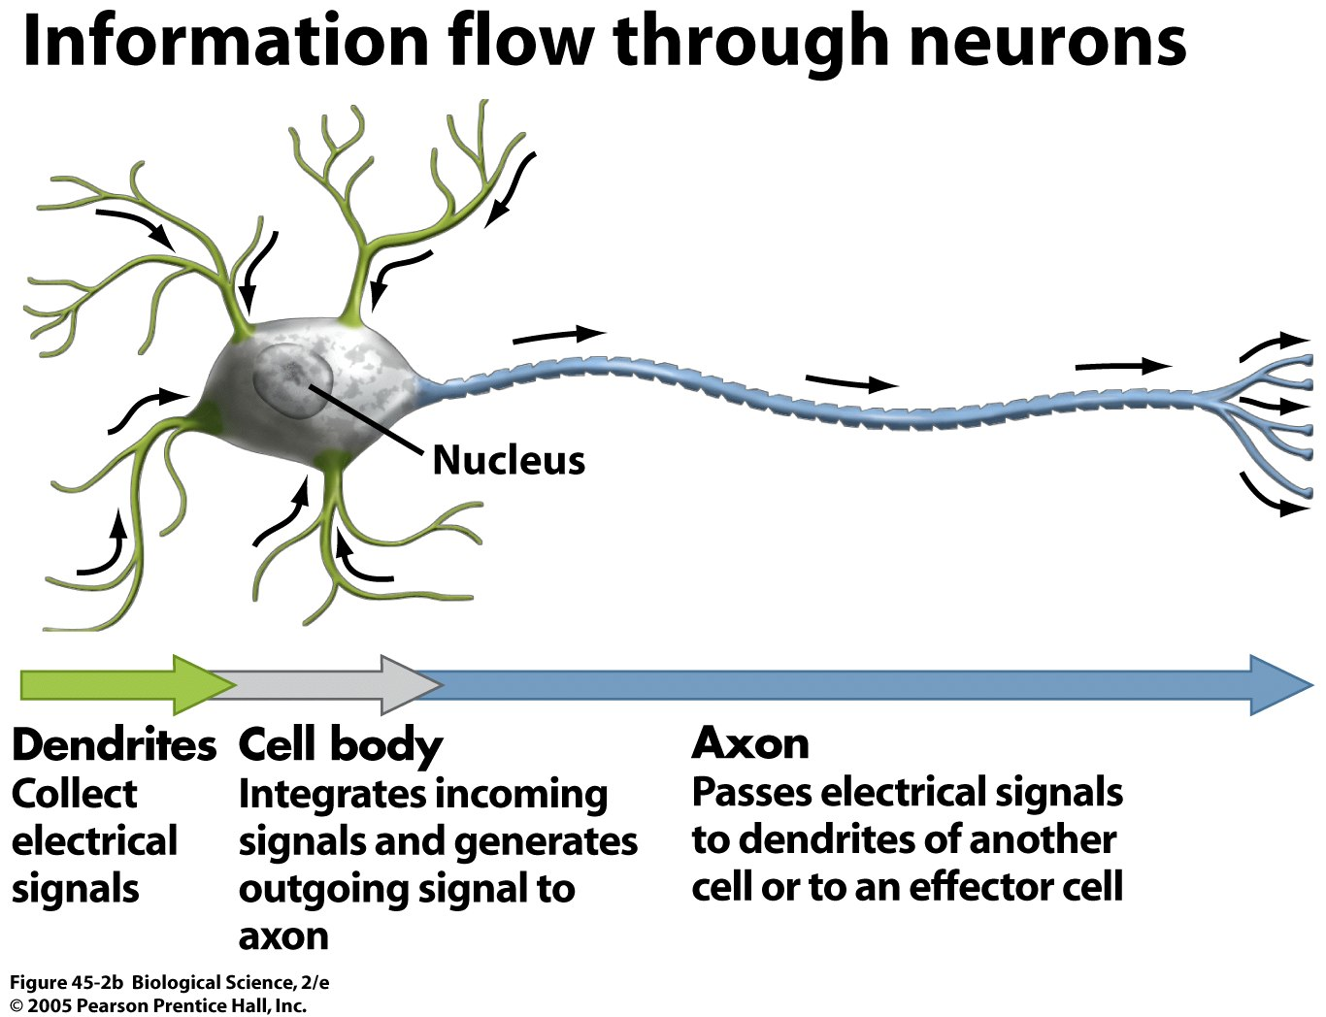
Neurons

Slide 12
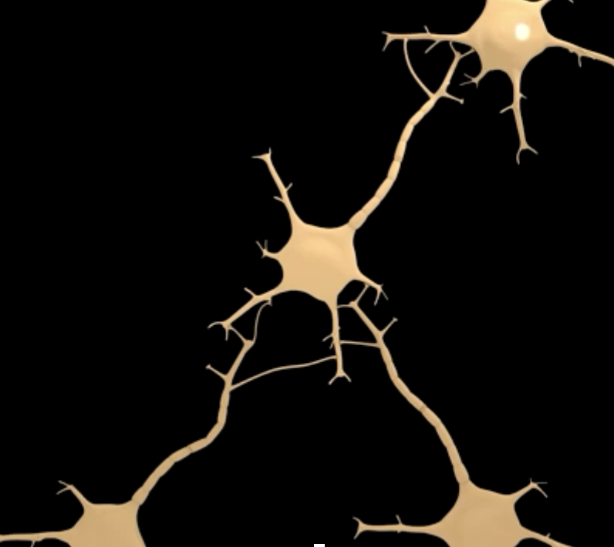
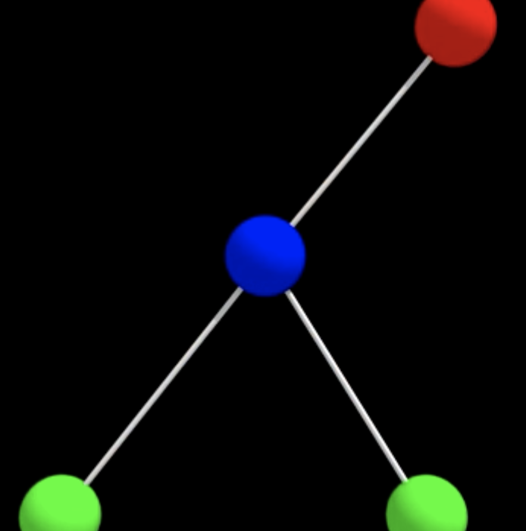
Neurons Form Networks
Neurons in the brain accumulate signals from other neurons integrating the input signals and then if a threshold is reached, they fire, propagating signals to other neurons as outputs
This can be schematized as a mathematical network of nodes and edges or a matrix
The interactions between nodes can be described as addition, subtraction and differentiation functions to do Boolean logic

Slide 13
Brain’s Neural Network for Image Recognition
How Your Brain
Interprets These
Observations
Observations

Slide 14
Artificial Neural Network for Image Recognition
nodes
Training Input Hidden Output
Set Layer Layer

Slide 15
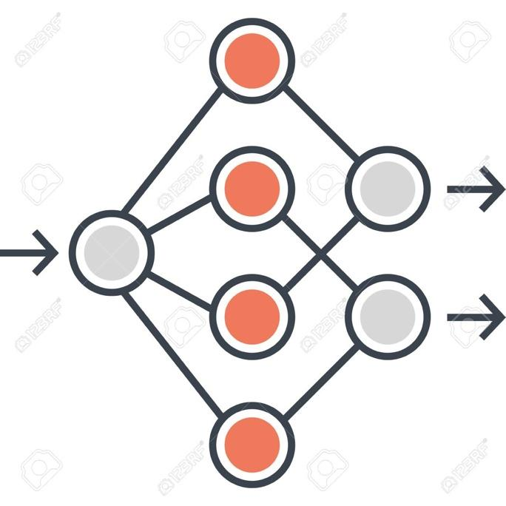
Artificial Neural Networks & Deep Learning
Conventional ANN
Deep Neural Net
*Deep learning is the “hottest” area of machine learning as DNNs seem to allow
more complex rules/patterns to be learned or found than other ML methods

Slide 16
Neural Network Timeline
1949
Hebb Model
of neuron
1958
Rosenblatt
Perceptron
1975 Werbos
Back
propagation
2009-2012
Schmidhuber
Recurrent ANNs
1943 McCulloch
& Pitts (Threshold
Logic Model)
1969 Minsky
XOR Failure
1986
Rummelhart
& McClelland
Book on ANNs
2015
DNNs
popularized

Slide 17
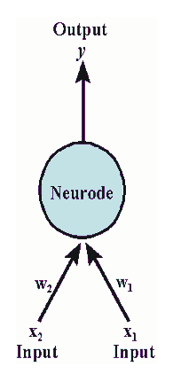
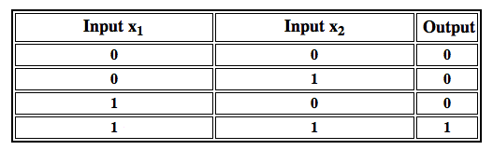
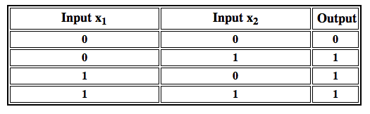
McCulloch & Pitts
Threshold Logic
AND Function
OR Function

Slide 18
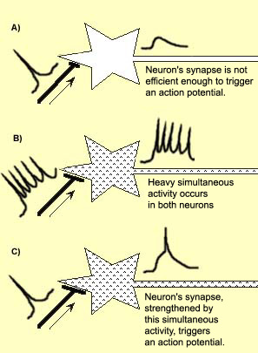
Donald Hebb (McGill)
When an axon of cell A is near enough to excite a cell B and repeatedly or persistently takes part in firing it, some growth process or metabolic change takes place in one or both cells such that A’s efficiency, as one of the cells firing B, is increased

Slide 19
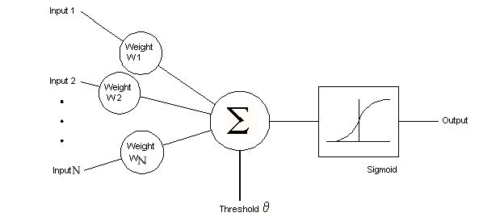
Rosenblatt Perceptron

Slide 20
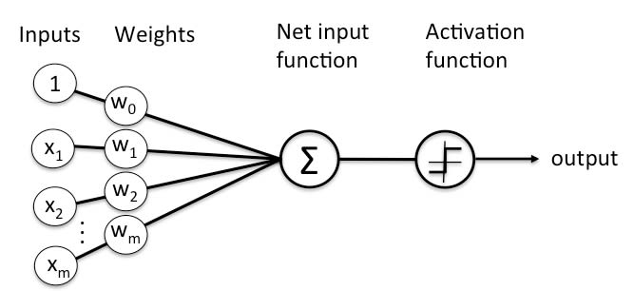
The Perceptron
The Perceptron is a mathematical model of a biological neuron, which takes in input values, weighs and adds them, and passes them through a function to determine an output

Slide 21

Activation Function
The activation function receives the weighted sum of all the inputs and outputs a value
A simple example is the step function, which will return 1 if the weighted sum is greater than 0, and 0 if otherwise

Slide 22
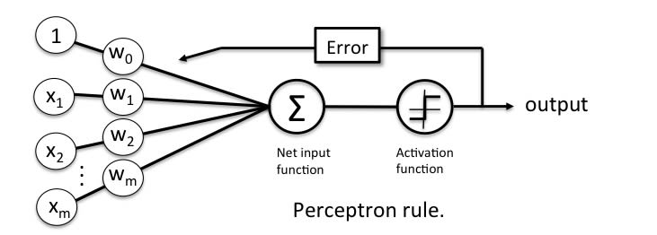
How The Perceptron Learns
In supervised learning, a training set is provided to the model
This allows it to make predictions on the inputs, and compare those predictions to the actual outputs in the training set
The error between the actual output and predicted output is then used to change the weights of the connections from the inputs
This process is repeated until the model attains a minimum error

Slide 23
How the Weights Change
To change the weights, a method called gradient descent is used
Simply put, the weights will change according to the slope of the error function
In this example, the value by which to update the weights is found by multiplying the errors (expected - predicted) by the inputs (x), which is further multiplied by an attenuating factor called learning rate
w = w - learning_rate * (expected - predicted) * x

Slide 24
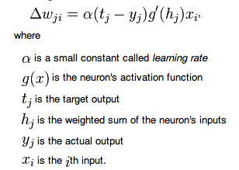



Delta Rule
Activation Functions

Slide 25

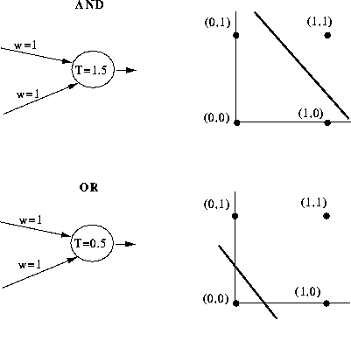
Perceptron Performance
A perceptron, using the learning rule shown previously, is able to classify linearly separable problems, that is, problems where input data is classified into one of two possible categories along a straight line
This is due to the fact that the output of the perceptron is decided based on a linear combination of its inputs
1 AND 1 = 1
0 AND 0 = 0
0 AND 1 = 0
1 OR 1 = 1
0 OR 0 = 0
0 OR 1 = 1
Logical Multiplication
Logical Addition

Slide 26
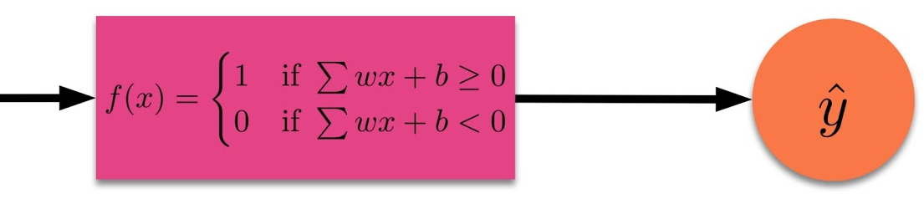
Perceptron Performance cont...
These examples show the performance of a perceptron in modeling the AND and OR logical functions
If the weighted sum of the two inputs x1 and x2 is greater than the threshold T, then the output is classified as 1
Otherwise, the output is classified as 0

Slide 27
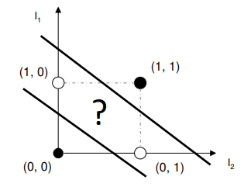
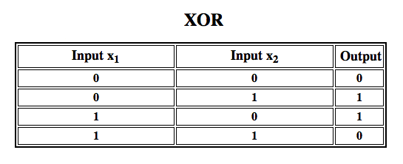
Limits of Perceptron Performance
Because the output is dependent on a linear combination of inputs, a perceptron cannot classify data that is not linearly separable
A simple example of this is the logical function XOR
Because no single line is able to separate the two classes, a perceptron will not be able to categorize the data
Logical Difference or Inequality

Slide 28
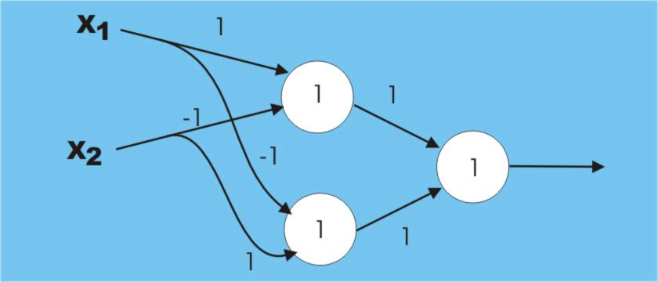
XOR Requires 2 layers

Slide 29
Neural Network Timeline
1949
Hebb Model
of neuron
1958
Rosenblatt
Perceptron
1975 Werbos
Back
propagation
2009-2012
Schmidhuber
Recurrent ANNs
1943 McCulloch
& Pitts (Threshold
Logic Model)
1969 Minsky
XOR Failure
1986
Rummelhart
& McClelland
Book on ANNs
2015
DNNs
popularized

Slide 30
Neural Networks or Multi-Layered Perceptron (MLP)
Extension of the perceptron
Uses multiple layers to mimic layered structure of the brain
NNs contain at least three layers, an input layer, a hidden layer, and an output layer
Multiple layers allow perceptrons to exhibit more learning and computational complexity
Uses more sophisticated learning algorithm (back propagation)
Capable of handling XOR, therefore can handle nonlinear separation and classification
“Rediscovered” and revived in the 1980s

Slide 31
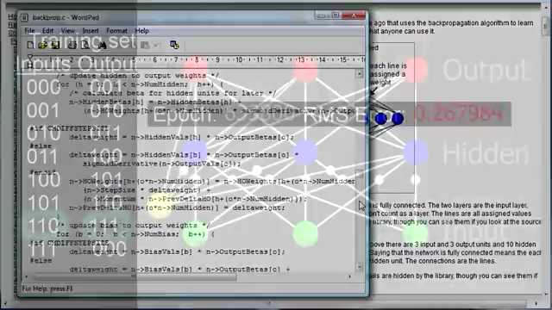
Neural Network Video
https://www.youtube.com/watch?v=WZDMNM36PsM

Slide 32
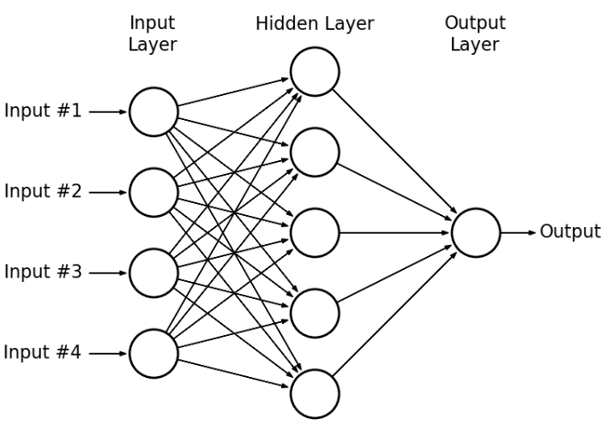
Neural Networks
Feedforward neural networks (NNs) or artificial neural networks (ANNs) or multi-layer perceptrons (MLPs) are known as universal function approximators, and are able to distinguish data that are not linearly separable

Slide 33
ANN Terminology
Hidden Layer – Any layer between the input and output is a hidden layer. These layers perform transformations on, and make associations between inputs.
Forward Propagation – The first step in learning, where a sample (input) is passed through the network. Inputs are multiplied by weights and evaluated by the activation function.

Slide 34
ANN Terminology
Backpropagation – The ANN uses the error between the predicted output and true output to change the weights and biases of previous layers
Epoch – The set of samples used to train the ANN can be applied multiple times. One iteration of the training set is known as an epoch

Slide 35
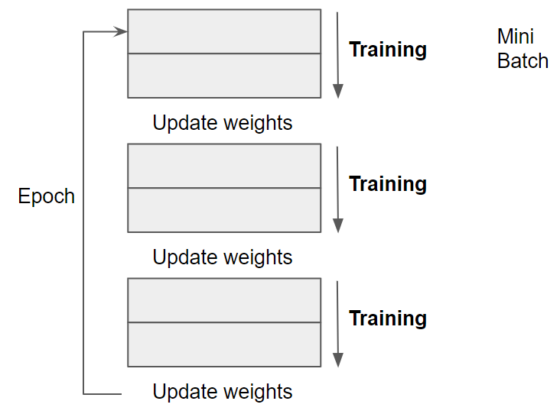
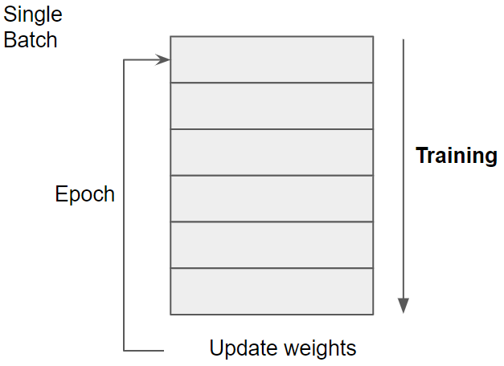
ANN Terminology
Batch Learning – In batch learning, the training set is first broken up into batches
Batch learning allows weights to be updated more frequently per epoch

Slide 36
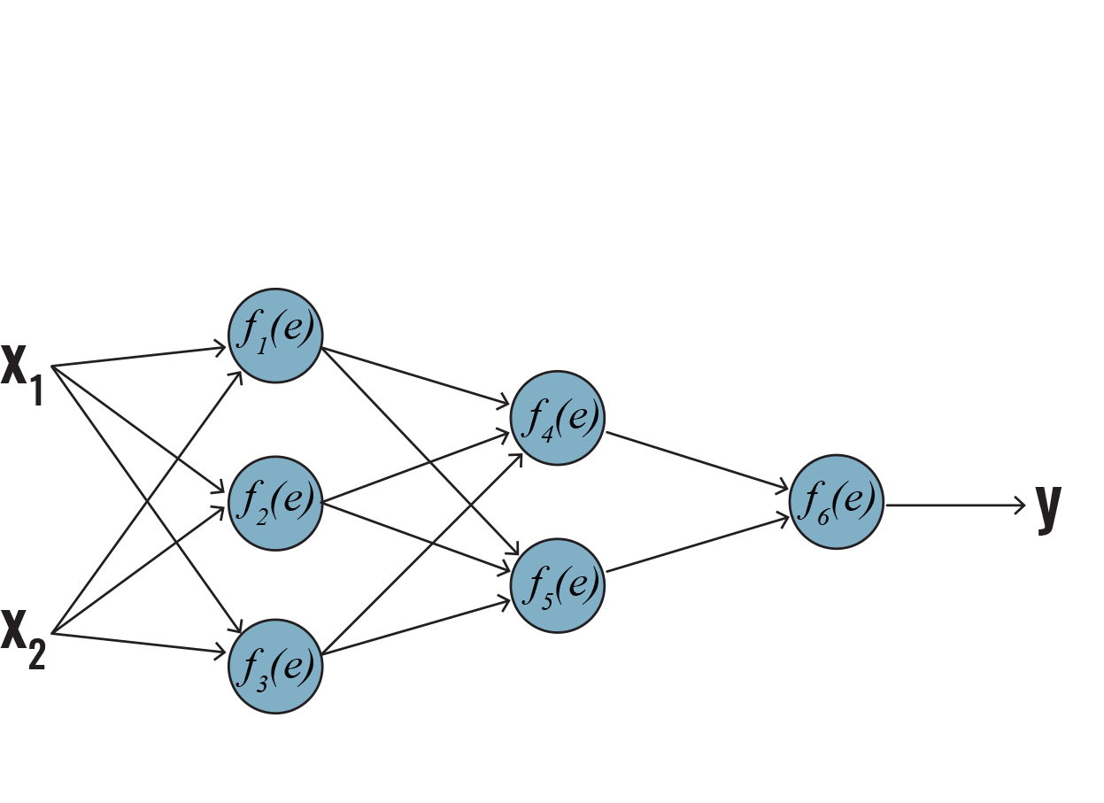
ANN Learning: Forward Propagation
Similar to a single perceptron, an MLP learns by propagating a training set forward, finding the error between the predicted values and actual values, and using that error to change the weights and biases to reduce that error
Forward propagation involves taking the weighted sum of inputs and applying the activation function
The output of the activation function is then propagated to the next layer
Arrows = matrix elements
y_{i} = outputs
e = linear comb of wgts x input
Input Hidden 1 Hidden 2 Output
https://www.icgi.no/Technology/Deep-learning

Slide 37
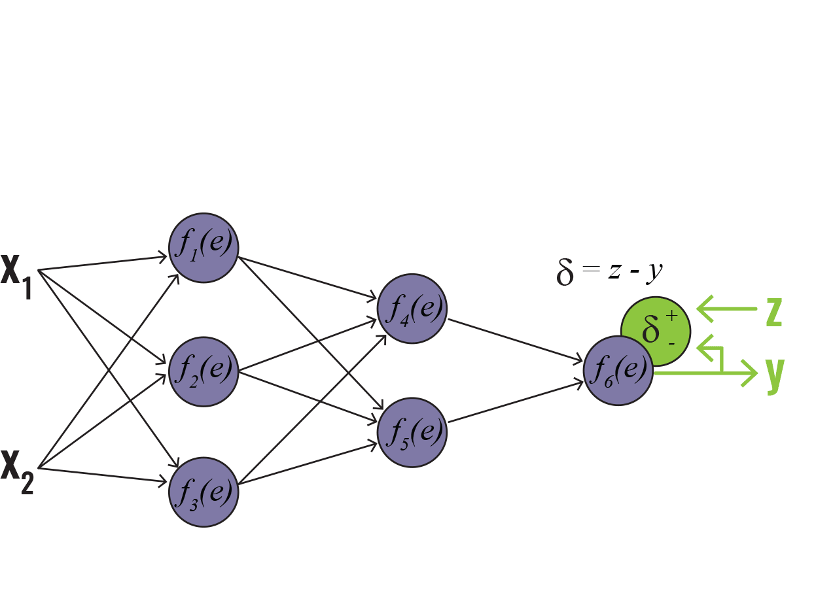
ANN Learning: Back Propagation
The next step in learning is back propagation
The output error is found by subtracting the actual value of the output by the predicted value
To determine the error in output caused by error in previous layers, the output error is back propagated
This is done by multiplying the error by the weight matrix of the previous layer
The ‘ẟ’ here represents the derivative of the cost function with respect to the predictions
Cost function = cross entropy
https://www.icgi.no/Technology/Deep-learning

Slide 38
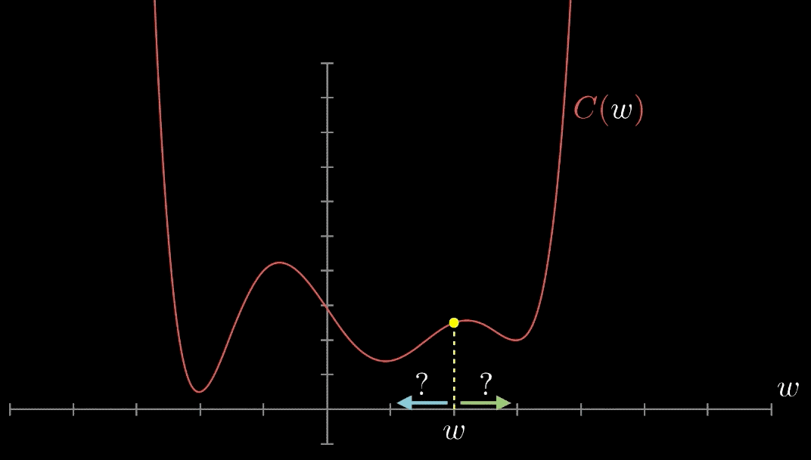
ANN Learning: Gradient Descent
The cost function is the function used to determine the error between the output found by the model and the actual output
To minimize the cost function, we use the derivative with respect to the weights
This gives the slope of the cost function, and therefore which direction the weights should be moved
If the derivative of the cost function at a particular set of weights is negative, then this subtracted by the current weights will increase the weights

Slide 39
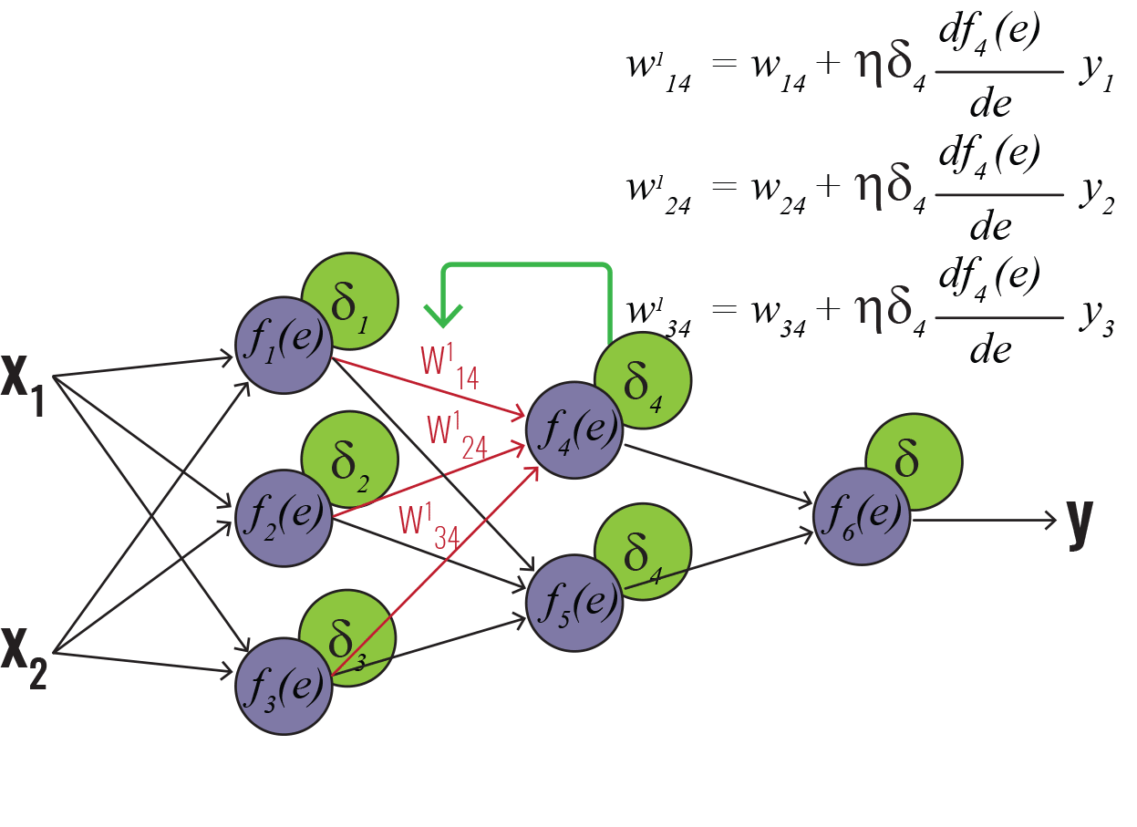
ANN Learning: Updating Weights
Using ‘ẟs’ found earlier, we can find the derivative of the cost function with respect to the weight matrices
To do this, the ‘ẟ’ for a given layer is multiplied by the derivative of the cost function with respect to the input of that layer
This is further multiplied by the corresponding input
This product is then multiplied by the constant factor ‘η’ called learning rate
δ is the derivative of cost function
df/de is derivative of activation function
relative to input “e” (weighted sum of inputs)
y_{i} is output of each neuron
Derivative of the cost function with respect to weights
-
-
-
https://www.icgi.no/Technology/Deep-learning

Slide 40
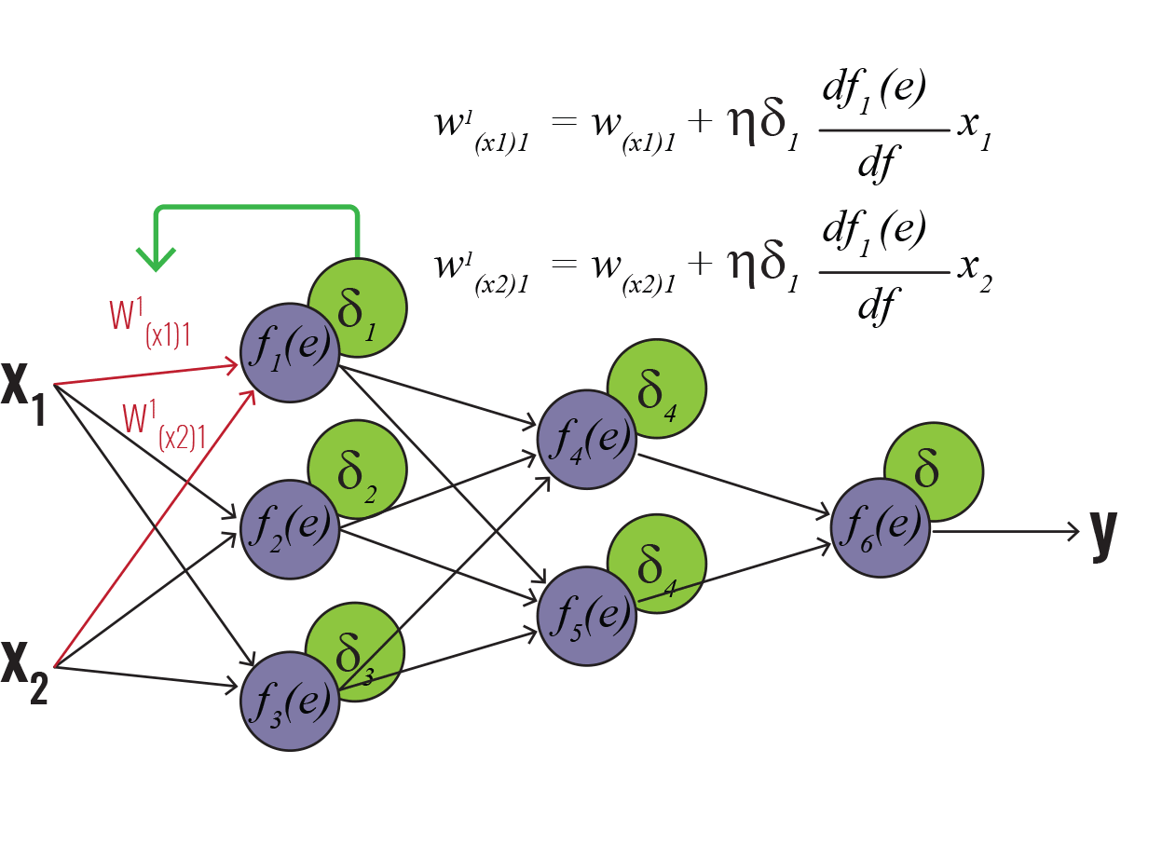
ANN Learning: Updating Weights
The total product is subtracted from the weights to find the new weight matrix
Through this algorithm, the weights will be updated so that the cost function will be decreased
https://www.icgi.no/Technology/Deep-learning

Slide 41
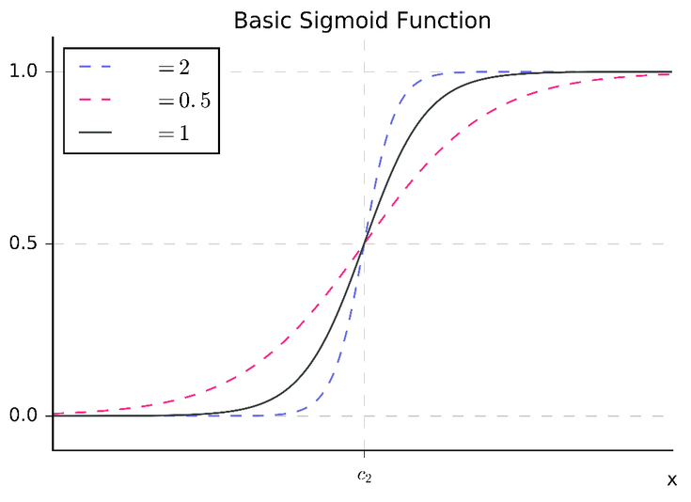



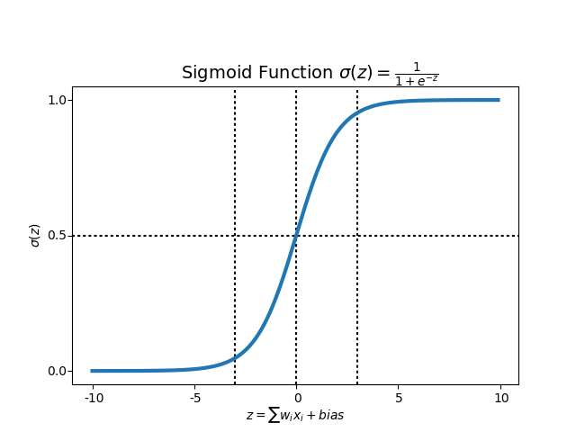
Effects of Weight Changes
Changing the weights can be understood as changing the steepness of the activation function curve
Higher weights
Lower weights
= y_{i}

Slide 42
Effects of Bias Changes
A bias term is used to shift the activation function left or right
For example, to get an output of 0.5 for an input of 5, we can apply a bias of -5

Slide 43
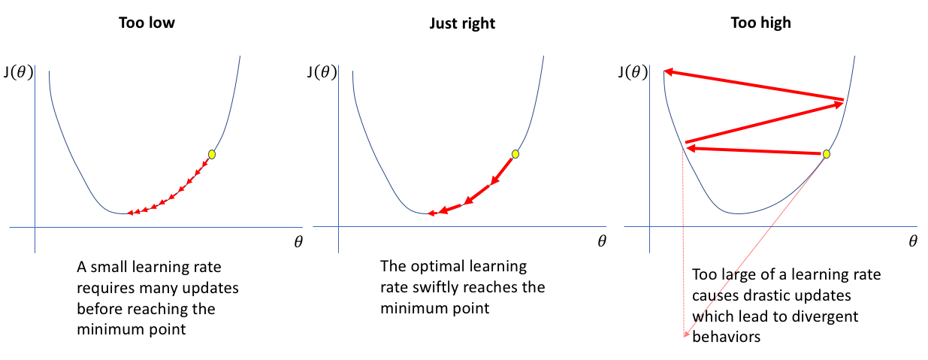
Effects of The Learning Rate
The learning rate (η) is a number between 0 and 1 used to decrease the amount by which the weights and biases are changed
Without adjusting learning rate, the model will overshoot the minimum of the cost function

Slide 44
ANN Mathematically
1
Activation
Function
1 + e^{-x}
1 x 2 array 2 x 3 array 1 x 3 array 3 x 1 array
.2 .4 .1
.1 .0 .4
.1
.0
.3
[0 1]
[.1 .0 .4]
[.13]
compare
[0]
Desired
output
Input Weight Interm. Weight Output
Vector Matrix1 Vector Matrix2 Vector

Slide 45
Back Propagation
1
Activation
Function
1 + e^{-x}
.1
.2
.1
.02
.2 .4 .1
.1 .0 .4
.1
.0
.3
[0 1]
[.1 .0 .4]
[.13]
.2
.1
.3
compare
[0]
Desired
output
Input Weight Interm. Weight Output
Vector Matrix1 Vector Matrix2 Vector

Slide 46
Calculate New Output
1
Activation
Function
1 + e^{-x}
.1 .2 .1
.1 .0 .3
.02
.0
.2
[0 1]
[.1 .0 .3]
[.062]
compare
[0]
Desired
output
Input Weight Interm. Weight Output
Vector Matrix1 Vector Matrix2 Vector

Slide 47
Train on Second Input Vector
1
Activation
Function
1 + e^{-x}
.1 .2 .1
.1 .0 .3
.02
.0
.2
[1 1]
[.2 .2 .4]
[.084]
compare
[1]
Desired
output
Input Weight Interm. Weight Output
Vector Matrix1 Vector Matrix2 Vector

Slide 48
Back Propagation
1
Activation
Function
1 + e^{-x}
.2
.2
.2
.03
.1 .2 .1
.1 .0 .3
.02
.0
.2
[0 1]
[.2 .2 .4]
[.084]
.4
.1
.4
compare
[0]
Desired
output
Input Weight Interm. Weight Output
Vector Matrix1 Vector Matrix2 Vector

Slide 49
After Many Iterations….
.03
.01
.42
.14 .21 .19
.13 .03 .38
Two “Generalized” Weight Matrices

Slide 50
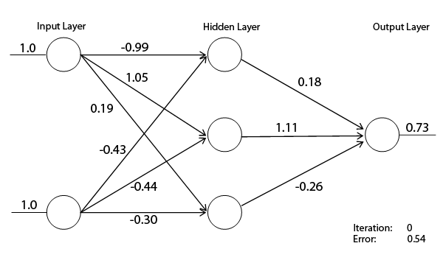
Neural Network Simulation
1 x 2 array 2 x 3 array 3 x 1 array 1 output

Slide 51
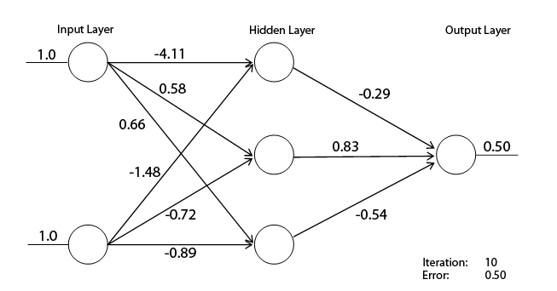
Neural Network Simulation

Slide 52
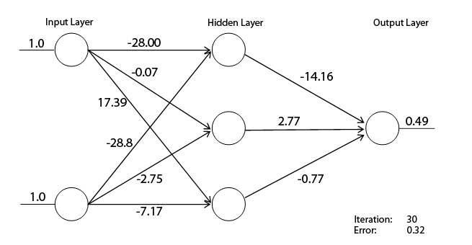
Neural Network Simulation

Slide 53
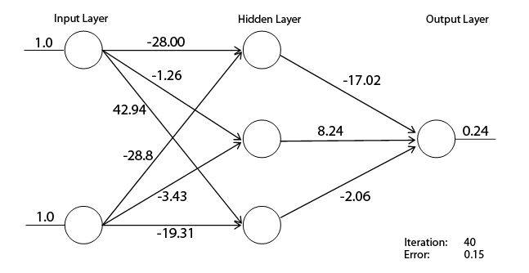
Neural Network Simulation

Slide 54
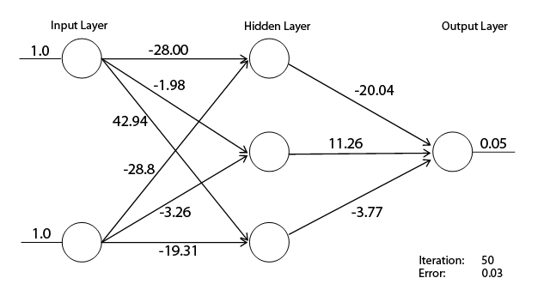
Neural Network Simulation

Slide 55
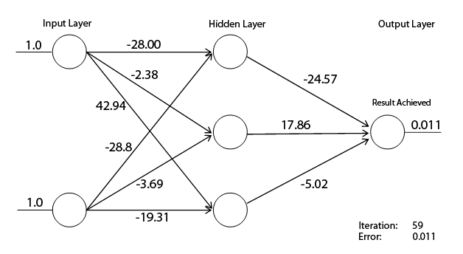
Neural Network Simulation

Slide 56
Let’s Try A Real Example

Slide 57
Machine Learning Workflow
Define an ML problem and propose a solution
Construct your dataset
Transform your dataset & select features
Use the model to make predictions
Test and validate your model
Choose and train a model
How do I classify Iris flowers in my area based on their floral dimensions?

Slide 58
Machine Learning Workflow
Define an ML problem and propose a solution
Construct your dataset
Transform your dataset & select features
Use the model to make predictions
Test and validate your model
Choose and train a model
Find a good training/testing data set

Slide 59
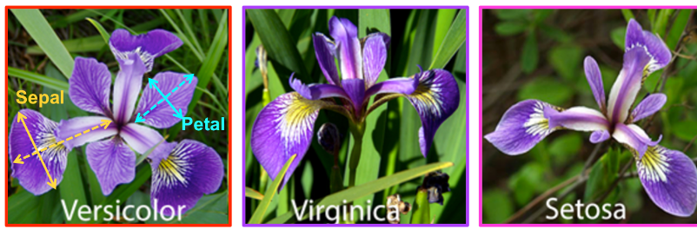
Iris Flower Data Set
Iris flower data set introduced in 1936 by Ronald Fisher (Statistician) to demonstrate linear discriminant analysis
Consists of 50 samples each of the Iris species: Iris setosa, Iris virginica, Iris versicolor
Four features measured from each sample, length and width of sepals and petals in cm
Different iris species can be differentiated by their petal/sepal dimensions

Slide 60
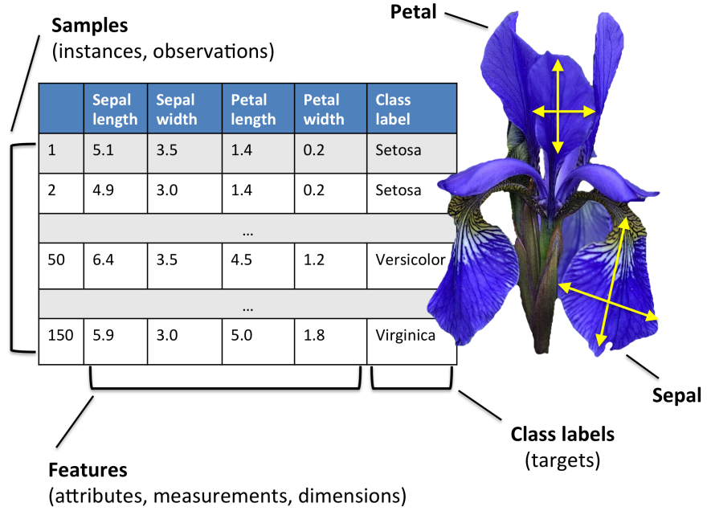
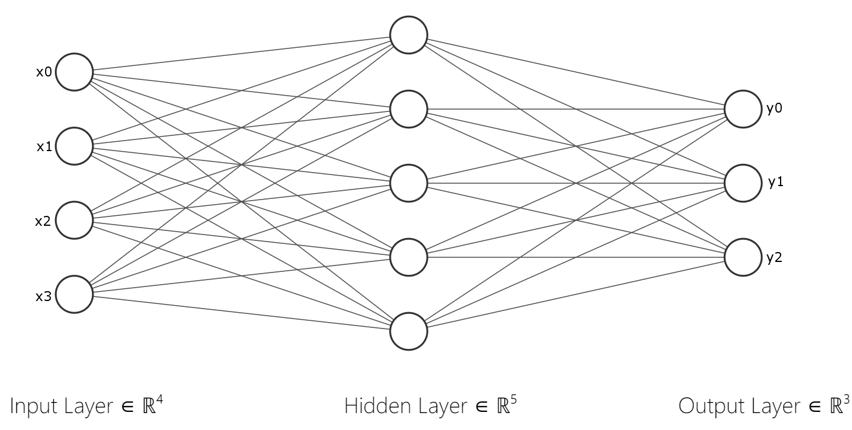
Iris Flower Neural Network
We will construct a neural network that will take as input these four features, and predict which category the flower belongs to
The neural network will be trained on a subset of the 150 samples (training set), and will be tested on another subset (test set)
https://sebastianraschka.com/Articles/2015_pca_in_3_steps.html

Slide 61
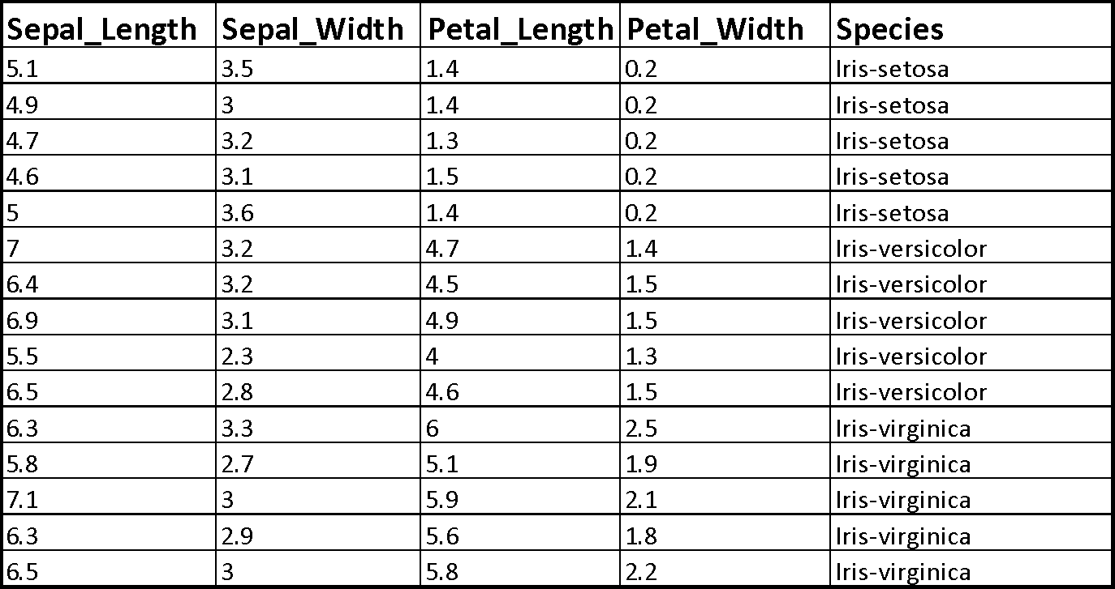
Format Data/Select Features

Slide 62
Let’s Try Programming an Artificial Neural Network to Classify Iris Flowers
IrisANN.ipynb

Slide 63
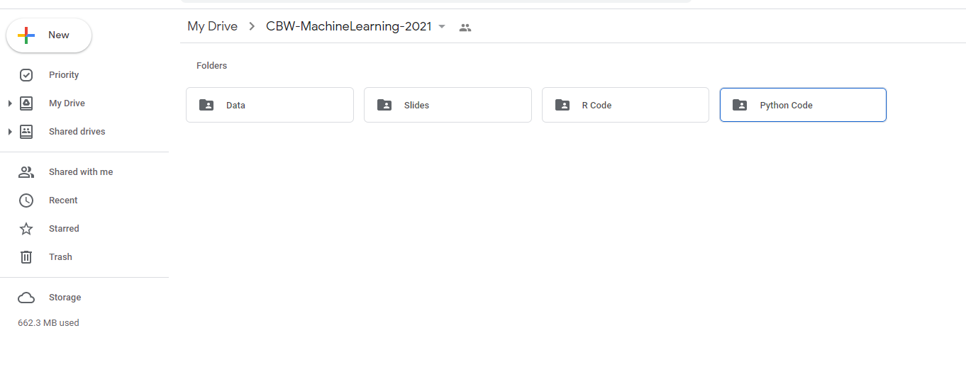

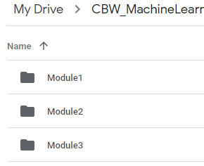
Open the Colab File
Find the Module 3 folder under Python Code in folder CBW-MachineLearning-2026 in your Google Drive

Slide 64


Open the Colab File cont...
Right click on ‘IrisANN.ipynb’ and select open with Google Colaboratory

Slide 65
General Algorithm
Read data
Check data
Create training/testing data sets
Create a one hot encoding function (to_one_hot)
Create a normalization function (normalize)
Normalize the data
Perform label encoding and one hot encoding
Define activation function (sigmoid or softmax)
Initialize weights and biases
Determine number of batches
Perform forward propagation
Calculate the errors
Perform back propagation
Update weights and biases

Slide 66
Import Functions for
Python Math
Numpy allows for mathematical operations and array handling
Pandas is used to read data and for providing dataframe capabilities
Seaborn and matplotlib are used for data visualization
import numpy as np
import pandas as pd
import seaborn as sns
import matplotlib.pyplot as plt
%matplotlib inline

Slide 67
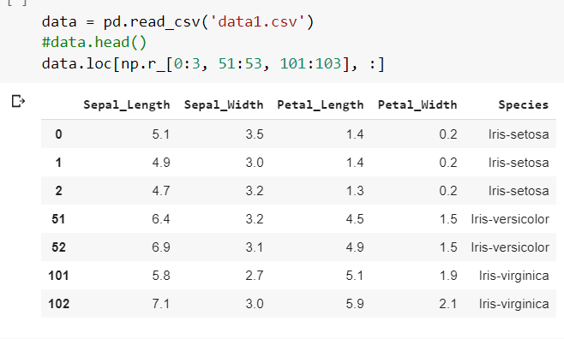
Code for Reading Data In

Slide 68
Data Check (Missing Values, Label Check)
#Check the dataset to make sure no data is missing and check the class labels – need to define “verify_dataset” function
def verify_dataset(data):
#Use data_found as a dummy variable to determine if to print missing value information
data_found = 1
for each_column in data.columns:
if data[each_column].isnull().any():
print("Data missing in Column " + each_column)
data_found = 0
quit()
if data_found == 1:
print("Dataset is complete. No missing value")
return
#Call verify_dataset and check data
verify_dataset(data)

Slide 69
Machine Learning Workflow
Define an ML problem and propose a solution
Construct your dataset
Transform your dataset & select features
Use the model to make predictions
Test and validate your model
Choose and train a model

Slide 70
Create a Training (70%) & Testing Set (30%)
The data set of 150 flowers is divided into 2/3 for training and 1/3 for testing (3-fold cross validation)
##Splitting The Database in training and testing
def split_dataset_test_train(data):
training_data = data.iloc[:int(0.7 * len(data))].reset_
index(drop=True)
##Determine the integer location (iloc) from beginning of array (:) to 0.7*150 and do a ”cleanup” with a reset call
testing_data = data.iloc[int(0.7 * len(data)):].reset_
index(drop=True)
##Determine the integer location (iloc) from 0.7*150 to end of array (: ) and do a ”cleanup” with a reset call
return [training_data, testing_data]
testtrain = split_dataset_test_train(data)
print(testtrain)
Notes:
1. Function definition
def split_dataset_test_train(data):
Defines a function that takes one argument: data
data is expected to be a pandas DataFrame
2. Creating the training set
training_data = data.iloc[:int(0.7 * len(data))].reset_index(drop=True)
Breaking it down:
len(data)
→ Total number of rows in the dataset
0.7 * len(data)
→ Calculates 70% of the dataset size
int(...)
→ Converts that value to an integer index (since row indices must be integers)
data.iloc[...]
→ Uses integer-based indexing:
: means “start from the beginning”
:int(0.7 * len(data)) means “go up to 70% of the rows”
👉 So this selects the first 70% of rows
.reset_index(drop=True)
→ Resets the row index to start from 0
→ drop=True avoids keeping the old index as a column
✔ Result: a clean training dataset with sequential indices
3. Creating the testing set
testing_data = data.iloc[int(0.7 * len(data)):].reset_index(drop=True)
Breaking it down:
int(0.7 * len(data)):
→ Starts at the 70% mark
: (end omitted)
→ Goes to the end of the dataset
👉 So this selects the remaining 30% of rows
Again, .reset_index(drop=True) cleans up the index
✔ Result: testing dataset with fresh indices starting at 0
4. Returning the result
return [training_data, testing_data]
Returns a list containing:
Training dataset
Testing dataset
5. Using the function
testtrain = split_dataset_test_train(data)
print(testtrain)
Calls the function with data
Stores the result in testtrain
Prints the two datasets

Slide 71
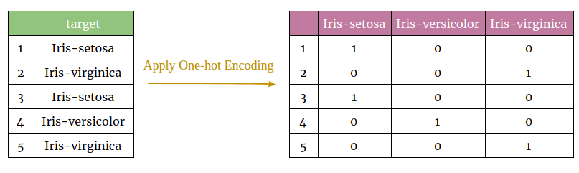
Transforming Data by One-Hot Encoding
ANNs require input data to be binary (one-hot) encoded so that the input can be properly manipulated by the matrix calculations
Need to change categorical or nominal variables to 1s and 0s

Slide 72
Create a One-Hot Encoding Function
#This function accepts an array of categorical variables and returns the one hot encoding
def to_one_hot(Y):
#Calculate number of columns
n_col = np.amax(Y) + 1
#Create an array of size (len(Y) x n_col) and fill it with 0s
binarized = np.zeros((len(Y), n_col))
for i in range(len(Y)):
#Populate array with 1’s at indicated array positions
binarized[i, Y[i]] = 1.
return binarized

Slide 73
Create a Normalization Function
A key step in preparing the data is normalization, also known as feature scaling – we are using L2 normalization so that for each row in the data set, the sum of squares adds up to one
The numerical input data (flower measurements) exist in different ranges
If this input data is not scaled, the model will assume that features with higher values are more important when predicting flower classes, which may not be the case
#Normalize array - linalg.norm is a function that linearly normalizes, expand_dims is a function that expands the shape of an array, atleast_1d is a function that converts inputs into arrays of at least 1D
def normalize(X, axis=-1, order=2):
L2 = np.atleast_1d(np.linalg.norm(X, order, axis))
L2[L2 == 0] = 1
return X / np.expand_dims(L2, axis)

Slide 74
Separate the Dataset into Input and Output & Normalize
The input data "x" is then extracted from the original dataset, and normalized by calling the "normalize" function
#Specifying the columns that belong to input data "x"
columns = ['SepalLengthCm', 'SepalWidthCm', 'PetalLengthCm', 'PetalWidthCm']
x = pd.DataFrame(iris, columns=columns)
#Calling the normalize function
x = normalize(x.as_matrix())
#Calls normalize function on the 4 x 150 iris data array

Slide 75
Encode the Categorical Variables
Before one hot encoding the output (categorical) variables, the labels are first replaced by 0,1,2 for setosa, virginica, and versicolor respectively
This is known as label encoding
#Replace the species with 0, 1, or 2 as appropriate
iris['Species'].replace(['Iris-setosa', 'Iris-virginica', 'Iris-versicolor'], [0, 1, 2],
inplace=True)

Slide 76
Encoding the Categorical Variables cont...
Next, the y values (flower species) are extracted from the iris dataset and then one-hot encoded by calling the “to_one_hot” function
#Get Output, flatten and encode to one-hot
columns = ['Species']
y = pd.DataFrame(iris, columns=columns)
#Convert y to a Numpy readable array
y = y.as_matrix()
#Fix format of array so dim=2 array becomes dim=1
y = y.flatten()
#Call one-hot conversion function for species
y = to_one_hot(y)

Slide 77
Feature Selection
Features can be turned on and off to determine their impact on the performance of the model
This will be used in exercises later
'''Change the values below'''
sepal_length = True
sepal_width = True
petal_length = True
petal_width = True
'''Change the values above'''
feature_list = [sepal_length,sepal_width,petal_length,petal_width]

Slide 78
Machine Learning Workflow
Define an ML problem and propose a solution
Construct your dataset
Transform your dataset & select features
Use the model to make predictions
Test and validate your model
Choose and train a model
We have chosen an Artificial Neural Network Model

Slide 79
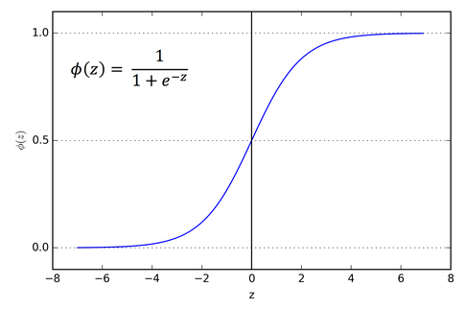
Define Activation Function
The sigmoid function is used for the activation function, as it outputs values between 0 and 1
This is useful because this model predicts probabilities as an output
Additionally, this function is differentiable
This allows for gradient descent optimization, which is used to minimize the error between the predicted and actual output (during training)
#sigmoid and its derivative
def sigmoid(x):
return 1/(1+np.exp(-x))
def sigmoid_deriv(x):
return sigmoid(x)*(1 - sigmoid(x))
Sigmoid function used for layer 1

Slide 80
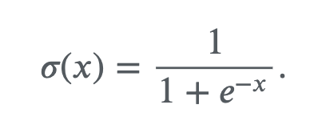
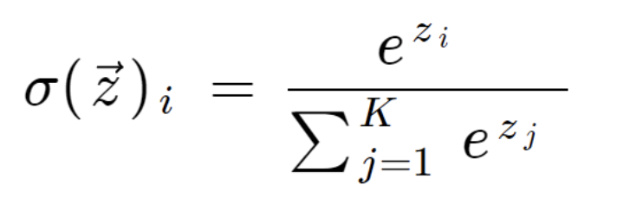








Some Math Reminders
Sigmoid
Function
SoftMax
Function
=

Slide 81

Define Activation Function
For multiclass problems, the output layer often uses the softmax activation function
This function has the benefit of outputting values that sum exactly to 1
def user_softmax(A):
expA = np.exp(A)
return expA / expA.sum(axis=1, keepdims=True)
Softmax function used for layer 2

Slide 82
Initialize Weights and Biases
Before training the model, the weights and biases are initialized as random values between 0 and 1
  w0 is the set of weights for connections between the input and hidden layer
  w1 is the set of weights for connections between the hidden and output layer
The biases bh and bo are for the hidden and output layers respectively
#random.random returns number from 0 to 1 while random.randn
#returns Gaussian random number from -1 to 1, with mean of 0
#Weight initialization
w0 = 2*np.random.random((X_train.shape[1], hidden_size)) - 1
w1 = 2*np.random.random((hidden_size, 3)) - 1
bh = np.random.randn(hidden_size)
bo = np.random.randn(3)

Slide 83
Determine Number of Batches
The number of batches ‘num_batch’ is calculated from the user-determined batch size and training size
The number of batches is corrected in case the training set size is not a multiple of the batch size
#Recall that % returns remainder (modulus)
#Recall that // returns largest divisor
rem = len(X_train) % batch_size
num_batch = len(X_train)//batch_size
if rem != 0:
num_batch += 1

Slide 84

The ANN Training Loop
Forward propagation, error determination, back propagation, and weight/bias updating are performed for every batch of input data
This process is repeated for multiple epochs

Slide 85

ANN Input and Output
The model takes learning rate, batch size, epochs, and the training set as input
The model will output the weights and biases for the input and hidden layer, as well as training error measurements
def training(lr, batch_size, epochs):
return [w0,bh,w1,bo], error, errors

Slide 86
Forward Propagation
The current batch of data is extracted from the total training set
The input is propagated through the layers by multiplying by weight matrices, adding biases, and running through the activation functions
# Finding the current batch
batch_start = curr_batch * batch_size
batch_end = batch_start + batch_size
input_batch = X_train[batch_start:batch_end]
#First layer propagation This equation calculates dot #product of input layer vector (batch size x 4) with weight #matrix w0 (4 x hidden layer size)
zh = np.dot(input_batch, w0) + bh
layer1 = sigmoid(zh)
#Second layer propagation
zo = np.dot(layer1, w1) + bo
layer2 = user_softmax(zo)

Slide 87
Determine the Error
The labels (true output) corresponding to the current batch of inputs is found
These are compared to the forward-propagated output of the model ‘layer2’ (δ is derivative of the cost function)
This subtraction represents the cost function which, through gradient descent, will be minimized
labels_batch = y_train[batch_start:batch_end]
layer2_error = layer2 - labels_batch
The ”complicated” partial derivatives
actually simplify to simple differences
Layer 0
Layer 1
Layer 2

Slide 88

Backpropagation (Layer 2 → 1)
Using the gradient descent algorithm, the derivative of the cost with respect to weights for layer 2 is calculated
This is called “layer2w_delta” as this will later be subtracted from the layer2 weights to find the new set of weights
The change in layer2 bias is simply the layer2 error
layer2w_delta = np.dot(layer1.T, layer2_error)
layer2b_delta = layer2_error
Layer 0
Layer 1
Layer 2

Slide 89

Backpropagation (Layer 1 → 0)
The cost function must be differentiated with respect to the hidden layer weights
The hidden layer partial derivatives are first found
ah = output of hidden layer (y here)
zh = weighted sum (e here)
dah/dzh = dy/de
dcost/dah = δ
#Propogation of error to layer1
dcost_dah = np.dot(layer2_error , w1.T)
dah_dzh = sigmoid_deriv(zh)
Layer 0
Layer 1
Layer 2
Layer 0
Layer 1
Layer 2

Slide 90
Backpropagation (Layer 1 → 0)
The partial derivatives are then multiplied to get ‘layer1w_delta’, the number used to change the layer1 weights
#Propogation of error to layer1
layer1_error = dah_dzh * dcost_dah
layer1w_delta = np.dot(input_batch.T, layer1_error)
layer1b_delta = layer1_error
Propagating from output
layer to hidden layer
Layer 0
Layer 1
Layer 2

Slide 91
Update Weights
Using the products found earlier, the weight matrices can now be updated
The respective delta matrices are multiplied by the learning rate and subtracted from the current weight values
#Update weights with learning rate n
w0 -= lr * layer1w_delta
w1 -= lr * layer2w_delta
wo = wo – lr*layer1w_delta

Slide 92
Update Biases
Similarly, the bias deltas are subtracted from the current bias values
#Update biases with learning rate n
bh -= lr * layer1b_delta.sum(axis=0)
bo -= lr * layer2b_delta.sum(axis=0)
bh = bh – lr*layer1b_delta
Sums all elements in 2D
array to put into 1D vector

Slide 93
Complete Training Process
The process is repeated for a number of epochs
for epoch in range(epochs):
for curr_batch in range(num_batch):
batch_start = curr_batch * batch_size # Finding the current batch
batch_end = batch_start + batch_size
input_batch = X_train[batch_start:batch_end]
zh = np.dot(input_batch, w0) + bh # First layer propagation
layer1 = sigmoid(zh)
zo = np.dot(layer1, w1) + bo # Second layer propagation
layer2 = user_softmax(zo)
labels_batch = y_train[batch_start:batch_end]
layer2_error = layer2 - labels_batch # Layer 2 error calculation
layer2w_delta = np.dot(layer1.T, layer2_error) # Layer 2 derivative calculations
layer2b_delta = layer2_error
dcost_dah = np.dot(layer2_error , w1.T) # Layer 1 derivative calculations
dah_dzh = sigmoid_deriv(zh)
layer1_error = dah_dzh * dcost_dah # Layer 1 error calculation
layer1w_delta = np.dot(input_batch.T, layer1_error)
layer1b_delta = layer1_error
w0 -= lr * layer1w_delta # Weight and bias updating
bh -= lr * layer1b_delta.sum(axis=0)
w1 -= lr * layer2w_delta
bo -= lr * layer2b_delta.sum(axis=0)

Slide 94

Training Output
In addition to outputting the trained parameters, the training function will also output all the layer2 errors found during training
This results in one error measurement per epoch, which can then be plotted
Error is difference
between output and
true label
Epochs

Slide 95
Program Statistics
Total number of lines: 215
Total number of comment lines: 30
Total number of coding lines: 185
Time to train on training data: 1.5 sec
Typical time to train and perform test run with program: 2.5 sec
This program actually trains every time you run it although you can choose to run certain cells to use the trained ANN with new input data (<0.5 sec)

Slide 96
Machine Learning Workflow
Define an ML problem and propose a solution
Construct your dataset
Transform your dataset & select features
Use the model to make predictions
Test and validate your model
Choose and train a model
Test on Testing Data Set

Slide 97
Forward Propagation (Evaluation) of the Test Set
Now that the model is trained, the test set can be evaluated
This function will take the trained parameters (training function output) and the test set as input
def evaluation(params,tst_set):
w0 = params[0]
bh = params[1]
w1 = params[2]
bo = params[3]

Slide 98
Forward Propagation (Evaluation) of the Test Set cont...
Using these parameters, the test set is propagated forward through the model
The final output ‘layer2’ is the model’s predictions on the test set
# First layer propagation
zh = np.dot(tst_set, w0) + bh
layer1 = sigmoid(zh)
# Second layer propagation
zo = np.dot(layer1, w1) + bo
layer2 = user_softmax(zo)
return layer2

Slide 99
Prediction Accuracy on Training & Test Sets (Confusion Matrices)
Training Set
Testing Set
 | Setosa (Observed) | Virginica (Observed) | Versicolor (Observed)
Setosa (Predicted) | 1 | 0 | 0
Virginica (Predicted) | 0 | 0.97 | 0.03
Versicolor (Predicted) | 0 | 0 | 1
 | Setosa (Observed) | Virginica (Observed) | Versicolor (Observed)
Setosa (Predicted) | 1 | 0 | 0
Virginica (Predicted) | 0 | 1 | 0
Versicolor (Predicted) | 0 | 0.05 | 0.95
Normally you want training & testing sets to be within 5-6% of each other
If they are much more than this, you have likely over-trained the system

Slide 100
Performance of IrisDT vs. IrisANN
(Confusion Matrices)
IrisDT Script
IrisANN Script
 | Setosa (Observed) | Virginica (Observed) | Versicolor (Observed)
Setosa (Predicted) | 1 | 0 | 0
Virginica (Predicted) | 0 | 1 | 0
Versicolor (Predicted) | 0 | 0.07 | 0.93
 | Setosa (Observed) | Virginica (Observed) | Versicolor (Observed)
Setosa (Predicted) | 1 | 0 | 0
Virginica (Predicted) | 0 | 1 | 0
Versicolor (Predicted) | 0 | 0.05 | 0.95

Slide 101
Program Statistics
 | Python | R
Packages used | numpy, pandas | N/A
Lines of code | 205 | 252
Average Running time (seconds) | 4.35 | 5.10

Slide 102
Summary
We now have a neural network program written in “pure” python that predicts iris flower classes
It has been thoroughly trained on a training set of 105 flowers and tested on a test set of 45
This is fairly generic code so you could use or adapt this code for many other kinds of classification problems such as patients (cases or controls) with different levels of gene, protein or metabolite expression
In the next section we will explore the code and run it on a few examples
If you would like to work with in R rather than Python, follow the steps indicated in the Lab to find the corresponding scripts

Slide 103
Module 3 - Lab
Let’s Take a Look at the Program

Slide 104

Open the Colab File in the Language of Your Choosing
The python script ‘IrisANN.ipynb’, covered during lecture, will be used for the Lab portion
However, you have the option of running the Lab in R
To do so, find the R code ‘IrisANN_R.ipynb’ in the R Code folder under Module 3

Slide 105
Open the Colab File in the Language of Your Choosing cont...
Right click on ‘IrisANN.ipynb’ (or alternatively IrisANN_R.ipynb in the R Code folder under Module 3) and select open with Google Colaboratory

Slide 106
Study the Program
Spend a few minutes studying the IrisANN.ipynb (or IrisANN_R.ipynb) program
See if you can understand the logic of the program
Ask questions of the TA’s if you are unclear about some of the functions or Python code
After studying the code, try running it

Slide 107




To Run: Upload the Data
Once the Colab file is open, click the folder icon to the right
When the panel opens, right click inside the panel and click upload
Then find the CBW_MachineLearning_2026 folder on your desktop
Open the Data folder followed by the Module 3 folder, and open the corresponding data file named ‘data1.csv’
6
3

Slide 108

Exercise 3.1- Run The Program
Select ‘Run all’ from the ‘Runtime’ menu
This will train the program (on the training set of 105) and test the program (on the test set of 45) and produce 1 confusion matrix on the test data
Check to see if your numbers match with the slide’s numbers

Slide 109

Exercise 3.1 – Change Epoch Numbers
Go to cell1 3 and change the number of epochs from 1000 to 100
Exercise 3.1

Slide 110
Exercise 3.1 – Optimize Epoch Numbers
Run cells 13 through 16 and observe the confusion matrix
The model will misclassify many versicolor samples
Try changing the number of epochs to other numbers
What is the lowest number of epochs that produces desirable results?
What combination of parameters yields the highest training accuracy?

Slide 111
Conclusion
This concludes the “formal” section on ANNs for iris classification
Feel free to explore the code, modify it if you wish or to review the slides and explanations – talk to the TAs

Slide 112






Coffee Break & Networking Session
Workshop Sponsors

