Slide 1

bioinformatics.ca
bioinformaticsdotca.github.io

Slide 2
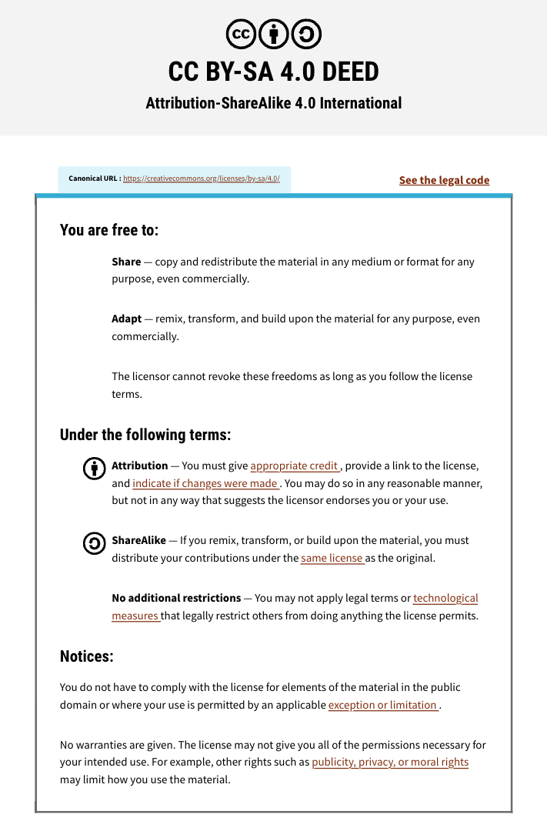

Slide 3

Module 4: ANNs for Secondary Structure Prediction
David Wishart
Machine Learning
Apr 22-23, 2026
University of Alberta

Slide 4

Schedule (MT)
Day 1 (MT) | Wednesday Apr. 22 | Day 2 (MT) | Day 2
9:00 AM | Introductions and Technology Check | 9:00 AM | Module 5: Gene Finding with NNs (Lecture and Lab)
9:45 AM | Module 1: Introduction to Machine Learning (Lecture) | 11:00 AM | Break (30 min)
11:00 AM | Break (30 min) | 11:30 AM | Module 6: Machine Learning with Keras and Scikit-Learn (Lecture/Lab)
11:30 AM | Module 2: Decision Trees (Lecture and Lab) | 1:00 PM | Break (45 min)
1:00 PM | Break (1 hour) | 2:00 PM | Module 7: Machine Learning with Keras and Scikit-Learn (Cont'd)
2:00 PM | Module 3: Neural Networks (Lecture and Lab) | 3:00 PM | Break (30 min)
3:00 PM | Break (30 min) | 3:30 PM | Module 8: LLMs and agentic coding for bioinformatics
3:30 PM | Module 4: Neural Networks for 2º Structure (Lecture and Homework) | 4:45 PM | Survey and Closing Remarks
5:00 PM | End of Day 1 | 5:00 PM | End of Day 2
Canadian Bioinformatics Workshops | bioinformatics.ca

Slide 5
Schedule (PT)
Day 1 (PT) | Wednesday Apr. 22 | Day 2 (PT) | Thursday Apr. 23
8:00 AM | Introductions and Technology Check | 8:00 AM | Module 5: Gene Finding with NNs (Lecture and Lab)
8:45 AM | Module 1: Introduction to Machine Learning (Lecture) | 10:00 AM | Break (30 min)
10:00 AM | Break (30 min) | 10:30 AM | Module 6: Machine Learning with Keras and Scikit-Learn (Lecture/Lab)
10:30 AM | Module 2: Decision Trees (Lecture and Lab) | 12:00 PM | Break (45 min)
12:00 PM | Break (1 hour) | 1:00 PM | Module 7: Machine Learning with Keras and Scikit-Learn (Cont'd)
1:00 PM | Module 3: Neural Networks (Lecture and Lab) | 2:00 PM | Break (30 min)
2:00 PM | Break (30 min) | 2:30 PM | Module 8: LLMs and agentic coding for bioinformatics
2:30 PM | Module 4: Neural Networks for 2º Structure (Lecture and Homework) | 3:45 PM | Survey and Closing Remarks
4:00 PM | End of Day 1 | 4:00 PM | End of Day 2
Canadian Bioinformatics Workshops | bioinformatics.ca

Slide 6
Learning Objectives
To introduce concept of secondary structure and secondary structure prediction
To show how ANNs can be used to handle and interpret sequence data
To review and explain python code for an ANN for protein secondary structure prediction (SSANN)
Lab – experiment with SSANN on your own with Colab

Slide 7
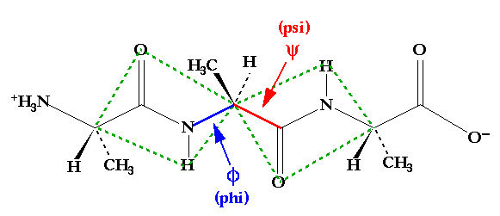
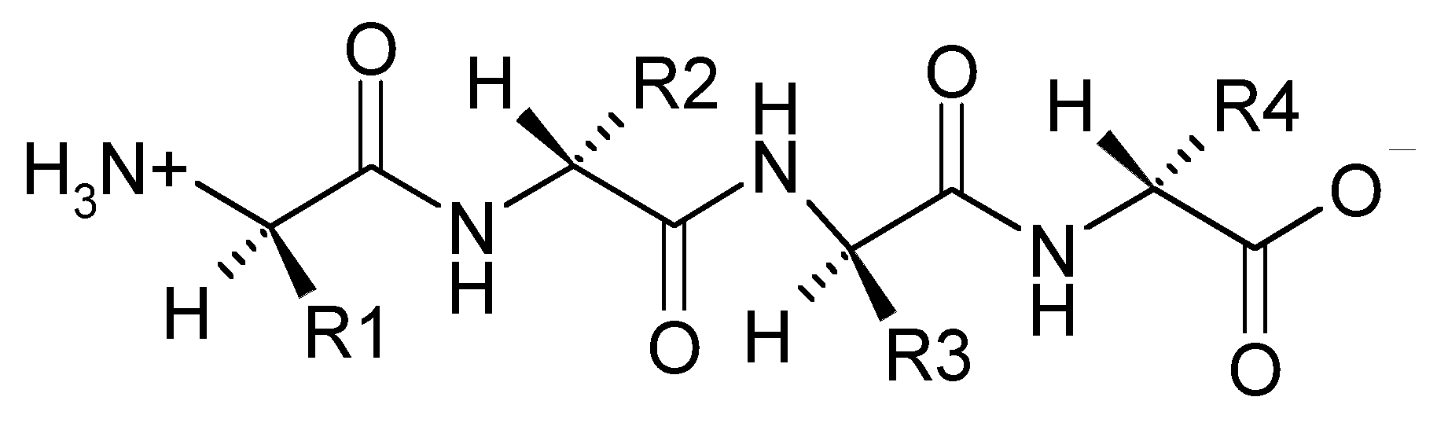
Polypeptides

Slide 8
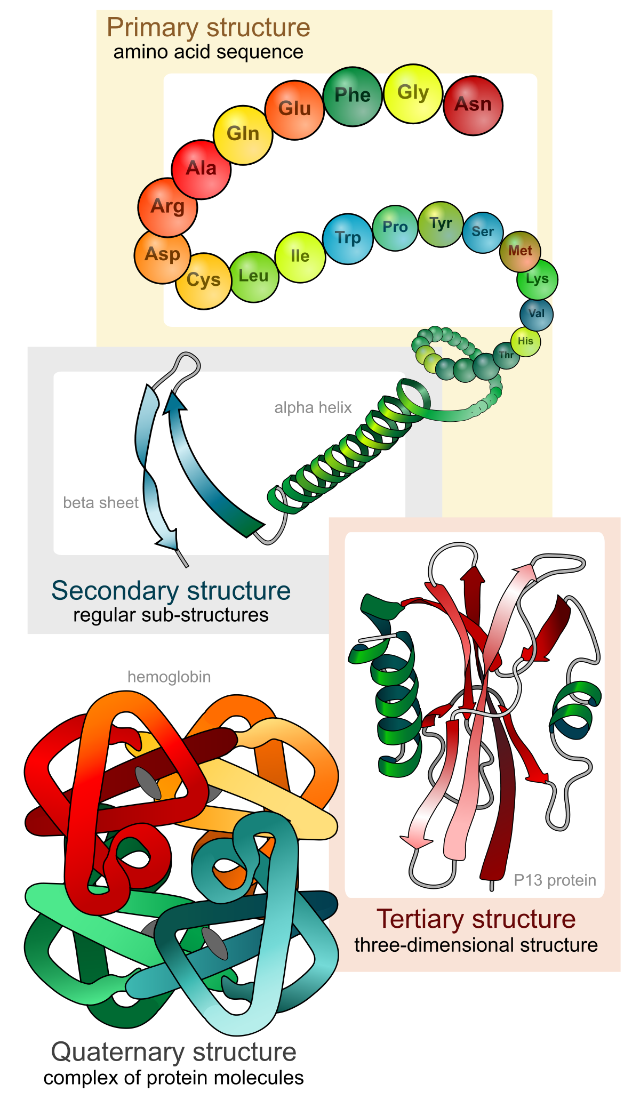
Levels of Protein Structure
Proteins are long (>40 aa) polypeptides
Primary structure = sequence
Secondary structure = helices/strands
Tertiary structure = 3D fold
Quaternary structure = protein complexes

Slide 9
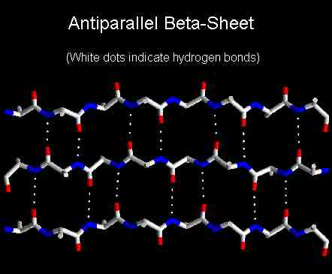
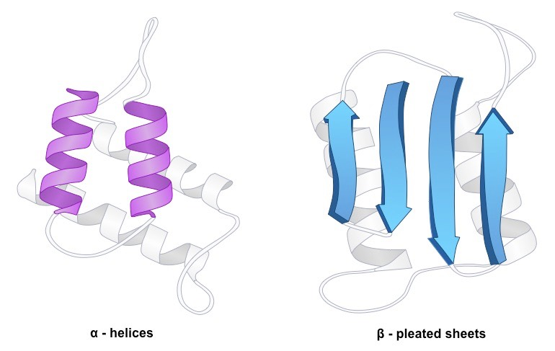
Secondary Structure Beta Sheet

Slide 10
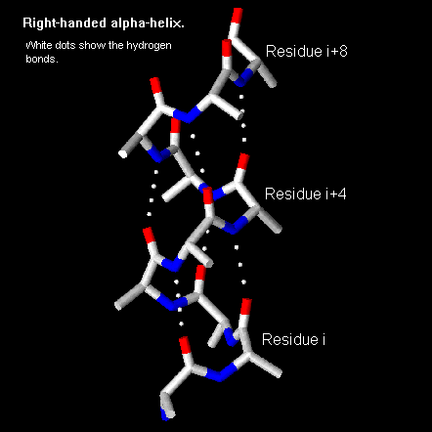
Secondary Structure Alpha Helix

Slide 11
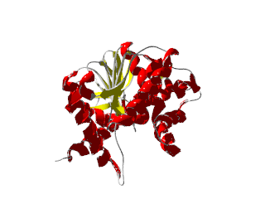
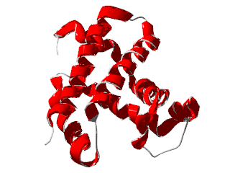

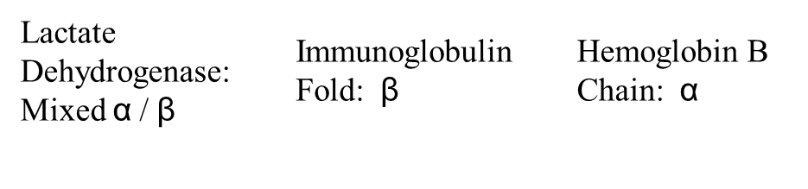
Tertiary Structure
Notes:
SLIDE 11 Captions were off screen

Slide 12
Secondary (2º) Structure Prediction
One of the first fields to emerge in bioinformatics (~1967)
Grew from a simple observation that certain amino acids or combinations of amino acids seemed to prefer to be in certain secondary structures
Subject of hundreds of papers and dozens of books, many methods
Useful in predicting 3D structure, for remote sequence similarity detection (threading) and understanding protein function – test of sequence-to-structure prediction
Reason why I got into bioinformatics & machine learning

Slide 13
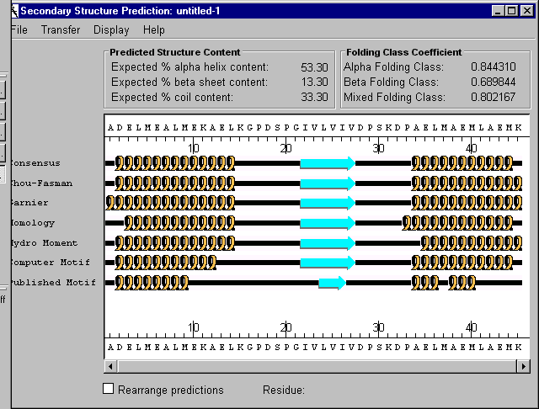
2º Structure Prediction cont...

Slide 14
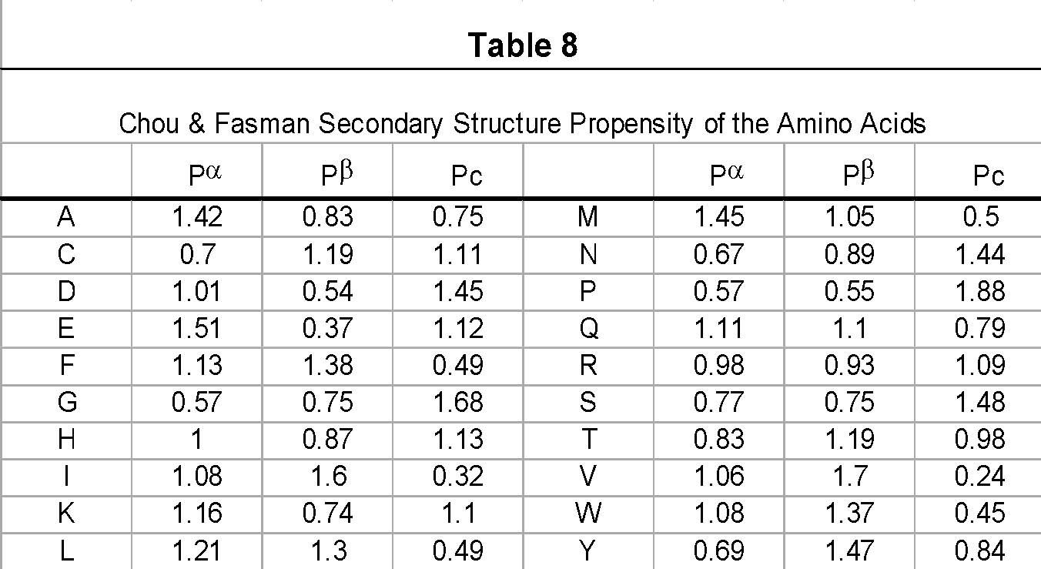
Chou-Fasman Statistics

Slide 15
Simplified Chou-Fasman Algorithm
Select a window of 7 residues
Calculate average P_{α} over this window and assign that value to the central residue
Repeat the calculation for P_{β} and P_{c}
Slide the window down one residue and repeat until sequence is complete
Analyze resulting “plot” and assign secondary structure (H, B, C) for each residue to highest value

Slide 16
Simplified Chou-Fasman Algorithm cont...
helix
beta
coil
10 20 30 40 50 60

Slide 17
Limitations of Chou-Fasman
Does not take into account long range information (>3 residues away)
Does not take into account sequence content or probable structure class
Assumes simple additive probability (not true in nature)
Does not identify patterns in amino acids that help define secondary structure (caps/ends)
Only about 50% accurate (on good days)

Slide 18

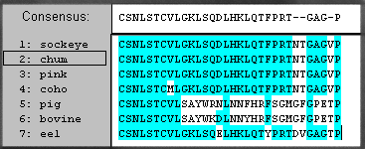
The PhD/Neural Network Approach
PROFILE...

Slide 19
2º Structure Evaluation
Q3 score – standard method in evaluating performance, 3 states (B,C,H) evaluated like a multiple-choice exam with 3 choices (same as % correct)
Confusion Matrix
 | Beta (Observed) | Coil (Observed) | Helix (Observed)
Beta (Predicted) | 0.775 | 0.201 | 0.024
Coil (Predicted) | 0.090 | 0.814 | 0.096
Helix (Predicted) | 0.011 | 0.103 | 0.885

Slide 20
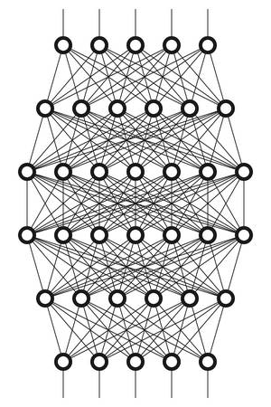
Artificial Neural Network
Input
Attempts to simulate the function and activity of the brain using inputs, outputs and neurons
ANNs are based on a collection of connected units or nodes called artificial neurons, which loosely model the neurons in a biological brain
Can be used for both classification and regression
Output

Slide 21
Neural Network for 2º Structure Prediction
Sequence Data
Matrix1
ACGAGG
Matrix2
ACGAAG
AGGAAG
AGCAAG
ACGAAA
AGCAAC
BBBBCC
Prediction
Input Input Hidden Output
Layer Layer

Slide 22
Neural Network for 2º Structure Prediction cont...
Training Set
Encoding
Sliding Window
ACGAAG
AGGAAG
AGCAAG
ACGAAA
AGCAAC
ACGAAG
A = [001]
C = [010]
G = [100]
B = [01]
C = [10]
[010100001]
Input Vector
BBBBCC
[01]
H = [11]
Output Vector
Desired Output

Slide 23
Neural Network Training
1
Logistic
Filter
.2 .4 .1
.1 .0 .4
.7 .1 .1
.0 .1 .1
.0 .0 .0
.2 .4 .1
.0 .3 .5
.1 .1 .0
.5 .3 .1
1 + e^{-x}
.1 .8
.0 .2
.3 .3
[010100001]
[.6 .4 .6]
[.24 .74]
compare
ACGAAG
[0 1]
Desired
output
Input Weight Interm. Weight Output
Vector Matrix1 Vector Matrix2 Vector

Slide 24
Back Propagation
1
Logistic
Filter
.2 .4 .1
.1 .0 .4
.7 .1 .1
.0 .1 .1
.0 .0 .0
.2 .4 .1
.0 .3 .5
.1 .1 .0
.5 .3 .1
1 + e^{-x}
.02
.83
.1 .8
.0 .2
.3 .3
[010100001]
[.6 .4 .6]
.23
[.24 .74]
.22
.33
compare
[0 1]
Desired
output
Input Weight Interm. Weight Output
Vector Matrix1 Vector Matrix2 Vector

Slide 25
Calculate New Output
1
Logistic
Filter
.1 .1 .1
.2 .0 .4
.7 .1 .1
.0 .1 .1
.0 .0 .0
.2 .2 .1
.0 .3 .5
.1 .3 .0
.5 .3 .3
1 + e^{-x}
.02 .83
.00 .23
.22 .33
[010100001]
[.7 .4 .7]
[.16 .91]
Converged!
[0 1]
Desired
output
Input Weight Interm. Weight Output
Vector Matrix1 Vector Matrix2 Vector

Slide 26
Train on Second Input Vector
1
Logistic
Filter
.1 .1 .1
.2 .0 .4
.7 .1 .1
.0 .1 .1
.0 .0 .0
.2 .2 .1
.0 .3 .5
.1 .3 .0
.5 .3 .3
1 + e^{-x}
.02 .83
.00 .23
.22 .33
[100001001]
[.8 .6 .5]
[.12 .95]
Compare
ACGAAG
[0 1]
Desired
output
Input Weight Interm. Weight Output
Vector Matrix1 Vector Matrix2 Vector

Slide 27
Back Propagation
1
Logistic
Filter
.1 .1 .1
.2 .0 .4
.7 .1 .1
.0 .1 .1
.0 .0 .0
.2 .2 .1
.0 .3 .5
.1 .3 .0
.5 .3 .3
1 + e^{-x}
.01
.84
.02 .83
.00 .23
.22 .33
[010100001]
[.8 .6 .5]
.24
[.12 .95]
.21
.34
compare
[0 1]
Desired
output
Input Weight Interm. Weight Output
Vector Matrix1 Vector Matrix2 Vector

Slide 28
After Many Iterations….
.13 .08 .12
.24 .01 .45
.76 .01 .31
.06 .32 .14
.03 .11 .23
.21 .21 .51
.10 .33 .85
.12 .34 .09
.51 .31 .33
.03 .93
.01 .24
.12 .23
Two “Generalized” Weight Matrices

Slide 29
Let’s Try a Real Example

Slide 30
Machine Learning Workflow
Define an ML problem and propose a solution
Construct your dataset
Transform your dataset & select features
Use the model to make predictions
Test and validate your model
Choose and train a model
How do I predict protein secondary structure from protein sequence data?

Slide 31
Machine Learning Workflow
Define an ML problem and propose a solution
Construct your dataset
Transform your dataset & select features
Use the model to make predictions
Test and validate your model
Choose and train a model
Find a good training/testing data set

Slide 32

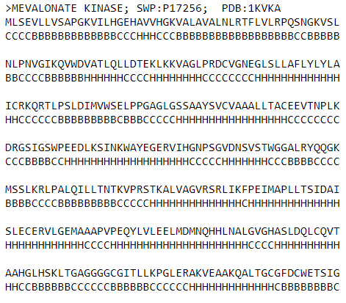
The Data Set
Protein information
Odd rows contain aa sequence
Even rows contain structure sequence
http://www.pptdb.ca/

Slide 33
Formatted Data
Protein | AA Sequence | Structure Sequence
>VACUOLAR MORPHOGENESIS PROTEIN VAM7; SWP:P32912; PDB:1KMDA | KMSEKLRIKVDDVKINPKYVLYGVSTPNKRLYKRYSEFWKLKTRLERDVGSTIPYDFPEKPGVLDRRWQRRYDDPEMIDERRIGLERFLNELYNDRFDSRWRDTKIAQDFLQLSKPN | CCCCCBBBBBCBBBBCCCCBBBBBBBBCBBBBBBHHHHHHHHHHHHHHCCCCCCCCCCCCCCCCCCCCCCCCCCHHHHHHHHCCHHHHHHHHHHCCCCCHHHHCHHHHHCCCCCCCC
>CIRCULIN A; SWP:P56871; PDB:1BH4 | CGESCVWIPCISAALGCSCKNKVCYRNGIP | CBBBCCCCCCCCCCCCBBBCCCBBBCCCCC
>BAND 3; SWP:P02730; PDB:1BH7 | IQLFDRILLFKPPKYHPDPYVKRVKTWRMHL | CCCCCCCCCCCCCCCCCCCCCCCCHHHHHCC
>Salt-mediated killer protoxin 1 [Precursor]; SWP:P19972; PDB:1KVDB | GEATTIWGVGADEAIDKGTPSKNDLQNMSADLAKNGFKGHQGVACSTVKDGNKDVYMIKFSLAGGSNDPGGSPCSDD | CCCCCBBBBBBBBBCCCCCCCHHHHHHHHHHHHHCCCCCCBBBBBBBBBCCCCCBBBBBBBBBCCCCCCCCCBBBCC
>MORICIN; SWP:P82818; PDB:1KV4A | AKIPIKAIKTVGKAVGKGLRAINIASTANDVFNFLKPKKRKA | CCCHHHHHHHHHHHHHHHHHHHHHHHHHHHHHHHCCCCCCCC
>Cyclin-dependent kinase 5 activator 1 [Precursor]; SWP:Q15078; PDB:1H4LD | STSELLRCLGEFLCRRCYRLKHLSPTDPVLWLRSVDRSLLLQGWQDQGFITPANVVFLYMLCRDVISSEVGSDHELQAVLLTCLYLSYSYMGNEISYPLKPFLVESCKEAFWDRCLSVINLMSSKMLQINADPHYFTQVFSDLKNES | CCCHHHHHHHHHHHHHHCCCCCCCCHHHHHHHHHHHHHHCCCCCCCCCCCCHHHHHHHHHHHHCCCCCCCCCHHHHHHHHHHHHHHHHHHHCCCCCCCCCCCCCCCCHHHHHHHHHHHHHHHHHHHHHHHHCHHHHHHHHHHHHHCC
>FIBRONECTIN CELL-ADHESION MODULE TYPE III-10; SWP:P02751; PDB:1FNA | GSLEVVAATPTSLLISWDAPAVTVRYYRITYGETGGNSPVQEFTVPGSKSTATISGLKPGVDYTITVYAVTGRGDSPASSKPISINYRTEI | CBBBBCCCCCBBBBBBBBCCCCCCBBBBBBBBBCCCCCCBBBBBBBCCCCBBBBBCCCCCBBBBBBBBBBBCCCCCCCCCCBBBBBBBBBC
>Methanol dehydrogenase subunit 2 [Precursor]; SWP:P14775; PDB:1H4ID | YDGTKCKAAGNCWEPKPGFPEKIAGSKYDPKHDPKELNKQADSIKQMEERNKKRVENFKKTGKFEYDVAKISA | CCCCCCCCCCCCCCCCCCCCCCCCCCCCCCCCCHHHHHHHHHHHHHHHHHHHHHHHHHHHHCCCCCCCCCCCC

Slide 34
Let’s Try Programming an ANN to Predict Secondary Structure
SSANN.ipynb

Slide 35
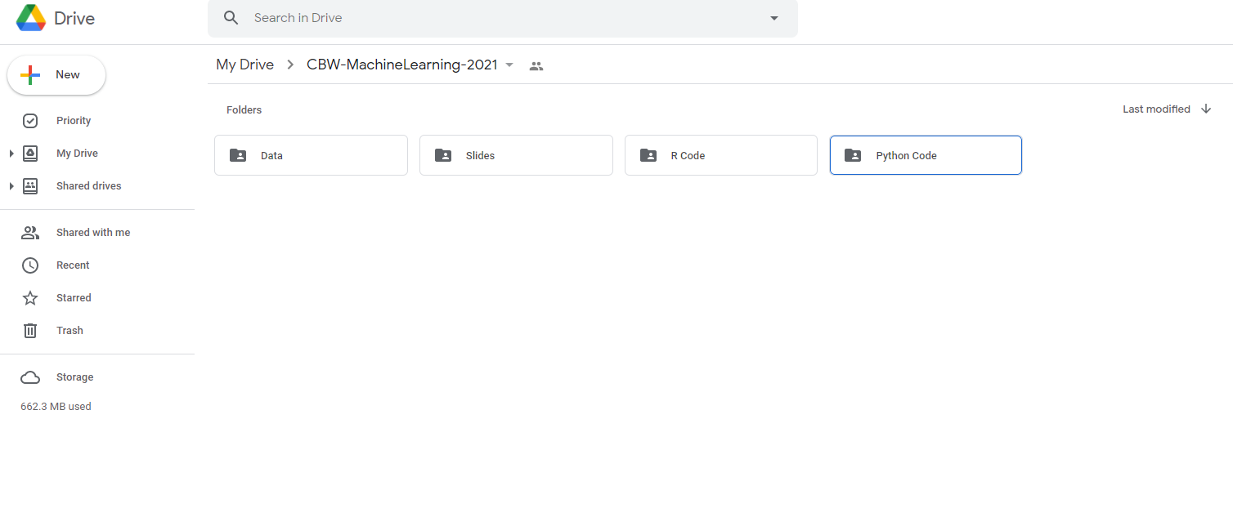

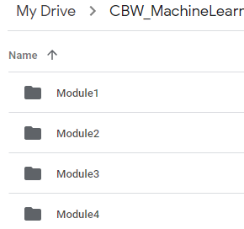
Open the Colab File
Find the Module 4 folder under Python Code in folder CBW-MachineLearning-2026 in your Google Drive

Slide 36
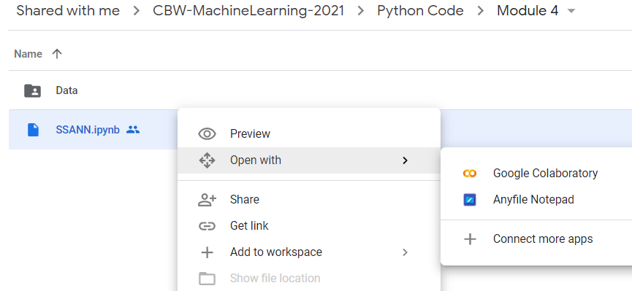

Open the Colab File cont...
Right click on ‘SSANN.ipynb’ and select open with Google Colaboratory

Slide 37
General Algorithm
Read data
Check data for missing data and invalid AAs
Create training/testing data sets
Encode amino acid alphabet
Encode secondary structure alphabet
Define amino acid encoding function (aa_encode)
Pad sequence with null AAs and flatten AA sequence
Define secondary structure encoding function (sst3_encode)
Define activation function (sigmoid or softmax)
Initialize weights and biases
Determine number of batches
Perform forward propagation
Calculate the errors
Perform back propagation
Update weights and biases

Slide 38
Import Functions for Python Math
Numpy allows for mathematical operations and array handling
Pandas is used to read data and for dataframe capabilities
import numpy as np
import pandas as pd

Slide 39
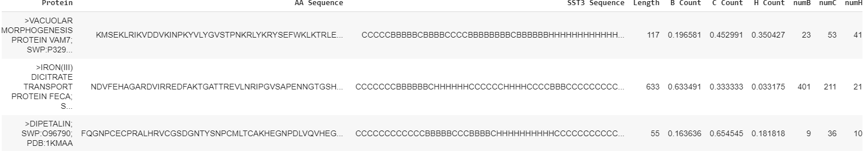
Read the Dataset
After importing the required libraries, the first step is to read in the data set.
data = pd.read_csv('converted_data.csv')
used_data = data.copy()
used_data = used_data.iloc[:,1:]
used_data.head()
A preview of the dataset

Slide 40
Code for Data Check
(Check for Invalid Amino Acids)
#Check the dataset to make sure only proteins with standard
#amino acids are included in the set
def remove_non_standard_aa():
num_nonstd = 0
aa_nonstd = []
num_prot = len(used_data)
for prot in range(num_prot):
if used_data.iloc[prot,1].find('X') != -1:
num_nonstd += 1
aa_nonstd.append(prot)
elif used_data.iloc[prot,1].find(';') != -1:
num_nonstd += 1
aa_nonstd.append(prot)
return aa_nonstd
aa_nonstd = remove_non_standard_aa()
used_data = used_data.drop(used_data.index[aa_nonstd])

Slide 41
Code for Data Check (Missing Values, Label Check)
#Check the dataset to make sure no data is missing and check the class labels – need to define “verify_dataset” function
def verify_dataset(data):
#Use data_found as a dummy variable to determine if to print missing value information
data_found = 1
for each_column in data.columns:
if data[each_column].isnull().any():
print("Data missing in Column " + each_column)
data_found = 0
quit()
if data_found == 1:
print("Dataset is complete. No missing value")
return
#Call verify_dataset and check data verify_dataset(data)

Slide 42
Create a Training (70%) & Testing Set (30%)
A parameter ‘data_frac’ is added to limit the amount of total data used. 20% of the data, 710 proteins, will be split into training (493) and test sets (217).
#Splitting The Data Set into training and testing
def split_dataset_test_train(data,limit,train_size):
data = data.sample(frac=limit).reset_index(drop=True)
training_data = data.iloc[:int(train_size*len(data))].reset_index(drop=True)
##Determine the integer location (iloc) from beginning of array (:) to the train_size and do a ”cleanup” with a reset call
testing_data = data.iloc[int(train_size*len(data)):].reset_index(drop=True)
##Determine the integer location (iloc) from train_size to end of array (: ) and do a ”cleanup” with a reset call
return training_data, testing_data
##Data_frac allows us to control the time it takes to execute subsequent code data_frac = 0.2
train_frac = 0.7
train_data, test_data = split_dataset_test_train(used_data,data_frac,train_frac)

Slide 43
Machine Learning Workflow
Define an ML problem and propose a solution
Construct your dataset
Transform your dataset & select features
Use the model to make predictions
Test and validate your model
Choose and train a model

Slide 44
One-Hot Encoding Amino Acids
ANNs require input data to be binary (one-hot) encoded so that the input can be properly manipulated by the matrix calculations
Need to change amino acids from characters to binary numbers
Amino Acid Character | Amino Acid Binary
A | 100000000000000000000
C | 010000000000000000000
D | 001000000000000000000
… | …
Null | 000000000000000000001

Slide 45
One-Hot Encoding Secondary Structure
Similarly, the secondary structure characters must be changed to binary numbers
Secondary Structure Character | Secondary Structure Binary
B | 100
C | 010
H | 001

Slide 46
Create an Amino Acid Encoding Alphabet
The binary number associations are made with the amino acid characters
‘aa_alphabet’ contains a unique binary number for each amino acid
#Defining codes for the alphabet
aa_codes = np.array(['A','C','D','E','F','G','H','I','K','L','M','N',
'P','Q','R','S','T','V','W','Y','Null']) #An identity matrix is one such that all diagonal elements are equal to 1, while the rest are 0
#Each column is assigned to an amino acid
aa_alphabet = pd.DataFrame(data=np.identity(21), columns=aa_codes)

Slide 47
Create a Secondary Structure Alphabet
A similar alphabet is created for the secondary structure characters
#Defining the encoding matrix for the structures
sst3_codes = np.array(['B','C','H'])
sst3_alphabet = pd.DataFrame(data=np.identity(3),columns=sst3_codes)

Slide 48
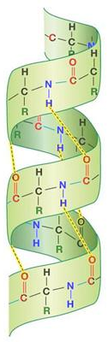
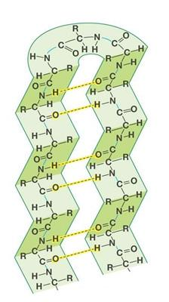
Amino Acid Windowing
Secondary structure arises from chemical interactions between nearby amino acids
To capture these interactions, amino acids are grouped into windows
The secondary structure will be predicted for the amino acid at the center of each window
β Pleated Sheet
α Helix

Slide 49
Amino Acid Encoding
A given amino acid sequence is first padded with null amino acids at the beginning and end of the sequence
Start
End
PKPGFPEKIA…GSKYDPKHDP
Null,…,Null,Null
PKPGFPEKIA…GSKYDPKHDP
Null,…,Null,Null

Slide 50
Windowing Method
A window of amino acids forms one set of inputs to the ANN
The corresponding output is the structure for the amino acid at the center of the window
Input set X
PKPGFPEKIAKEPGFPDPAIGSKYDPKHDP
BBBBBBBBHHHHHHHHHCCCCCCBBBBBBB
Output y

Slide 51
Windowing Method cont...
Shifting the window results in the next set of inputs and corresponding output
Before this data can be used, the amino acid and structure sequences must be encoded
Input set X+1
PKPGFPEKIAKEPGFPDPAIGSKYDPKHDP
BBBBBBBBHHHHHHHHHCCCCCCBBBBBBB
Output y+1

Slide 52
Amino Acid Encoding (Windowing Method)
Null
Null
Null
Null
Null
Null
Null
Null
I
E
E
E
L
L
L
Q
Q
I
D
.
000000000000000000001
000000000000000000001
000000000000000000001
.
.
.
.
An amino acid sequence is first encoded by applying the binary (0/1) amino acid alphabet codes
Start
000000010000000000000
.
.
.
.
000000000000010000000

Slide 53
Amino Acid Encoding (Windowing Method) cont...
Null
Null
Null
Null
Null
Null
Null
Null
I
E
E
E
L
L
L
Q
Q
I
D
.
000000000000000000001
000000000000000000001
Amino acids in the first window are grouped and placed into one row of an array (flattening)
With a window size of 17, the flattened rows will be 357 bits long (17x21)
000000000000000000001
.
.
.
.
Start
000000010000000000000
.
.
.
.
000000000000010000000

Slide 54
Flattening
A flattened row of data
.
I
D
Q
Q
I
D
N
I
K
A
Y
Null
Null
Null
Null
Null
Null
Null
Null
000000000000000000001
000000000000000000001
…
…
000000000000000000010
000000000000000000001
.
.
.
.
000000000000000000010
.
.
.
.
000000000000000000001

Slide 55
Amino Acid Encoding (Windowing Method) cont...
Null
Null
Null
Null
Null
Null
Null
Null
I
E
E
E
L
L
L
Q
Q
I
D
.
000000000000000000001
000000000000000000001
000000000000000000001
.
.
.
.
The window is shifted by one amino acid and the process is repeated
New Centre
000100000000000000000
.
.
.
.
000000010000000000000

Slide 56
Amino Acid Encoding (Windowing Method) cont...
.
I
D
Q
Q
I
D
N
I
K
A
Y
Null
Null
Null
Null
Null
Null
Null
Null
000000000000000000001
000000000000000000001
The process repeats until we reach the end of the amino acid sequence
The next sequence in the set is then windowed
000000000000000000001
.
.
.
.
End
000000000000000000010
.
.
.
.
000000000000000000001

Slide 57

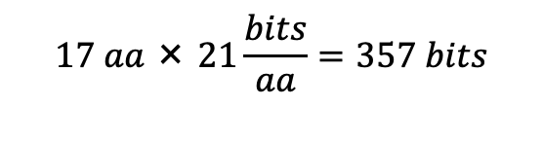
Encoded Data
With encoding complete, each row of data covering length L of the protein corresponds to one set of inputs and outputs
Input Data
Output Data
000000000000000000001
…
000000010000000000000
…
000000000000010000000
100
…
…
010
000000000000000000001
000100000000000000000
000000010000000000000
...
...
…
…
100
000000000000010000000
000100000000000000000
000000000000000000001

Slide 58
Amino Acid Encoding (Windowing Method) cont...
For each sequence in a set, the amino acids are first transformed to a binary representation
def aa_encode(data_set):
#The array that will contain the encoded sequences is first #initialized with window_size*21 columns rows of encoded data will then be added
aa_encoded = np.empty((0,(window_size*21)))
#The null padding length is calculated from the window size
null_size = int(window_size/2)
null_pad = [aa_alphabet['Null']]*null_size
null_pad = np.array(null_pad)
for i in range(len(data_set)):
#For each amino acid in a sequence, retrieve the “bitized” sequence from #aa_alphabet. to_encode = [aa_alphabet[aa] for aa in data_set.iloc[i,1]]
to_encode = np.array(to_encode)

Slide 59
Amino Acid Encoding (Windowing Method) cont...
The encoded sequence is then padded with the null amino acids at the beginning and end of the protein sequence
#After retrieving the bit sequences of all amino acids in a given #sequence, we attach the null sequence using np.concatenate()
#Using axis=0 attaches the null padding in-line with the encoded #sequence. Using axis=1 would place the padding in a separate row #below the encoded sequence
to_encode = np.concatenate((null_pad,to_encode), axis=0)
to_encode = np.concatenate((to_encode,null_pad), axis=0)

Slide 60
Amino Acid Encoding (Windowing Method) cont...
The encoded and padded protein sequence is windowed
Each window is placed as a row (flattened) in the final array
#The encoded sequences representing the amino acids are gathered in groups according to the window size
X_data = [to_encode[top:top+window_size,:].flatten() for top in
range(len(data_set.iloc[i,1]))]
X_data = np.array(X_data)
#The current protein's data is added to the array of all encoded proteins
aa_encoded = np.concatenate((X_data,aa_encoded),axis=0)

Slide 61
Secondary Structure Encoding
The secondary structure for the sequence is encoded by simply fetching the binary encoding for each structure (H,C,B) character
def sst3_encode(data_set):
sst3_encoded = np.empty((0,3))
for i in range(len(data_set)):
to_encode = [sst3_alphabet[sst3] for sst3 in
data_set.iloc[i,2]]
to_encode = np.array(to_encode)
sst3_encoded = np.concatenate((to_encode,sst3_encoded),axis=0)
return sst3_encoded

Slide 62
Machine Learning Workflow
Define an ML problem and propose a solution
Construct your dataset
Transform your dataset & select features
Use the model to make predictions
Test and validate your model
Choose and train a model
We have chosen an ANN Model

Slide 63
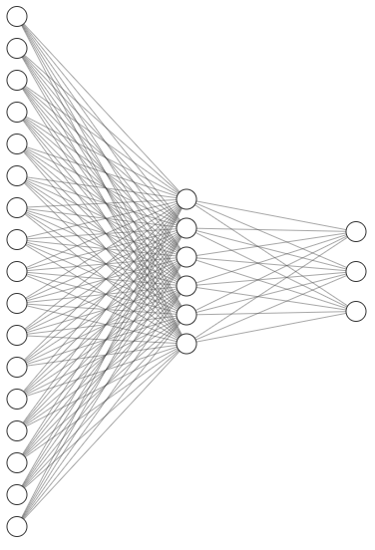
ANN Model
The model’s architecture is chosen to match the dimensionality of the input and output data
Because each input sample consists of 357 bits, the model will have 357 inputs
There are 3 possible secondary structures, thus we will have 3 output units
The hidden layer size will be variable
Each input unit in the diagram represents 21 inputs

Slide 64
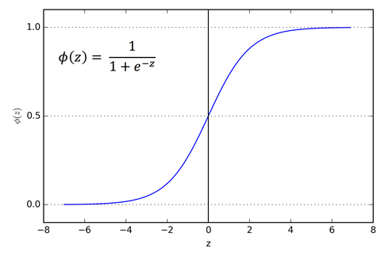
Define Activation Function
The sigmoid function is used for the activation function, as it outputs values between 0 and 1
This is useful because this model predicts probabilities as an output
Additionally, this function is differentiable
This allows for gradient descent optimization, which is used to minimize the error between the predicted and actual output (during training)
#sigmoid and its derivative
def sigmoid(x):
return 1/(1+np.exp(-x))
def sigmoid_deriv(x):
return sigmoid(x)*(1 - sigmoid(x))

Slide 65
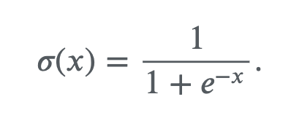
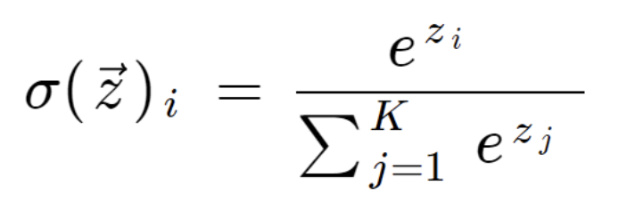
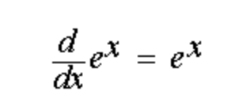
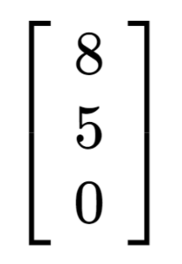
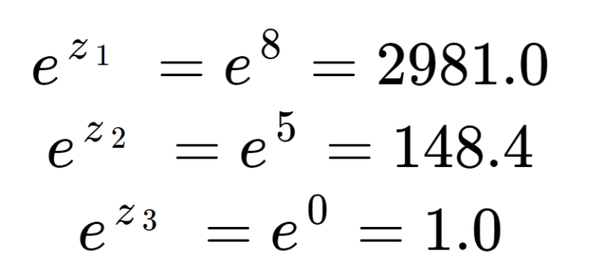
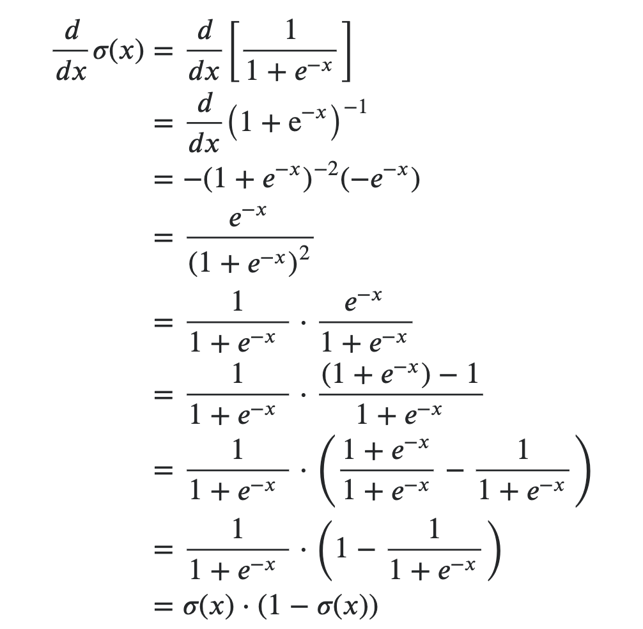
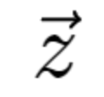
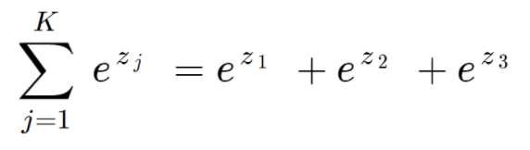
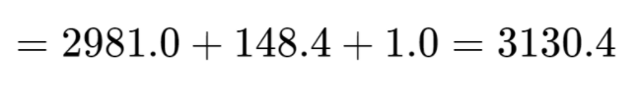
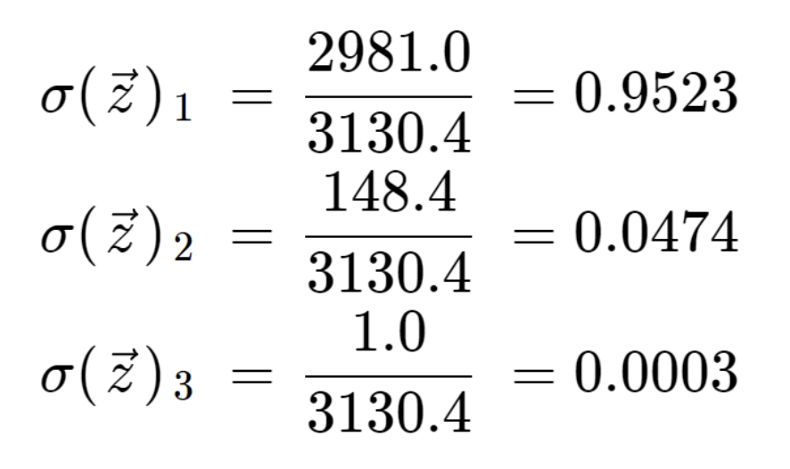
Some Math Reminders
Sigmoid
Function
SoftMax
Function
=

Slide 66
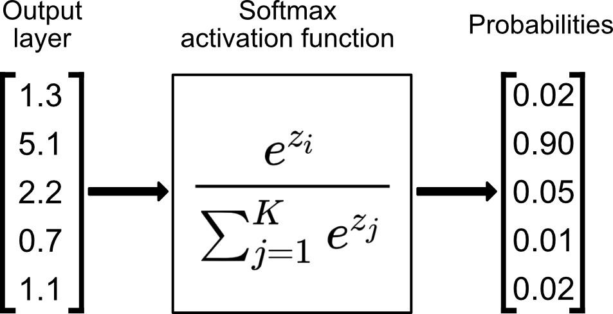
Define Activation Function
For multiclass problems, the output layer often uses the softmax activation function
This function has the benefit of outputting values that sum exactly to 1
def user_softmax(A):
expA = np.exp(A)
return expA / expA.sum(axis=1, keepdims=True)

Slide 67
Initialize Weights and Biases
Before training the model, the weights and biases are initialized as random values between 0 and 1
w0 is the set of weights for connections between the input and hidden layer
w1 is the set of weights for connections between the hidden and output layer
The biases bh and bo are for the hidden and output layers respectively
#random.random returns number from 0 to 1 while random.randn
#returns Gaussian random number from -1 to 1, with mean of 0
#Weight initialization
w0 = 2*np.random.random((X_train.shape[1], hidden_size)) - 1
w1 = 2*np.random.random((hidden_size, 3)) - 1
bh = np.random.randn(hidden_size)
bo = np.random.randn(3)

Slide 68
Determine Number of Batches
The number of batches ‘num_batch’ is calculated from the user-determined batch size and training size
The number of batches is corrected in case the training set size is not a multiple of the batch size
#Recall that % returns remainder (modulus)
#Recall that // returns largest divisor
rem = len(X_train) % batch_size
num_batch = len(X_train)//batch_size
if rem != 0:
num_batch += 1

Slide 69
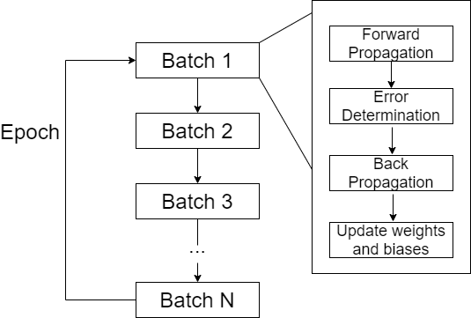
The ANN Training Loop
Forward propagation, error determination, back propagation, and weight/bias updating are performed for every batch of input data
This process is repeated for multiple epochs

Slide 70
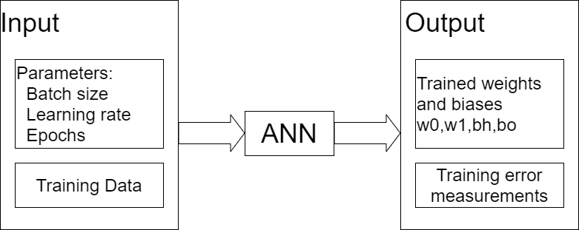
ANN Input and Output
The model takes learning rate, batch size, epochs, and the training set as input
The model will output the weights and biases for the input and hidden layer, as well as training error measurements
def training(lr, batch_size, epochs):
return [w0,bh,w1,bo], error, errors

Slide 71
Forward Propagation
The current batch of data is extracted from the total training set
The input is propagated through the layers by multiplying by weight matrices, adding biases, and running through the activation functions
# Finding the current batch
batch_start = curr_batch * batch_size
batch_end = batch_start + batch_size
input_batch = X_train[batch_start:batch_end]
#First layer propagation. This equation calculates dot #product of input layer vector (batchsize x (window_size*21)) #with weight matrix w0 ((window_size*21)xhiddenlayer size) zh = np.dot(input_batch, w0) + bh
layer1 = sigmoid(zh)
#Second layer propagation. This equation calculates dot #product of the first layer and weight
zo = np.dot(layer1, w1) + bo
layer2 = user_softmax(zo)

Slide 72
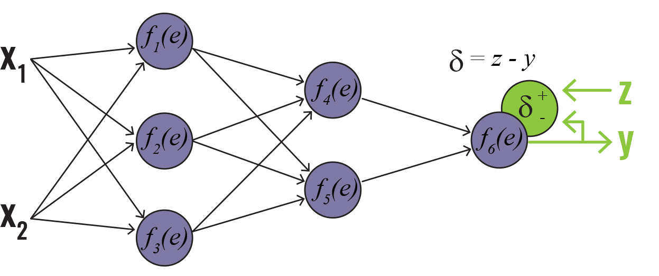
Determine the Error
The labels (true output) corresponding to the current batch of inputs is found
These are compared to the forward-propagated output of the model ‘layer2’ (δ is derivative of the cost function)
This subtraction represents the cost function which, through gradient descent, will be minimized
labels_batch = y_train[batch_start:batch_end]
layer2_error = layer2 - labels_batch
The ”complicated” partial derivatives
actually simplify to simple differences
Layer 0
Layer 1
Layer 2

Slide 73
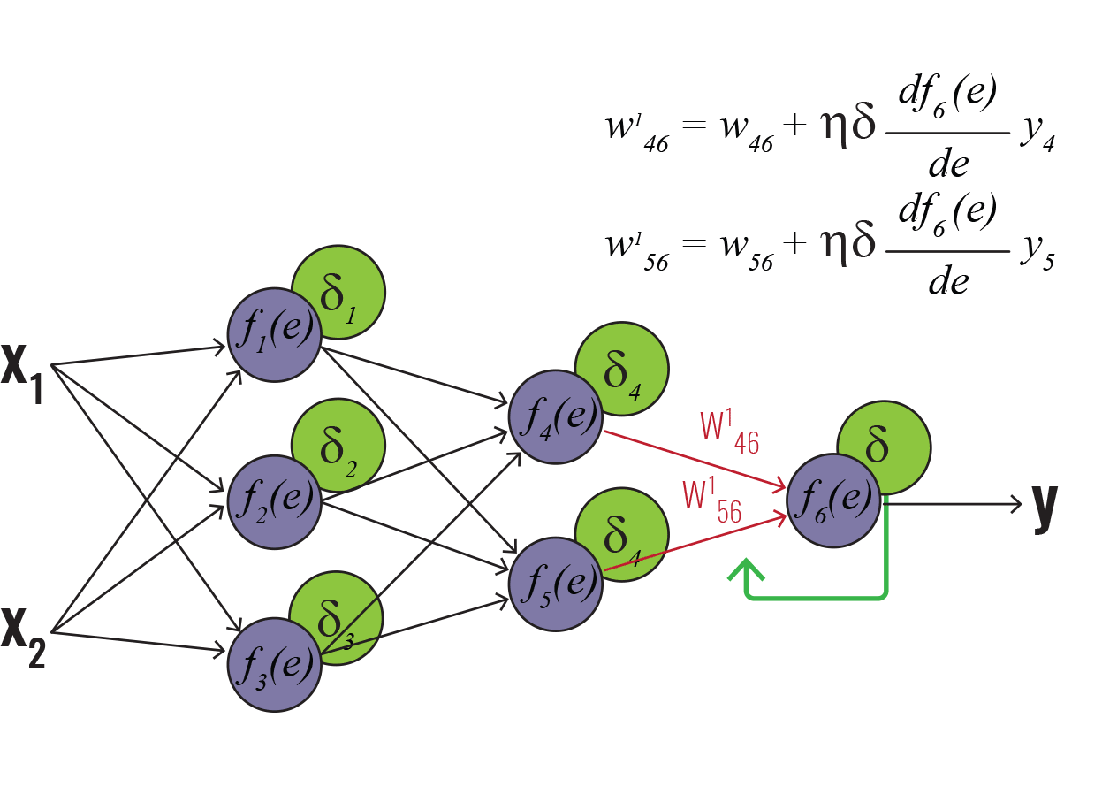
Backpropagation
Using the gradient descent algorithm, the derivative of the cost with respect to weights for layer 2 is calculated
This is called “layer2w_delta” as this will later be subtracted from the layer2 weights to find the new set of weights
The change in layer2 bias is simply the layer2 error
layer2w_delta = np.dot(layer1.T, layer2_error)
layer2b_delta = layer2_error
Layer 0
Layer 1
Layer 2

Slide 74
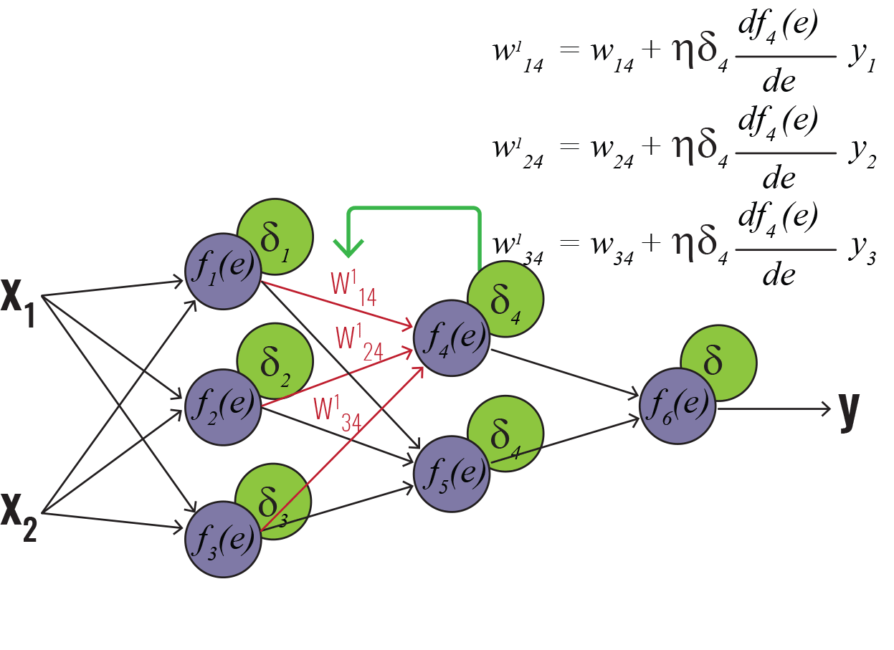
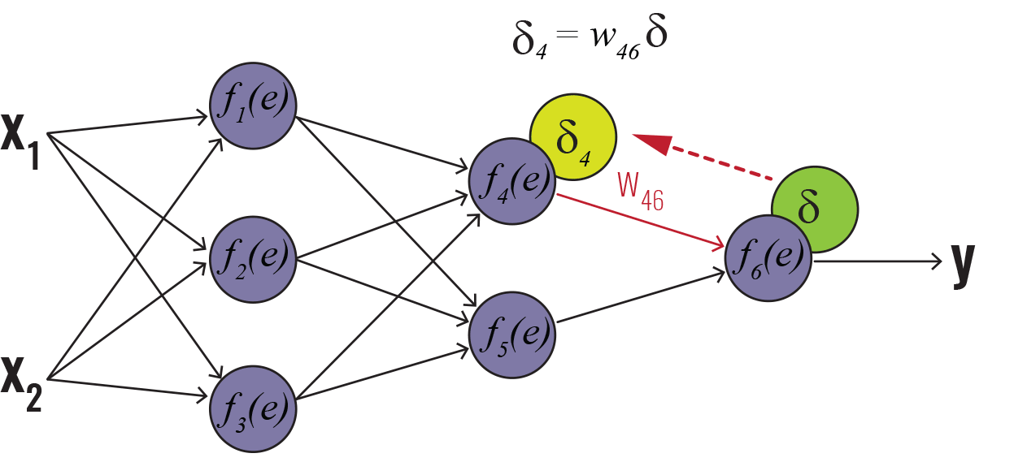
Backpropagation cont...
The cost function must be differentiated with respect to the hidden layer weights
The hidden layer partial derivatives are first found
#Propogation of error to layer1
dcost_dah = np.dot(layer2_error , w1.T)
dah_dzh = sigmoid_deriv(zh)
Layer 0
Layer 1
Layer 2
Layer 0
Layer 1
Layer 2

Slide 75
Backpropagation cont...
The partial derivatives are then multiplied to get ‘layer1w_delta’, the number used to change the layer1 weights
#Propogation of error to layer1
layer1_error = dah_dzh * dcost_dah
layer1w_delta = np.dot(input_batch.T, layer1_error)
layer1b_delta = layer1_error
Layer 0
Layer 1
Layer 2

Slide 76
Update Weights
Using the products found earlier, the weight matrices can now be updated
The respective delta matrices are multiplied by the learning rate and subtracted from the current weight values
#Update weights with learning rate n
w0 -= lr * layer1w_delta
w1 -= lr * layer2w_delta
wo = wo – lr*layer1w_delta

Slide 77
Update Biases
Similarly, the bias deltas are subtracted from the current bias values
bh = bh – lr*layer1b_delta
#Update biases with learning rate n
bh -= lr * layer1b_delta.sum(axis=0)
bo -= lr * layer2b_delta.sum(axis=0)
Sums all elements in 2D
array to put into 1D vector

Slide 78
Complete Training Process
The process is repeated for a number of epochs
for epoch in range(epochs):
for curr_batch in range(num_batch):
batch_start = curr_batch * batch_size # Finding the current batch
batch_end = batch_start + batch_size
input_batch = X_train[batch_start:batch_end]
zh = np.dot(input_batch, w0) + bh # First layer propagation
layer1 = sigmoid(zh)
zo = np.dot(layer1, w1) + bo # Second layer propagation
layer2 = user_softmax(zo)
labels_batch = y_train[batch_start:batch_end]
layer2_error = layer2 - labels_batch # Layer 2 error calculation
layer2w_delta = np.dot(layer1.T, layer2_error) # Layer 2 derivative calculations layer2b_delta = layer2_error
dcost_dah = np.dot(layer2_error , w1.T) # Layer 1 derivative calculations
dah_dzh = sigmoid_deriv(zh)
layer1_error = dah_dzh * dcost_dah # Layer 1 error calculation
layer1w_delta = np.dot(input_batch.T, layer1_error)
layer1b_delta = layer1_error
w0 -= lr * layer1w_delta # Weight and bias updating
bh -= lr * layer1b_delta.sum(axis=0)
w1 -= lr * layer2w_delta
bo -= lr * layer2b_delta.sum(axis=0)

Slide 79
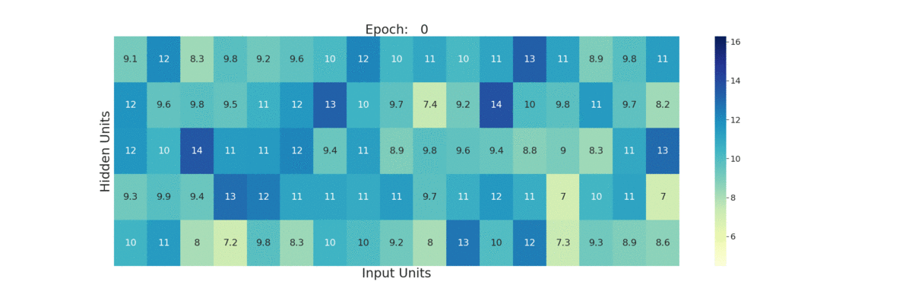
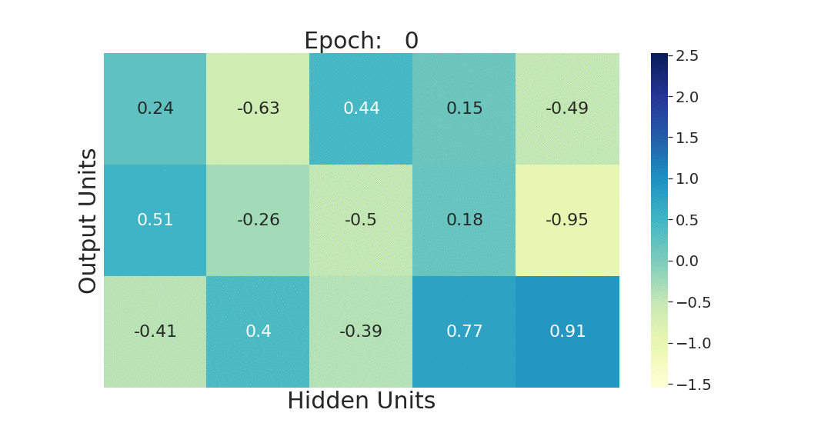
Updating Weights
The 17 input units each represent 21 bits (they are condensed)

Slide 80
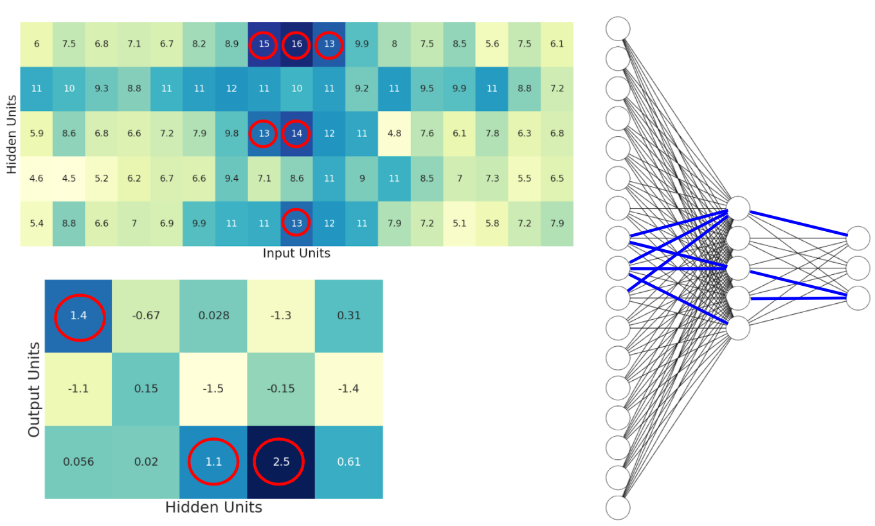
Updating Weights

Slide 81
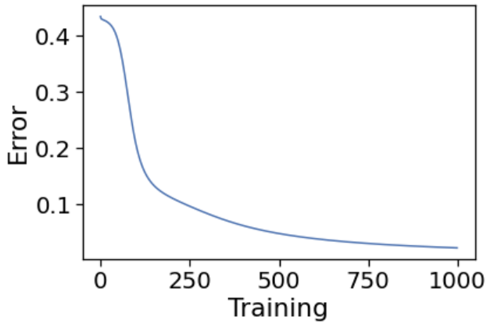
Training Output
In addition to outputting the trained parameters, the training function will also output all the layer2 errors found during training
This results in one error measurement per epoch, which can then be plotted
Error is difference
between output and
true label
Epochs

Slide 82
Program Statistics
 | Python | R
Packages used | numpy, pandas | N/A
Lines of code | 183 | 316
Average Running time (seconds) | 21.70 | 23.34
This program actually trains every time you run it although you can choose to run certain cells to use the trained ANN with new input data (<5 sec)

Slide 83
Machine Learning Workflow
Define an ML problem and propose a solution
Construct your dataset
Transform your dataset & select features
Use the model to make predictions
Test and validate your model
Choose and train a model
Test on Test Data Set

Slide 84
Forward Propagation (Evaluation) of the Test Set
Now that the model is trained, the test set can be evaluated
This function will take the trained parameters (training function output) and the test set as input
def evaluation(params,tst_set):
w0 = params[0]
bh = params[1]
w1 = params[2]
bo = params[3]

Slide 85
Forward Propagation (Evaluation) of the Test Set cont...
Using these parameters, the test set is propagated forward through the model
The final output ‘layer2’ is the model’s predictions on the test set
# First layer propagation
zh = np.dot(tst_set, w0) + bh
layer1 = sigmoid(zh)
# Second layer propagation
zo = np.dot(layer1, w1) + bo
layer2 = user_softmax(zo)
return layer2

Slide 86
Training and Test Sets
To manage the time it takes to execute the data encoding and training steps, we will limit the amount of data used for training
The encoded set length is the number of rows in the encoded data, which corresponds to the number of windows, i.e. the total number of amino acids
Data Set | Number of Sequences | (AAs) Encoded Set Length
PPT-DB Total Set | 7117 | 1456308
Training Set | 497 | 120733
Test Set | 213 | 53668

Slide 87


Performance of SSANN (Training vs. Testing Set)
Training
Testing
 | Beta (B) (Observed) | Coil (C) (Observed) | Helix (H) (Observed)
Beta (B) (Predicted) | 0.48 | 0.31 | 0.21
Coil (C) (Predicted) | 0.14 | 0.69 | 0.17
Helix (H) (Predicted) | 0.14 | 0.22 | 0.63
 | Beta (B) (Observed) | Coil (C) (Observed) | Helix (H) (Observed)
Beta (B) (Predicted) | 0.46 | 0.32 | 0.22
Coil (C) (Predicted) | 0.14 | 0.69 | 0.17
Helix (H) (Predicted) | 0.13 | 0.22 | 0.65
Normally you want training & testing sets to be within 5-6% of each other
If they are much more than this, you have likely over-trained the system

Slide 88
Can We Do Better?

Slide 89
What’s Needed
An ANN architecture that could capture more distant residue interactions
An ANN architecture such that each residue sees the whole sequence, not just a local region (attention)
An ANN that handles different sequence lengths without the need for feature selection or engineering
An ANN that learns features directly from the data without the need for hand-made features
An ANN that uses embeddings instead of one-hot encoding
Answer: A Transformer

Slide 90
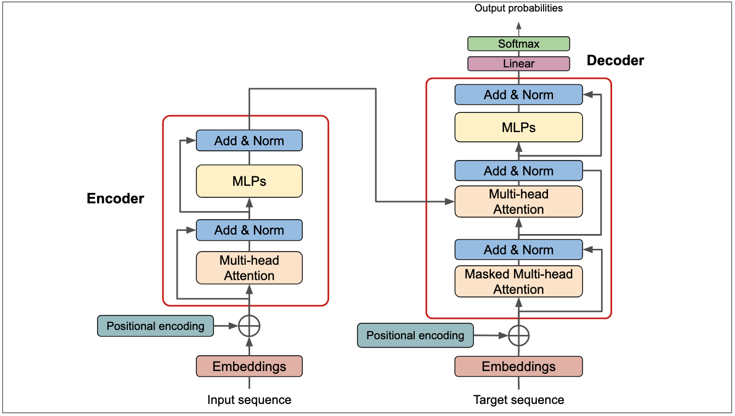
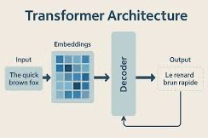
Transformer Architecture

Slide 91
Transformers vs. ANNs
Both: ANNs and Transformers trainable via backpropagation
Structure: ANN = same weights, static connections; Transformer = attention-based with input-dependent weights and dynamic focus (attention) on inputs
Structure: ANNs don’t have encoders/decoders, Transformers do
Input: ANN = fixed vectors; Transformer = variable sequences
Context: ANN = limited; Transformer = long-range via attention
Parallelism: both can run in parallel, but Transformer handles sequences and parallelism much more efficiently
Position: Transformer encodes order; ANN does not inherently encode order

Slide 92
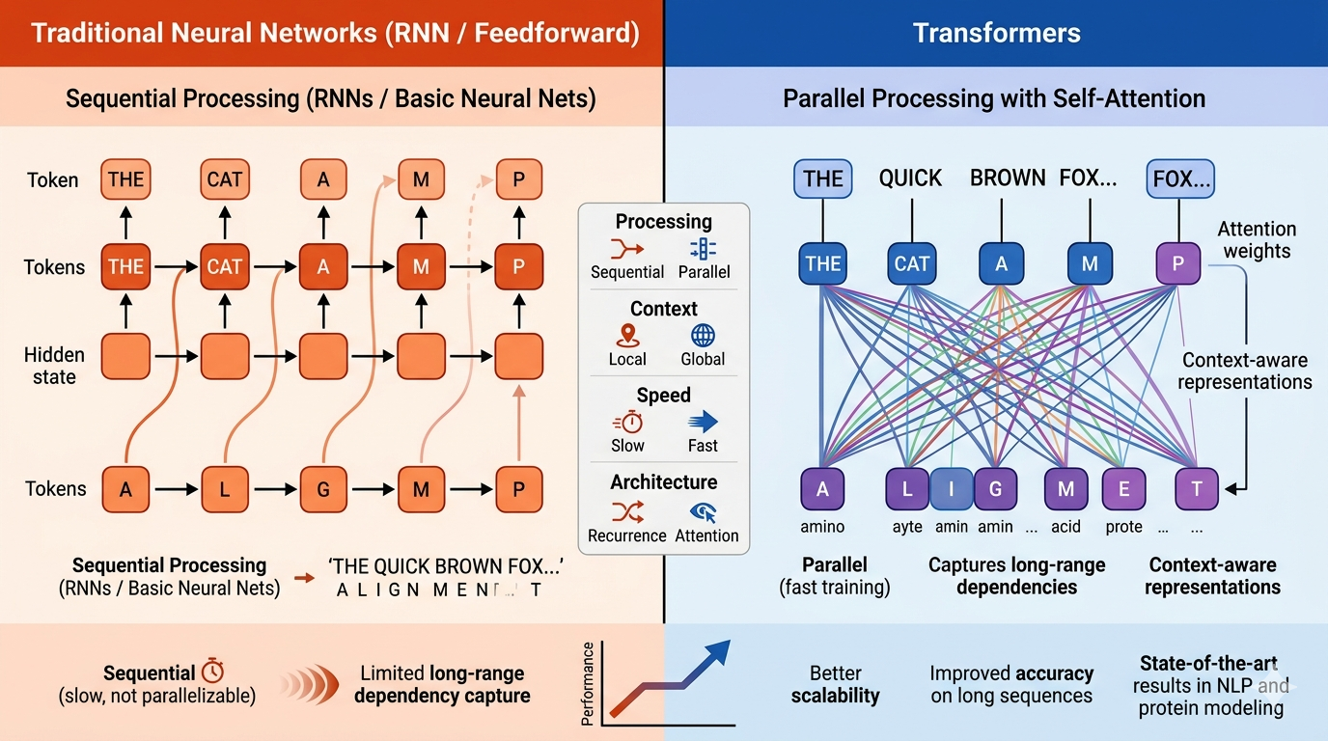

Slide 93
Predicting Secondary Structure with Transformers
What are PLMs?
PLMs (Protein Language Models) are a type of machine learning model (like Large Language Models or LLMs) that are trained specifically on protein data
ProtBERT is a model trained on 217 million protein sequences that uses the transformer architecture to learn the context of sequences
We can utilize PLMs to train models relating to protein data, such as predicting protein secondary structure

Slide 94
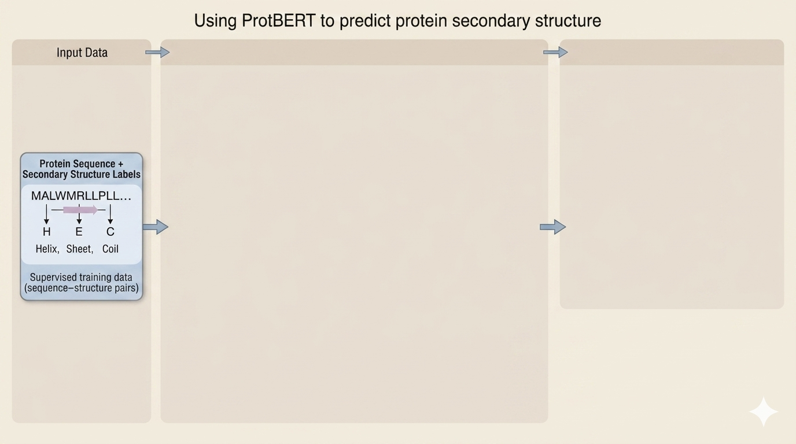

Slide 95
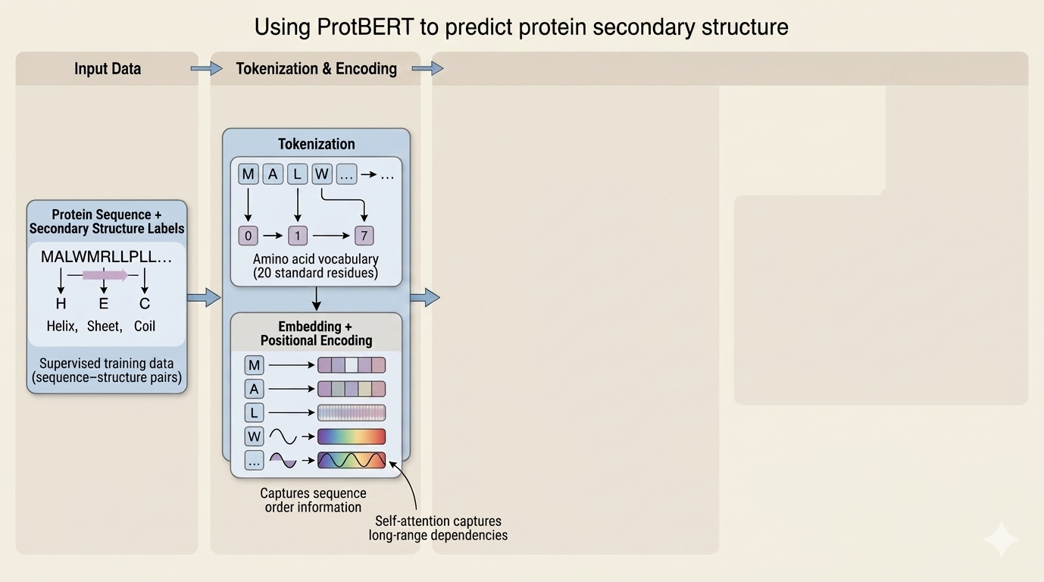

Slide 96


Slide 97


Slide 98
Performance of Transformer vs. ANN
PLM-Transformer
ANN
 | Beta (B) (Observed) | Coil (C) (Observed) | Helix (H) (Observed)
Beta (B) (Predicted) | 0.78 | 0.09 | 0.12
Coil (C) (Predicted) | 0.14 | 0.88 | 0.06
Helix (H) (Predicted) | 0.09 | 0.02 | 0.93
 | Beta (B) (Observed) | Coil (C) (Observed) | Helix (H) (Observed)
Beta (B) (Predicted) | 0.46 | 0.32 | 0.22
Coil (C) (Predicted) | 0.14 | 0.69 | 0.17
Helix (H) (Predicted) | 0.13 | 0.22 | 0.65

Slide 99
Summary
We now have a neural network program written in “pure” python that predicts secondary structure
It has been thoroughly trained on a large training set and tested on a modest test set
You can now use this code or adapt this code for other similar kinds of sequence analysis (membrane spanning helix prediction, signal site prediction, gene prediction) or improve the performance of the program by adding other hidden layers or other features to the training/testing data
In the next section we will explore the code and run it on a few examples
If you would like to work with in R rather than Python, follow the steps indicated in the Lab to find the corresponding scripts

Slide 100
Module 4 (Homework)
Let’s Take a Closer Look at the Program
SSANN.ipynb

Slide 101
Open the Colab File in the Language of Your Choosing
The python script ‘SSANN.ipynb’, covered during lecture, will be used for the Lab portion
However, you have the option of running the Lab in R
To do so, find the R code ‘SSANN_R.ipynb’ in the R Code folder under Module 4

Slide 102

Open the Colab File in the Language of Your Choosing cont...
Right click on ‘SSANN.ipynb’ (or alternatively SSANN_R.ipynb in the R Code folder under Module 4) and select open with Google Colaboratory

Slide 103
Study the Program
Spend a few minutes studying the SSANN.ipynb (or SSANN_R.ipynb) program
See if you can understand the logic of the program
Ask questions of the TA’s if you are unclear about some of the functions or Python code
After studying the code, try running it

Slide 104




To Run: Upload the Data
Once the Colab file is open, click the folder icon to the right
When the panel opens, right click inside the panel and click upload
Then find the CBW_MachineLearning_2026 folder on your desktop
Open the Data folder followed by the Module 4 folder, and open the corresponding data file named ‘converted_data.csv’
4
converted_data

Slide 105

Run The Program
Select ‘Run all’ from the ‘Runtime’ menu

Slide 106

Exercise 4.1
Because there is a lot of data, cell 15 (data encoding) and cell 16 (training) will take ~30 seconds each to execute
After the code finishes running, observe the confusion matrix (cell 19)
The accuracy for ‘B’ prediction will be close to 30%
Go to cell 14 and change the data_frac from 0.1 to 0.12. Run cells 14 through 19 sequentially by clicking the run button on each cell in order
The accuracy for C and H prediction will be similar to before (around 66%) with an improvement in B prediction accuracy

Slide 107

Exercise 4.2 and 4.3
Go to the last cell, cell 20 and observed the predicted structure of the test sequence.
Change the file name to a different test sequence file name (sequence3.txt) and run the cell again
Go to cell 16 and change the learning rate from 0.0001 to 0.01
Run cells 16 and 17
The error plot will look more jagged – Why do you think this happens?
??????????????????????????????????????????????????????????????????????????????????????????

Slide 108
Conclusion
This concludes the “formal” section on ANNs for protein secondary structure
Feel free to explore the code, modify it if you wish or to review the slides and explanations – talk to the TAs
Feel free to look at other modules or other programs we have presented today

Slide 109






Coffee Break & Networking Session
Workshop Sponsors

