Slide 1

bioinformatics.ca
bioinformaticsdotca.github.io

Slide 2


Slide 3

Module 5: Gene Finding with ANNs
David Wishart
Machine Learning
Apr 22-23, 2026
University of Alberta

Slide 4

Schedule (MT)
Day 1 (MT) | Wednesday Apr. 22 | Day 2 (MT) | Day 2
9:00 AM | Introductions and Technology Check | 9:00 AM | Module 5: Gene Finding with NNs (Lecture and Lab)
9:45 AM | Module 1: Introduction to Machine Learning (Lecture) | 11:00 AM | Break (30 min)
11:00 AM | Break (30 min) | 11:30 AM | Module 6: Machine Learning with Keras and Scikit-Learn (Lecture/Lab)
11:30 AM | Module 2: Decision Trees (Lecture and Lab) | 1:00 PM | Break (45 min)
1:00 PM | Break (1 hour) | 2:00 PM | Module 7: Machine Learning with Keras and Scikit-Learn (Cont'd)
2:00 PM | Module 3: Neural Networks (Lecture and Lab) | 3:00 PM | Break (30 min)
3:00 PM | Break (30 min) | 3:30 PM | Module 8: LLMs and agentic coding for bioinformatics
3:30 PM | Module 4: Neural Networks for 2º Structure (Lecture and Homework) | 4:45 PM | Survey and Closing Remarks
5:00 PM | End of Day 1 | 5:00 PM | End of Day 2
Canadian Bioinformatics Workshops | bioinformatics.ca

Slide 5
Schedule (PT)
Day 1 (PT) | Wednesday Apr. 22 | Day 2 (PT) | Thursday Apr. 23
8:00 AM | Introductions and Technology Check | 8:00 AM | Module 5: Gene Finding with NNs (Lecture and Lab)
8:45 AM | Module 1: Introduction to Machine Learning (Lecture) | 10:00 AM | Break (30 min)
10:00 AM | Break (30 min) | 10:30 AM | Module 6: Machine Learning with Keras and Scikit-Learn (Lecture/Lab)
10:30 AM | Module 2: Decision Trees (Lecture and Lab) | 12:00 PM | Break (45 min)
12:00 PM | Break (1 hour) | 1:00 PM | Module 7: Machine Learning with Keras and Scikit-Learn (Cont'd)
1:00 PM | Module 3: Neural Networks (Lecture and Lab) | 2:00 PM | Break (30 min)
2:00 PM | Break (30 min) | 2:30 PM | Module 8: LLMs and agentic coding for bioinformatics
2:30 PM | Module 4: Neural Networks for 2º Structure (Lecture and Homework) | 3:45 PM | Survey and Closing Remarks
4:00 PM | End of Day 1 | 4:00 PM | End of Day 2
Canadian Bioinformatics Workshops | bioinformatics.ca

Slide 6
Learning Objectives
To review the structure of prokaryotic genes
To explain how prokaryotic gene prediction or identification can be done
To explain how gene prediction is assessed
To review and explain the python code for different ANNs to predict prokaryotic genes
To show how the addition of an HMM helps with an ANN gene predictor
To use Colab to explore gene prediction code

Slide 7
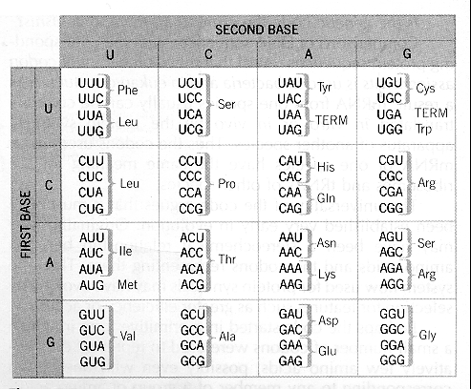
The Genetic Code

Slide 8
Translating DNA/RNA
Frame3 A Y S D A H
Frame2 C V * R C A
Frame1 M R I A M R I
ATGCGTATAGCGATGCGCATT
TACGCATATCGCTACGCGTAA
Frame-1 H T Y R H A N
Frame-2 R I A I R M
Frame-3 A Y L S A C

Slide 9
Prokaryotic Gene Structure
100 bp
upstream
ORF (open reading frame)
TATA box
Start codon
Stop codon
ATGACAGATTACAGATTACAGATTACAGGATAG
Frame 1
Frame 2
Frame 3

Slide 10
Gene Finding In Prokaryotes
Scan forward to find all start codons, track position
Scan forward to find all stop codons, track position
Find all start/stop codon pairs where stop position > start position and difference is divisible by 3
If # of codons between start and end is greater than 14, identify as gene
If # codons between start and end is less than 14, then not a gene
At end of chromosome, repeat process for reverse complement

Slide 11
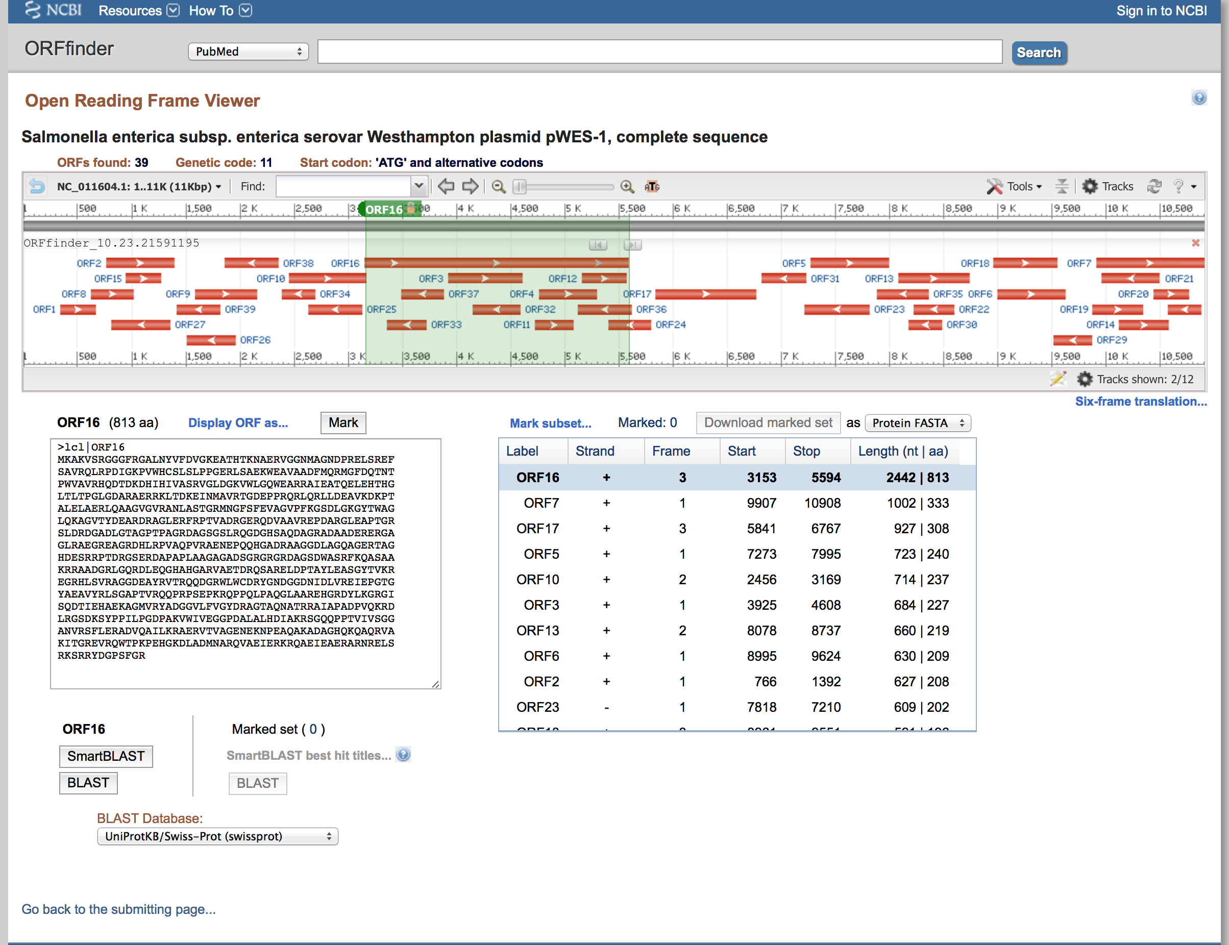
Prokaryotic Gene Finding

Slide 12
Gene Prediction (Evaluation)
TP
FP
TN
FN
TP
FN
TN
Actual
Predicted
Sensitivity - Measure of the % of false negative results (sn =
0.996 means 0.4% false negatives)
Specificity - Measure of the % of false positive results
Precision - Measure of the % positive results
Correlation - Combined measure of sensitivity and specificity

Slide 13
Gene Prediction (Evaluation) cont...
TP
FP
TN
FN
TP
FN
TN
Actual
Predicted
Sensitivity or Recall Sn = TP/(TP + FN)
Specificity Sp = TN/(TN + FP)
Precision Pr = TP/(TP + FP)

Slide 14
Finding Open Reading Frames (ORFs)
Start
['ATG']
['AAA']
['CGC']
['ATT']
['AGC']
['ACC']
['ACC']
['ATT']
['ACC']
['ACC']
['ACC']
['ATC']
['ACC']
['ATT']
['ACC']
['ACA']
['GGT']
['AAC']
['GGT']
['GCG']
['GGC']
['TGA']
Prokaryotic genes are constrained to open reading frames
ORFs are characterized by a start codon and end codon in the same frame
Only ORFs of certain length will be potential genes
Start Codons | ATG, GTG, TTG
Stop Codons | TAA, TAG, TGA
End

Slide 15
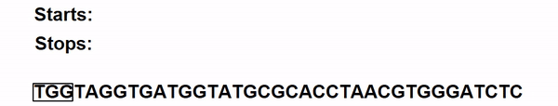
ORF Finder
The first step is to find the indices (positions) of all start and stop codons in the genome
To find ORFs, valid start and stop codons will be paired
Determine if (Stop codon position – Start codon position) modulo 3 = 0 to find Start/Stop pairs

Slide 16
ORF Finder cont...
This ORF finder will find almost all correct gene locations, but also many ‘false’ genes
Not all ORFs are genes
ORF start and stop locations
Genome
ORF Finder
Forward
Reverse Complement
ORF Start | ORF Stop
337 | 2799
567 | 780
798 | 915
2801 | 3733
ORF Start | ORF Stop
678 | 977
1346 | 2063
5893 | 6534
7652 | 9788
Correct
False
False
Correct
False
False
Correct
False

Slide 17
Let’s Try Programming an ORF Finder
ORFfinder.ipynb

Slide 18
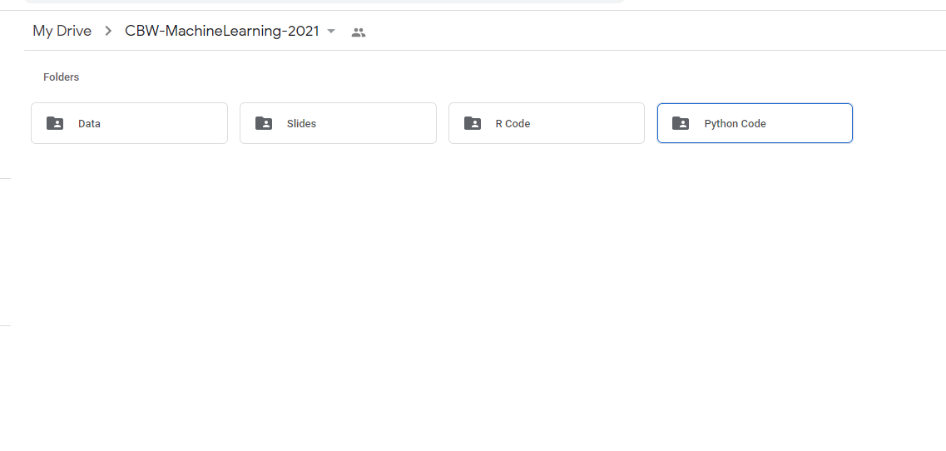

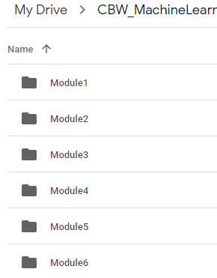
Open the Colab File
Find the Module 5 folder under Python Code in folder CBW-MachineLearning-2026 in your Google Drive

Slide 19
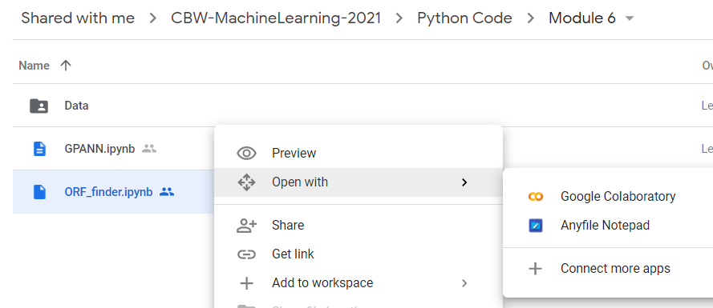




Open the Colab File cont...
Right click on ‘OPFfinder.ipynb’ and select open with Google Colaboratory
5

Slide 20
General Algorithm
Read data
Create verify data set function (verify_dataset) and call it to check for missing data
Create codon function (codons) and create list of stop/start points
Identify start and stop codon pairs in all 3 reading frames
Pair start and stop codons to define ORFs in same reading frame
Create ORF function (ORF), set minimum ORF length to 40 bases
Identify start codons + up to 3 stop codons in same reading frame
Create ORFfinder function (ORFfinder) and run it
Calculate correct and incorrect ORFs

Slide 21
Import Functions for Python Math
Numpy allows for mathematical operations and array handling
Pandas is used to read data and for dataframe capabilities
import numpy as np
import pandas as pd

Slide 22
Read the Dataset
Read the genome sequence (forward and reverse complement)
#Reading full forward direction genome
#.replace() removes the newline characters (enter)
with open('full_sequence.fasta', 'r') as file:
full_seq = file.read().replace('\n', '')
#The first 71 characters contain the genome’s #information (reference number etc.). This is removed
full_seq = full_seq[71:]
#Reading full reverse complement direction genome
with open('rev_comp.fasta', 'r') as file:
full_rev = file.read().replace('\n', '')
#Remove the first line
full_rev = full_rev[82:]

Slide 23
Code For Data Check (Missing Values, Label Check)
#Check the dataset to make sure no data is missing and Check the class labels – need to define “verify_dataset” function
def verify_dataset(data):
#Use data_found as a dummy variable to determine if to print missing value information
data_found = 1
for each_column in data.columns:
if data[each_column].isnull().any():
print("Data missing in Column " + each_column)
data_found = 0
quit()
if data_found == 1:
print("Dataset is complete. No missing value")
return
#Call verify_dataset and check data verify_dataset(data)

Slide 24
ORF Finder Code
Stop codons are defined, Start codon (ATG) set
Two lists are created that will contain the indices of the found start and stop codons
def codons(seq,start_c):
stops = ["TAA","TGA","TAG"]
lst1 = [[],[],[]] #List for the start codons
lst2 = [[],[],[]] #List for the stop codons
start = 0 #Counter for 3 optional frames

Slide 25
ORF Finder
The code will execute for the three different frames (start goes from 0 to 2)
For a given frame position, look at the first codon
If it is a start codon, add it to start codon list
If it is a stop codon, add it to the stop codon list
Once all codons in the current frame are checked, move to the next frame
while (start < 3): for i in range(start,len(seq),3):
#Codon extraction
codon = seq[i:i+3]
if (codon == start_c):
lst1[start].append(i+1)
if (codon in stops):
lst2[start].append(i+1)
start += 1
return lst1,lst2

Slide 26
ORF Finder
Once the positions of the start and stop codons are found, they must be paired to form ORFs
For a given start codon, a valid stop codon must be in the same frame with position greater than the start codon
Frame 1 [190, ...]
Frame 2 [...]
Frame 3 [...]
Frame 1 [13, 46, 61, 64, 112, 253, ...]
Frame 2 [...]
Frame 3 [...]
Start Codons
Stop Codons
Correct stop codon

Slide 27
ORF Finder cont...
Two lists are created for valid ORF start and stop codons
The minimum length of ORFs is set to 40 nucleotides
The frame of a start codon is found
#lst1 is the list of start codon positions, lst2 is the #stop codon positions
def ORF(lst1,lst2):
ORFstarts = []
ORFstops = []
min_len = 40
start_min = 0
...
for s_cod in all_frames:
if s_cod > start_min:
for s_frame in range(3):
if s_cod in lst1[s_frame]:
frame = s_frame
break

Slide 28
ORF Finder cont...
For a given start codon, the first 3 stop codons in the same frame position are found
This is to account for the possibility of finding the correct start codon but the wrong stop codon (one that appears after the first stop codon)
The starting position is then updated and the process is repeated
stop_count = 0
for stp_cod in lst2[frame]:
if stp_cod > s_cod + min_len:
ORFstarts.append(s_cod)
ORFstops.append(stp_cod)
if stop_count > 3:
start_min = start_min + min_len - look_back
break

Slide 29
ORF Finder cont...
Finally, we define the main ORF finder function, which runs the previous functions on a list of start codons
This returns a list of all the ORF predictions separated into correct and incorrect predictions
def ORFfinder(dta,nucleotides, sel_gen, rev):
#Initializing arrays that will contain the correctly and incorrectly
#found ORFs
all_corORFs = np.empty((0,2))
all_incorORFs = np.empty((0,2))
start_codons = ["ATG","GTG","TTG"]
#Iterate the ORF finder functions over the start codons
for start_cod in range(len(start_codons)):
#Finding the locations of the start and stop codons
lst1, lst2 = codons(dta[0:nucleotides], start_codons[start_cod])
#Pair valid ORF start and stops locations
ORFstarts, ORFstops, found_frame = ORF(lst1,lst2)
corr, corORF, incorORF = ORFcheck(ORFstarts,ORFstops, sel_gen, rev)
all_corORFs = np.concatenate((all_corORFs,corORF),axis=0)
all_incorORFs = np.concatenate((all_incorORFs,incorORF),axis=0) return all_corORFs, all_incorORFs

Slide 30
Let’s Assess our ORF Finder on E. coli

Slide 31
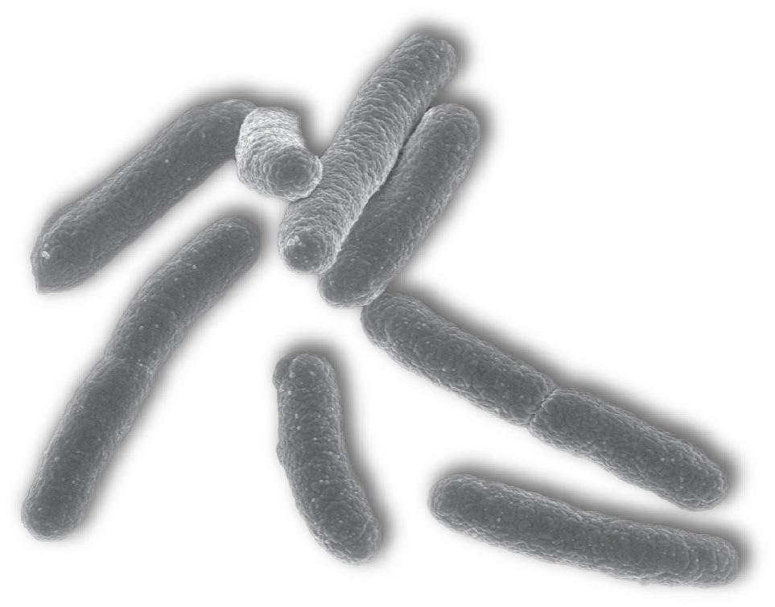
E. Coli K12 Genome
E. Coli K12 is a prototypical prokaryotic organism
This genome is a reference genome and is widely used in the study of prokaryotes
Protein Genes | 4407
Length | 4,641,652
https://pax-db.org/species/511145

Slide 32
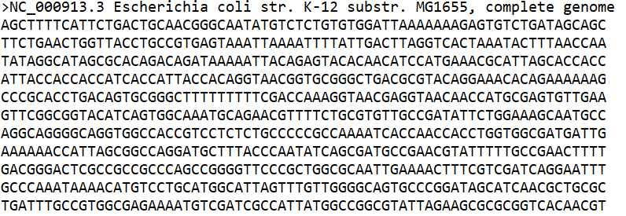
Data Used
Genome:
…
Forward
Reverse Complement
Gene Start | Gene End
337 | 2799
2801 | 3733
3734 | 5020
5234 | 5530
Gene Start | Gene End
1346 | 2063
6342 | 7212
7907 | 8420
11130 | 12798
Correct Gene Locations:
…
…

Slide 33
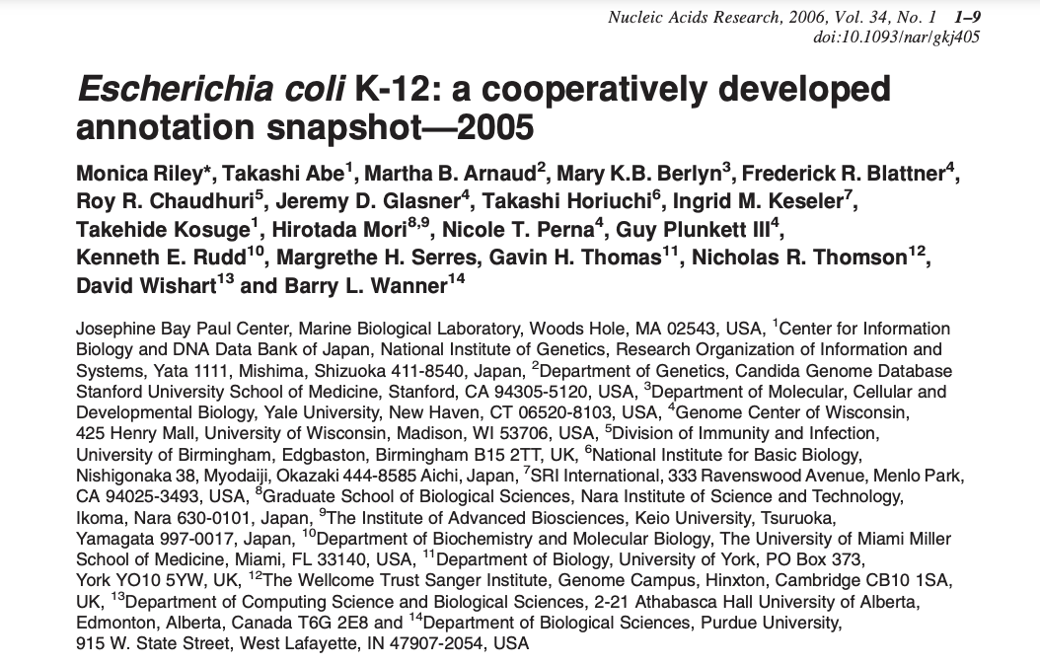
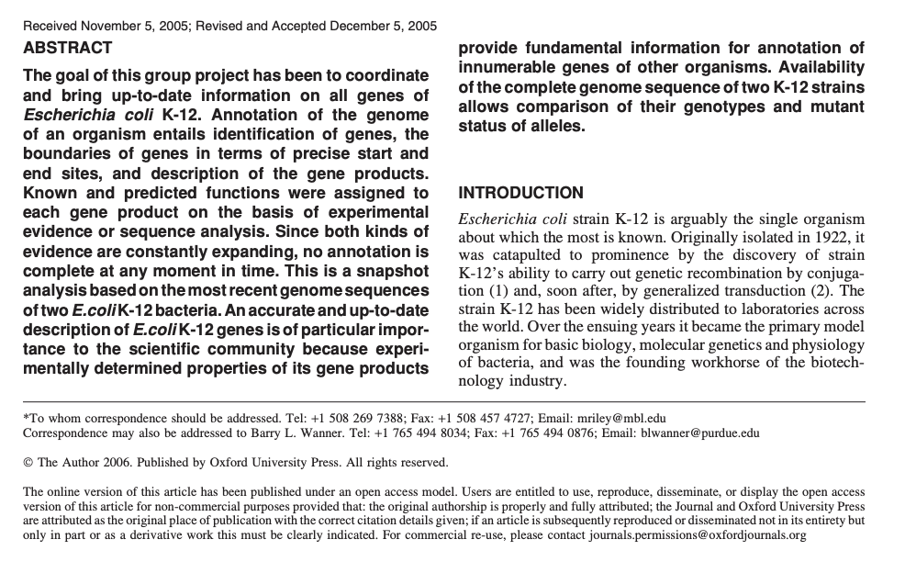
E. Coli Genome Data

Slide 34
Simple ORF Finder - Performance
E. coli Genome – 4,641,652 bp
E. coli Genome – 4407 genes
Number of Genes correctly predicted 4282
Number of Genes over-predicted 1,632,645
 | Predicted Genes (Yes) | Predicted Genes (No)
Actual Genes (Yes) | 0.91 | 0.09
Actual Genes (No) | 1 | 0

Slide 35
Let’s Program an ANN to Find Prokaryotic Genes

Slide 36
Machine Learning Workflow
Define an ML problem and propose a solution
Construct your dataset
Transform your dataset & select features
Use the model to make predictions
Test and validate your model
Choose and train a model
How do I find genes in prokaryotic DNA sequence data?

Slide 37
Rationale
Gene prediction is conceptually similar to secondary structure prediction except instead of predicting locations of H, B and C, you are predicting location of N (non-coding) and C (coding)
ACDEFGHIKLMNPQACDMQRTSWYDAAGHVIVIVKDAH…
CCHHHHHHHHHHCCCCCCCHHHHHHHHCCBBBBBCCCC…
ATGCGATTATCGCAGTCGATCTACCATTATTACGACCG…
CCCCCCCCCCCCCCCCCCCCCCNNNNNNNNNNNNNNNN
Protein
Gene

Slide 38
Machine Learning Workflow
Define an ML problem and propose a solution
Construct your dataset
Transform your dataset & select features
Use the model to make predictions
Test and validate your model
Choose and train a model
Find a good training/testing data set

Slide 39
E. Coli Genome Data
Genome:
…
Forward
Reverse Complement
Gene Start | Gene End
337 | 2799
2801 | 3733
3734 | 5020
5234 | 5530
Gene Start | Gene End
1346 | 2063
6342 | 7212
7907 | 8420
11130 | 12798
Correct Gene Locations:
…
…

Slide 40
E. Coli Genome Data

Slide 41
Machine Learning Workflow
Define an ML problem and propose a solution
Construct your dataset
Transform your dataset & select features
Use the model to make predictions
Test and validate your model
Choose and train a model

Slide 42
Encoding Data
The input genomic data will be encoded in a similar way to the amino acid data for secondary structure prediction (one-hot encoding)
The output data can be encoded with one bit
Nucleotide Coding
Output Coding
Nucleotide | Encoding
A | 1000
C | 0100
G | 0010
T | 0001
Coding Status | Encoding
C | 0
N | 1

Slide 43
Encoding Data cont...
In secondary structure, we used a ‘Null’ input to mark the end of each amino acid sequence
To simplify things, we do not use ‘Null’ here, as we are only looking at one long sequence (the genome)

Slide 44
Neural Network For Gene Finding
Training Set
Definitions
Sliding Window
ATGAAG
AGGAAG
AGTAAG
ATGAAA
AGTAAG
ATGAAG
A = [001]
T = [010]
G = [100]
C = [0]
N = [1]
[010100001]
Input Vector
NNNNCC
[1]
Desired Output
Output Vector

Slide 45
Neural Network Training
1
.2 .4 .1
.1 .0 .4
.7 .1 .1
.0 .1 .1
.0 .0 .0
.2 .4 .1
.0 .3 .5
.1 .1 .0
.5 .3 .1
1 - e^{-x}
.8
.4
.3
[010100001]
[.6 .4 .6]
[.74]
compare
ATGAAG
[1]
Input Weight Hidden Weight Output
Vector Matrix1 Layer Matrix2 Vector

Slide 46
Back Propagation
1
.2 .4 .1
.1 .0 .4
.7 .1 .1
.0 .1 .1
.0 .0 .0
.2 .4 .1
.0 .3 .5
.1 .1 .0
.5 .3 .1
1 - e^{-x}
.83
.8
.4
.3
.8
.4
.3
[010100001]
[.6 .4 .6]
.23
[.74]
.33
compare
[1]
Input Weight Hidden Weight Output
Vector Matrix1 Layer Matrix2 Vector

Slide 47
Calculate New Output
1
.1 .1 .1
.2 .0 .4
.7 .1 .1
.0 .1 .1
.0 .0 .0
.2 .2 .1
.0 .3 .5
.1 .3 .0
.5 .3 .3
1 - e^{-x}
.83
.23
.33
[010100001]
[.7 .4 .7]
[.91]
Converged!
[1]
Input Weight Hidden Weight Output
Vector Matrix1 Layer Matrix2 Vector

Slide 48
Train on Second Input Vector
1
.1 .1 .1
.2 .0 .4
.7 .1 .1
.0 .1 .1
.0 .0 .0
.2 .2 .1
.0 .3 .5
.1 .3 .0
.5 .3 .3
1 - e^{-x}
.83
.23
.33
[100001001]
[.8 .6 .5]
[.95]
Compare
ATGAAG
[1]
Input Weight Hidden Weight Output
Vector Matrix1 Layer Matrix2 Vector

Slide 49
Back Propagation
1
.1 .1 .1
.2 .0 .4
.7 .1 .1
.0 .1 .1
.0 .0 .0
.2 .2 .1
.0 .3 .5
.1 .3 .0
.5 .3 .3
1 - e^{-x}
.84
.83
.23
.33
[010100001]
[.8 .6 .5]
.24
[.95]
.34
compare
[1]
Input Weight Hidden Weight Output
Vector Matrix1 Layer Matrix2 Vector

Slide 50
After Many Iterations….
.13 .08 .12
.24 .01 .45
.76 .01 .31
.06 .32 .14
.03 .11 .23
.21 .21 .51
.10 .33 .85
.12 .34 .09
.51 .31 .33
.93
.24
.23
Two “Generalized” Weight Matrices

Slide 51
Windowing Method
A window of nucleotides forms one set of inputs to the ANN
The corresponding output is the coding/non-coding label for the nucleotide at the center of the window
Input set X
AGTCTCGAATGTGATAAATGCGCCGTTAAC
NNNCCCCCCCCCCCCCCCCCCCCCNNNNN
Output y

Slide 52
Windowing Method cont...
Because we are not using the ‘Null’ input and predictions are made on the nucleotide at the center of the windows, no predictions will be made for the first few nucleotides and last few, according to the size of the window
Sliding Window
AGTCTCGAATGTCGAG…TGAAATGCGCCGTTAAC
First prediction
Last prediction

Slide 53
Input Coding
Nucleotides in a window are grouped and placed into one row of an array (flattening)
With a window size of 17, rows will be 68 bits long (17x4)
Much smaller than the 357 bit window for protein secondary structure prediction
A
C
G
G
G
T
C
G
T
T
T
C
G
T
A
G
C
T
A
.
.
1000
0100
0010
Start
0001
.
.
.
.
0100

Slide 54
Input Coding cont...
A
C
G
G
G
T
C
G
T
T
T
C
G
T
A
G
C
T
A
.
.
0100
The window is shifted by one nucleotide and the process is repeated until the end of the sequence (genome)
Same thing is done for reverse complement
0010
0010
New Centre
0001
.
.
.
.
0001

Slide 55
Output Coding
To create the output data (0 or 1 for the entire length of the genome) we make a string of ‘1’s (non-coding) the length of the genome
We replace coding locations with ‘0’s
..111111111111111111111111111111111111111111111111111111111111…
Replace coding regions with ‘0’s
…11111100000…000000111111…110000000….0000000000001111111111…
Gene Start | Gene End
337 | 2799
3734 | 5020
5234 | 5530
… | …
337
2799
3734
5020

Slide 56
Training and Test Data
The training data will be 70% of the genome
The test data will be 30% of the genome
4,641,652 total nucleotides:
3,249,156 training samples (rows)
1,392,496 test samples (rows)
For each input row, there is an associated coding/non-coding bit
Training Data
Window size x 4 bits
0100…1000…0001…0100…1000… | 0
0010…0100…0001…0010…0001… | 0
1000…1000…0001…0100…0100… | 0
0100…1000…0010…0010…0100… | 1
1000…1000…0100…0100…1000… | 1
1000…0010…0001…0100…0100… | 1
3,249,156 rows

Slide 57
Let’s Try Programming a Simple ANN to Identify Bacterial Genes
GSANN.ipynb

Slide 58
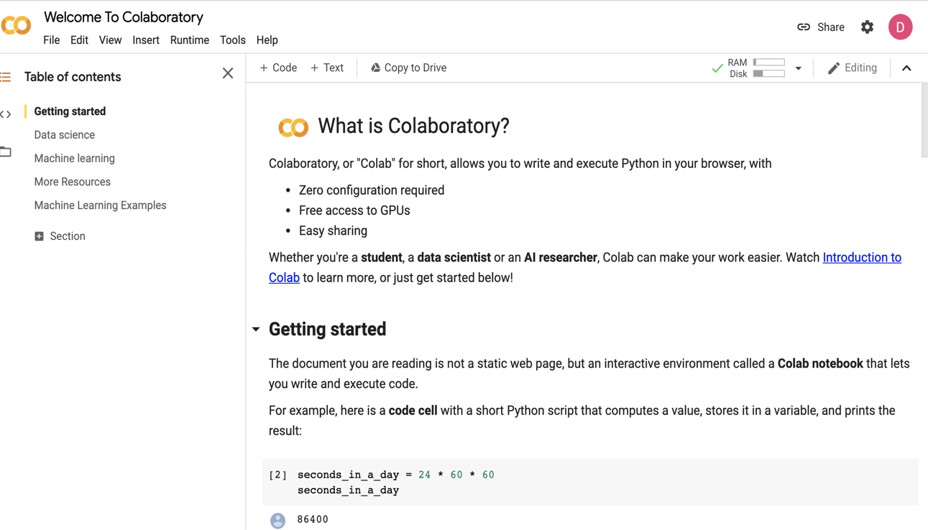
Step 1: Go to Colab (Google Colab)
Create A Google Colab Notebook

Slide 59
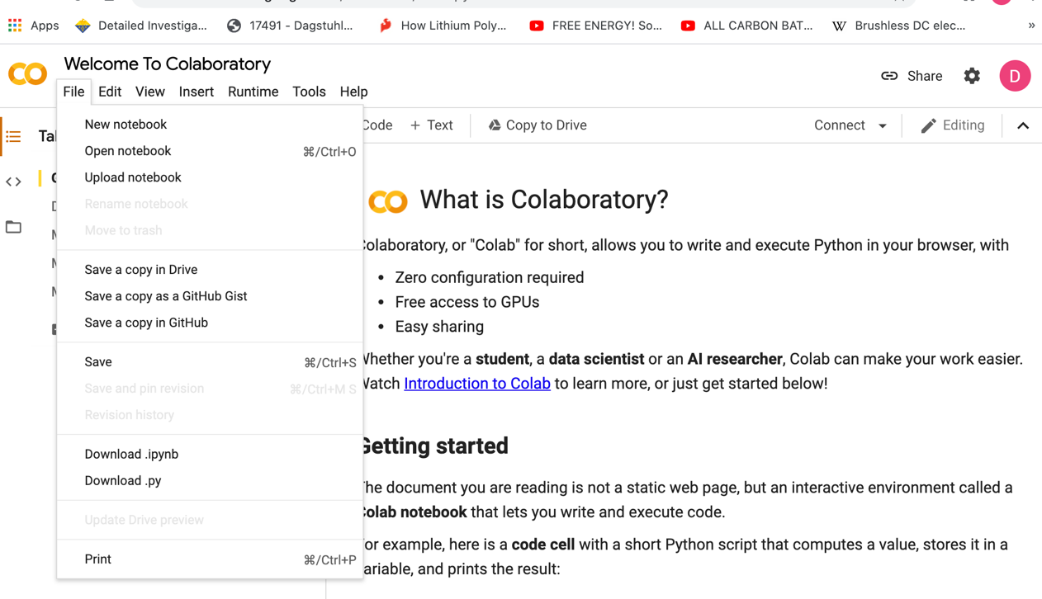
Open a New Notebook
Step 2: Go to File and Select “New notebook”

Slide 60
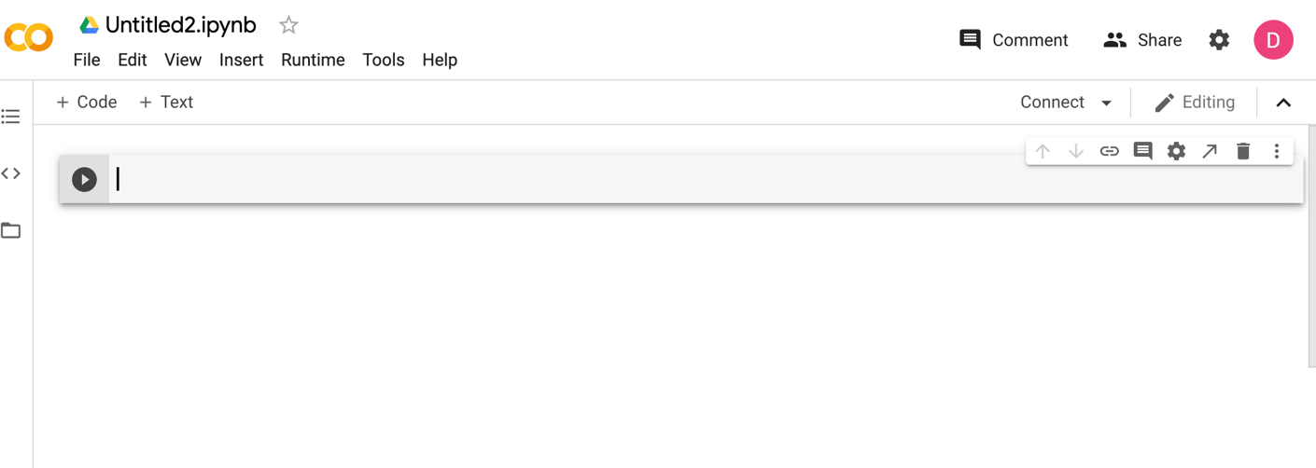
Rename the Notebook
Rename the notebook by clicking on the name and type in GSANN.ipynb in the red circle as shown below
Start Coding!!

Slide 61
Import Functions for Python Math
Numpy allows for mathematical operations and array handling
Pandas is used to read data and for dataframe capabilities
Seaborn and matplotlib are used for data visualization (later in the code)
import numpy as np
import pandas as pd
import seaborn as sns
import matplotlib.pyplot as plt
%matplotlib inline

Slide 62
Read the Dataset
Importing the gene position data
all_gene_data = pd.read_csv('all_gene_positions.txt',header=None).to_numpy()
gene_position = all_gene_data[0:2269,:]
gene_position_r = all_gene_data[2269:,:]
gene_position
gene_position_r
Gene Start | Gene End
337 | 2799
2801 | 3733
3734 | 5020
5234 | 5530
Gene Start | Gene End
1346 | 2063
6342 | 7212
7907 | 8420
11130 | 12798

Slide 63
Read the Dataset
Importing the genome (forward and reverse complement)
#Reading full forward direction genome
with open('full_sequence.fasta', 'r') as file:
full_seq = file.read().replace('\n', '')
#Remove first line (description of the data)
full_seq = full_seq[71:]
#Reading full reverse complement direction genome
with open('rev_comp.fasta', 'r') as file:
full_rev = file.read().replace('\n', '')
#Remove the first line
full_rev = full_rev[82:]

Slide 64
Remainder of Coding
The remaining code is nearly identical to the SSANN program we developed in Module 4
For now, let’s just jump to the results where we look at different window sizes and the GSANN performance

Slide 65
Predictive Performance on Test Data
For both window sizes tested, the model will predict non-coding the majority of the time
Window Size: 7
Window Size: 9
 | Predicted Coding | Predicted Non Coding
Actual Coding | 0.33 | 0.67
Actual Non Coding (No) | 0.25 | 0.75
 | Predicted Coding | Predicted Non Coding
Actual Coding | 0.4 | 0.6
Actual Non Coding (No) | 0.27 | 0.73

Slide 66
Prediction Usefulness
Because this model makes a coding/non-coding prediction on every window of nucleotides (1 prediction per nucleotide)
This causes flip-flopping in the output, which does not give very useful gene predictions
Need to do a re-think: How about looking for other gene-specific features?
Input
…AACGTTGACACATGACTCGATTTAGCCTAGCTAGGCATTAGTCA…
…NNNNNNNNNNNCCCCCCCCCCCCCCCCCCCCCCCCCCNNNNN…
…NCNNNNCNCCNNCCCNCCCNCCCNNCNCCCNNCCCCCNNNCN…
True Output
Predicted Sequence

Slide 67
Improving Gene Prediction Performance
Include more information than just standard start and stop codons
Include alternate start codons
Include codon frequency information
Include hexamer data on genes & promoters and terminator regions
Include information on RNA polymerase promoter site (-10,-35 site or Pribnow box)
Include Shine-Dalgarno sequence (Ribosome binding site-RBS)

Slide 68
Alternate Start Codons (E. coli)
ATG Met
GTG Val
TTG Leu
Class I
Class IIa
CTG Met
ATT Val
ATA Leu
ACG Thr

Slide 69
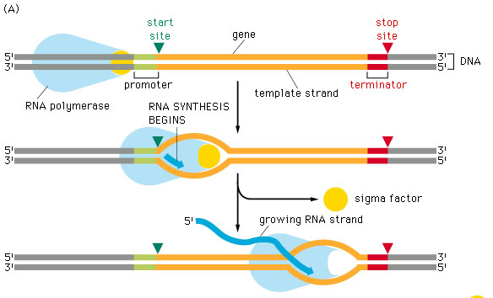
-10, -35 Site (RNA pol Promoter)
-36 -35 -34 -33 -32 …. -12 -11 -10 -9 -8 -7
T T G A C T A t A A T
Pribnow Box – transcript initiation at nucleotide 0

Slide 70
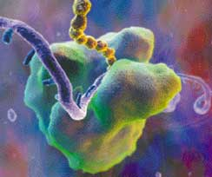
RBS (Shine Dalgarno Seq)
-13 -12 -11 -10 -9 -8 … -1 0 1 2 3 4
A G G A G G n A T G n C
Recruits bacterial ribosome to bind the mRNA strand

Slide 71
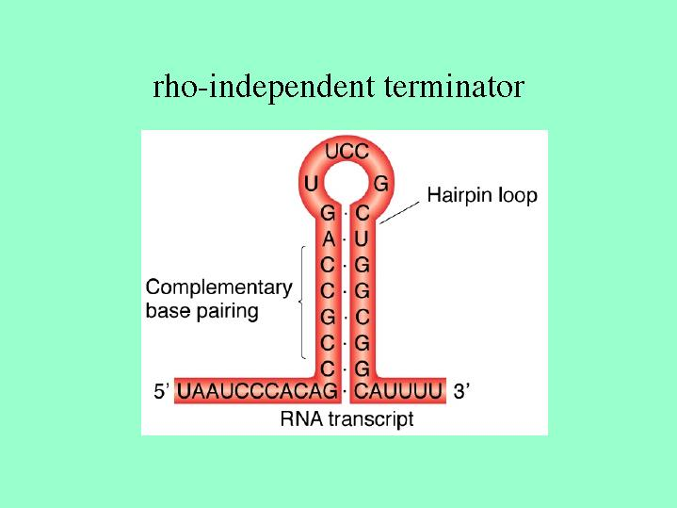
Terminator Stem-loops

Slide 72
Feature Extraction in Machine Learning

Slide 73
What is Feature Extraction?
Feature extraction is the use of statistical methods to accurately describe data
We can intelligently select what data will be used for our model
Allows us to collapse sequences to the same length of features -- a necessary step for ANN
Raw sequence data
Seq 1:
TTGTTGTTT…
AACTCCTGGTGCTA…
GCACCATTACCC…
Seq 2:
Seq 3:
Feature Extraction
Seq 1:
0.12 | 0.23 | 0.19 | 1.2 | 3.2
0.93 | 0.44 | 0.8 | 1.1 | 2.4
1.1 | 2.1 | 0.32 | 0.22 | 0.19
Seq 2:
Seq 3:

Slide 74
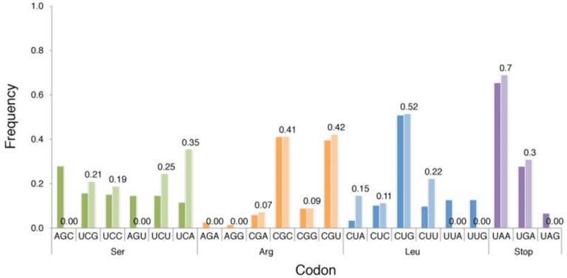
Codon Usage Frequency
The first feature considered is codon usage frequency
The use of this feature assumes that there is a difference in codon usage in coding versus non-coding DNA
For example, ‘GGG’ may be found very infrequently in coding DNA compared to non-coding

Slide 75
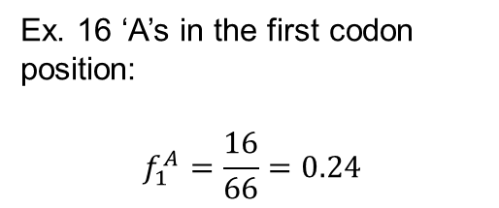
Codon/Base Usage Frequency
ORF
['ATG']
['AAA']
['CGC']
['ATT']
['AGC']
['ACC']
['ACC']
['ATT']
['ACC']
['ACC']
['ACC']
['ATC']
['ACC']
['ATT']
['ACC']
['ACA']
['GGT']
['AAC']
['GGT']
['GCG']
['GGC']
['TGA']
Count occurrence of each base at each codon position
Divide by total bases in the sequence
Results in a vector of length 12

Slide 76

Codon/Base Usage Frequency
Since the sum of the elements is equal to 1, we can remove one element (to avoid redundancy)
This element can be replaced by a Shannon entropy parameter (a measure of the randomness or bias of codon usage)
First, the total Shannon entropy of the vector, H, is found according to the formula:

Slide 77
Codon Usage Frequency
The first element of the original vector is then replaced by the entropy parameter 𝛾

Slide 78
Hexamer Scoring
The next feature to consider is hexamer usage
Each hexamer (4**6=4096) is given three scores based on its appearance in the promoter, terminator, and ORF regions of coding DNA vs non-coding DNA
These scores are logarithmic ratios
A positive score indicates higher usage in coding DNA sequences
Hexamer | Promoter | Terminator | In-ORF
ATTAGC | -0.32 | -0.25 | 0.07
TAAAAA | 0.45 | 0.62 | -0.09

Slide 79
Hexamer Scoring
ORF
['ATG']
['AAA']
['CGC']
['ATT']
['AGC']
['ACC']
['ACC']
['ATT']
['ACC']
['ACC']
['ACC']
['ATC']
['ACC']
['ATT']
['ACC']
['ACA']
['GGT']
['AAC']
['GGT']
['GCG']
['GGC']
['TGA']
['ATGAAA'] ['TGAAAC']
.
. ['GGGCTG']
['GGCTGA']
Extract ORF Hexamers
Sum Scores
-5.947
Features
Extract Promoter Region Hexamers
['CAGATA'] ['AGATAA']
.
.
['CCATGA']
['CATGAA']
Sum Scores
10.180
Extract Terminator Region Hexamers
['GCTGAC'] ['CTGACG']
.
.
['AGCCCG'] ['GCCCGC']
Sum Scores
2.529

Slide 80
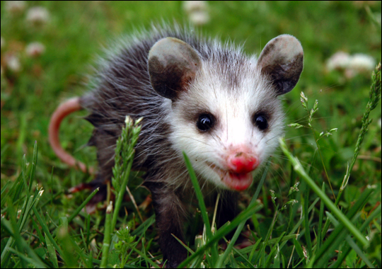
PSSMs
Avcustom scoring matrix called a position specific scoring matrix (PSSM) built from multiple sequence alignments
A PSSM

Slide 81
Building a PSSM - Step 1
A T T T A G T A T C
G T T C T G T A A C
A T T T T G T A G C
A A G C T G T A A C
C A T T T G T A C A
Multiple
Alignment
A 3 2 0 0 1 0 0 5 2 1
C 1 0 0 2 0 0 0 0 1 4
G 1 0 1 0 0 5 0 0 1 0
T 0 3 4 3 4 0 5 0 1 0
Table of
Occurrences

Slide 82
Building a PSSM - Step 2
A 3 2 0 0 1 0 0 5 2 1
C 1 0 0 2 0 0 0 0 1 4
G 1 0 1 0 0 5 0 0 1 0
T 0 3 4 3 4 0 5 0 1 0
Table of
Occurrences
A .6 .4 0 0 .2 0 0 1 .4 .2
C .2 0 0 .4 0 0 0 0 .2 .8
G .2 0 .2 0 0 1 0 0 .2 0
T 0 .6 .8 .6 .8 0 1 0 .2 0
PSSM with no
pseudocounts

Slide 83
Pseudocounts
Method to account for small sample size of multi-sequence alignment
Gets around problem of having “0” score in PSSM or profile
Defined by a correction factor “B” which reflects overall composition of sequences under consideration
B = √ N or B = 0.1 which falls off with N where N = # sequences

Slide 84
Pseudocounts
Score(X_{i}) = (q_{x} + p_{x})/(N + B)
q = observed counts of residue X at pos. i
p = pseudocounts of X = B*frequency(X)
N = total number of sequences in MSA
B = number of pseudocounts (assume √ N)
Score(A₁) = (3 + √ 5(0.32 ))/(5 + √ 5) = 0.51
0.32 is the frequency of A’s over the entire genome sequence

Slide 85
Including Pseudocounts - Step 2
A .6 .4 0 0 .2 0 0 1 .4 .2
C .2 0 0 .4 0 0 0 0 .2 .8
G .2 0 .2 0 0 1 0 0 .2 0
T 0 .6 .8 .6 .8 0 1 0 .2 0
PSSM with no
pseudocounts
A .51 .38 .09 .09 .24 .09 .09 .79 .38 .24
C .19 .06 .06 .33 .06 .06 .06 .06 .19 .61
G .19 .06 .19 .06 .06 .75 .06 .06 .19 .06
T .09 .51 .65 .51 .65 .09 .79 .09 .24 .09
PSSM with
pseudocounts

Slide 86
Calculating Log-odds - Step 3
A .51 .38 .09 .09 .24 .09 .09 .79 .38 .24
C .19 .06 .06 .33 .06 .06 .06 .06 .19 .61
G .19 .06 .19 .06 .06 .75 .06 .06 .19 .06
T .09 .51 .65 .51 .65 .09 .79 .09 .24 .09
PSSM with
pseudocounts
-Log₁₀
A 0.2 0.4 1.1 1.1 0.7 1.1 1.1 0.1 0.4 0.7
C 0.7 1.2 1.2 0.4 1.2 1.2 1.2 1.2 0.7 0.1
G 0.7 1.2 0.7 1.2 1.2 0.1 1.2 1.2 0.7 1.2
T 1.1 0.2 0.1 0.2 0.1 1.1 0.1 1.1 0.7 1.1
Log-odds
PSSM

Slide 87
Scoring a Sequence - Step 4
Slide the window
….C G A A T T T A G T A A C T A G C…
A T T T A G T A T C
G T T C T G T A A C
A T T T T G T A G C
A A G C T G T A A C
C A T T T G T A C A
How good a match is this
sequence?
How good a match is the next
sequence?

Slide 88
Scoring a Sequence - Step 4
A 0.2 0.4 1.1 1.1 0.7 1.1 1.1 0.1 0.4 0.7
C 0.7 1.2 1.2 0.4 1.2 1.2 1.2 1.2 0.7 0.1
G 0.7 1.2 0.7 1.2 1.2 0.1 1.2 1.2 0.7 1.2
T 1.1 0.2 0.1 0.2 0.1 1.1 0.1 1.1 0.7 1.1
Log-odds
PSSM
A T T T A G T A A C
Score = 2.2
(Lowest score wins)
A 0.2 0.4 1.1 1.1 0.7 1.1 1.1 0.1 0.4 0.7
C 0.7 1.2 1.2 0.4 1.2 1.2 1.2 1.2 0.7 0.1
G 0.7 1.2 0.7 1.2 1.2 0.1 1.2 1.2 0.7 1.2
T 1.1 0.2 0.1 0.2 0.1 1.1 0.1 1.1 0.7 1.1

Slide 89
Promoter PSSMs
PSSMs will be used to look for the -35 and -10 box regions in the promoter regions of ORFs
Promoter regions are grouped by the distance between the two boxes
Five PSSMs will be constructed for box distances of 15,16,17,18, and 19 nucleotides
16
17

Slide 90
Promoter PSSMs
Using the PSSMs, we score the promoter region of an ORF at every location
Using logarithmic PSSMs, a low score produced by a PSSM indicates the presence of a -35 and -10 box
18
GCGGATTACTTACCAGTTCAAGCAGGGTTTGTATATTATGCACAAGCCGA
PSSM box distance | Score
17 | 6.49
18 | 4.97
19 | 5.54

Slide 91
Promoter PSSMs
To get the most information, the minimum score for each PSSM along the promoter is found
The locations of these minimums on the promoter sequence are also found
Scanning the region with all PSSMs
ATTGAGCTTAGCGGATTACTTACCAGTTCAAGCAGGGTTTGTATATTATGCACAAGCCGA…
PSSM box distance | Minimum Score | Location
15 | 5.33 | 90
16 | 5.41 | 65
17 | 6.49 | 65
18 | 4.97 | 58
19 | 5.54 | 95

Slide 92
Shine Dalgarno Scoring
The last feature used is the Shine Dalgarno score for each promoter region sequence
This uses one PSSM based on the consensus sequence ‘AGGAGG’
These scores are found for the region location 3-14 nucleotides before the start codon (7 scores)
TTACCAGTTCAAGCAGGGTTTGATTGAGGCACAAGCCGAATG
A
1 | 0 | 0 | 1 | 0 | 0
0 | 0 | 0 | 0 | 0 | 0
0 | 1 | 1 | 0 | 1 | 1
0 | 0 | 0 | 0 | 0 | 0
C
Scores: [1, 3, 2, 0, 2, 3, 0]
G
T

Slide 93
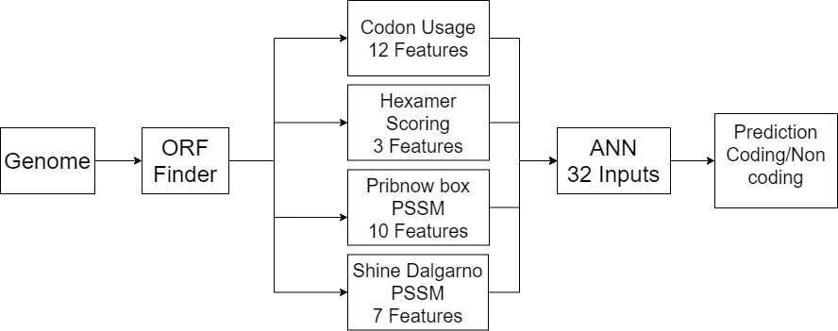
Model Input and Output

Slide 94
Let’s Try Programming a Feature-Based ANN to Identify Bacterial Genes
GPANN.ipynb

Slide 95
Open the Colab File
Find the Module 5 folder under Python Code in folder CBW-MachineLearning-2026 in your Google Drive

Slide 96
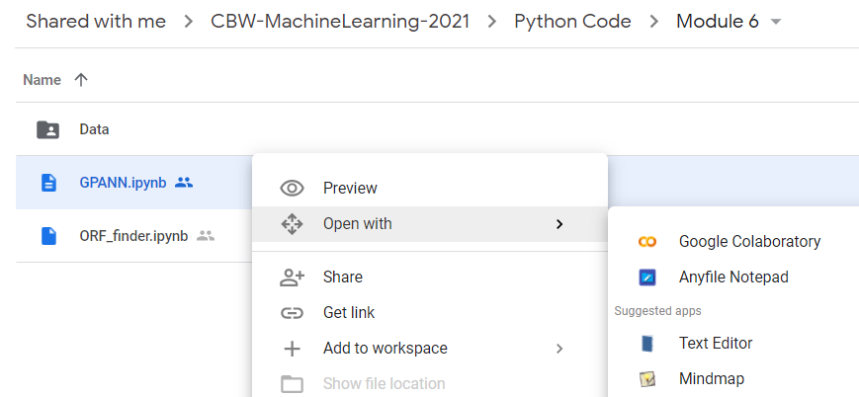
Open the Colab File cont...
Right click on ‘GPANN.ipynb’ and select open with Google Colaboratory
5

Slide 97
General Algorithm
Read data, import gene position data and read forward and reverse complement fasta sequence
Create verify data set function (verify_dataset) and call it to check for missing data
Create codon function (codons) and create list of stop/start points
Identify start and stop codon pairs in all 3 reading frames and create start/stop codon lists
Create ORF function (ORF), set minimum ORF length to 40 bases
Pair start and stop codons to define ORFs in same reading frame
Identify start codons + up to 3 stop codons in same reading frame
Determine codon usage frequency and entropy parameter for ORFs
Create hexamer counting function (hex_count), run on coding and non-coding data
Create hexamer scoring function (affix_scorer), run on coding and non-coding data
Run PSSM scoring functions on promoter sequences
Create Shine Dalgarno scoring function (SD_dict) relative to SD hexamers
Create Shine Dalgarno scorer (SDscorer) and evaluate SD scores
Take all inputs into an ANN with 32 input units and 5 hidden units and train/test

Slide 98
Import Functions for Python Math
Numpy allows for mathematical operations and array handling
Pandas is used to read data and for dataframe capabilities
Seaborn and matplotlib are used for data visualization
import numpy as np
import pandas as pd

Slide 99
Read the Dataset
Importing the gene position data
all_gene_data = pd.read_csv('all_gene_positions.txt',header=None).to_numpy()
gene_position = all_gene_data[0:2269,:]
gene_position_r = all_gene_data[2269:,:]
gene_position
gene_position_r
Gene Start | Gene End
337 | 2799
2801 | 3733
3734 | 5020
5234 | 5530
Gene Start | Gene End
1346 | 2063
6342 | 7212
7907 | 8420
11130 | 12798

Slide 100
Read the Dataset
Importing the genome (forward and reverse complement)
#Reading full forward direction genome
with open('full_sequence.fasta', 'r') as file:
full_seq = file.read().replace('\n', '')
#Remove first line (description of the data)
full_seq = full_seq[71:]
#Reading full reverse complement direction genome
with open('rev_comp.fasta', 'r') as file:
full_rev = file.read().replace('\n', '')
#Remove the first line
full_rev = full_rev[82:]

Slide 101
Data Check (Missing Values, Label Check)
#Check the dataset to make sure no data is missing and Check the class labels – need to define “verify_dataset” function
def verify_dataset(data):
#Use data_found as a dummy variable to determine if to print missing value information
data_found = 1
for each_column in data.columns:
if data[each_column].isnull().any():
print("Data missing in Column " + each_column)
data_found = 0
quit()
if data_found == 1:
print("Dataset is complete. No missing value")
return
#Call verify_dataset and check data verify_dataset(data)

Slide 102
ORF Finder
Stop codons are defined (TAA, TGA, TAG)
Two lists are created that will contain the indices of the found start and stop codons
def codons(seq,start_c):
stops = ["TAA","TGA","TAG"]
lst1 = [] #List for the start codons
lst2 = [] #List for the stop codons
start = 0 #Counter for 3 optional frames

Slide 103
ORF Finder
The code will execute for the three different frames (start goes from 0 to 2)
For a given frame position, look at the first codon
If it is a start codon, add it to start codon list
If it is a stop codon, add it to the stop codon list
Once all codons in the current frame are checked, move to the next frame
while (start < 3): for i in range(start,len(seq),3):
#Codon extraction
codon = seq[i:i+3]
if (codon == start_c):
lst1[start].append(i+1)
if (codon in stops):
lst2[start].append(i+1)
start += 1
return lst1,lst2

Slide 104
ORF Finder
Once the positions of the start and stop codons are found, they must be paired to form ORFs
For a given start codon, a valid stop codon must be in the same frame with position greater than the start codon
Frame 1 [190, ...]
Frame 2 [...]
Frame 3 [...]
Frame 1 [13, 46, 61, 64, 112, 253, ...]
Frame 2 [...]
Frame 3 [...]
Start Codons
Stop Codons
Correct stop codon

Slide 105
ORF Finder
Two lists are created for valid ORF start and stop codons
The minimum length of ORFs is set to 40 nucleotides
The frame of a start codon is found
def ORF(lst1,lst2):
ORFstarts = []
ORFstops = []
min_len = 40
start_min = 0
...
for s_cod in all_frames:
if s_cod > start_min:
for s_frame in range(len(lst1)):
if s_cod in lst1[s_frame]:
frame = s_frame
found_frame.append(frame)
break

Slide 106
ORF Finder
For a given start codon, the first 3 stop codons in the same frame position are found
This is to account for the possibility of finding the correct start codon but the wrong start codon
The starting position is then updated and the process is repeated
stop_count = 0
for stp_cod in lst2[frame]:
if stp_cod > s_cod + min_len:
ORFstarts.append(s_cod)
ORFstops.append(stp_cod)
stop_count +=1
if stop_count > 3:
start_min = start_min + min_len - look_back
break

Slide 107
General Algorithm
Read data, import gene position data and read forward and reverse complement fasta sequence
Create verify data set function (verify_dataset) and call it to check for missing data
Create codon function (codons) and create list of stop/start points
Identify start and stop codon pairs in all 3 reading frames and create start/stop codon lists
Create ORF function (ORF), set minimum ORF length to 40 bases
Pair start and stop codons to define ORFs in same reading frame
Identify start codons + up to 3 stop codons in same reading frame
Determine codon usage frequency and entropy parameter for ORFs
Create hexamer counting function (hex_count), run on coding and non-coding data
Create hexamer scoring function (affix_scorer), run on coding and non-coding data
Run PSSM scoring functions on promoter sequences
Create Shine Dalgarno scoring function (SD_dict) relative to SD hexamers
Create Shine Dalgarno scorer (SDscorer) and evaluate SD scores
Take all inputs into an ANN with 32 input units and 5 hidden units and train/test

Slide 108
Codon Usage Frequency
Before getting the codon usage frequency of an ORF, it must first be framed as a sequence of codons
The number of nucleotide occurrences in each frame position is counted
ATGCCATAC ……ACCTAA
ATGCCATAC…ACCTAA
for i in range(len(framed)):
framed_c_x = framed[i]
flen = len(framed_c_x)*3
p0 = [framed_c_x[i][0][0] for i in range(len(framed_c_x))]
p1 = [framed_c_x[i][0][1] for i in range(len(framed_c_x))]
p2 = [framed_c_x[i][0][2] for i in range(len(framed_c_x))]

Slide 109
Codon Usage Frequency
The frequency vector is created by dividing by the total bases in the ORF
The first element in the vector is then replaced by the entropy parameter γ
#Use the .count() function to the occurrence of each nucleotide at #each codon position. p0 is the first position
A = [p0.count('A'),p1.count('A'),p2.count('A')]
C = [p0.count('C'),p1.count('C'),p2.count('C')]
G = [p0.count('G'),p1.count('G'),p2.count('G')]
T = [p0.count('T'),p1.count('T'),p2.count('T')]
v = np.array((A,C,G,T))
#Divide the number of occurrences of a given nucleotide at a position by
#the total number of nucleotides in the ORF (flen)
fv = np.array([base[pos]/flen for base in v for pos in range(3)])
#Calculation of the entropy parameter. np.log() returns the natural #logarithm
H = -1*sum(fv*np.log(fv))
gamma = 1-(H/H_0)
#Replace the first element of the frequency vector with the calculated entropy parameter
fv[0] = gamma
fv = fv.reshape(1,-1)
fvec = np.concatenate((fvec,fv), axis=0)
return fvec

Slide 110
Hexamer Scoring
A function is defined that will return the amounts of each hexamer present in a given set of data
This function is run on both the coding and non-coding hexamer data (ORFs, promoter, and terminator regions)
#The input hxd_data is a list of lists containing hexamers sequences #for many ORFs/promoters/terminators
def hex_count(hxd_data):
all_individual_hexs = []
for gene in range(len(hxd_data)):
for hex in range(len(hxd_data[gene])):
#By iterating over all sequence groups, we count the numbers of
#each of the 4096 possible hexamers
all_individual_hexs.append(hxd_data[gene][hex][0])
hxs, hxs_count = np.unique(all_individual_hexs, return_counts=True)
return hxs, hxs_count
#Running this function on the groups of hexamers found in ORFs
coding_hexs, coding_hex_count = hex_count(all_coding_hexs)
ncoding_hexs, ncoding_hex_count = hex_count(all_ncoding_hexs)

Slide 111
Hexamer Scoring
Each hexamer is given a score based on its occurrence in coding vs. non-coding DNA
def affix_scorer(cod_hx,cod_hx_cnt,ncod_hx,ncod_hx_cnt):
import math
#Filling in missing hexamers if not present in a given region
hexs_not_in_coding = [hx for hx in ncod_hx if hx not in cod_hx]
#Finding the total number of hexamers in the region
tot_cod_hexs = sum(cod_hx_cnt)
tot_ncod_hexs = sum(ncod_hx_cnt)
#The occurrence of each hexamer is divided by the total to produce a frequency measure
cod_hx_freqs = cod_hx_cnt/tot_cod_hexs
ncod_hx_freqs = ncod_hx_cnt/tot_ncod_hexs cod_hx_freqs = dict(zip(cod_hx,cod_hx_freqs))
ncod_hx_freqs = dict(zip(ncod_hx,ncod_hx_freqs))
#Giving the missing hexamers a value of zero
for hx in hexs_not_in_coding:
cod_hx_freqs[hx] = 0
#Dividing the frequencies found for coding region hexamers by those for non coding region
ratio = np.array([cod_hx_freqs[hx]/ncod_hx_freqs[hx] for hx in ncod_hx])
ratio = np.log(ratio)
#Because there may be some missing hexamers (eg. AATAAT was found in non-coding promoters
#but never found in coding promoters) a division will lead to indefinite values. We set
#these to have the lowest value (-3)
ratio[np.where(ratio == -math.inf)[0]] = -3
freq_dict = dict(zip(ncod_hx,ratio))

Slide 112
PSSM Scoring
Promoter sequences are grouped by their box distances
PSSMs are constructed for each group of sequences
#For each set of sequences, extract the -35 and -10 box sequences (hexamers)
extr15 = boxExtract(all_15_seq)
extr16 = boxExtract(all_16_seq)
extr17 = boxExtract(all_17_seq)
extr18 = boxExtract(all_18_seq)
extr19 = boxExtract(all_19_seq)
#The PSSMs are constructed on each group of the box-extracted sequences sm15 = pssm(extr15)
sm16 = pssm(extr16)
sm17 = pssm(extr17)
sm18 = pssm(extr18)
sm19 = pssm(extr19)

Slide 113
PSSM Scoring
These PSSMs are then used in a scoring function, which will take promoter sequences as input
#This function is called on the promoter sequences using each PSSM
# ‘sm’ is the PSSM that will be passed into this function
def scoring(seq,sm):
all_scores = []
box_extracted = True
if box_extracted:
seq = boxExtract(seq)
For each sequence in the set, find the positions at which each nucleotide is found
The function enumerate returns the index and element of a sequence or list for s in seq:
Apos = [i for i, ltr in enumerate(s) if ltr == 'A']
Cpos = [i for i, ltr in enumerate(s) if ltr == 'C']
Gpos = [i for i, ltr in enumerate(s) if ltr == 'G']
Tpos = [i for i, ltr in enumerate(s) if ltr == 'T']
#Find the elements in the PSSM corresponding to the positions found above and sum to find the score for the sequence score = sum(sm['A'][Apos])+sum(sm['C'][Cpos])+sum(sm['G'][Gpos])
+sum(sm['T'][Tpos])
all_scores.append(score)

Slide 114
Shine Dalgarno Scoring
Each hexamer is given a score based on its similarity to the consensus sequence AGGAGG
#Find the positions of A and G in the sequence AGGAGG
consA = [i for i,j in enumerate('AGGAGG') if j == 'A']
consG = [i for i,j in enumerate('AGGAGG') if j == 'G']
def SD_dict():
cons_scores = []
#Score all hexamers (4096)
for hx in unique_hexs:
cons_score = 0
G_occ = [i for i,j in enumerate(hx) if j == 'G']
A_occ = [i for i,j in enumerate(hx) if j == 'A']
#If the positions of A and G in a hexamer match the
#consensus sequence, increment the score
for idx in G_occ:
if idx in consG:
cons_score += 1
for idx in A_occ:
if idx in consA:
cons_score += 1

Slide 115
Shine Dalgarno Scoring
These scores are then applied to a list of input sequences, with a selectable range of nucleotides to consider
#returns a list of SD scores in a given region of a promoter
def SDscorer(seq,reg_start,reg_stop):
all_scrs = []
for s in seq:
#For a promoter sequence, extract the region defined by
#the region start and stop parameters
region = s[250-reg_start:250-reg_stop+1]
#For each hexamer in the region, get the score that was
#determined by the previous function
hxs = [region[i:i+6] for i in range(len(region)-5)]
scrs = [SDhex_score[hx] for hx in hxs]
all_scrs.append(scrs)
return all_scrs

Slide 116
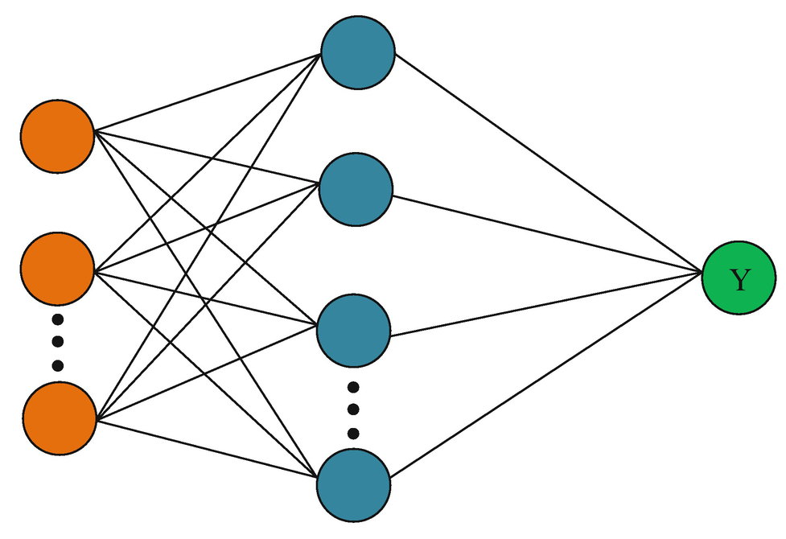
ANN Model
Now that we have all the features, the model can be defined
32 features
0: Coding
1: Non-coding
32 input units
Hidden layer with 5 units

Slide 117
Program Statistics
Total number of lines: 884
Total number of comment lines: 71
Total number of coding lines: 915
Time to extract all features: 70 sec
Time to train on training data: 3 sec
Typical time to train and perform test run with program: 75 sec
This program actually trains every time you run it although you can choose to run certain cells to use the trained ANN with new input data (<0.5 sec)

Slide 118
Machine Learning Workflow
Define an ML problem and propose a solution
Construct your dataset
Transform your dataset & select features
Use the model to make predictions
Test and validate your model
Choose and train a model
Test on Testing Data Set

Slide 119
How Well Do We Do?
Comparison between different versions of our Gene Finder

Slide 120
Performance – Naïve Algorithm (Version 1.0) Simple ORF Finder
 | Predicted Genes (Yes) | Predicted Genes (No)
Actual Genes (Yes) | 0.91 | 0.09
Actual Genes (No) | 1 | 0
Millions of FPs
Number of Genes correctly predicted 4282
Number of Genes over-predicted 1,632,645

Slide 121
Performance Simple Neural Net (GSANN)
9 base window
 | Predicted Genes (Yes) | Predicted Genes (No)
Actual Genes (Yes) | 0.40 | 0.60
Actual Genes (No) | 0.27 | 0.73

Slide 122
Performance – Feature Based ANN (Version 1.0)
Incorporation of codon frequency statistics
 | Predicted Genes (Yes) | Predicted Genes (No)
Actual Genes (Yes) | 0.922 | 0.0784
Actual Genes (No) | 0.09 | 0.91
Huge
Improvement!!!

Slide 123
Performance – Improved Algorithm (Version 2.0)
Incorporation of codon frequency + hexamer statistics
 | Predicted Genes (Yes) | Predicted Genes (No)
Actual Genes (Yes) | 0.923 | 0.077
Actual Genes (No) | 0.083 | 0.917

Slide 124
Performance – Improved Algorithm (Version 3.0)
Incorporation of codon stats + hexamer + PSSM promoter
 | Predicted Genes (Yes) | Predicted Genes (No)
Actual Genes (Yes) | 0.928 | 0.072
Actual Genes (No) | 0.079 | 0.921

Slide 125
Performance – Improved Algorithm (Version 4.0)
Incorporation of the HMM model for promoter prediction
 | Predicted Genes (Yes) | Predicted Genes (No)
Actual Genes (Yes) | >0.928 | <0.072
Actual Genes (No) | <0.079 | >0.921

Slide 126
Can We Do Better?
Short Answer: YES
Just like for proteins, we can use similar transformer-based architectures to help predict different elements in gene sequences
DNABERT is a transformer model that is capable of gene identification, promoter prediction, and binding or splice site prediction
Trained on ~3.2 billion base pairs

Slide 127
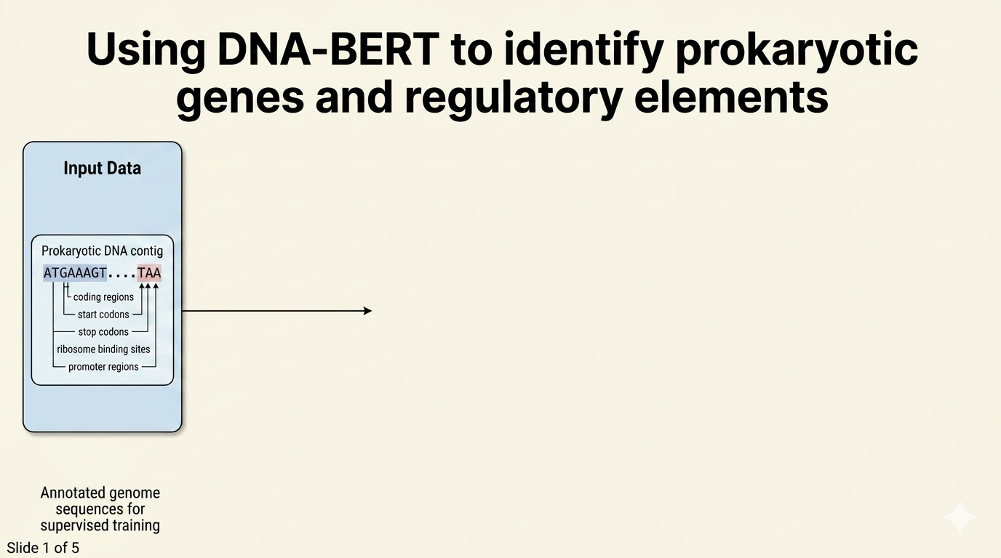

Slide 128
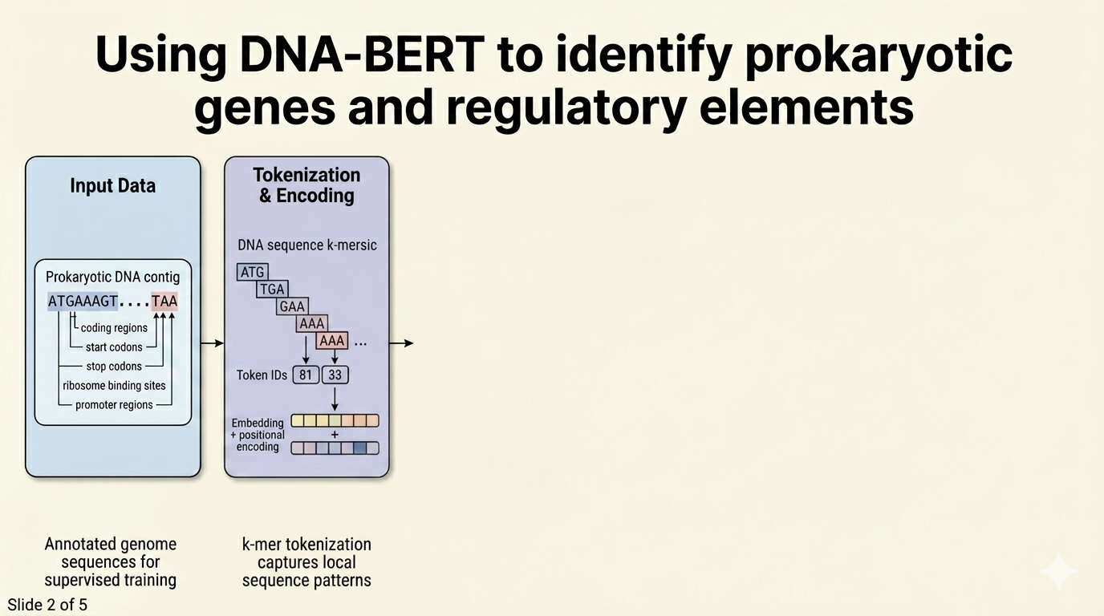

Slide 129
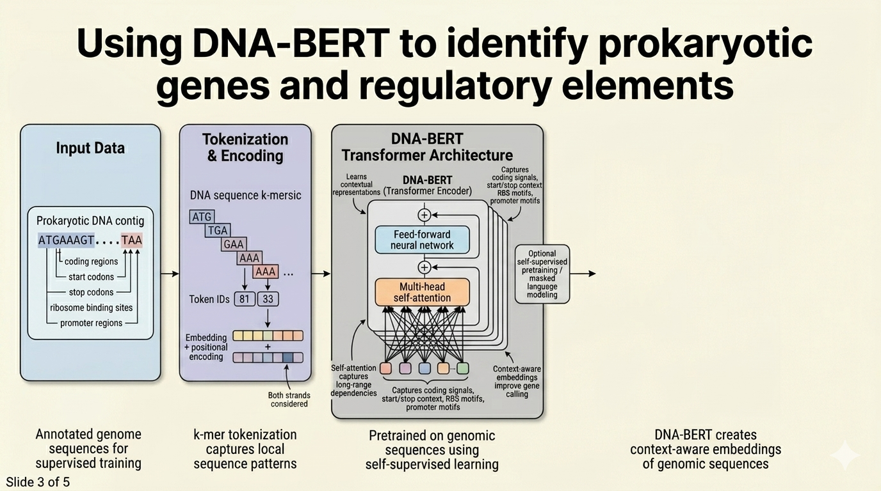

Slide 130
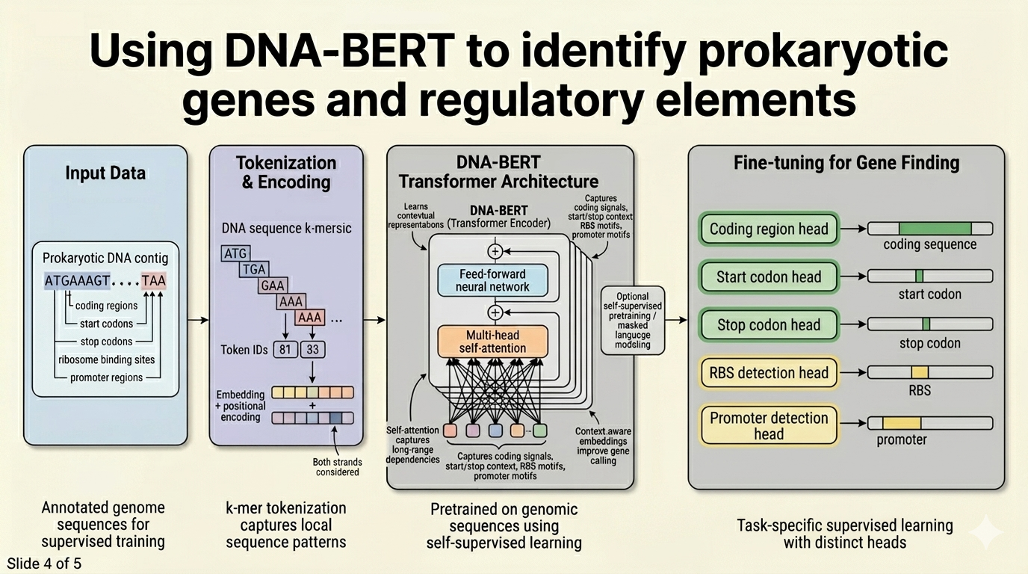

Slide 131
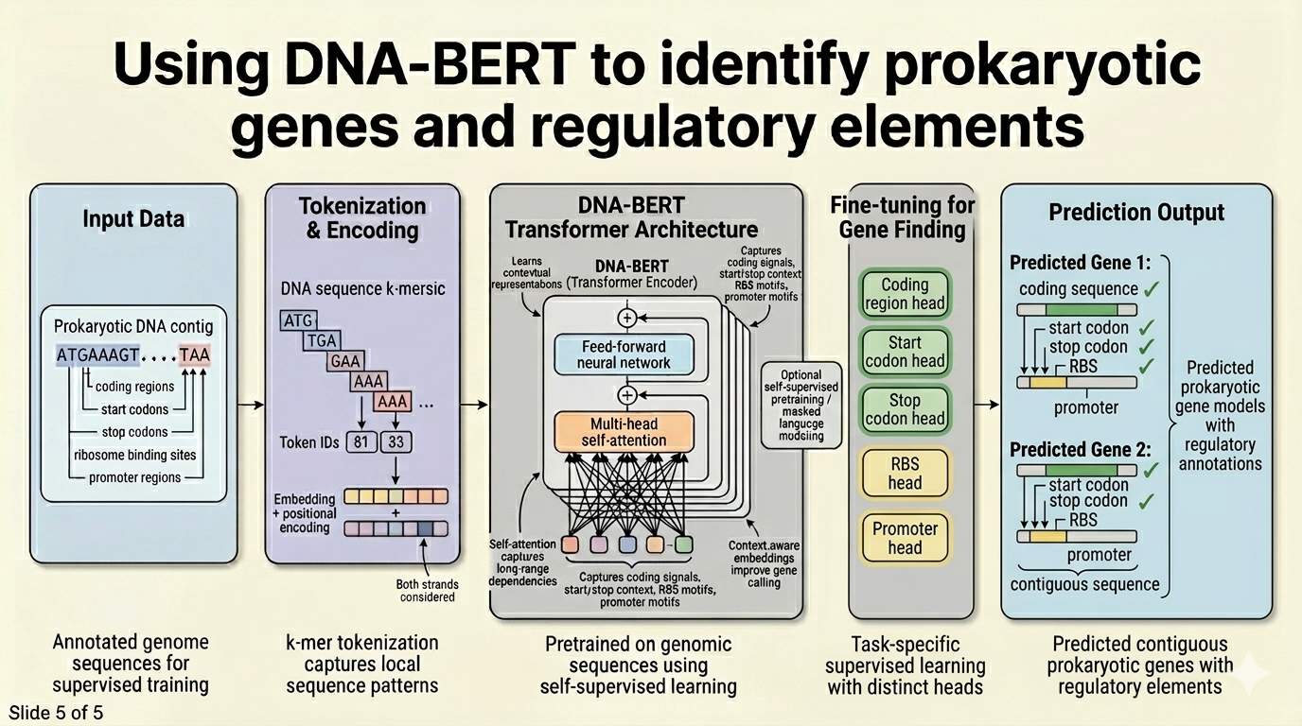

Slide 132
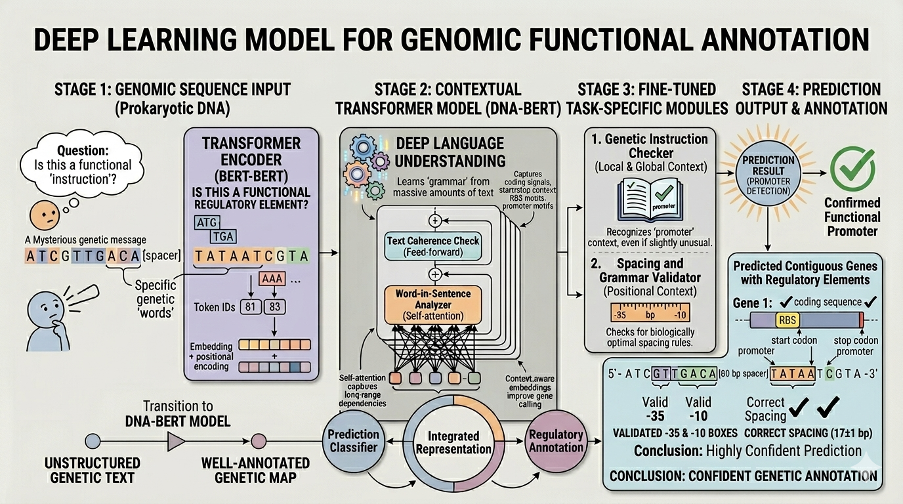

Slide 133
Performance – DNABert Model
 | Predicted Genes (Yes) | Predicted Genes (No)
Actual Genes (Yes) | >0.94 | <0.05
Actual Genes (No) | <0.05 | >0.94

Slide 134
Summary
We now have a neural network program written in “pure” python that predicts prokaryotic gene locations
It has been thoroughly trained on the E. coli genome data set
This is fairly generic code so it should be able to predict gene locations on most other prokaryotic genomes
Writing code for predicting eukaryotic gene locations would be much MUCH more complicated
In the next section we will explore the GPANN code and run it on a few examples
If you would like to work with in R rather than Python, follow the steps indicated in the Lab to find the corresponding scripts
While the Python code runs in less than a second, the R code takes around 10-15 minutes to complete!

Slide 135
Module 5 - Lab
Let’s Take a Look at the Program
GPANN.ipynb

Slide 136
Open the Colab File in the Language of Your Choosing
The python script ‘GPANN.ipynb’, covered during lecture, will be used for the Lab portion

Slide 137
Open the Colab File in the Language of Your Choosing cont...
Right click on ‘GPANN.ipynb’ under Module 5 and select open with Google Colaboratory
5

Slide 138
Study the Program
Spend a few minutes studying the GPANN.ipynb program
See if you can understand the logic of the program
Ask questions of the TA’s if you are unclear about some of the functions or Python code
After studying the code, try running it

Slide 139
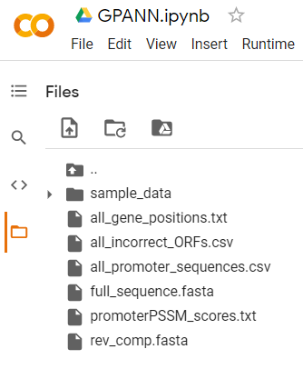
Upload the Data
Once the Colab file is open, click the folder icon to the right
When the panel opens, right click inside the panel and click upload
Then find the CBW_MachineLearning_2026 folder on your desktop
Open the Data folder followed by the Module 5 folder, and open all data files: “all_genes_positions.csv”, “all_incorrect_ORFs.csv”, “all_promoter_sequence.fasta”, “full_sequence.fasta”, “promoterPSSM_scores.txt”, “rev_comp.fasta”

Slide 140
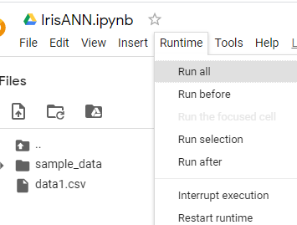

Run The Program
Select ‘Run all’ from the ‘Runtime’ menu

Slide 141
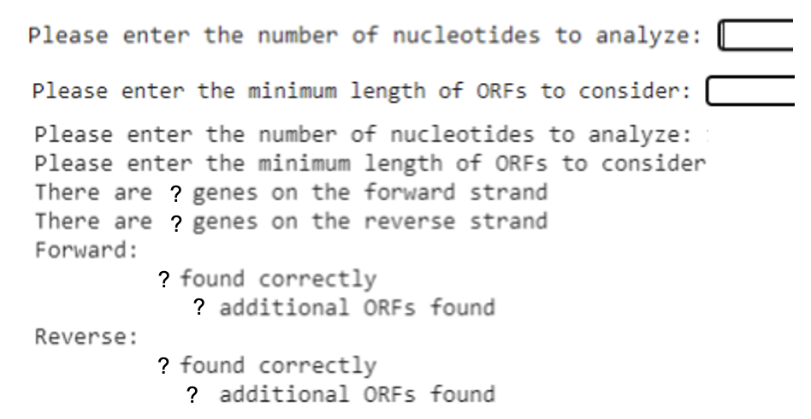
Exercise 5.1
Select “Run all” from the runtime menu
Scroll to the cell 8, and enter a length between 10000 and 50000 nucleotides of the genome to analyze
Hit enter, and type in a minimum ORF length between 40 and 200
Hit enter to view the results

Slide 142
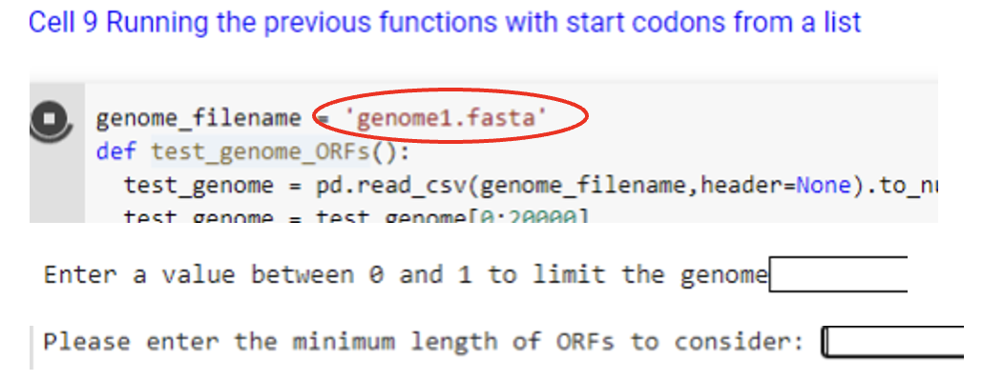
Exercise 5.1
Go to cell 9 and enter in the file name of a test genome
Run the cell
When prompted, enter in a decimal value between 0 and 0.3 and hit enter
Enter a minimum ORF length of 40 to 100 nucleotides
Hit enter to view the results

Slide 143
Exercise 5.1 numpy installation
1) Run the first cell in ORFfinder.ipynb:
!pip install numpy==1.23.5 import numpy as np import pandas as pd
2) Restart session
3) Use the notebook as usual

Slide 144
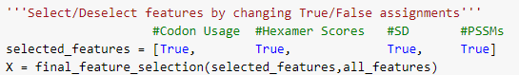
Exercise 5.2
Go to Colab – GPANN.ipynb
Select ‘Run all’ from the Runtime menu
Scroll to the last cell (cell 61) and observe the confusion matrix
Go to cell 54 and remove the codon usage frequency features by setting the corresponding value to false
Select ‘Run After’ from the Runtime menu and check the confusion matrix again
The coding sequence prediction accuracy should decrease by a few percent
Repeat by selecting/deselecting other features
Which features make the most difference?

Slide 145
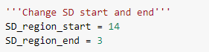
Exercise 5.3
Scroll to cell 50 and change the SD start and end locations
Select ‘Run after’ from the Runtime menu and observe the effects on the confusion matrix (cell 61)
Does changing these parameters make a large difference in prediction accuracy?

Slide 146






Coffee Break & Networking Session
Workshop Sponsors

