Slide 1

bioinformatics.ca
bioinformaticsdotca.github.io

Slide 2
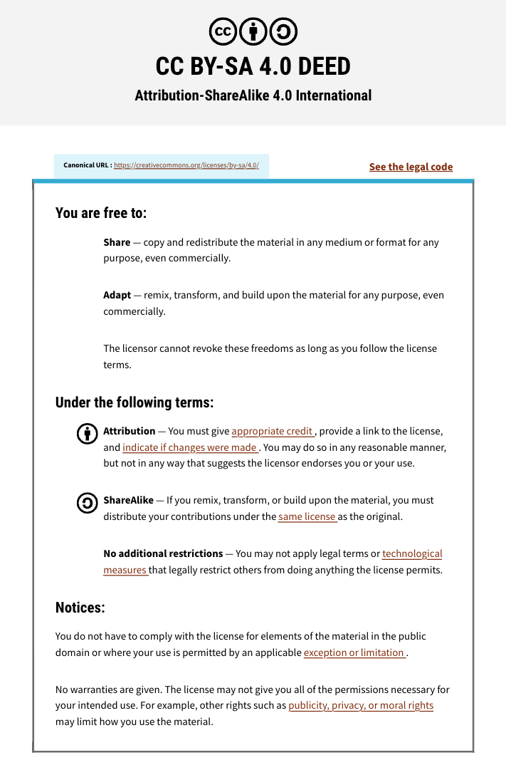

Slide 3

Module 6: Machine Learning with Keras & Scikit-Learn
David Wishart
Machine Learning
Apr 22-23, 2026
University of Alberta

Slide 4

Schedule (MT)
Day 1 (MT) | Wednesday Apr. 22 | Day 2 (MT) | Day 2
9:00 AM | Introductions and Technology Check | 9:00 AM | Module 5: Gene Finding with NNs (Lecture and Lab)
9:45 AM | Module 1: Introduction to Machine Learning (Lecture) | 11:00 AM | Break (30 min)
11:00 AM | Break (30 min) | 11:30 AM | Module 6: Machine Learning with Keras and Scikit-Learn (Lecture/Lab)
11:30 AM | Module 2: Decision Trees (Lecture and Lab) | 1:00 PM | Break (45 min)
1:00 PM | Break (1 hour) | 2:00 PM | Module 7: Machine Learning with Keras and Scikit-Learn (Cont'd)
2:00 PM | Module 3: Neural Networks (Lecture and Lab) | 3:00 PM | Break (30 min)
3:00 PM | Break (30 min) | 3:30 PM | Module 8: LLMs and agentic coding for bioinformatics
3:30 PM | Module 4: Neural Networks for 2º Structure (Lecture and Homework) | 4:45 PM | Survey and Closing Remarks
5:00 PM | End of Day 1 | 5:00 PM | End of Day 2
Canadian Bioinformatics Workshops | bioinformatics.ca

Slide 5
Schedule (PT)
Day 1 (PT) | Wednesday Apr. 22 | Day 2 (PT) | Thursday Apr. 23
8:00 AM | Introductions and Technology Check | 8:00 AM | Module 5: Gene Finding with NNs (Lecture and Lab)
8:45 AM | Module 1: Introduction to Machine Learning (Lecture) | 10:00 AM | Break (30 min)
10:00 AM | Break (30 min) | 10:30 AM | Module 6: Machine Learning with Keras and Scikit-Learn (Lecture/Lab)
10:30 AM | Module 2: Decision Trees (Lecture and Lab) | 12:00 PM | Break (45 min)
12:00 PM | Break (1 hour) | 1:00 PM | Module 7: Machine Learning with Keras and Scikit-Learn (Cont'd)
1:00 PM | Module 3: Neural Networks (Lecture and Lab) | 2:00 PM | Break (30 min)
2:00 PM | Break (30 min) | 2:30 PM | Module 8: LLMs and agentic coding for bioinformatics
2:30 PM | Module 4: Neural Networks for 2º Structure (Lecture and Homework) | 3:45 PM | Survey and Closing Remarks
4:00 PM | End of Day 1 | 4:00 PM | End of Day 2
Canadian Bioinformatics Workshops | bioinformatics.ca

Slide 6
Learning Objectives
To introduce scikit-learn and Keras to the class
To demonstrate how lengthy, hard-to-understand code written purely in Python and numpy are significantly shortened using scikit-learn and Keras
To show how the Iris classification problem with decision trees can be simplified using scikit-learn (sklearn)
To show how the ANN Iris classifier can be coded using Keras and sklearn
To use Colab to explore different code sets

Slide 7

SciKit-Learn
Scikit-learn (sklearn) is an open source Python library that implements algorithms for machine learning such as DTs, random forests, etc.
Started in 2010, now one of the most popular machine learning libraries on Github
To learn more on SciKit-Learn https://scikit-learn.org/stable/

Slide 8

TensorFlow and Keras
TensorFlow is a deep learning framework created by Google and released in 2015
Keras is a neural network library for TensorFlow adapted by Google in 2017
Both provide high-level neural network APIs to develop and evaluate various ANN and deep learning (DNN) models
You can learn more about TensorFlow at: TensorFlow.org

Slide 9
TensorFlow Fundamentals
Tensors are another (mathematical) name for matrices and vectors
TensorFlow makes computational graphs that allow visualization of mathematical processes
Graphs are data structures that contain tf.Operation objects representing units of computation
tf.Tensor objects represent the units of data that flow between operations
The graphs run with sessions

Slide 10
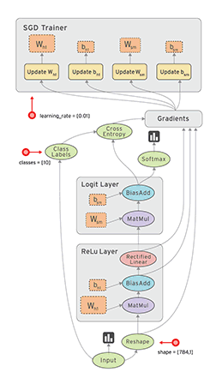
Data Flow Graph
In TensorFlow, a computation is described by a Data Flow Graph
Graphs are made of nodes that are connected by edges
Each node in the graph represents an instance of a mathematical operation
Each edge is a multi-dimensional data set (tensors) on which the operations are performed

Slide 11
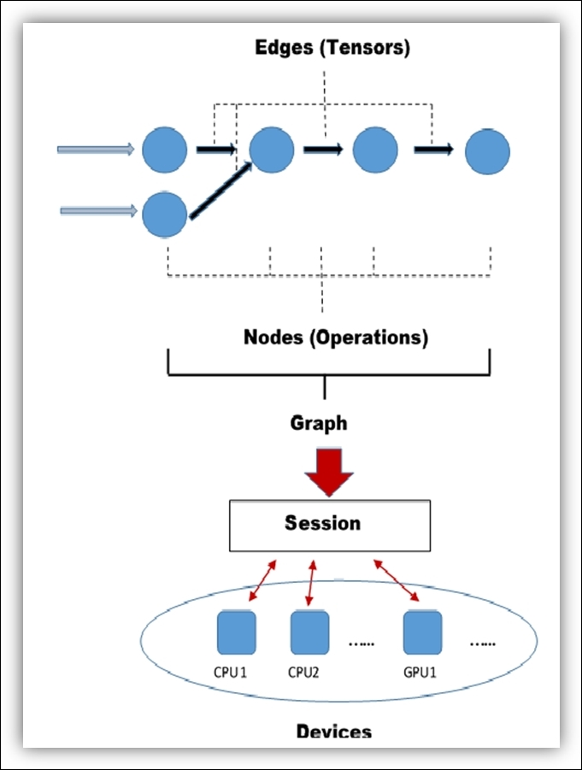
Graphs in TensorFlow

Slide 12
Keras and Sklearn
Modules in Python are simply pre-written Python files that contain classes, functions, and variables
These can be called in your programs to simplify and abbreviate the amount of code you must write
In the previous examples, the numpy and pandas modules were used, which make mathematical operations and data handling simpler to code
Keras contains classes and functions that allow for efficient creation, training and testing of artificial neural networks (ANNs, DNNs)
Sklearn contains classes and functions that allow for preparatory operations on datasets as well as creating of ML models such as DTs and RFs

Slide 13
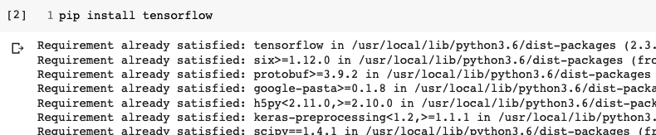
How To Install TensorFlow?
In a Colab code cell write: pip install tensorflow
Pip is a recursive acronym that stands for “Pip installs Packages”

Slide 14
Let’s Try Programming a Decision Tree to Classify Iris Flowers Using Scikit-Learn
IrisDT_sklearn.ipynb

Slide 15
Writing Python Code via Scikit-Learn
We learned how to write the Python code using standard “raw” Python with numpy and pandas as our function libraries
Our first numpy/pandas program was the Iris decision tree classifier IrisDT4.ipynb
Let’s make use of scikit-learn using its own function called: DecisionTreeClassifier

Slide 16
Machine Learning Workflow
Define an ML problem and propose a solution
Construct your dataset
Transform your dataset & select features
Use the model to make predictions
Test and validate your model
Choose and train a model
How do I classify Iris flowers in my area based on their floral dimensions?

Slide 17
Machine Learning Workflow
Define an ML problem and propose a solution
Construct your dataset
Transform your dataset & select features
Use the model to make predictions
Test and validate your model
Choose and train a model
Find a good training/testing data set

Slide 18
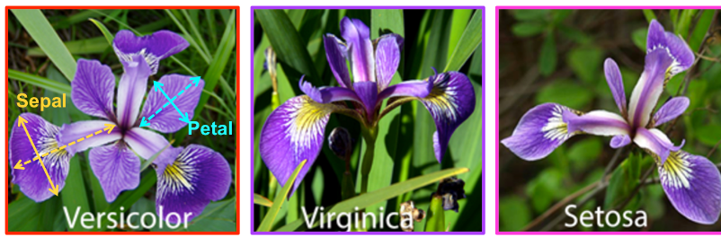
Iris Flower Data Set
Iris flower dataset consists of 50 samples each of the iris species: Iris setosa, Iris virginica, Iris versicolor
Four features measured from each sample: length and width of sepals and petals (in cm)
Different iris species can be differentiated by their petal/sepal dimensions

Slide 19
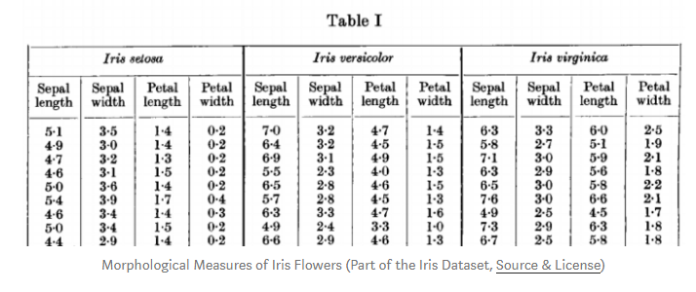
Iris Flower Data Set

Slide 20
Machine Learning Workflow
Define an ML problem and propose a solution
Construct your dataset
Transform your dataset & select features
Use the model to make predictions
Test and validate your model
Choose and train a model

Slide 21
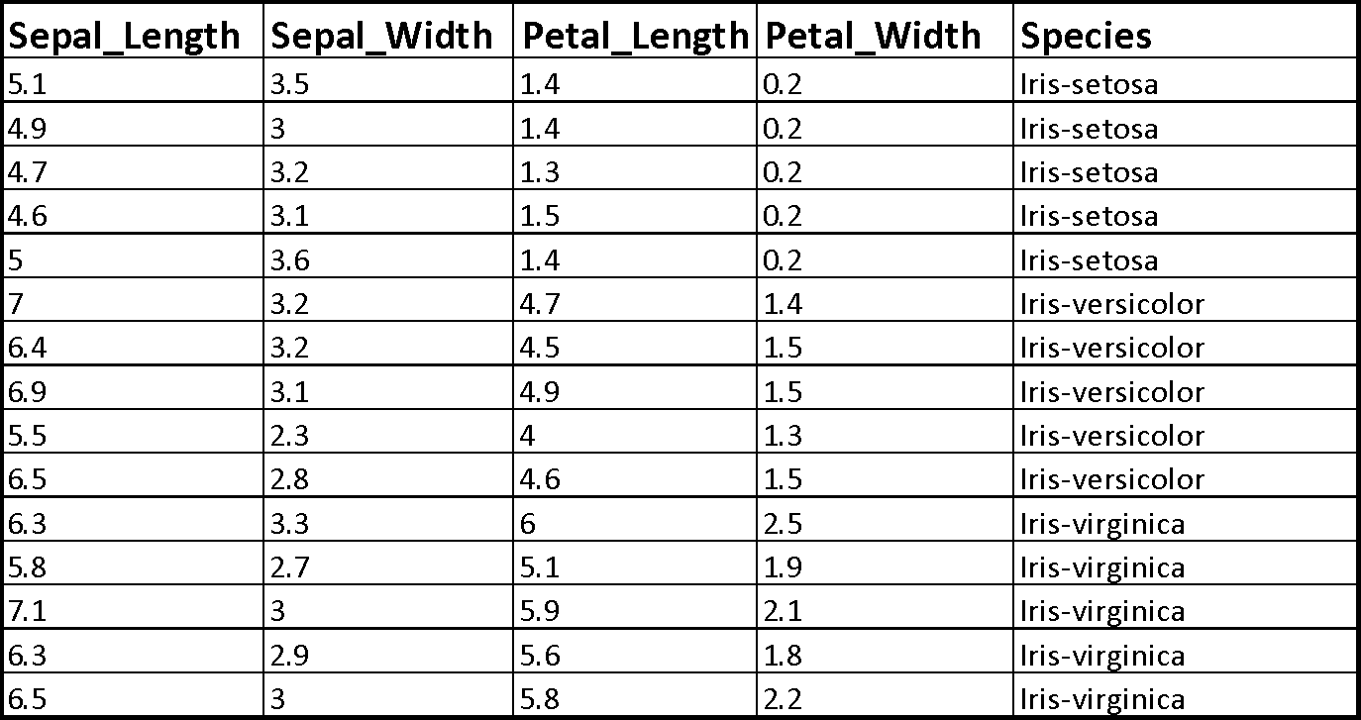
Format Data/Select Features

Slide 22
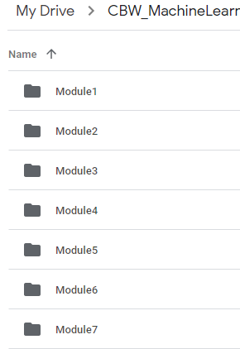
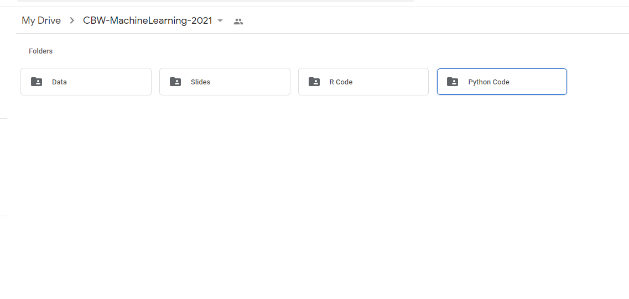

Open the Colab File
Find the Module 6 folder under Python Code in folder CBW-MachineLearning-2026 in your Google Drive

Slide 23

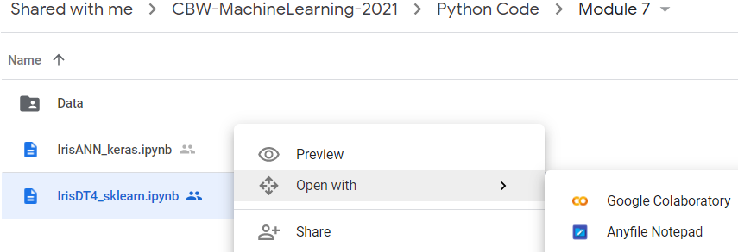

Open the Colab File cont...
Right click on ‘IrisDT_sklearn.ipynb’ and select open with Google Colaboratory

Slide 24
“Old” IrisDT4 Algorithm
Read data
Check data
Create training/testing data sets
Create a test splitting function (test_split)
Create a Gini Index calculation function (gini_index)
Create optimal split function (get_split)
Create terminal node function (to_terminal)
Create a recursive splitting function (split)
Create a program to call the trained DT

Slide 25
“New” IrisDT4 Algorithm
Read data via sklearn.datasets
Call a dataset split function via sklearn’s train_test_split
Call sklearn’s DecisionTreeClassifier
Repeat until max depth of 4 is reached

Slide 26
Import Functions for Python Math
Numpy allows for mathematical operations and array handling
Pandas is used to read data and for dataframe capabilities
import numpy as np
import pandas as pd

Slide 27
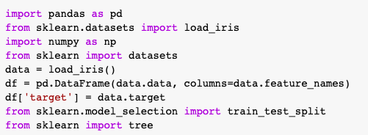
Code for Reading Data
The iris data set is imported using the sklearn.datasets function
We are using the “datasets” function imported from sklearn to simplify data reading

Slide 28
Create a Dataset Split Function
The dataset must be split into training and testing sets
From the sklearn package we can import the train_test_split method
X_train, X_test, Y_train, Y_test =train_test_split(df[data.feature_names], df['target'], random_state=0)
We are using the “train_test_split” function imported from sklearn to simplify data handling

Slide 29
Machine Learning Workflow
Define an ML problem and propose a solution
Construct your dataset
Transform your dataset & select features
Use the model to make predictions
Test and validate your model
Choose and train a model
We have chosen a decision tree model

Slide 30
Choose and Train a Model
We will be training our model with sklearn’s DecisionTreeClassifier using a max_depth of 4
from sklearn.tree import DecisionTreeClassifier
clf = DecisionTreeClassifier(max_depth = 4, random_state = 0) #Make an instance of the Model
clf.fit(X_train, Y_train) #Train the model on the data
# Predict for 1 observation
clf.predict(X_test.iloc[0].values.reshape(1, -1))
# Predict for multiple observations
clf.predict(X_test[0:10])

Slide 31
Repeat Process Until Max Depth Reached
This code is a decision tree model which will execute a decision tree graph with maximum depth of 4
# List of values to try for max_depth:
max_depth_range = list(range(1, 6))
# List to store the average RMSE for each value of max_depth:
accuracy = []
for depth in max_depth_range:
clf = DecisionTreeClassifier(max_depth = depth, random_state = 0)
clf.fit(X_train, Y_train)
score = clf.score(X_test, Y_test)
accuracy.append(score)
print(accuracy)
#Feature Importance
importances = pd.DataFrame({'feature':X_train.columns,
'importance':np.round(clf.feature_importances_,3)})
importances = importances.sort_values('importance',ascending=False)
print(importances)

Slide 32
Program Statistics (Using Sklearn)
Total number of lines: 61
Total number of comment lines: 9
Total number of coding lines: 52
Time to train on training data: 1.5 sec
Typical time to train and perform test run with program: 2.5 sec

Slide 33
“Old” Program Statistics (Everything in Python)
Total number of lines: 123
Total number of comment lines: 32
Total number of coding lines: 91
Time to train on training data: 1.5 sec
Typical time to train and perform test run with program: 2.5 sec

Slide 34
Machine Learning Workflow
Define an ML problem and propose a solution
Construct your dataset
Transform your dataset & select features
Use the model to make predictions
Test and validate your model
Choose and train a model
Test on Testing Data Set

Slide 35
Decision Tree Visualization
For visualization we will import the graphviz function
import graphviz
iris = datasets.load_iris()
dot_data = tree.export_graphviz(clf, out_file=None)
graph = graphviz.Source(dot_data)
graph.render("iris")
dot_data = tree.export_graphviz(clf, out_file=None,
feature_names=iris.feature_names,
class_names=iris.target_names,
filled=True, rounded=True,
special_characters=True)
graph = graphviz.Source(dot_data)
graph

Slide 36
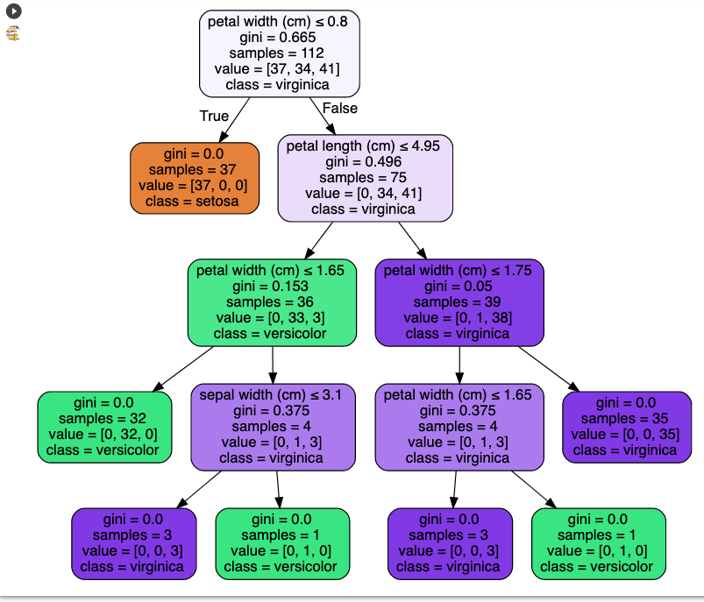
Resulting Decision Tree

Slide 37
Performance on Training Set (Confusion Matrix)
 | Setosa (Observed) | Virginica (Observed) | Versicolor (Observed)
Setosa (Predicted) | 1 | 0 | 0
Virginica (Predicted) | 0 | 1 | 0
Versicolor (Predicted) | 0 | 0 | 1

Slide 38
Performance on Testing Set (Confusion Matrix)
 | Setosa (Observed) | Virginica (Observed) | Versicolor (Observed)
Setosa (Predicted) | 1 | 0 | 0
Virginica (Predicted) | 0 | 0.94 | 0.062
Versicolor (Predicted) | 0 | 0 | 1

Slide 39
Training & Testing (Old Code)
Training
Testing
 | Setosa (Observed) | Virginica (Observed) | Versicolor (Observed)
Setosa (Predicted) | 1 | 0 | 0
Virginica (Predicted) | 0 | 1 | 0
Versicolor (Predicted) | 0 | 0 | 1
 | Setosa (Observed) | Virginica (Observed) | Versicolor (Observed)
Setosa (Predicted) | 1 | 0 | 0
Virginica (Predicted) | 0 | 1 | 0
Versicolor (Predicted) | 0 | 0.07 | 0.93

Slide 40

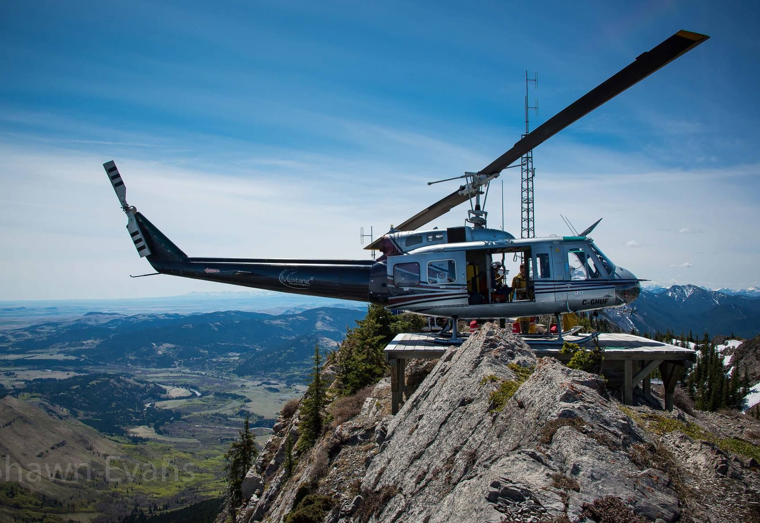
Getting To The Top
The Hard Way
The Easy Way
Walk up
Take a Helicopter

Slide 41
Module 6.1 - Lab
Let’s Take a Look at the Program
IrisDT4_sklearn.ipynb

Slide 42
Open the Colab File in the Language of Your Choosing
The python script ‘IrisDT4_sklearn.ipynb’, covered during lecture, will be used for the Lab portion
However, you have the option of running the Lab in R
To do so, find the R code ‘IrisDT4_sklearn_R.ipynb’ in the R Code folder under Module 6

Slide 43


Open the Colab File in the Language of Your Choosing cont...
Right click on ‘IrisDT4_sklearn.ipynb’ (or alternatively IrisDT4_sklearn_R.ipynb in the R Code folder under Module 6) and select open with Google Colaboratory
6

Slide 44
Study the Program
Spend a few minutes studying the IrisDT4_sklearn.ipynb (or IrisDT4_sklearn_R.ipynb) program
See if you can understand the logic of the program
Ask questions of the TA’s if you are unclear about some of the functions or Python code
After studying the code, try running it

Slide 45
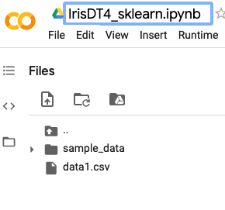
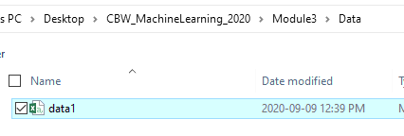
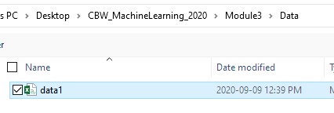

Upload the Data
Once the Colab file is open, click the folder icon to the right
When the panel opens, right click inside the panel and click upload
Then find the CBW-MachineLearning-2026 folder on your desktop
Open the Data folder followed by the Module 6 folder, and open ‘data1.csv’
6

Slide 46
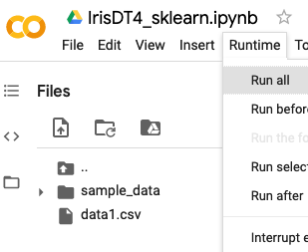
Exercise 6.1- Run The Program
Select ‘Run all’ from the ‘Runtime’ menu

Slide 47
Try Running a Few Examples
Output:
Enter the Sepal length in cm : 5.2
Enter the Sepal width in cm :3.2
Enter the Petal length in cm :1.6
Enter the Petal width in cm :0.3
What do you get???

Slide 48
Try Running a Few Examples
Output:
Enter the Sepal length in cm : 8.3
Enter the Sepal width in cm : 2.0
Enter the Petal length in cm : 1.5
Enter the Petal width in cm : 1.2
What do you get???

Slide 49
Try Running a Few Examples
Output:
Enter the Sepal length in cm : 1.3
Enter the Sepal width in cm : 1.0
Enter the Petal length in cm : 4.6
Enter the Petal width in cm : 0.2
What do you get???

Slide 50
Try Running a Few Examples
Output:
Enter the Sepal length in cm : 10.3
Enter the Sepal width in cm : 11.0
Enter the Petal length in cm : 4.6
Enter the Petal width in cm : 10.2
What do you get???

Slide 51
Let’s Try Programming an ANN to Classify Iris Flowers with Keras
IrisANN_keras.ipynb

Slide 52
Machine Learning Workflow
Define an ML problem and propose a solution
Construct your dataset
Transform your dataset & select features
Use the model to make predictions
Test and validate your model
Choose and train a model
How do I classify Iris flowers in my area based on their floral dimensions?

Slide 53
Machine Learning Workflow
Define an ML problem and propose a solution
Construct your dataset
Transform your dataset & select features
Use the model to make predictions
Test and validate your model
Choose and train a model
Find a good training/testing data set

Slide 54
Open the Colab File
Find the Module 6 folder under Python Code in folder CBW-MachineLearning-2026 in your Google Drive

Slide 55
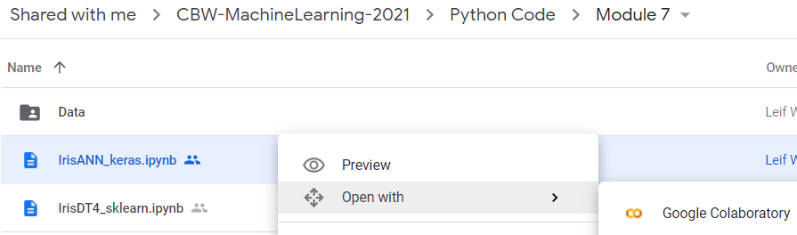
Open the Colab File cont...
Right click on ‘IrisANN_keras.ipynb’ and select open with Google Colaboratory
6

Slide 56
Import Functions for Python Math
The same libraries as the numpy version of the Iris ANN are imported
import numpy as np
import pandas as pd
import matplotlib.pyplot as plt
import seaborn as sns

Slide 57
Machine Learning Workflow
Define an ML problem and propose a solution
Construct your dataset
Transform your dataset & select features
Use the model to make predictions
Test and validate your model
Choose and train a model

Slide 58
Loading the Data
Again, the same data set is imported and is checked for missing values
#read data from csv
iris = pd.read_csv("data1.csv")
iris.head()
#Check the dataset to make sure no data is missing and Check the class labels – need to define “verify_dataset” function
def verify_dataset(data):
#Use data_found as a dummy variable to determine if to print missing value information
data_found = 1
for each_column in data.columns:
if data[each_column].isnull().any():
print("Data missing in Column " + each_column)
data_found = 0
quit()
if data_found == 1:
print("Dataset is complete. No missing value")
return
#Call verify_dataset and check data verify_dataset(data)

Slide 59
Extracting Species Information
Assign species names to numbers, perform one-hot encoding, flatten the input into a single vector
#Replace the species with 1,2 or 0 as appropriate
label_dict = dict()
label_dict['0'] = 'setosa'
label_dict['1'] = 'virginica'
label_dict['2'] = 'versicolor'
iris['Species'].replace(['Iris-setosa', 'Iris-virginica', 'Iris-versicolor'], [0, 1, 2], inplace=True)
#Get Output, flatten and encode to one-hot
columns = ['Species']
y = pd.DataFrame(iris, columns=columns)
y = y.to_numpy()
y = y.flatten()
y = to_one_hot(y)

Slide 60
Splitting Data and Comparing
The split_dataset_test_train function is then called to create the input and output training and test sets (70% training, 30% test)
x_y = pd.DataFrame(np.concatenate((x,y), axis=1))
def split_dataset_test_train(data,train_size):
data = data.sample(frac=1).reset_index(drop=True)
training_data = data.iloc[:int(train_size * len(data))].reset_index(drop=True)
testing_data = data.iloc[int(train_size * len(data)):].reset_index(drop=True)
return [training_data, testing_data]
train_test_data = split_dataset_test_train(x_y,0.7)
X_train = train_test_data[0].iloc[:,0:4].to_numpy()
X_test = train_test_data[1].iloc[:,0:4].to_numpy()
y_train = train_test_data[0].iloc[:,-3:].to_numpy()
y_test = train_test_data[1].iloc[:,-3:].to_numpy()

Slide 61
Build the Model
Import the necessary keras packages required for building and training the neural network
Unlike the previous example where the layers of the network were defined in the training process, with keras, the architecture of the model is defined first, then the model is trained with a different function
The Sequential constructor "Sequential()" creates the framework of the model
from tensorflow.python.keras.layers import Dense
from tensorflow.python.keras import Sequential
#Creating the framework of the model
classifier = Sequential()

Slide 62
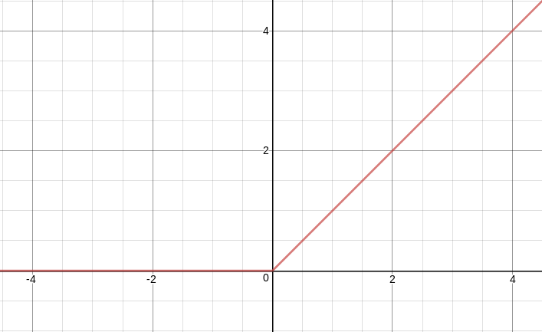
Hidden Layer Activation Function
The rectifier function 'relu' is used as the activation function for the hidden layer
ReLU stands for "rectified linear unit", meaning a neural network unit (neuron) that uses the rectified linear function as the activation function
This function returns the maximum of zero or the input value
Used in hidden layer neurons because of its computational simplicity

Slide 63
Input and Hidden Layer
The ".add()" function is used to add layers to the model
"Dense(...,...,...)" specifies the architecture of the layer that is added
The rectifier function 'relu' is used as the activation function for the input and hidden layer
#The first .add() creates both the input layer (size 4) and hidden layer (size 6)
classifier.add(Dense(units = 6, kernel_initializer='random_uniform', activation = 'relu', input_dim = np.size(X_train,1)))

Slide 64
Output Layer
For the output layer, the softmax activation function is used
Recall that the softmax function is very similar to the sigmoid function, but will output probabilities such that the sum of all probabilities for the classes (flower species) equates to one
classifier.add(Dense(units = 3, kernel_initializer='random_uniform', activation = 'softmax'))

Slide 65
Defining Model Parameters Comparison
#Weight initialization
w0 = 2*np.random.random((X_train.shape[1], hidden_size)) - 1
w1 = 2*np.random.random((hidden_size, 3)) - 1
bh = np.random.randn(hidden_size)
bo = np.random.randn(3)
#sigmoid and its derivative
def sigmoid(x):
return 1/(1+np.exp(-x))
def sigmoid_deriv(x):
return sigmoid(x)*(1 - sigmoid(x))
def user_softmax(A):
expA = np.exp(A)
return expA / expA.sum(axis=1, keepdims=True)
Without Keras
classifier.add(Dense(units = 3, kernel_initializer='random_uniform', activation = 'softmax'))
With Keras

Slide 66
Machine Learning Workflow
Define an ML problem and propose a solution
Construct your dataset
Transform your dataset & select features
Use the model to make predictions
Test and validate your model
Choose and train a model
We have chosen an ANN

Slide 67
Compiling the Model
The final step in building the model is compilation, which configures the model for training
The .compile() function compiles the model using the preceding information defining the layers, and allows specification of the optimizer algorithm and loss function
An optimizer algorithm is used to find optimal weights
“adam” is a stochastic gradient descent optimizer
For the Loss (cost) function we use categorical_crossentropy
Metrics - using accuracy as the metric for training
classifier.compile(optimizer = 'adam',loss = 'categorical_crossentropy', metrics = ['accuracy'])

Slide 68
Training the Model
To train the model that has been created, the .fit() method is used
This method takes as input both the input and output training data
"batch_size" specifies the number of training samples after which to update the weights.
"nb_epochs" specifies the number of training epochs or the number of times over which the entire training set is iterated
Weights are updated after every 10 observations (batch_size=10)
Training is repeated over the whole dataset 100 times (epochs=100)
classifier.fit(X_train, y_train, batch_size = 10, epochs = 100)

Slide 69
Training Without Keras
def training(lr, batch_size, epochs): w0 = 2*np.random.random((X_train.shape[1], hidden_size)) - 1
w1 = 2*np.random.random((hidden_size, 3)) - 1 bh = np.random.randn(hidden_size)
bo = np.random.randn(3) rem = len(X_train) % batch_size
num_batch = len(X_train)//batch_size
if rem != 0:
num_batch += 1
errors = [] for epoch in range(epochs):
for curr_batch in range(num_batch):
# Finding the current batch
batch_start = curr_batch * batch_size
batch_end = batch_start + batch_size
input_batch = X_train[batch_start:batch_end]
zh = np.dot(input_batch, w0) + bh
layer1 = sigmoid(zh)
zo = np.dot(layer1, w1) + bo
layer2 = user_softmax(zo)
labels_batch = y_train[batch_start:batch_end]
layer2_error = layer2 - labels_batch
layer2w_delta = np.dot(layer1.T, layer2_error)
layer2b_delta = layer2_error
dcost_dah = np.dot(layer2_error , w1.T)
dah_dzh = sigmoid_deriv(zh)
layer1_error = dah_dzh * dcost_dah
layer1w_delta = np.dot(input_batch.T, layer1_error) layer1b_delta = layer1_error
w0 -= lr * layer1w_delta
bh -= lr * layer1b_delta.sum(axis=0) w1 -= lr * layer2w_delta
bo -= lr * layer2b_delta.sum(axis=0) error = np.mean(np.abs(layer2_error))
errors.append(error) return [w0,bh,w1,bo], error, errors
Training with Keras
classifier.fit(X_train, y_train, batch_size = 10, epochs = 100)

Slide 70
Machine Learning Workflow
Define an ML problem and propose a solution
Construct your dataset
Transform your dataset & select features
Use the model to make predictions
Test and validate your model
Choose and train a model
Test on Testing Data Set

Slide 71
Testing the Model
After the model has been trained, we can now test the performance
The .predict() method is used on the input testing data to obtain the models predictions "y_pred" from the input data (X_test)
These predictions can then be compared to the actual test outputs "y_test”
Predicting flower species using the test set
y_pred = classifier.predict(X_test)

Slide 72
Testing the Model
Testing without Keras
def evaluation(params):
w0 = params[0]
bh = params[1]
w1 = params[2]
bo = params[3]
zh = np.dot(X_test, w0) + bh
layer1 = sigmoid(zh)
# Phase 2 layer2 is final output
zo = np.dot(layer1, w1) + bo
layer2 = sigmoid(zo)
return layer2
y_pred = evaluation(trained_params)
Testing with Keras
y_pred = classifier.predict(X_test)

Slide 73
Confusion Matrix
from sklearn.metrics import confusion_matrix
import seaborn as sns
cm = confusion_matrix(y_test.argmax(axis=1), y_pred.argmax(axis=1),
normalize='true')
from matplotlib.colors import ListedColormap
df_cm = pd.DataFrame(cm, index = ['setosa','virginica','versicolor'],
columns = ['setosa','virginica','versicolor'])
plt.figure(figsize = (6,6))
with sns.axes_style('white'):
sns.heatmap(df_cm,
cbar=False,
square=False,
annot=True,
annot_kws={"size": 20},
cmap=ListedColormap(['white']),
linewidths=0.5)
sns.set(font_scale=1.8)

Slide 74
Confusion Matrix Comparison
With Keras Without Keras
 | Setosa (Observed) | Virginica (Observed) | Versicolor (Observed)
Setosa (Predicted) | 1 | 0 | 0
Virginica (Predicted) | 0 | 0.94 | 0.056
Versicolor (Predicted) | 0 | .062 | 0.94
 | Setosa (Observed) | Virginica (Observed) | Versicolor (Observed)
Setosa (Predicted) | 1 | 0 | 0
Virginica (Predicted) | 0 | 0.94 | 0.056
Versicolor (Predicted) | 0 | 0 | 1

Slide 75
Comparison of Code Length with ANN Code using Keras vs. numpy
IrisANN: numpy only 215 lines of code
IrisANN_keras: 136 lines of code

Slide 76
Program Statistics
IrisANN
IrisDT4
 | Python | R | Python | R
Packages used | keras, sklearn | neuralnet, dplyr | sklearn | tree
Lines of code | 136 | 105 | 52 | 73
Average Running time (seconds) | 4.20 | 19.48 | 3.89 | 5.89
 | Python | R | Python | R
Packages used | keras, sklearn | neuralnet, dplyr | sklearn | tree
Lines of code | 136 | 105 | 52 | 73
Average Running time (seconds) | 4.20 | 19.48 | 3.89 | 5.89

Slide 77
Module 6.2 - Lab
Let’s Take a Look at the Program
IrisANN_keras.ipynb

Slide 78
Open the Colab File in the Language of Your Choosing
The python script ‘IrisANN_keras.ipynb’, covered during lecture, will be used for the Lab portion
However, you have the option of running the Lab in R
To do so, find the R code ‘IrisANN_keras_R.ipynb’ in the R Code folder under Module 6

Slide 79
Open the Colab File in the Language of Your Choosing cont...
Right click on ‘IrisANN_keras.ipynb’ (or alternatively IrisANN_keras_R.ipynb in the R Code folder under Module 6) and select open with Google Colaboratory
6

Slide 80
Study the Program
Spend a few minutes studying the IrisANN_keras.ipynb (or IrisANN_keras_R.ipynb) program
See if you can understand the logic of the program
Ask questions of the TA’s if you are unclear about some of the functions or Python code
After studying the code, try running it

Slide 81

Upload the Data
Once the Colab file is open, click the folder icon to the right
When the panel opens, right click inside the panel and click upload
Then find the CBW-MachineLearning-2026 folder on your desktop
Open the Data folder followed by the Module 6 folder, and open ‘data1.csv’
1
6

Slide 82
Exercise 6.2- Run The Program
Select ‘Run all’ from the ‘Runtime’ menu

Slide 83
Try Running a Few Examples
Output:
Enter the Sepal length in cm : 5.2
Enter the Sepal width in cm :3.2
Enter the Petal length in cm :1.6
Enter the Petal width in cm :0.3
What do you get???

Slide 84
Try Running a Few Examples
Output:
Enter the Sepal length in cm : 8.3
Enter the Sepal width in cm : 2.0
Enter the Petal length in cm : 1.5
Enter the Petal width in cm : 1.2
What do you get???

Slide 85
Try Running a Few Examples
Output:
Enter the Sepal length in cm : 1.3
Enter the Sepal width in cm : 1.0
Enter the Petal length in cm : 4.6
Enter the Petal width in cm : 0.2
What do you get???

Slide 86
Try Running a Few Examples
Output:
Enter the Sepal length in cm : 10.3
Enter the Sepal width in cm : 11.0
Enter the Petal length in cm : 4.6
Enter the Petal width in cm : 10.2
What do you get???

Slide 87
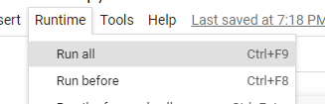
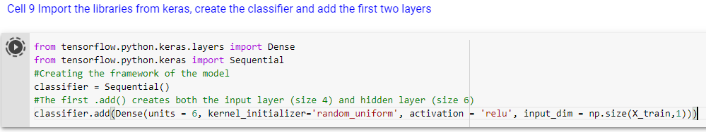
Exercise 6.3 – Alter It
From the ‘Runtime’ menu, select ‘Run all’
Go to cell 14 and observe the confusion matrix
Go to cell 9 and change the hidden layer units from 6 to 10
Select ‘Run after’ from the runtime menu. Does this change produce an appreciable difference in performance?

Slide 88
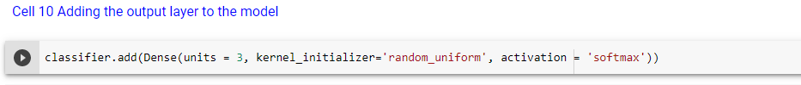
Exercise 6.4
Go to cell 10
Change the output layer activation function from ‘softmax’ to ‘sigmoid’
Select ‘Run after’ from the runtime menu and note the confusion matrix results
While still set to ‘sigmoid’, rerun the code starting from cell 9.
What is the difference between running the code from cell 9 and running the code from cell 10?

Slide 89
Exercise 6.5 Random Forest Regression
Machine learning is also employed for multivariate regression analysis
While categorical variables are used for classification problems, ML regression is mostly performed on continuous predicted variables
A Random Forest regression model operates by constructing several decision trees at random during training time
For each input into the model, the predicted output equals the mean of the predicted values from all trees in the forest

Slide 90
Using RF to Predict Flower Properties
The data set we have can be used for more than just predicting flower varieties from flower dimensions – we can use it in reverse
That is we can use flower varieties and other flower dimensions to “predict” specific features
Here we will show how categorical values (flower type) and numerical values (flower dimensions) can be used to predict other flower dimensions

Slide 91

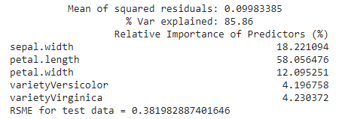
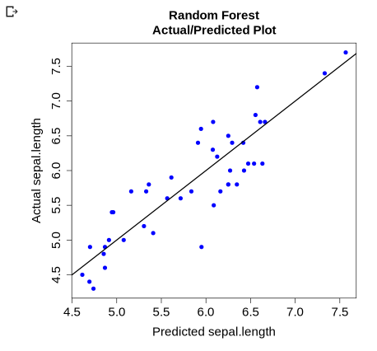
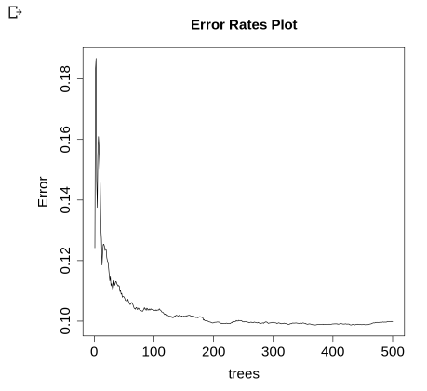
Predicting Sepal Length Based on Flower Variety & Dimensions
Predicted variable = sepal length

Slide 92
Random Forest Regression
We have provided both a python script and an R script, so that you can practice RF regression on the classic Iris data set
The python script ‘IrisRF_sklearn.ipynb’ can be found in the Python Code folder under Module 6
You can find the R script ‘IrisRF_randomForest_R.ipynb’ in the R Code folder under Module 6
The accompanying data for both scripts, ‘data1.csv’, can be found in the Data folder under Module 6

Slide 93
Study the Programs
Study both the python code ‘IrisRF_sklearn.ipynb’ and the R code ‘IrisRF_randomForest_R.ipynb’
See if you can understand the logic of the programs
Ask questions of the TA’s if you are unclear about some of the functions or code
After studying the codes, try running them

Slide 94






Coffee Break & Networking Session
Workshop Sponsors

