Slide 1

bioinformatics.ca
bioinformaticsdotca.github.io

Slide 2
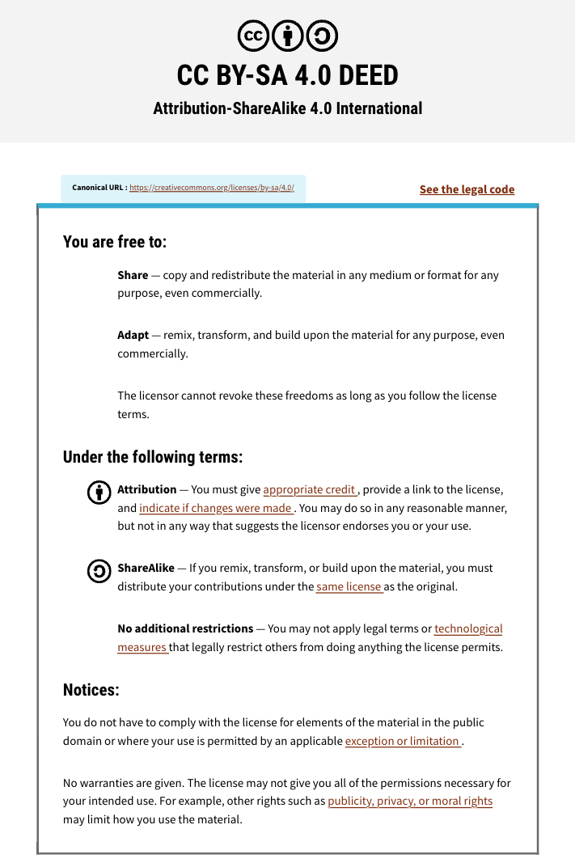

Slide 3

Module 7: Machine Learning with Keras & Scikit-Learn
Mark Berjanskii
Machine Learning
Apr 22-23, 2026
University of Alberta

Slide 4

Schedule (MT)
Day 1 (MT) | Wednesday Apr. 22 | Day 2 (MT) | Day 2
9:00 AM | Introductions and Technology Check | 9:00 AM | Module 5: Gene Finding with NNs (Lecture and Lab)
9:45 AM | Module 1: Introduction to Machine Learning (Lecture) | 11:00 AM | Break (30 min)
11:00 AM | Break (30 min) | 11:30 AM | Module 6: Machine Learning with Keras and Scikit-Learn (Lecture/Lab)
11:30 AM | Module 2: Decision Trees (Lecture and Lab) | 1:00 PM | Break (45 min)
1:00 PM | Break (1 hour) | 2:00 PM | Module 7: Machine Learning with Keras and Scikit-Learn (Cont'd)
2:00 PM | Module 3: Neural Networks (Lecture and Lab) | 3:00 PM | Break (30 min)
3:00 PM | Break (30 min) | 3:30 PM | Module 8: LLMs and agentic coding for bioinformatics
3:30 PM | Module 4: Neural Networks for 2º Structure (Lecture and Homework) | 4:45 PM | Survey and Closing Remarks
5:00 PM | End of Day 1 | 5:00 PM | End of Day 2
Canadian Bioinformatics Workshops | bioinformatics.ca

Slide 5
Schedule (PT)
Day 1 (PT) | Wednesday Apr. 22 | Day 2 (PT) | Thursday Apr. 23
8:00 AM | Introductions and Technology Check | 8:00 AM | Module 5: Gene Finding with NNs (Lecture and Lab)
8:45 AM | Module 1: Introduction to Machine Learning (Lecture) | 10:00 AM | Break (30 min)
10:00 AM | Break (30 min) | 10:30 AM | Module 6: Machine Learning with Keras and Scikit-Learn (Lecture/Lab)
10:30 AM | Module 2: Decision Trees (Lecture and Lab) | 12:00 PM | Break (45 min)
12:00 PM | Break (1 hour) | 1:00 PM | Module 7: Machine Learning with Keras and Scikit-Learn (Cont'd)
1:00 PM | Module 3: Neural Networks (Lecture and Lab) | 2:00 PM | Break (30 min)
2:00 PM | Break (30 min) | 2:30 PM | Module 8: LLMs and agentic coding for bioinformatics
2:30 PM | Module 4: Neural Networks for 2º Structure (Lecture and Homework) | 3:45 PM | Survey and Closing Remarks
4:00 PM | End of Day 1 | 4:00 PM | End of Day 2
Canadian Bioinformatics Workshops | bioinformatics.ca

Slide 6
Learning Objectives
To demonstrate how much more efficiently ML code can be written with keras and sklearn
To write and run an ANN for secondary structure prediction using keras and sklearn
To learn how to modify an sklearn program to improve or assess its performance

Slide 7
Let’s Try to Predict Secondary Structure via an ANN with Keras
SSANN_keras.ipynb

Slide 8
Machine Learning Workflow
Define an ML problem and propose a solution
Construct your dataset
Transform your dataset & select features
Use the model to make predictions
Test and validate your model
Choose and train a model
How do I predict protein secondary structure from protein sequence data using Keras?

Slide 9
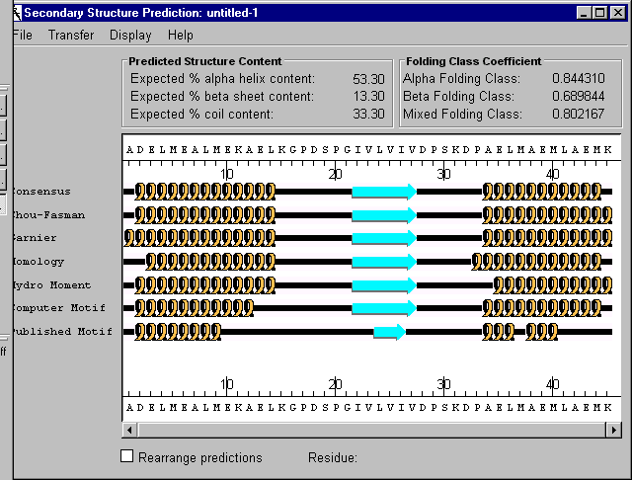
2º Structure Prediction

Slide 10
Machine Learning Workflow
Define an ML problem and propose a solution
Construct your dataset
Transform your dataset & select features
Use the model to make predictions
Test and validate your model
Choose and train a model
Find a good training/testing data set

Slide 11

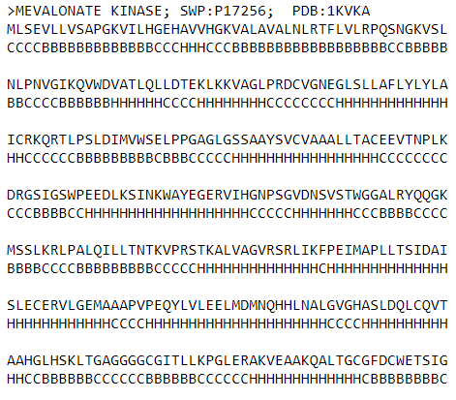
The Data Set
Protein information
Odd rows contain aa sequence
Even rows contain structure sequence
http://www.pptdb.ca/

Slide 12
Formatted Data
We will use the same data set as the numpy or Python implementation
Protein | AA Sequence | Structure Sequence
>VACUOLAR MORPHOGENESIS PROTEIN VAM7; SWP:P32912; PDB:1KMDA | KMSEKLRIKVDDVKINPKYVLYGVSTPNKRLYKRYSEFWKLKTRLERDVGSTIPYDFPEKPGVLDRRWQRRYDDPEMIDERRIGLERFLNELYNDRFDSRWRDTKIAQDFLQLSKPN | CCCCCBBBBBCBBBBCCCCBBBBBBBBCBBBBBBHHHHHHHHHHHHHHCCCCCCCCCCCCCCCCCCCCCCCCCCHHHHHHHHCCHHHHHHHHHHCCCCCHHHHCHHHHHCCCCCCCC
>CIRCULIN A; SWP:P56871; PDB:1BH4 | CGESCVWIPCISAALGCSCKNKVCYRNGIP | CBBBCCCCCCCCCCCCBBBCCCBBBCCCCC
>BAND 3; SWP:P02730; PDB:1BH7 | IQLFDRILLFKPPKYHPDPYVKRVKTWRMHL | CCCCCCCCCCCCCCCCCCCCCCCCHHHHHCC
>Salt-mediated killer protoxin 1 [Precursor]; SWP:P19972; PDB:1KVDB | GEATTIWGVGADEAIDKGTPSKNDLQNMSADLAKNGFKGHQGVACSTVKDGNKDVYMIKFSLAGGSNDPGGSPCSDD | CCCCCBBBBBBBBBCCCCCCCHHHHHHHHHHHHHCCCCCCBBBBBBBBBCCCCCBBBBBBBBBCCCCCCCCCBBBCC
>MORICIN; SWP:P82818; PDB:1KV4A | AKIPIKAIKTVGKAVGKGLRAINIASTANDVFNFLKPKKRKA | CCCHHHHHHHHHHHHHHHHHHHHHHHHHHHHHHHCCCCCCCC
>Cyclin-dependent kinase 5 activator 1 [Precursor]; SWP:Q15078; PDB:1H4LD | STSELLRCLGEFLCRRCYRLKHLSPTDPVLWLRSVDRSLLLQGWQDQGFITPANVVFLYMLCRDVISSEVGSDHELQAVLLTCLYLSYSYMGNEISYPLKPFLVESCKEAFWDRCLSVINLMSSKMLQINADPHYFTQVFSDLKNES | CCCHHHHHHHHHHHHHHCCCCCCCCHHHHHHHHHHHHHHCCCCCCCCCCCCHHHHHHHHHHHHCCCCCCCCCHHHHHHHHHHHHHHHHHHHCCCCCCCCCCCCCCCCHHHHHHHHHHHHHHHHHHHHHHHHCHHHHHHHHHHHHHCC
>FIBRONECTIN CELL-ADHESION MODULE TYPE III-10; SWP:P02751; PDB:1FNA | GSLEVVAATPTSLLISWDAPAVTVRYYRITYGETGGNSPVQEFTVPGSKSTATISGLKPGVDYTITVYAVTGRGDSPASSKPISINYRTEI | CBBBBCCCCCBBBBBBBBCCCCCCBBBBBBBBBCCCCCCBBBBBBBCCCCBBBBBCCCCCBBBBBBBBBBBCCCCCCCCCCBBBBBBBBBC
>Methanol dehydrogenase subunit 2 [Precursor]; SWP:P14775; PDB:1H4ID | YDGTKCKAAGNCWEPKPGFPEKIAGSKYDPKHDPKELNKQADSIKQMEERNKKRVENFKKTGKFEYDVAKISA | CCCCCCCCCCCCCCCCCCCCCCCCCCCCCCCCCHHHHHHHHHHHHHHHHHHHHHHHHHHHHCCCCCCCCCCCC

Slide 13
Machine Learning Workflow
Define an ML problem and propose a solution
Construct your dataset
Transform your dataset & select features
Use the model to make predictions
Test and validate your model
Choose and train a model
Encode the Data and Choose ANN model

Slide 14
Neural Network for 2º Structure Prediction cont...
Training Set
Encoding
Sliding Window
ACGAAG
AGGAAG
AGCAAG
ACGAAA
AGCAAC
ACGAAG
A = [001]
C = [010]
G = [100]
B = [01]
C = [10]
[010100001]
Input Vector
BBBBCC
[01]
H = [11]
Output Vector
Desired Output

Slide 15
Let’s Try Programming an ANN to Predict Secondary Structure
SSANN_keras.ipynb

Slide 16
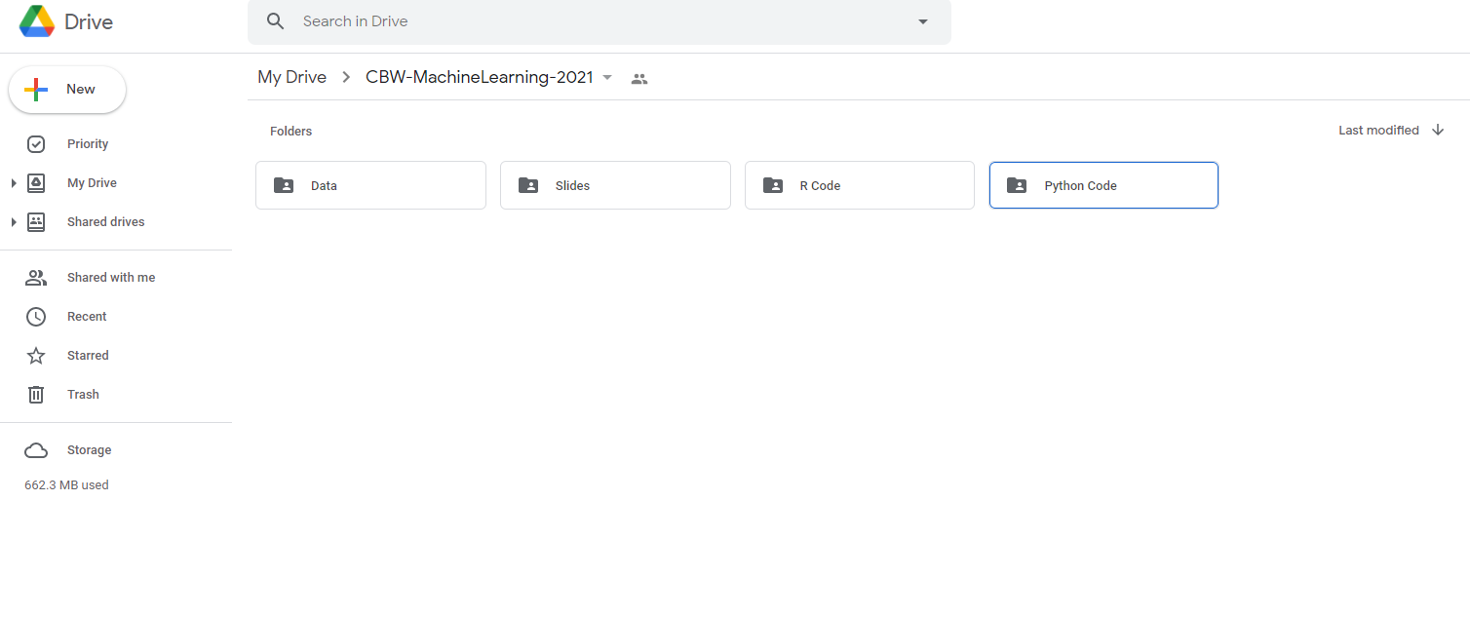

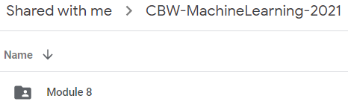
Open the Colab File
Find the Module 7 folder under Python Code in folder CBW-MachineLearning-2026 in your Google Drive
7

Slide 17
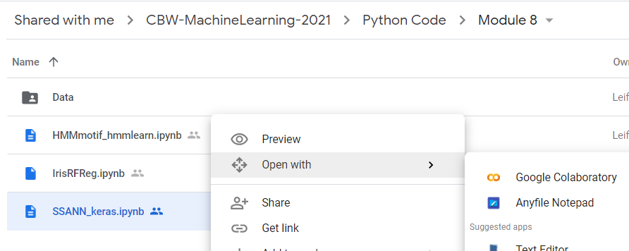

Open the Colab File cont...
Right click on ‘SSANN_keras.ipynb’ and select open with Google Colaboratory
7

Slide 18
Import Functions for
Python Math & Data Handling
Numpy allows for mathematical operations and array handling
Pandas is used to read data and for dataframe capabilities
import numpy as np
import pandas as pd

Slide 19
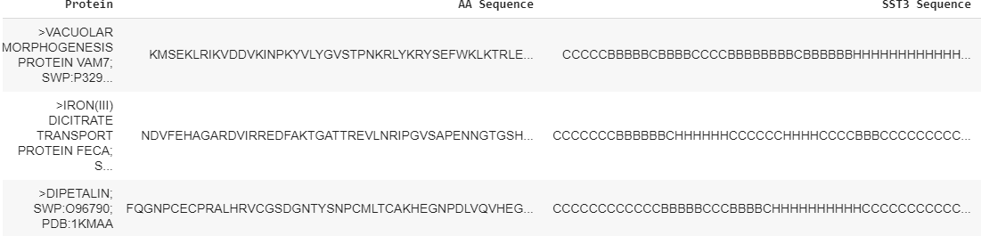
Read the Dataset
After function definitions, the first step is to import the required dataset.
data = pd.read_csv('converted_data.csv')
used_data = data.copy()
used_data = used_data.iloc[:,1:]
used_data.head()
A preview of the dataset

Slide 20
Code For Data Check
(Invalid Amino Acids)
#Check the dataset to make sure only proteins with standard
#amino acids are included in the set
def remove_non_standard_aa():
num_nonstd = 0
aa_nonstd = []
num_prot = len(used_data)
for prot in range(num_prot):
if used_data.iloc[prot,1].find('X') != -1:
num_nonstd += 1
aa_nonstd.append(prot)
elif used_data.iloc[prot,1].find(';') != -1:
num_nonstd += 1
aa_nonstd.append(prot)
return aa_nonstd
aa_nonstd = remove_non_standard_aa()
used_data = used_data.drop(used_data.index[aa_nonstd])

Slide 21
Code For Data Check (Missing Values, Label Check)
#Check the dataset to make sure no data is missing and check the class labels – need to define “verify_dataset” function
def verify_dataset(data):
#Use data_found as a dummy variable to determine if to print missing value information
data_found = 1
for each_column in data.columns:
if data[each_column].isnull().any():
print("Data missing in Column " + each_column)
data_found = 0
quit()
if data_found == 1:
print("Dataset is complete. No missing value")
return
#Call verify_dataset and check data
verify_dataset(data)

Slide 22
Create a Training (70%) & Testing Set (30%)
#Splitting The Data Set into training and testing
def split_dataset_test_train(data,limit,train_size):
data = data.sample(frac=limit).reset_index(drop=True)
training_data = data.iloc[:int(train_size*len(data))].reset_index(drop=True)
testing_data = data.iloc[int(train_size*len(data)):].reset_index(drop=True)
return training_data, testing_data
data_frac = 0.1
train_frac = 0.7
train_data, test_data = split_dataset_test_train(used_data,data_frac,train_frac)

Slide 23
Machine Learning Workflow
Define an ML problem and propose a solution
Construct your dataset
Transform your dataset & select features
Use the model to make predictions
Test and validate your model
Choose and train a model

Slide 24
One-Hot Encoding Amino Acids
ANNs require input data to be binary (one-hot) encoded so that the input can be properly manipulated by the matrix calculations
Need to change amino acids from characters to binary numbers
Amino Acid Character | Amino Acid Binary
A | 100000000000000000000
C | 010000000000000000000
D | 001000000000000000000
… | …
Null | 000000000000000000001

Slide 25
One-Hot Encoding Secondary Structures
Similarly, the secondary structure characters must be changed to binary numbers
Secondary Structure Character | Secondary Structure Binary
B | 100
C | 010
H | 001

Slide 26
Create an Amino Acid Encoding Alphabet
The binary number associations are made with the amino acid characters
‘aa_alphabet’ contains a unique binary number for each amino acid
#Defining codes for the alphabet
aa_codes = np.array(['A','C','D','E','F','G','H','I','K','L','M','N',
'P','Q','R','S','T','V','W','Y','Null']) #An identity matrix is one such that all diagonal elements are equal to 1, while the rest are 0
aa_alphabet = pd.DataFrame(data=np.identity(21), columns=aa_codes)

Slide 27
Create a Secondary Structure Alphabet
A similar alphabet is created for the secondary structure characters
#Defining the encoding matrix for the structures
sst3_codes = np.array(['B','C','H'])
sst3_alphabet = pd.DataFrame(data=np.identity(3),columns=sst3_codes)

Slide 28
Null-Padding Amino Acid Sequences
A null sequence is created
This will be added to the beginning and end of the amino acid sequences to allow for “windowing”
null_pad = [aa_alphabet['Null']]*8
null_pad = np.array(null_pad)

Slide 29
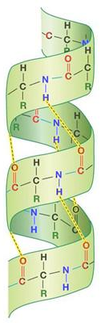
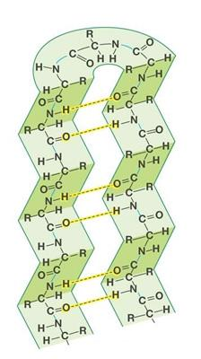
Amino Acid Windowing
Secondary structure arises from chemical interactions between nearby amino acids
To capture these interactions, amino acids are grouped into windows
The secondary structure will be predicted for the amino acid at the center of each window
β Pleated Sheet
α Helix

Slide 30
Amino Acid Encoding
A given amino acid sequence is first padded with null amino acids at the beginning and end of the sequence
Start
End
PKPGFPEKIA…GSKYDPKHDP
Null,…,Null,Null
PKPGFPEKIA…GSKYDPKHDP
Null,…,Null,Null

Slide 31
Windowing Method
A window of amino acids forms one set of inputs to the ANN
The corresponding output is the structure for the amino acid at the center of the window
Input set X
PKPGFPEKIAKEPGFPDPAIGSKYDPKHDP
BBBBBBBBHHHHHHHHHCCCCCCBBBBBBB
Output y

Slide 32
Windowing Method cont...
Shifting the window results in the next set of inputs and corresponding output
Before this data can be used, the amino acid and structure sequences must be encoded
Input set X+1
PKPGFPEKIAKEPGFPDPAIGSKYDPKHDP
BBBBBBBBHHHHHHHHHCCCCCCBBBBBBB
Output y+1

Slide 33
Amino Acid Encoding (Windowing Method)
Null
Null
Null
Null
Null
Null
Null
Null
I
E
E
E
L
L
L
Q
Q
I
D
.
000000000000000000001
000000000000000000001
000000000000000000001
.
.
.
.
An amino acid sequence is first encoded by applying the binary (0/1) amino acid alphabet codes
Start
000000010000000000000
.
.
.
.
000000000000010000000

Slide 34
Amino Acid Encoding (Windowing Method) cont...
Null
Null
Null
Null
Null
Null
Null
Null
I
E
E
E
L
L
L
Q
Q
I
D
.
000000000000000000001
000000000000000000001
Amino acids in the first window are grouped and placed into one row of an array (flattening)
With a window size of 17, the flattened rows will be 357 bits long (17x21)
000000000000000000001
.
.
.
.
Start
000000010000000000000
.
.
.
.
000000000000010000000

Slide 35
Flattening
A flattened row of data
.
I
D
Q
Q
I
D
N
I
K
A
Y
Null
Null
Null
Null
Null
Null
Null
Null
000000000000000000001
000000000000000000001
…
…
000000000000000000010
000000000000000000001
.
.
.
.
000000000000000000010
.
.
.
.
000000000000000000001

Slide 36
Amino Acid Encoding (Windowing Method) cont...
Null
Null
Null
Null
Null
Null
Null
Null
I
E
E
E
L
L
L
Q
Q
I
D
.
000000000000000000001
000000000000000000001
000000000000000000001
.
.
.
.
The window is shifted by one amino acid and the process is repeated
New Centre
000100000000000000000
.
.
.
.
000000010000000000000

Slide 37
Amino Acid Encoding (Windowing Method) cont...
.
I
D
Q
Q
I
D
N
I
K
A
Y
Null
Null
Null
Null
Null
Null
Null
Null
000000000000000000001
000000000000000000001
The process repeats until we reach the end of the amino acid sequence
The next sequence in the set is then windowed
000000000000000000001
.
.
.
.
End
000000000000000000010
.
.
.
.
000000000000000000001

Slide 38

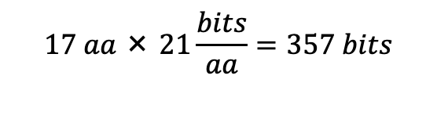
Encoded Data
With encoding complete, each row of data covering length L of the protein corresponds to one set of inputs and outputs
Input Data
Output Data
000000000000000000001
…
000000010000000000000
…
000000000000010000000
100
…
…
010
000000000000000000001
000100000000000000000
000000010000000000000
...
...
…
…
100
000000000000010000000
000100000000000000000
000000000000000000001

Slide 39
Amino Acid Encoding (Windowing Method)
For each sequence in a set, the amino acids are first transformed to binary representation
def aa_encode(data_set):
aa_encoded = np.empty((0,(window_size*21)))
null_size = int(window_size/2)
null_pad = [aa_alphabet['Null']]*null_size
null_pad = np.array(null_pad)
for i in range(len(data_set)):
to_encode = [aa_alphabet[aa] for aa in data_set.iloc[i,1]]
to_encode = np.array(to_encode)

Slide 40
Amino Acid Encoding (Windowing Method)
The encoded sequence is then padded with the Null sequence
to_encode = np.concatenate((null_pad,to_encode), axis=0)
to_encode = np.concatenate((to_encode,null_pad), axis=0)

Slide 41
Amino Acid Encoding (Windowing Method)
The encoded and padded sequence is windowed
Each window is placed as a row (flattened) in the final array
#The encoded sequences representing the amino acids are gathered in groups according to the window size
X_data = [to_encode[top:top+window_size,:].flatten() for top in
range(len(data_set.iloc[i,1]))]
X_data = np.array(X_data)
#The current protein's data is added to the array of all encoded proteins
aa_encoded = np.concatenate((X_data,aa_encoded),axis=0)

Slide 42
Secondary Structure Encoding
The structure sequence is encoded by simply fetching the binary sequence for each structure character
def sst3_encode(data_set):
sst3_encoded = np.empty((0,3))
for i in range(len(data_set)):
to_encode = [sst3_alphabet[sst3] for sst3 in
data_set.iloc[i,2]]
to_encode = np.array(to_encode)
sst3_encoded = np.concatenate((to_encode,sst3_encoded),axis=0)
return sst3_encoded

Slide 43
Machine Learning Workflow
Define an ML problem and propose a solution
Construct your dataset
Transform your dataset & select features
Use the model to make predictions
Test and validate your model
Choose and train a model
We have chosen an ANN model

Slide 44
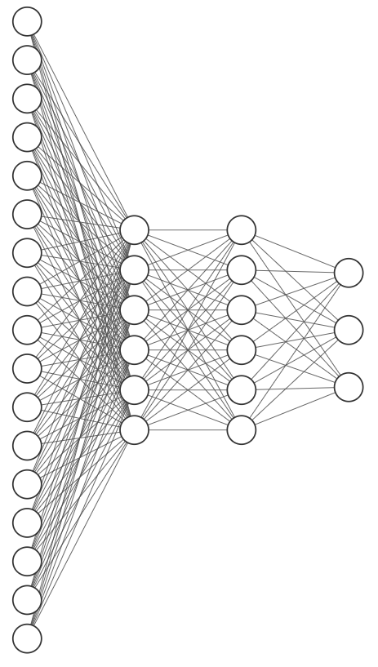
ANN Model: Deep NN
The model’s architecture is chosen to match the dimensionality of the input and output data
The input layer will again consist of 357 units
Using keras, we can easily add more hidden layers and choose the size of each
Neural networks with more than one hidden layer (deep networks) are capable of solving more difficult problems

Slide 45
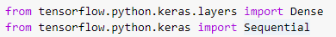
Importing Keras Libraries
From Keras, we import Dense and Sequential
Sequential is used to create the framework of the model itself
Dense is a fully connected layer type, where all neurons in one layer will form connections to all neuron in the next

Slide 46
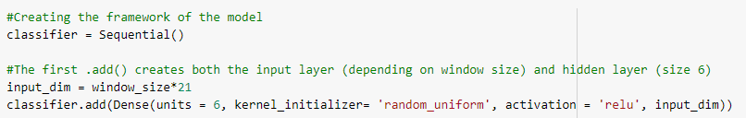
Creating the Model
The model framework of the model is created by calling the ‘Sequential()’ function
The first ‘.add()’ creates both the input layer and first hidden layer
Similar to the iris example, ReLu will be used as the activation function for the first hidden layer

Slide 47
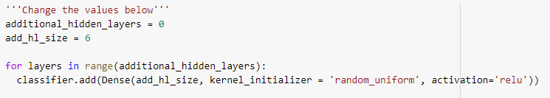
Adding More Layers
More layers can be added by simply calling the ‘.add()’ method more times on the classifier object
By placing this in a loop we can change the number and size of these additional hidden layers

Slide 48
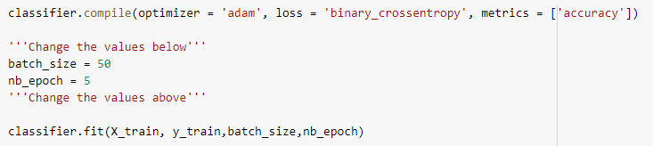
Training the Model
The ‘.compile()’ method is called to put all the layers together
The optimizer function is used to dynamically find optimal learning rates for each parameter
The ‘.fit()’ method will initiate training

Slide 49
Machine Learning Workflow
Define an ML problem and propose a solution
Construct your dataset
Transform your dataset & select features
Use the model to make predictions
Test and validate your model
Choose and train a model
Test on Testing Data Set

Slide 50
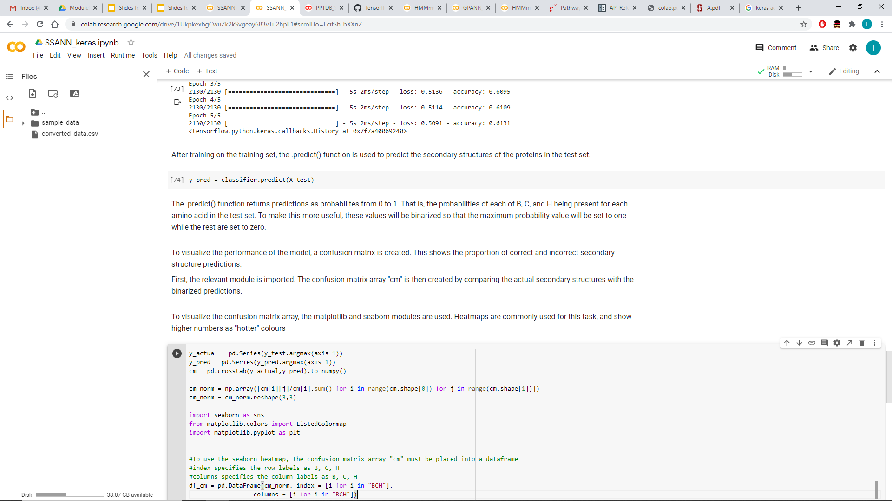
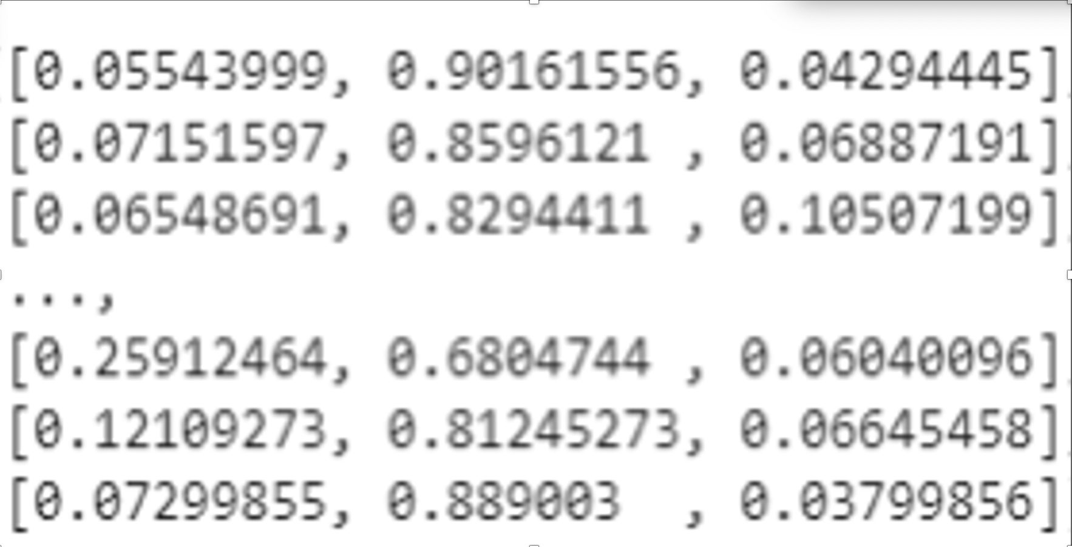
Testing the Model
The ‘.predict()’ method is called for the test set of inputs
The resulting array ‘y_pred’ contains the probabilities of B,C,H for each sample in the test set
90% probability that the structure associate with the first window is “C”

Slide 51
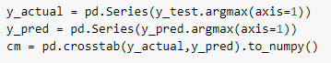
Decoding Predictions
To construct the confusion matrix, we find the maximum probability for each row of the prediction matrix
These are then compared to the true structures

Slide 52
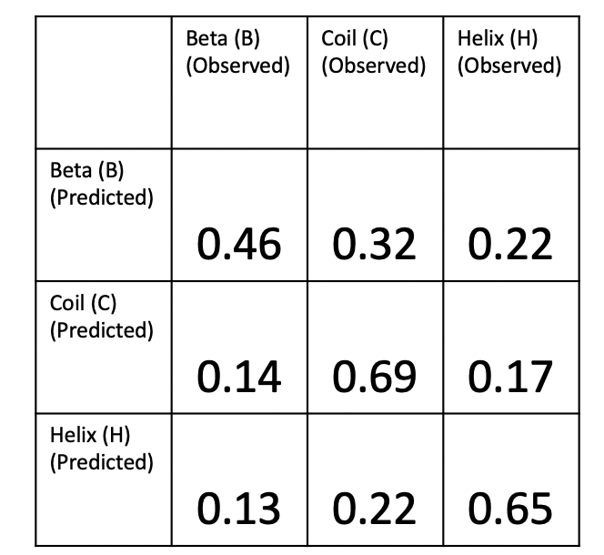
Pure Python SSANN
Confusion Matrix

Slide 53
Keras SSANN
Confusion Matrix
0.43
0.33
0.25
0.12
0.70
0.19
0.12
0.66

Slide 54
Program Statistics
Python SSANN with keras
Total number of lines: 270
Total number of coding lines: 240
Typical time to train and perform test run with program (total): 54 sec
Total number of lines: 179
Total number of coding lines 151
Typical time to train and perform test run with program (total): 9 sec
R SSANN with deepnet

Slide 55
Summary
We now have a neural network program for predicting secondary structure written as a mix of python and Keras functions
A similar program has also been written in R using Deepnet functions
Both have been thoroughly trained on a training set of 490 proteins and tested on a test set of 210
This is fairly generic code so you could use or adapt this code for many other kinds of prediction problems such as membrane spanning region prediction, signal site prediction, etc.
In the next section we will explore the code and run it on a few examples

Slide 56
Module 7.1 - Lab
Let’s Take a Look at the Program
SSANN_keras.ipynb

Slide 57
Open the Colab File in the Language of Your Choosing
The python script ‘SSANN_keras.ipynb’, covered during lecture, will be used for the Lab portion
However, you have the option of running the Lab in R
To do so, find the R code ‘SSANN_deepnet_R.ipynb’ in the R Code folder under Module 7
7

Slide 58

Open the Colab File in the Language of Your Choosing cont...
Right click on ‘SSANN_keras.ipynb’ (or alternatively SSANN_deepnet_R.ipynb in the R Code folder under Module 7) and select open with Google Colaboratory

Slide 59
Study the Program
Spend a few minutes studying the SSANN_keras.ipynb (or SSANN_deepnet_R.ipynb) program
See if you can understand the logic of the program
Ask questions of the TA’s if you are unclear about some of the functions or Python code
After studying the code, try running it

Slide 60
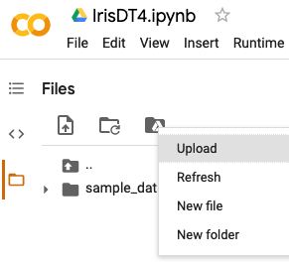
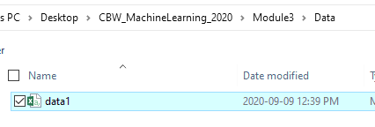
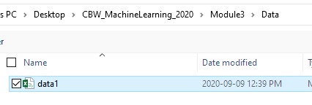

To Run: Upload the Data
Once the Colab file is open, click the folder icon to the right
When the panel opens, right click inside the panel and click upload
Then find the CBW-MachineLearning-2024 folder on your desktop
Open the Data folder followed by the Module 7 folder, then select the corresponding data file named ‘converted_data.csv’
7
8
converted_data

Slide 61
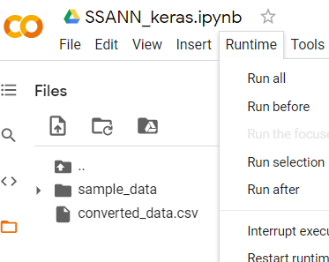
Run The Program
Select ‘Run all’ from the ‘Runtime’ menu

Slide 62
Exercise 7.1
Go to cell 16 and observe the confusion matrix. Are the results better than the numpy only implementation?
Go to cell 13 and change the additional hidden layers from 0 to 1. Select “Run after” from the “Runtime” menu
Repeat the tests for different hidden layer numbers and sizes. What is the best performance obtainable?
Compare your results with the confusion matrix generated from the original Numpy SSANN (see next slide for the performance)

Slide 63






Coffee Break & Networking Session
Workshop Sponsors

