Slide 1

bioinformatics.ca
bioinformaticsdotca.github.io

Slide 2
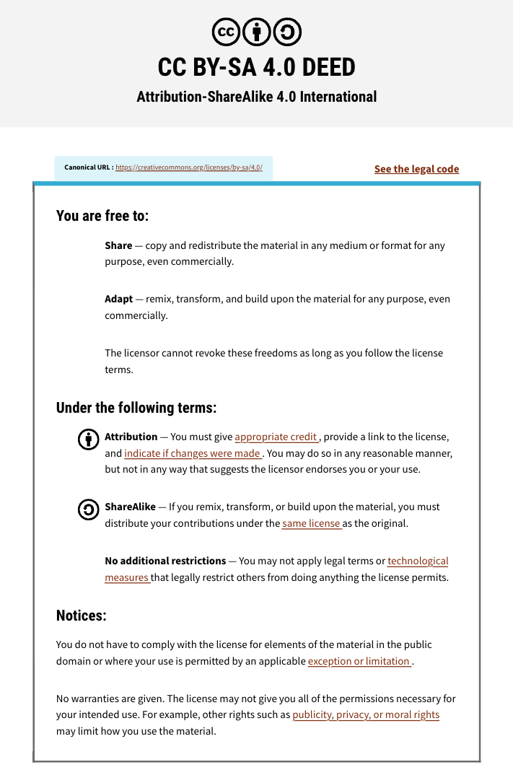

Slide 3

Module 8: LLMs and agentic coding for bioinformatics
Mark Berjanskii
Machine Learning
Apr 22-23, 2026
University of Alberta

Slide 4

Schedule (MT)
Day 1 (MT) | Wednesday Apr. 22 | Day 2 (MT) | Day 2
9:00 AM | Introductions and Technology Check | 9:00 AM | Module 5: Gene Finding with NNs (Lecture and Lab)
9:45 AM | Module 1: Introduction to Machine Learning (Lecture) | 11:00 AM | Break (30 min)
11:00 AM | Break (30 min) | 11:30 AM | Module 6: Machine Learning with Keras and Scikit-Learn (Lecture/Lab)
11:30 AM | Module 2: Decision Trees (Lecture and Lab) | 1:00 PM | Break (45 min)
1:00 PM | Break (1 hour) | 2:00 PM | Module 7: Machine Learning with Keras and Scikit-Learn (Cont'd)
2:00 PM | Module 3: Neural Networks (Lecture and Lab) | 3:00 PM | Break (30 min)
3:00 PM | Break (30 min) | 3:30 PM | Module 8: LLMs and agentic coding for bioinformatics
3:30 PM | Module 4: Neural Networks for 2º Structure (Lecture and Homework) | 4:45 PM | Survey and Closing Remarks
5:00 PM | End of Day 1 | 5:00 PM | End of Day 2
Canadian Bioinformatics Workshops | bioinformatics.ca

Slide 5
Schedule (PT)
Day 1 (PT) | Wednesday Apr. 22 | Day 2 (PT) | Thursday Apr. 23
8:00 AM | Introductions and Technology Check | 8:00 AM | Module 5: Gene Finding with NNs (Lecture and Lab)
8:45 AM | Module 1: Introduction to Machine Learning (Lecture) | 10:00 AM | Break (30 min)
10:00 AM | Break (30 min) | 10:30 AM | Module 6: Machine Learning with Keras and Scikit-Learn (Lecture/Lab)
10:30 AM | Module 2: Decision Trees (Lecture and Lab) | 12:00 PM | Break (45 min)
12:00 PM | Break (1 hour) | 1:00 PM | Module 7: Machine Learning with Keras and Scikit-Learn (Cont'd)
1:00 PM | Module 3: Neural Networks (Lecture and Lab) | 2:00 PM | Break (30 min)
2:00 PM | Break (30 min) | 2:30 PM | Module 8: LLMs and agentic coding for bioinformatics
2:30 PM | Module 4: Neural Networks for 2º Structure (Lecture and Homework) | 3:45 PM | Survey and Closing Remarks
4:00 PM | End of Day 1 | 4:00 PM | End of Day 2
Canadian Bioinformatics Workshops | bioinformatics.ca

Slide 6
Learning Objectives
To learn about LLMs and how ChatGPT and other chatbots work and what they can do
To learn about prompt engineering
To learn about other options to ChatGPT
To learn about how AI-assisted coding can be used to facilitate programming in bioinformatics
To learn how LLMs can be used in bioinformatics

Slide 7
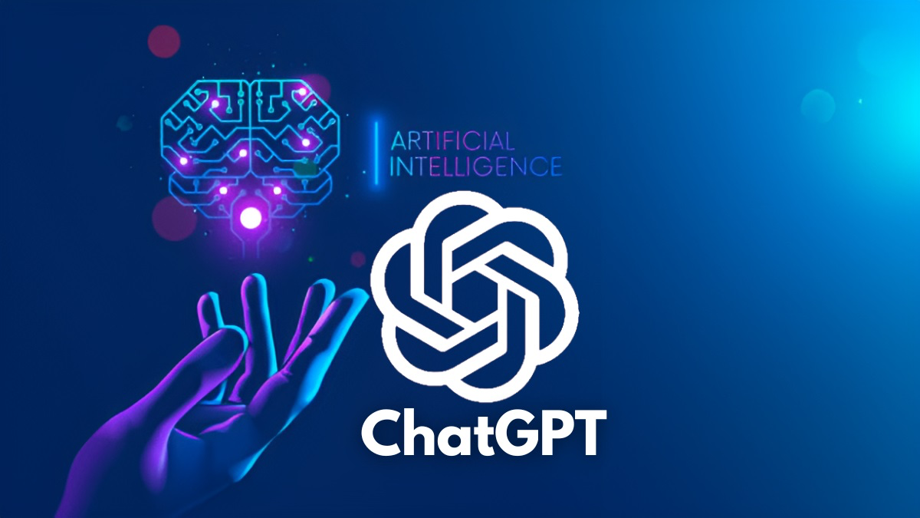
ChatGPT
ChatGPT was developed by OpenAI
OpenAI was started in 2015 as a not-for-profit AI foundation in San Francisco
Switched to for-profit model with $1 billion investment from MicroSoft

Slide 8
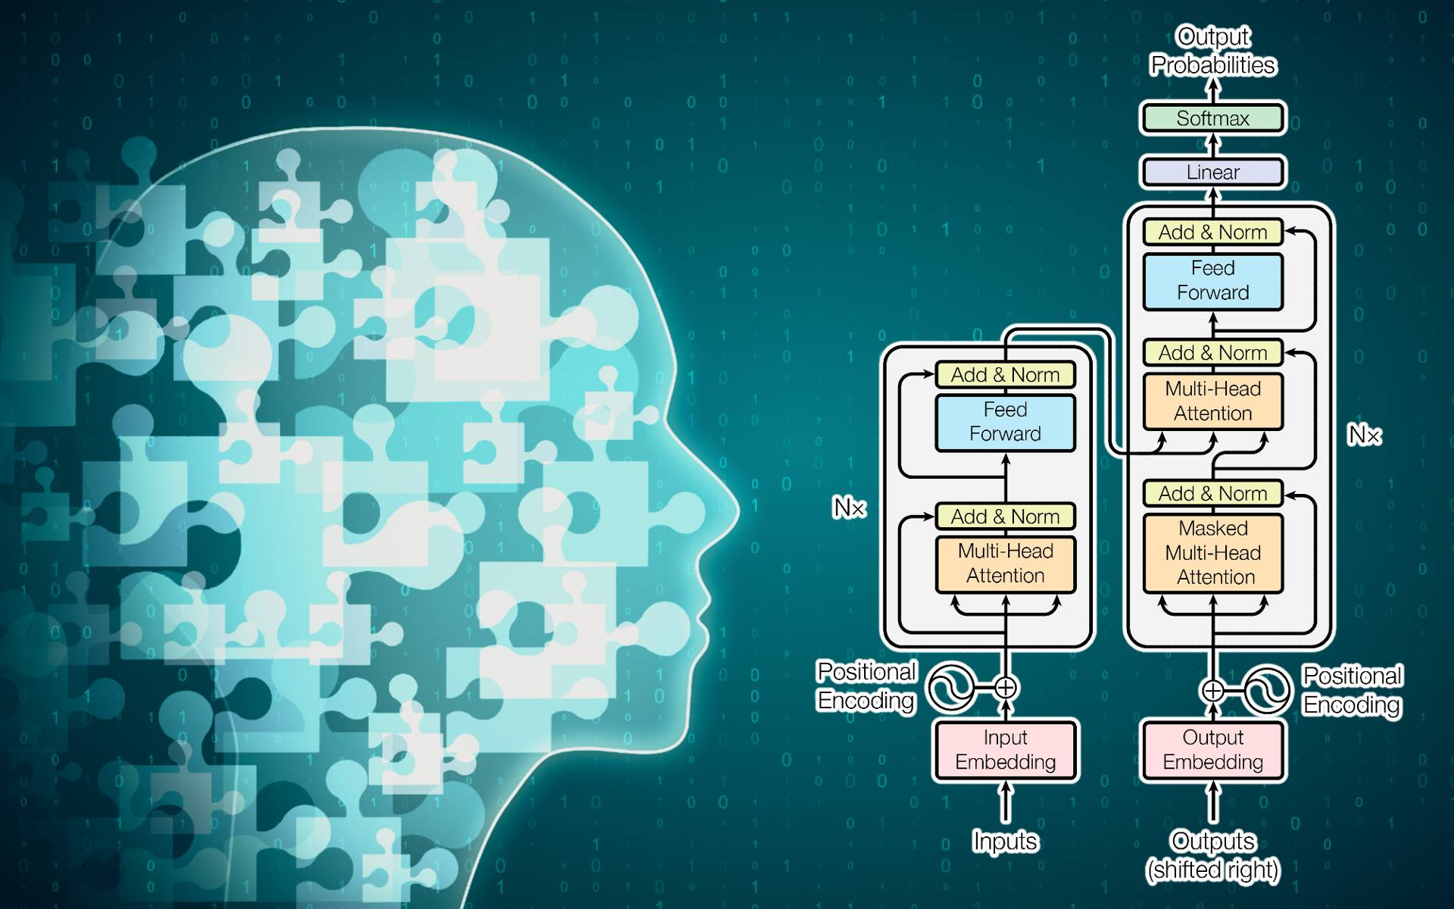
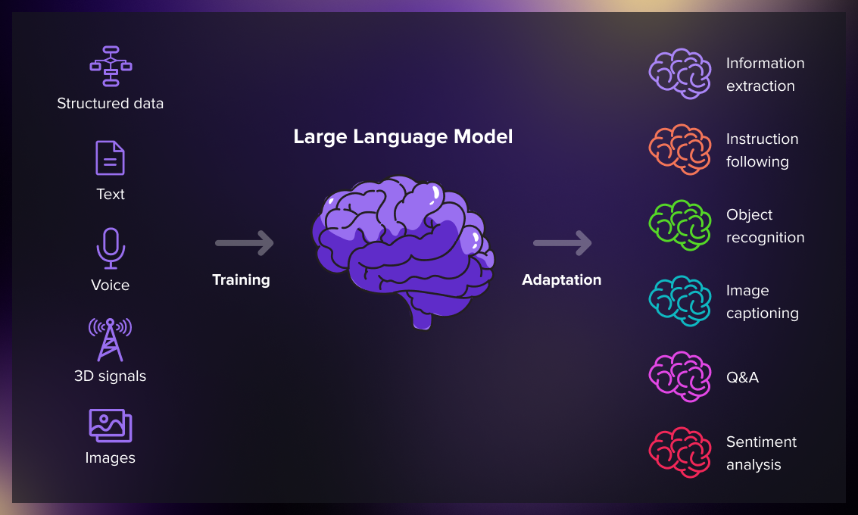
ChatGPT (by OpenAI)
Chat bot released by OpenAI on Nov. 30, 2022 (initially GPT-3.5 family)
Development cost, team size, and timeline have not been publicly disclosed by OpenAI
GPT = Generative Pre-trained Transformer — a distinct neural network architecture (not related to Graph Neural Networks)
Large Language Model (LLM) — training data size and composition have not been officially published
Predicts the next token (like advanced auto-suggest), but also uses instruction tuning and reinforcement learning from human feedback (RLHF)

Slide 9
ChatGPT history
Dec. 2015 – OpenAI founded; AI safety and language research begins
Feb. 2019 – GPT-2 announced; full 1.5B model released Nov. 2019
Jan. 2022 – InstructGPT published; fine-tuned via RLHF
Nov. 30, 2022 – ChatGPT launched (GPT-3.5)
Feb. 2023 – ChatGPT Plus ($20/mo); Microsoft Bing integration
Mar. 14, 2023 – GPT-4 released (Plus users)
May 2023 – iOS app launched; plugins introduced
Nov. 2023 – GPT-4 Turbo (128k context); GPT Store (Jan. 2024)
May 2024 – GPT-4o: natively multimodal (text, voice, vision)
Sept. 2024 – o1 reasoning model for complex tasks
Apr. 2025 – GPT-4.1 (1M token context); GPT-5 (Aug. 2025)

Slide 10
Large Language Models
An LLM is a Transformer-based language model that has billions of neural network parameters determined by training on vast amounts of text data (billions to trillions of words) drawn from large text corpora including web pages, books, code, and academic papers
Their size is enabled by AI accelerators (GPUs/TPUs), which enable the massive parallel computation required for training and inference
LLMs work by taking an input text and repeatedly predicting the next token or word
The computational cost of training a 12-billion-parameter LLM is ~72,300 A100-GPU-hours (illustrative; 12B parameters is now considered small-to-medium – frontier models cost orders of magnitude more; H100 GPUs are ~3× faster)

Slide 11
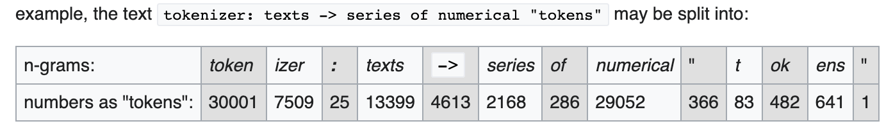
Large Language Models
LLMs use subword tokenization (e.g., Byte-Pair Encoding/BPE) to split text into tokens; text generation is the probabilistic step, not tokenization
The training data is split into the most frequent n-grams
These subword units are the tokens; each token is assigned a unique integer ID (token index) used by the model
The average size of a token is 4 letters
Generative pre-trained transformers (GPTs) learn the probabilities of these tokens through repeated training and optimization on the training data

Slide 12
Large Language Models
LLMs have to be fine tuned through user interaction and user “correction”
This is called “Reinforcement learning from human feedback” (RLHF)
Reinforcement learning is a branch of machine learning often used to help improve robot performance
OpenAI paid hundreds of people to manually correct and reinforce its responses over many months
One reason why OpenAI released ChatGPT was to get even more user feedback to improve its model
Self-instruction (by the chatbot itself) also helps bootstrap the quality of responses

Slide 13
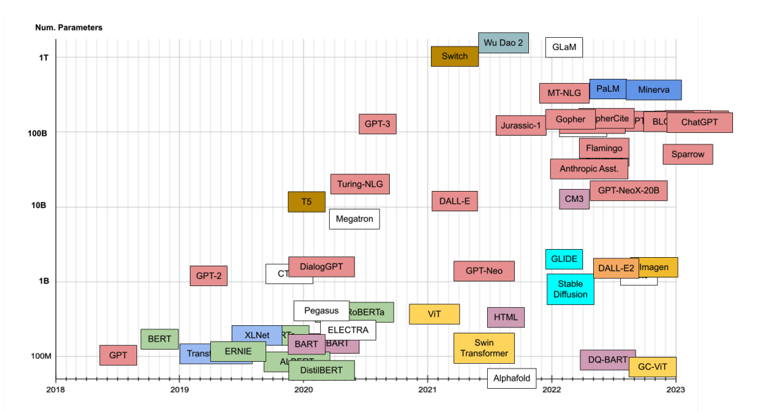
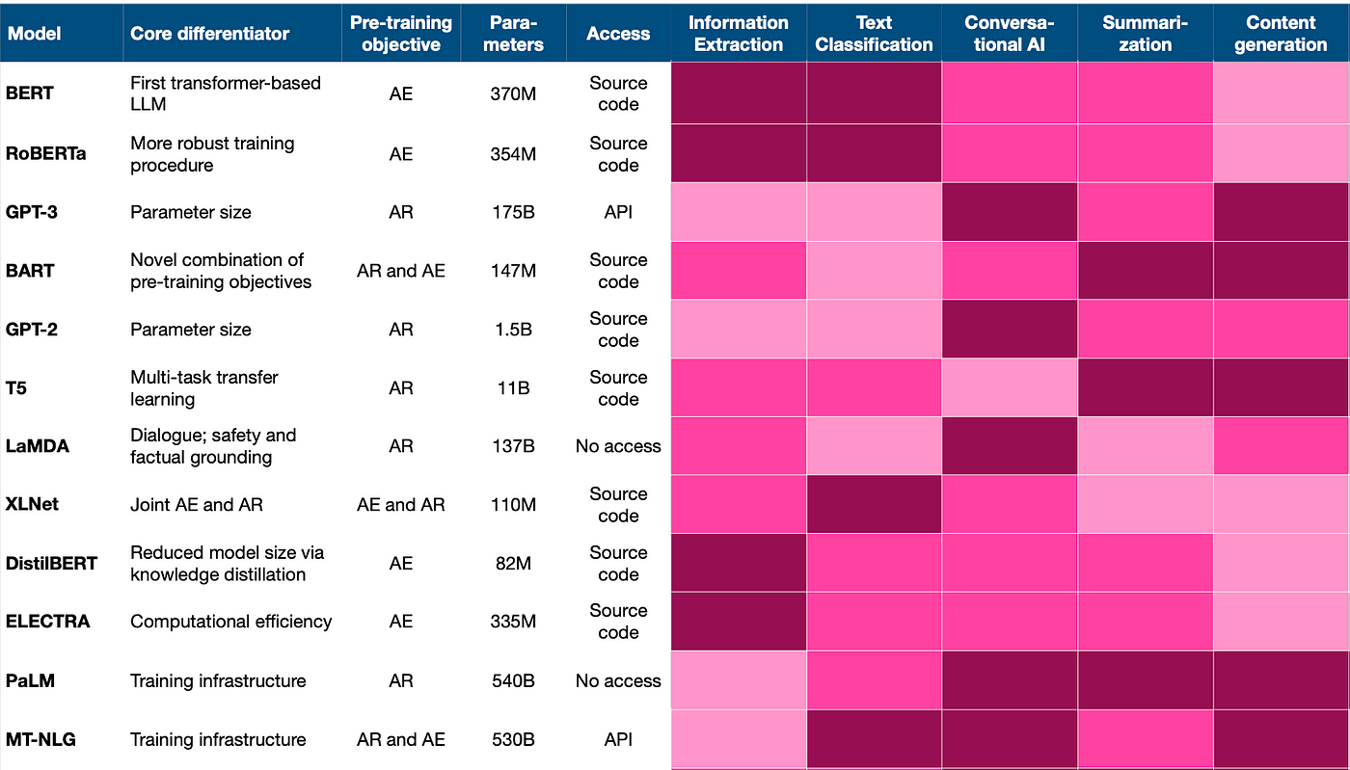
Large Language Models
Because of their extreme size, the largest LLMs are thought to acquire key knowledge about syntax, semantics, and “ontology” (the properties and relations between concepts and categories) that appear to be inherent in all language and written text

Slide 14
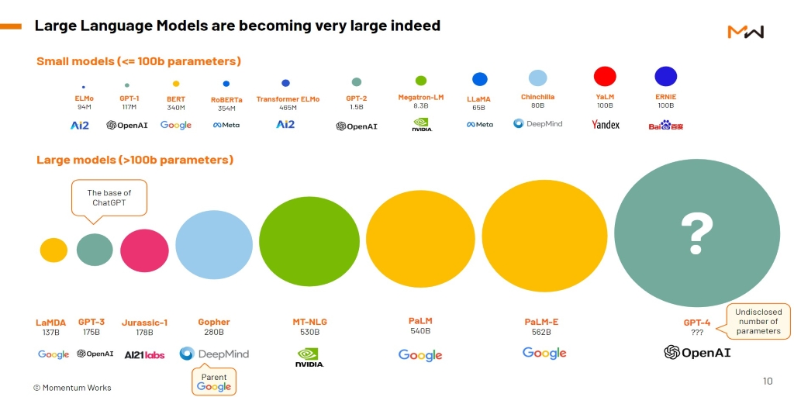
Size of LLMs

Slide 15
Sample ChatGPT Applications
Information extraction
Instruction following
Question answering
Topic summarization
Cover letter writing
Trip planning/itinerary
Providing professional advice (https://github.com/Troyanovsky/AI-Professional-Prompts/tree/main)
Grammar checking
Code debugging
Coding advice
Adding code comments
Menu planning
Recipe writing
Poetry/lyric writing
Essay writing
Story writing
Scientific paper writing

Slide 16
Sample ChatGPT Applications
Language translation
Web searching and information finding
Topic summarization
Role playing
Generating copy or ads for marketing efforts
Tutoring and mentoring
Brainstorming ideas
Performing virtual assist tasks
Image generation with DALL-E
Customer service (QA tasks)
Interpreting queries for music and art generators (DALL-E, Midjourney, MusicLM)
Writing jokes
Solving riddles and puzzles
Suggesting chords for lyrics
Gift recommendations
Table generation
Information classification
Product descriptions/keywords

Slide 17
Why the Hype?
GPT-4 got 1410/1600 on SAT (90th percentile)
GPT-4 passed the GRE (80-99th percentile)
GPT-4 scored in 99th percentile in US Biology Olympiad exam
GPT-4 easily passed all high school AP exams
GPT-4o achieved 91-94% accuracy on USMLE Steps 1, 2 & 3 (vs. ~66-72% for GPT-3.5)
o1 (2024) performs at PhD-level in physics, biology & chemistry; o3 scored 87.5% on ARC-AGI general intelligence benchmark (previous models: <30%)
GPT-5 (2025) scored 94.6% on AIME math olympiad and 84.2% on MMMU multimodal understanding

Slide 18
ChatGPT Limitations
Has a tendency to “hallucinate” (i.e., generates non-sensical or false statements
Fails at simple, open-ended questions
Has a training data (knowledge) cutoff – the model has no awareness of events after its training ended (GPT-5.2 cutoff: August 2025); responses on recent events may be outdated or absent
Can reflect and amplify biases present in its training data (gender, race, cultural, political)

Slide 19
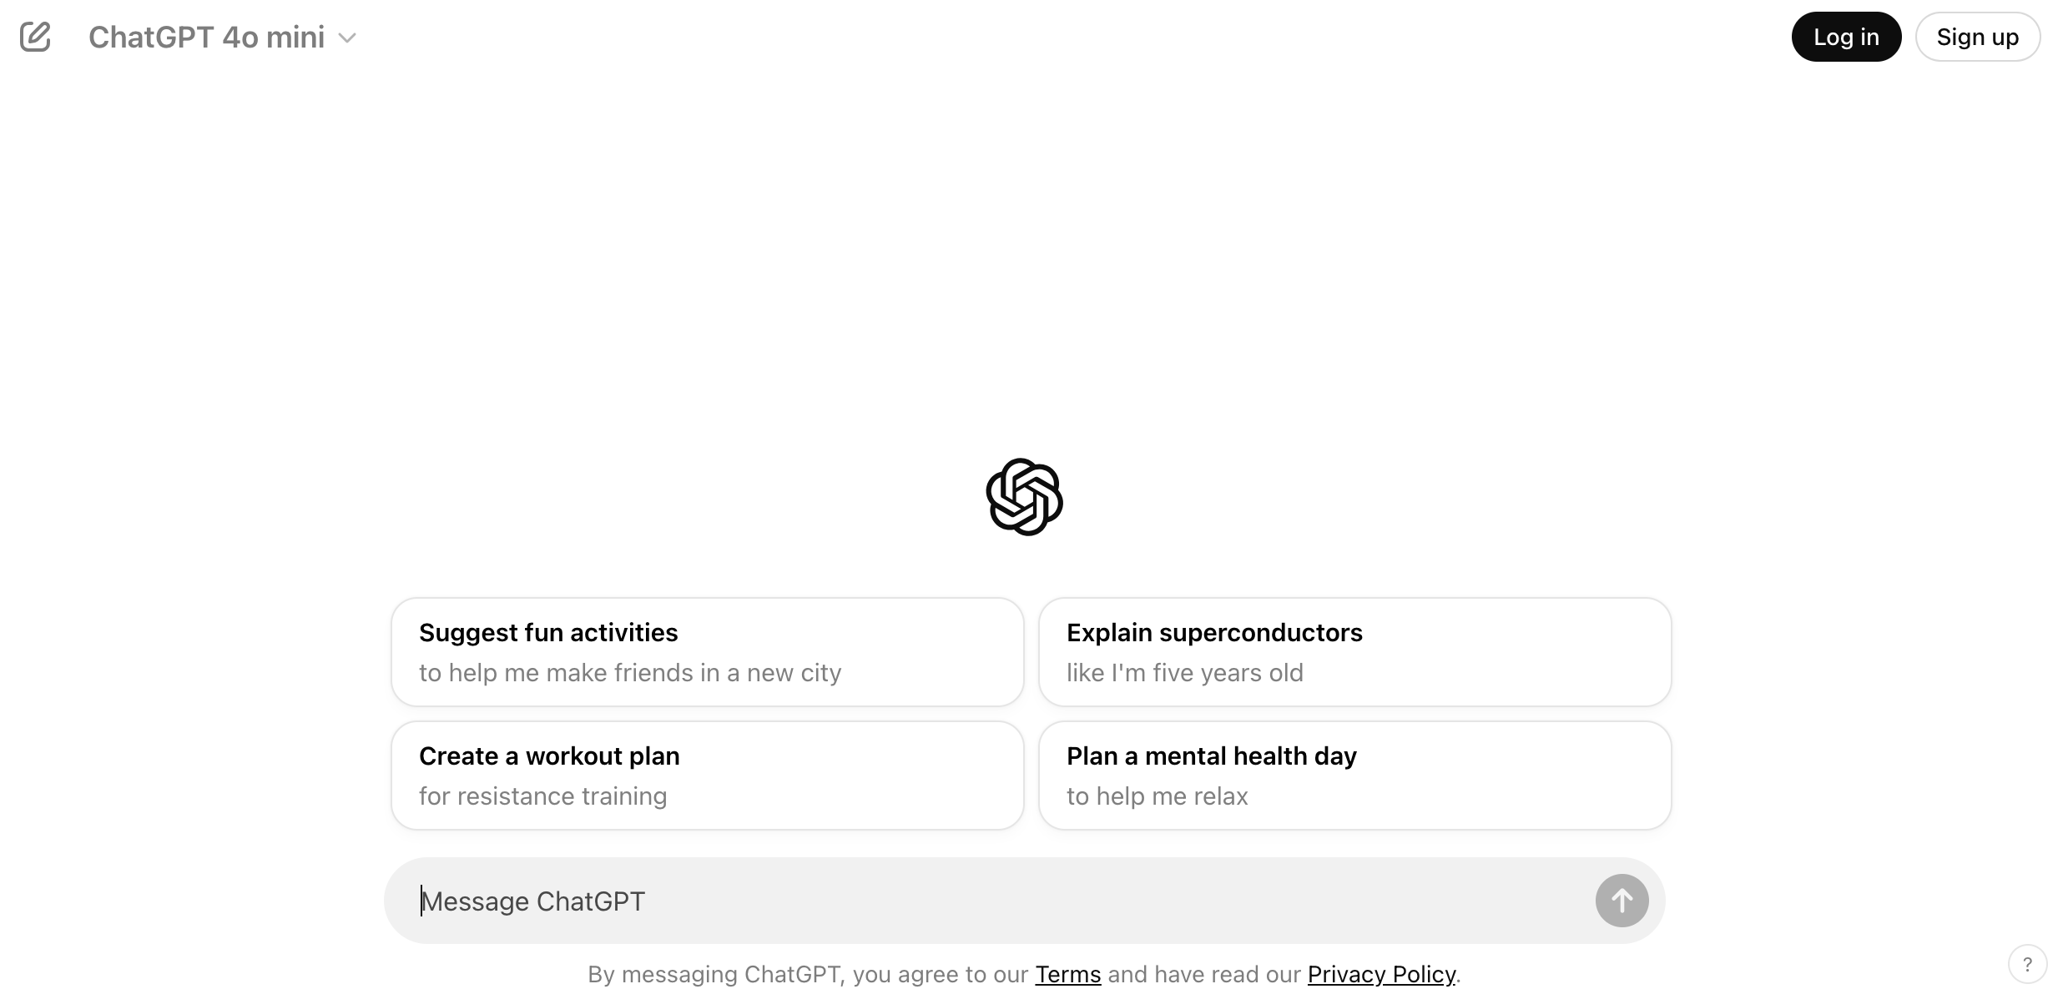
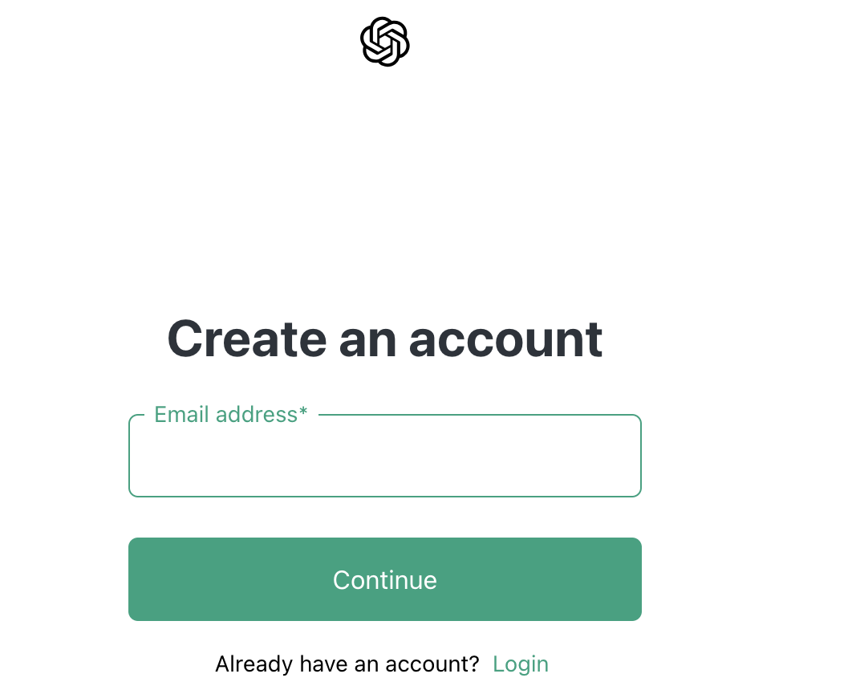
Using ChatGPT
Go to https://chatgpt.com

Slide 20
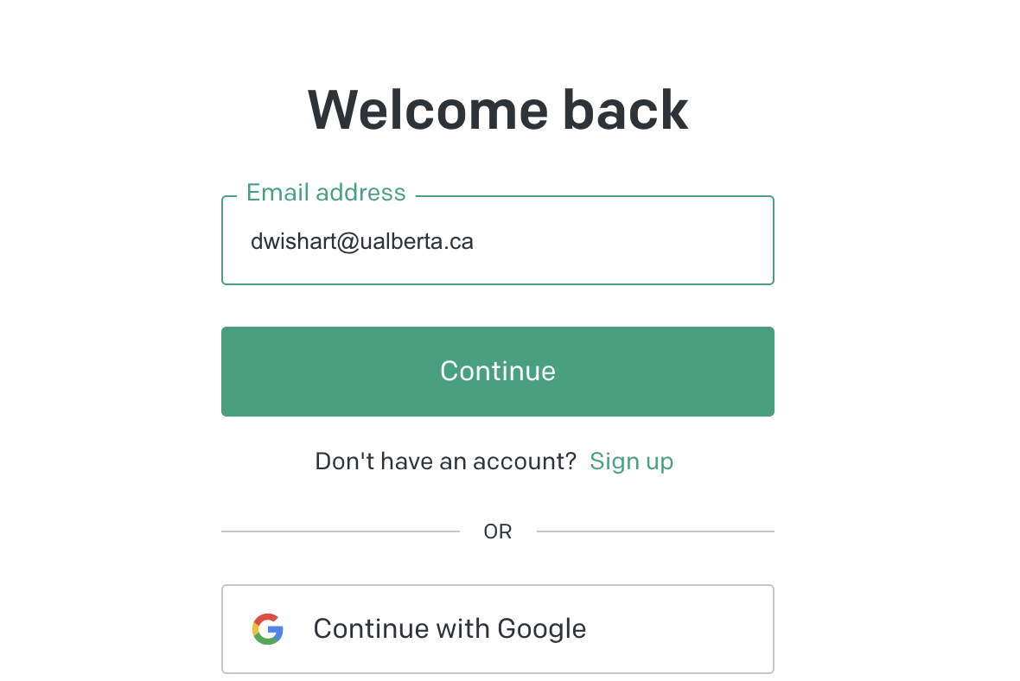
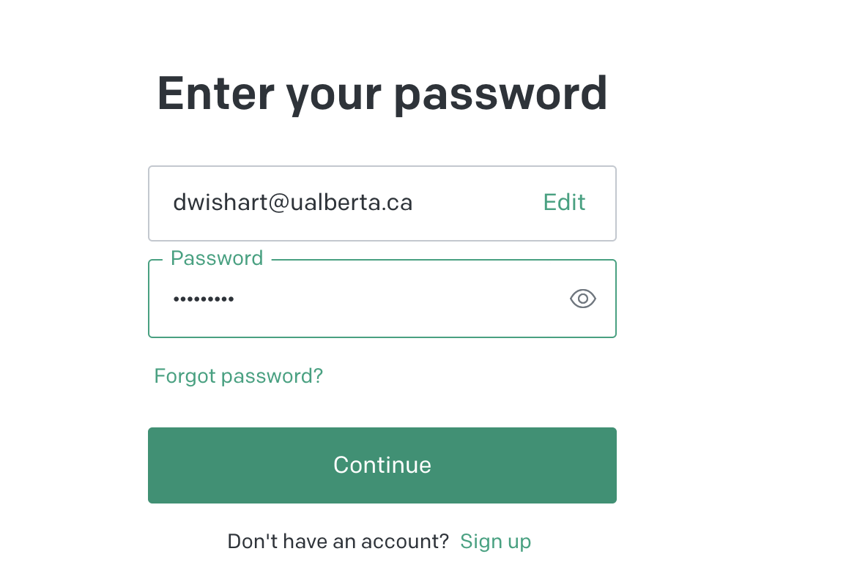
Using ChatGPT

Slide 21
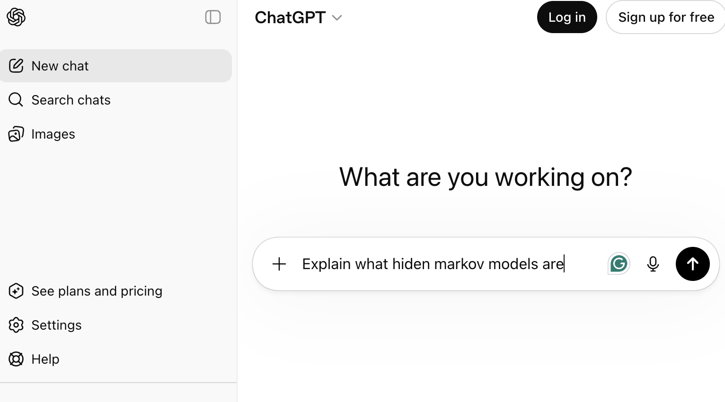
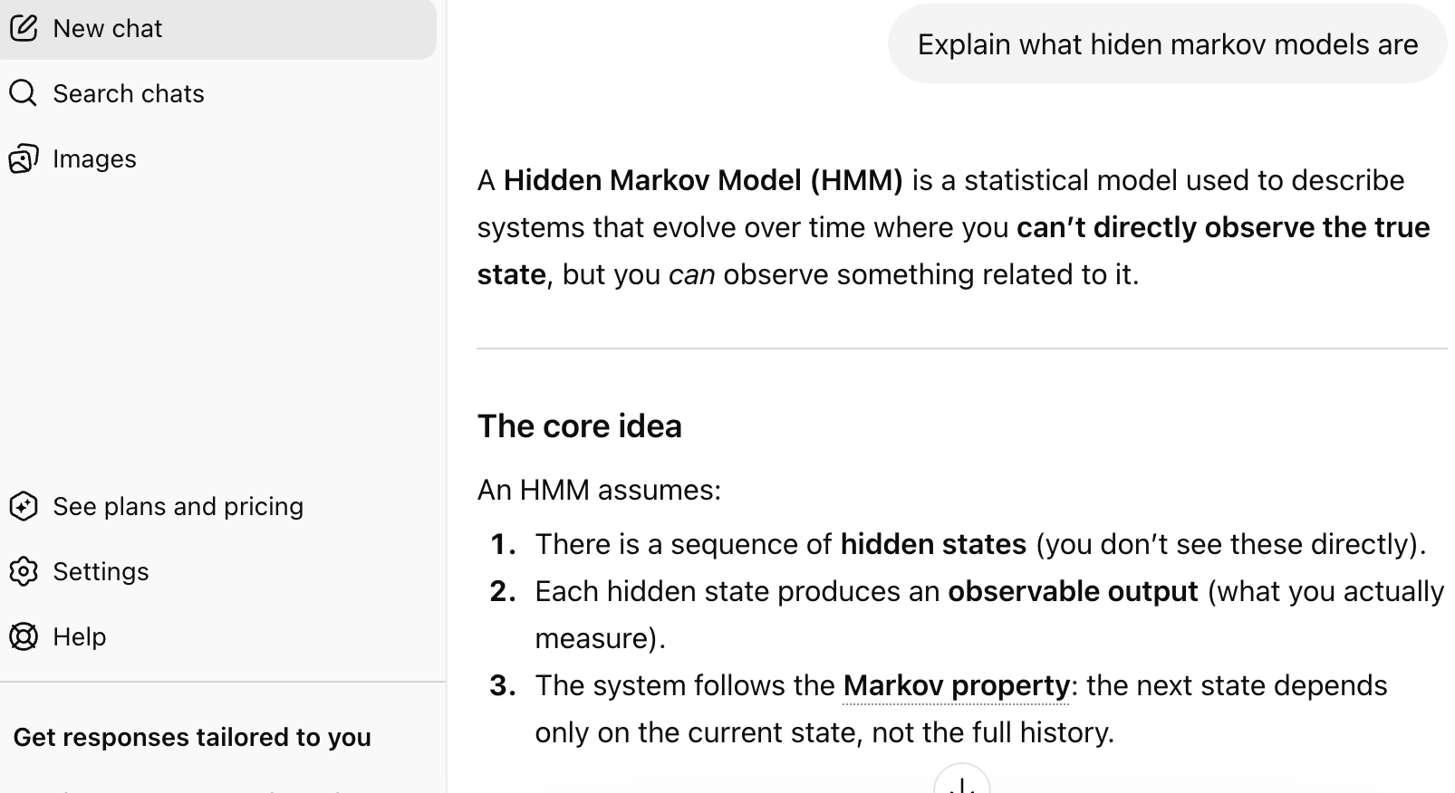
Using ChatGPT

Slide 22
Accessing ChatGPT-Plus and the ChatGPT API
ChatGPT Plus provides users with access to current models (GPT-4o, GPT-5, and others). It also makes it easier for users to interact and retrieve information via ChatGPT
The ChatGPT Plus subscription covers usage on chatgpt.com and costs $20/month (USD)
ChatGPT Plus provides higher usage limits and access to advanced models. Note: GPT-4o is now available on the free tier (with limits); Plus unlocks higher limits and access to newer models such as GPT-5
The ChatGPT app is available for iOS and Android, but it's only available in specific countries & regions

Slide 23
Accessing the ChatGPT API
The ChatGPT API allows developers to integrate ChatGPT into their applications, products, or services
This means users can implement ChatGPT functionality in their own applications, enabling users to have conversational interactions with ChatGPT as a customized chatbot
Developers can access the ChatGPT API through OpenAI's platform - https://platform.openai.com
Users need to sign up for an API key and follow the documentation to integrate it into their specific application

Slide 24
Accessing ChatGPT-Plus and the ChatGPT API
The ChatGPT API and ChatGPT Plus subscriptions are billed separately
The API has its own pricing where the costs vary based on the ChatGPT model and the number of tokens used
Tokens can be thought of as pieces of words (about 4 characters long) for English text, approximately 1,000 tokens equate to about 750 words
Example current rates (2026): GPT-4o input ~$0.0025 per 1,000 tokens ($2.50/M); output ~$0.010 per 1,000 tokens ($10/M). Note: GPT-3.5 Turbo has been deprecated

Slide 25
Accessing ChatGPT-Plus and the ChatGPT API
Pricing varies by model; newer models like GPT-5 cost more but offer substantially improved capabilities. GPT-4.1 API: ~$0.002/1K input, $0.008/1K output (2026 rates – verify at platform.openai.com/pricing)
Fine-tuning is now available for multiple OpenAI models including GPT-4o-mini, GPT-3.5 Turbo, and others
Fine-tuning costs vary by model
Fine-tuning is the most expensive task compared with inference with a pre-existing ChatGPT model

Slide 26
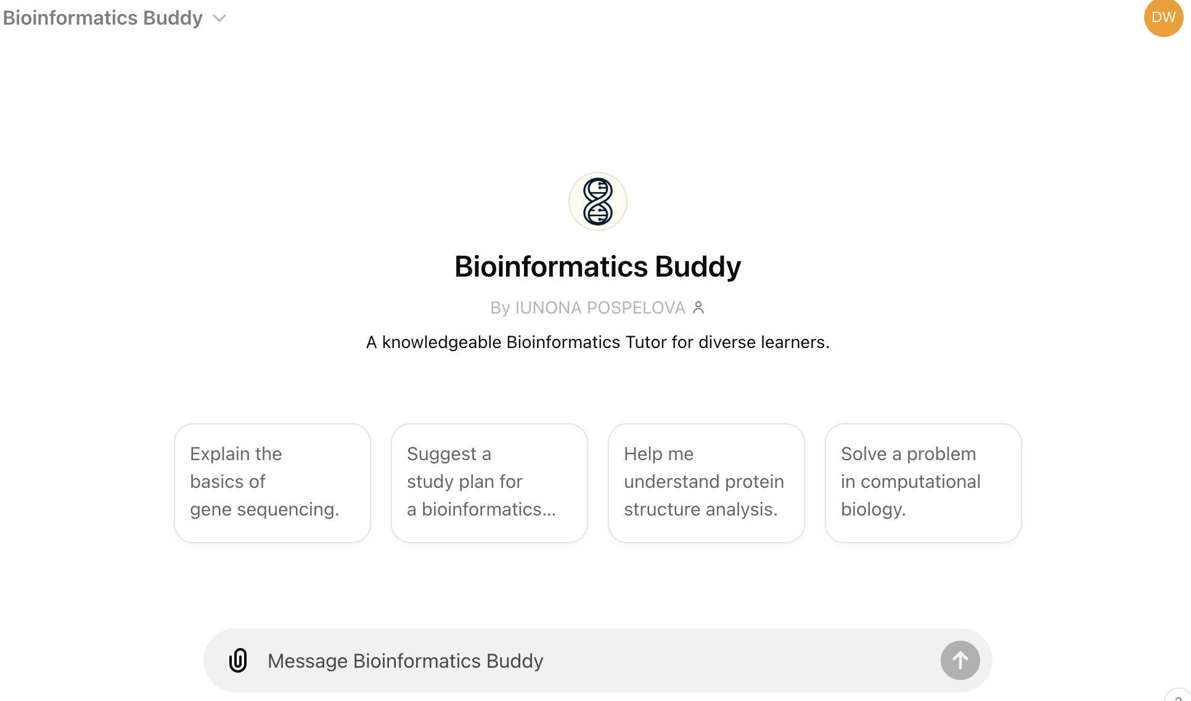
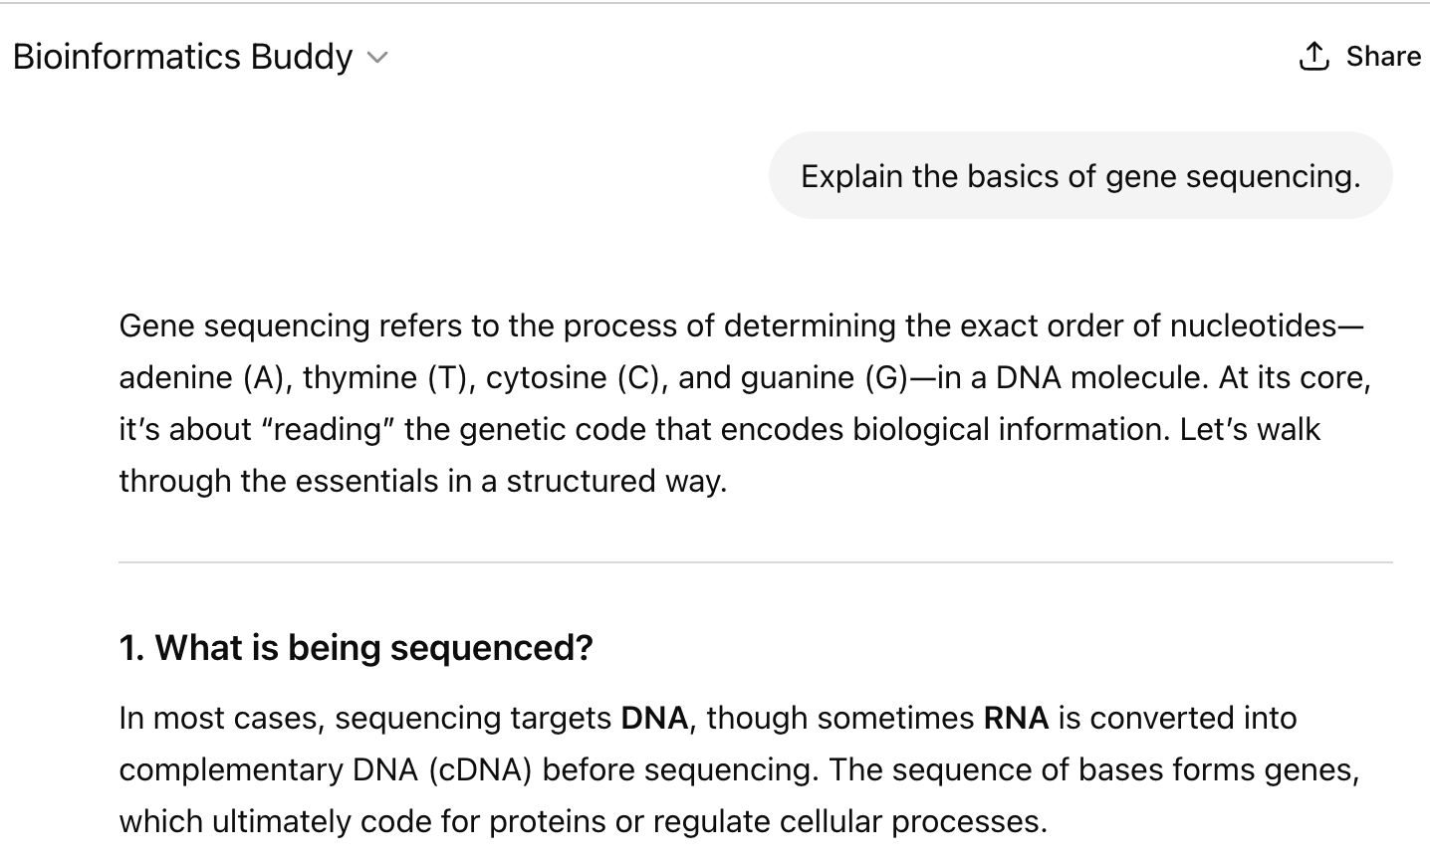
Specialized ChatGPTs
Bioinformatics Buddy is a specialized version of ChatGPT designed to provide detailed and advanced information on bioinformatics and related scientific fields

Slide 27
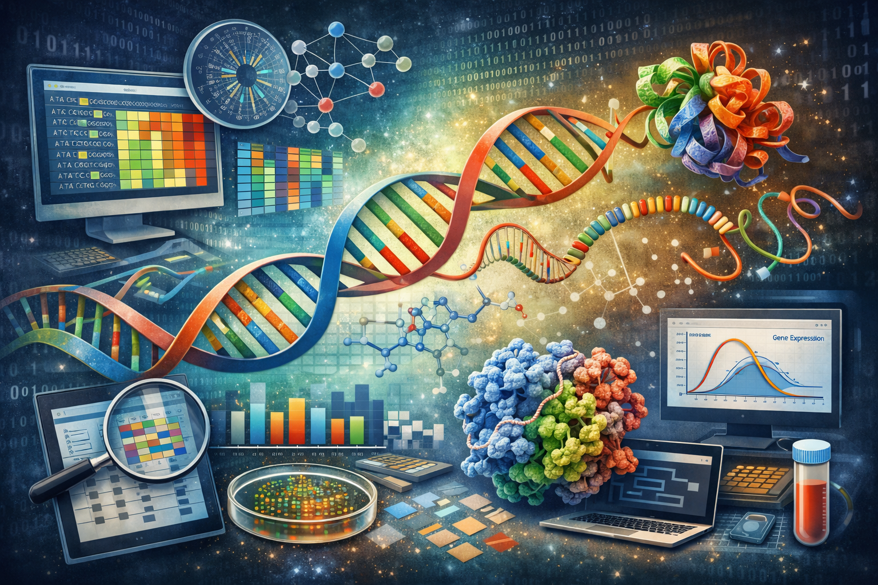
Image Generation with ChatGPT
(multimodal gpt-4o)
Bioinformatics by ChatGPT

Slide 28
Maximizing Return on ChatGPT or any LLM
Design your requests or queries so that they are specific and well-crafted
Prompt engineering - the process of designing and refining input prompts to optimize responses from AI models, enhancing their accuracy, relevance, and utility for specific tasks or queries – a form of zero-shot learning

Slide 29
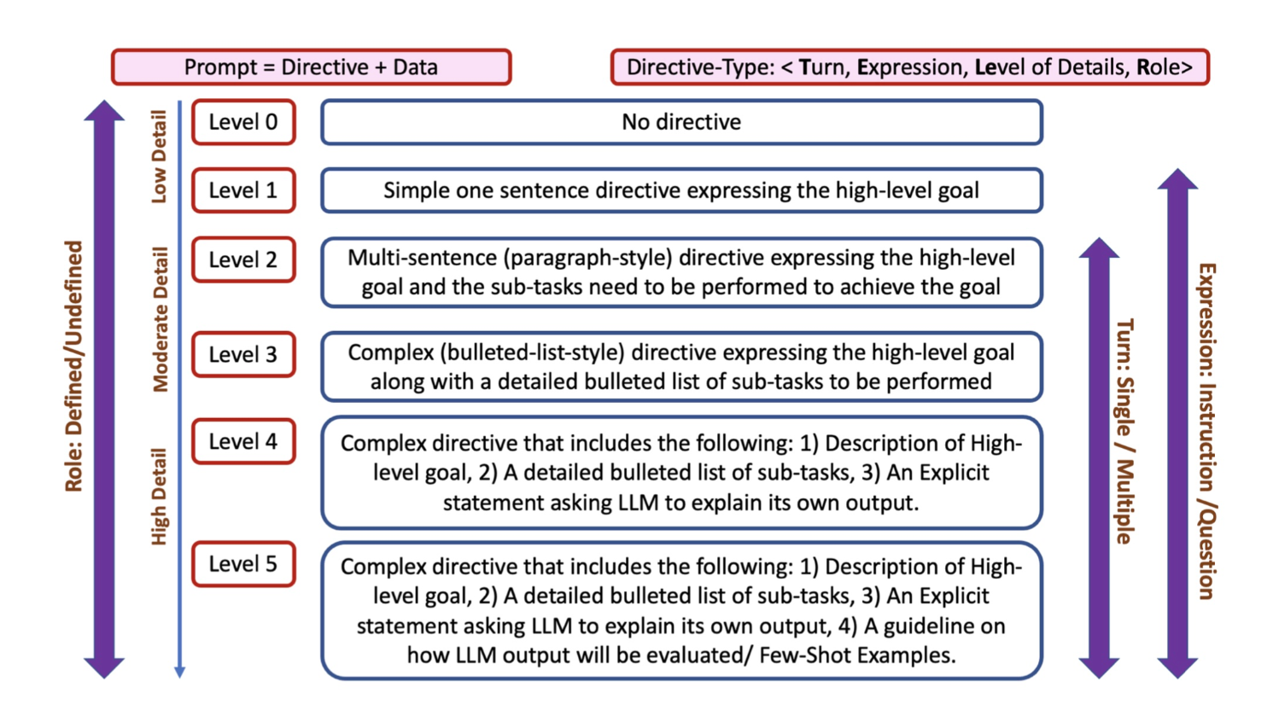
Prompt Engineering

Slide 30
Prompt Engineering
Level 0: "Explain gene prediction.”
Level 1: "Explain the process of gene prediction in bioinformatics, including the types of algorithms used.”
Level 2: "Describe the computational algorithms used in gene prediction, such as Hidden Markov Models and Neural Networks, and explain how they identify coding regions in genomic sequences."

Slide 31
Prompt Engineering
Level 3: "In the context of prokaryotic gene prediction, compare rule-based methods and machine learning-based methods, and discuss their effectiveness in identifying genes in bacterial genomes.”
Level 4: "For a bioinformatics researcher working on bacterial genomes, what are the current challenges and advancements in gene prediction techniques, and how do machine learning models like CNNs and RNNs address these issues?"

Slide 32
Exercise
Go to ChatGPT (or your favorite Chatbot) and try each of these 5 prompts and see what kind of answers you get
Check things out with different Chatbots (see next section) and see which ones give you the best results

Slide 33






ChatGPT Alternatives
Claude
Perplexity
Microsoft copilot
ChatSonic

Slide 34
ChatGPT Alternatives
Chatsonic – Uses multiple LLMs (including GPT-4o and others); knowledge graphs, provides citations, accesses the internet, can use audio, built-in image generator,limited to 25 generations/day, not open source
Gemini (Google) – Free (depending on account), uses knowledge graphs to access Google ecosystem, very fast, very context aware, offers citations; Gemini 2.0/2.5 Pro (2025) adds advanced reasoning and coding capabilities, requires google account, not open source

Slide 35
ChatGPT Alternatives
Perplexity – Perplexity generates answers using sources from the web and cites links within the text response. Works on a freemium model; the free product uses the company’s LLM, while the paid version Perplexity Pro has access to GPT-4o, Claude 3.7 Sonnet, Mistral Large, Llama 4 and other current models, not open source

Slide 36
ChatGPT Alternatives
Claude 4 (Anthropic) – Uses different LLM technology, writes complex code, performs text extraction, fast, widely available globally, not open source
Microsoft Copilot– free (basic tier), performs web queries, multimodal answers, powered by GPT-4o and other Microsoft-integrated models, provides citations, fast and accurate, not open source

Slide 37
AI-Powered Tools for Coding
Exploring how AI-powered tools assist developers with code generation, debugging, and optimization
Notes:
Overview of AI in Software Development, Popular AI Coding Assistants, Benefits and Challenges of AI-Based Coding

Slide 38
Types of AI-assisted coding
Autocomplete — Predicts the next token, line, or block as you type. ~1–3 keystrokes trigger a ghost-text suggestion; Tab or Enter accepts. (e.g., GitHub Copilot, Colab Gemini inline completions)
In-Editor Prompt (Inline Chat) — Natural-language prompt issued inside the editor on a selection. Typical: 1–3 turns to refine. (e.g., Copilot Inline Chat, Cursor Cmd+K, Colab Gemini cell generation)
Chat Prompting — Sidebar or panel conversation with full codebase context. Typical: 3–10 turns per task. (e.g., Copilot Chat, Cursor Chat, Colab Gemini side panel)
Agentic Coding — AI autonomously plans, writes, runs, and iterates across multi-step tasks. Typical: 5–20+ turns as it self-corrects. (e.g., Claude Code, Copilot Workspace, Colab Gemini notebook agent)

Slide 39
Types of AI-coding assistants
Code Editor Extensions: AI plugins installed in code editors such as VS Code adding autocomplete, inline chat, and agentic features. (e.g., GitHub Copilot, KiloCode, Cline, RooCode, etc)
Terminal-Based: AI assistants running in the command line, orchestrating code edits and tests across the entire project. (e.g., Claude Code, Codex CLI, Gemini CLI, OpenCode, Freebuff, AMP, etc)
Standalone Programs: Full desktop applications with AI built in from the ground up. (e.g., Claude Desktop. Codex app, Zed, VSCode forks: Cursor 1 and 2, Windsurf, Antigravity, etc.)
Web-Based — Browser-accessible environments with (e.g., ChatGPT, Google Colab, Replit, GitHub Codespaces, Firebase Studio, Codex via ChatGPT, Jules, Claude on the web , etc)

Slide 40
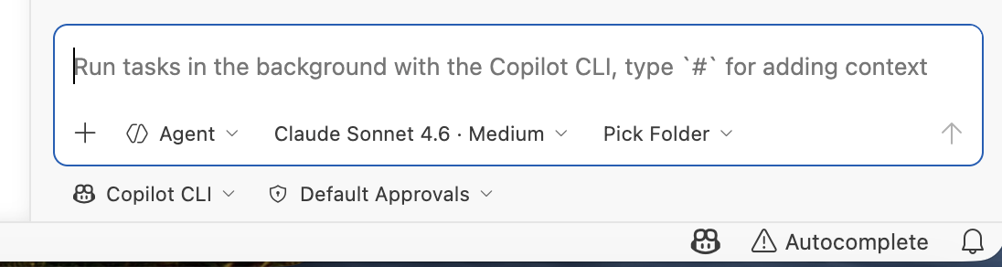




Coding Assistants: VSCode Extensions
GitHub Copilot — Microsoft/GitHub's flagship AI pair programmer. Autocomplete, inline chat, and Copilot Chat sidebar powered by OpenAI models.
KiloCode — Open-source VS Code extension for agentic coding. Supports multiple AI backends; can autonomously edit files, run terminal commands, and browse the web.
Cline — Agentic AI assistant that works directly in VS Code. Uses any LLM API to read/write files, execute commands, and iterate on multi-step coding tasks.
RooCode — Community fork of Cline with enhanced model routing, custom modes, and extended tool support for VS Code agentic workflows.
KiloCode
Cline
RooCode
GitHub Copilot

Slide 41
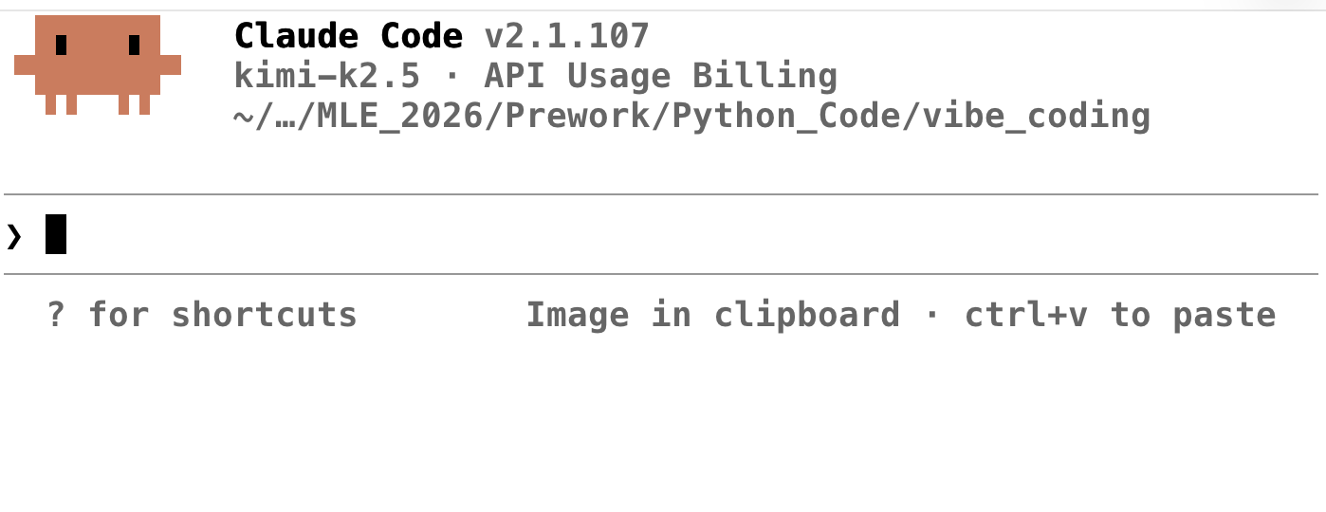
Coding Assistants: Terminal-Based
Claude Code — Anthropic's agentic CLI. Reads, writes, runs code autonomously across your entire project; integrates with git and shell.
Codex CLI — OpenAI's open-source terminal agent. Runs in a sandboxed environment; executes shell commands and edits files guided by natural language.
Gemini CLI — Google's terminal AI agent. Long-context reasoning over large codebases; free tier with generous Gemini 2.5 Pro quota

Slide 42
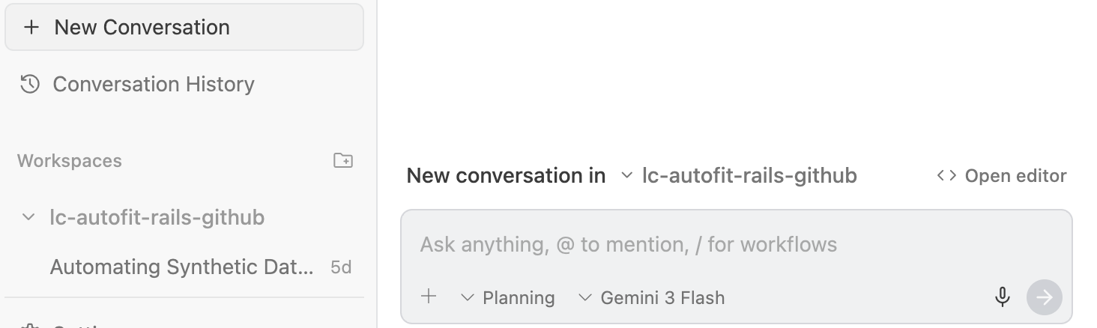
Standalone Programs: AI-Native Desktop Apps
Claude Desktop — Anthropic's standalone AI app with deep tool use, file access
Codex App — OpenAI's desktop coding agent with agentic task execution
Cursor, Windsurf, Google Antigravity — VSCode forks rebuilt around AI pair programming, with inline edits, chat, and agentic code generation.
Agentic interface of Google Antigravity

Slide 43
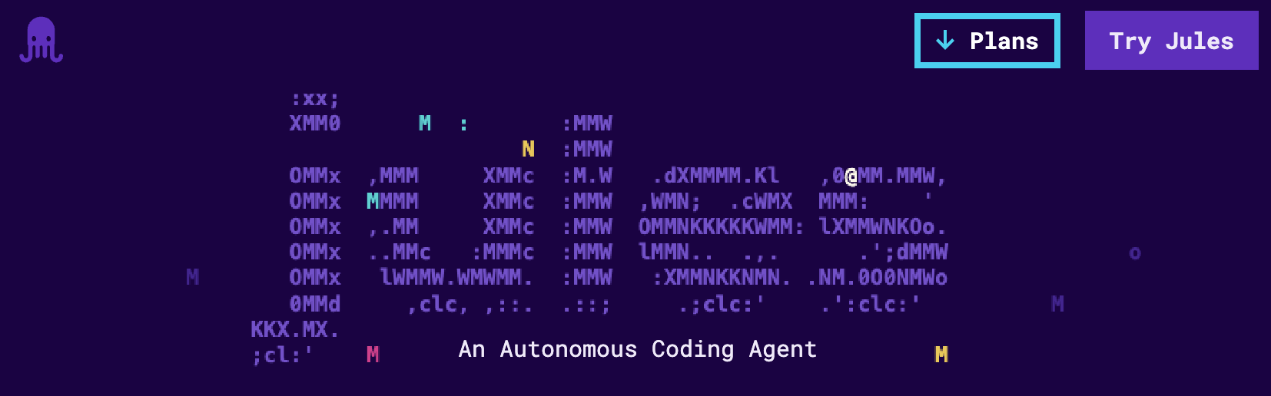
Web-Based: Browser-Accessible AI Environments
Codex and Claude on the web— OpenAI's web chat and agentic coding assistant, accessible from any browser.
Google Colab, Firebase Studio, Jules — Google's browser-based notebooks and AI-powered app development environment.
Replit & GitHub Codespaces — Cloud-hosted coding environments with AI assistance, run and deployed entirely in the browser.

Slide 44
Coding with ChatGPT
Using ChatGPT to do Work

Slide 45
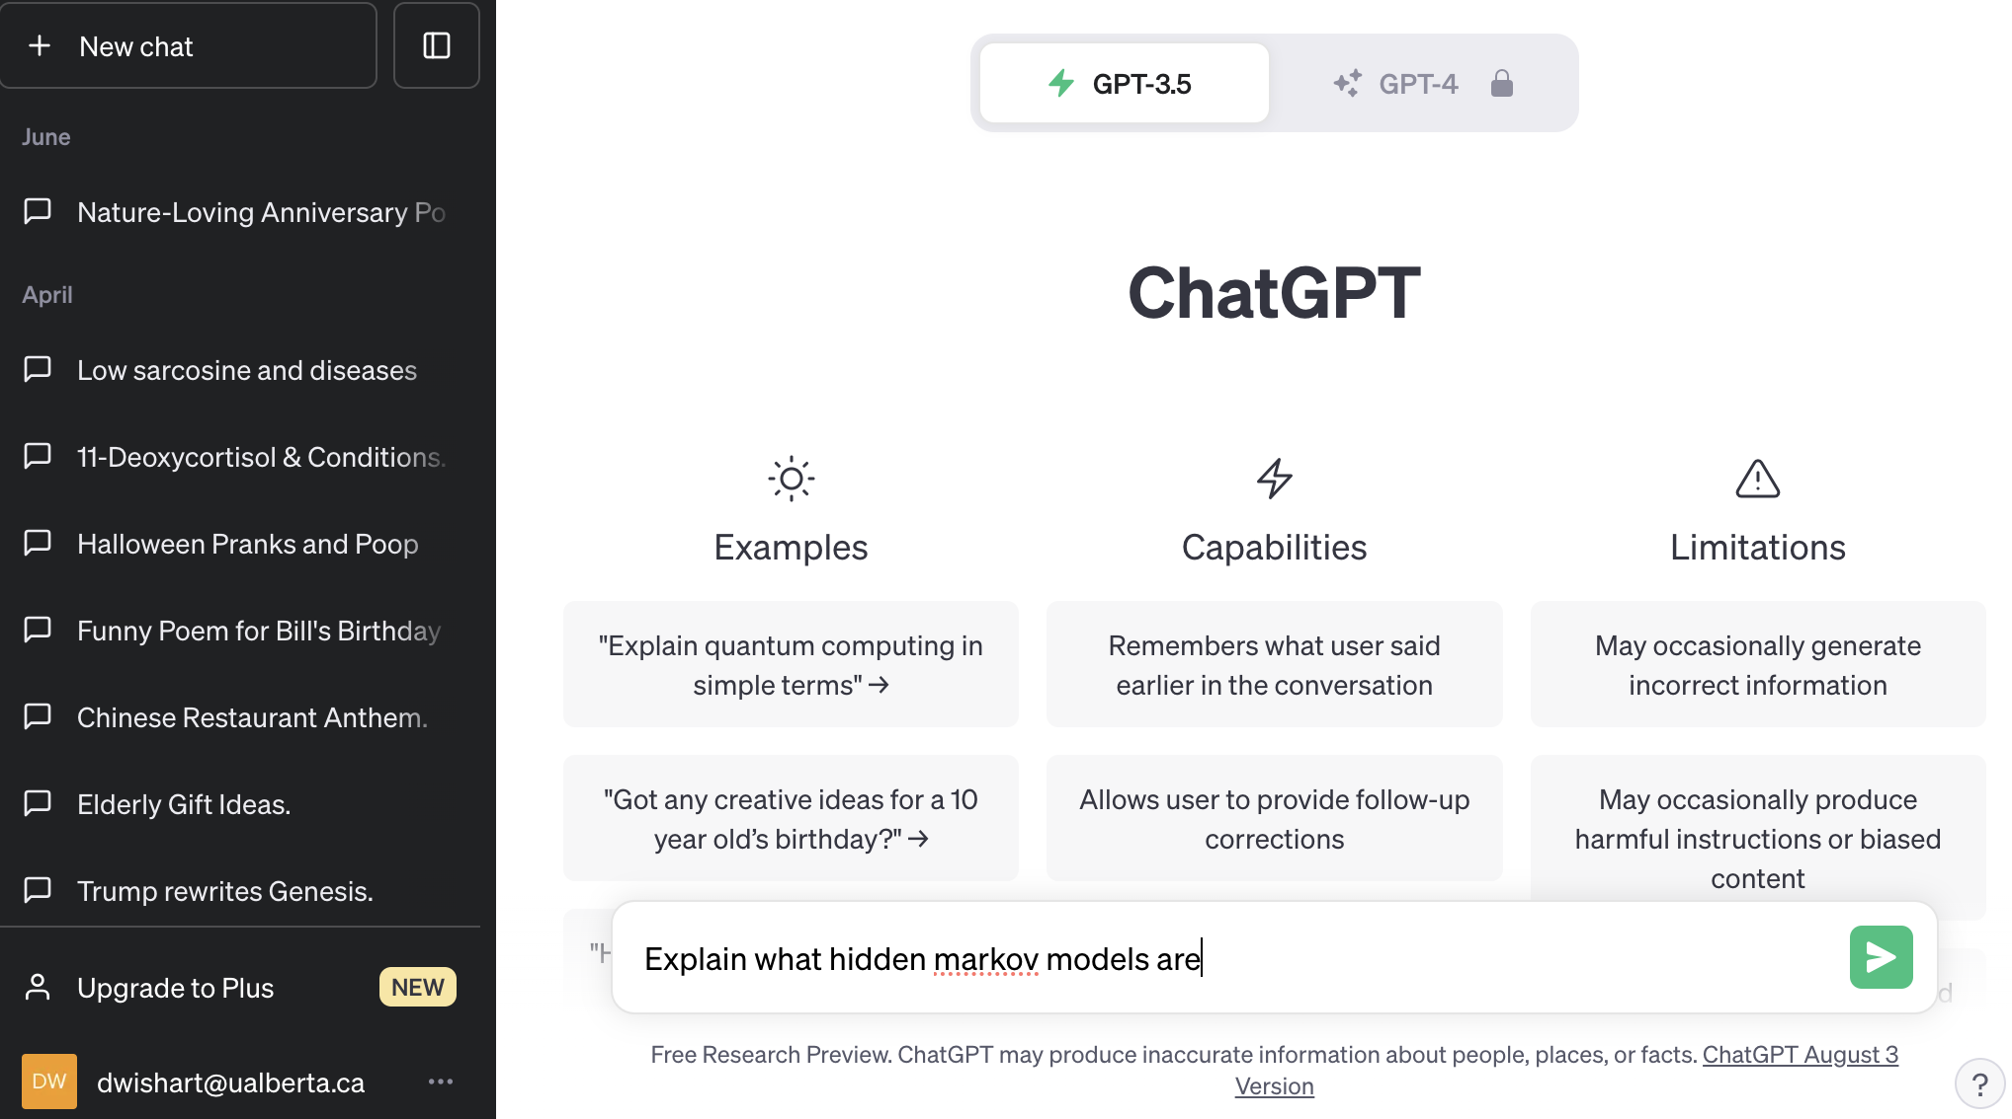
Coding With ChatGPT
Click Here
Type Here
To submit any Query either click on “New Chat” or Type instructions in the query box.

Slide 46
Coding With ChatGPT – Example 1
Click Here
Write a python program for translating DNA

Slide 47
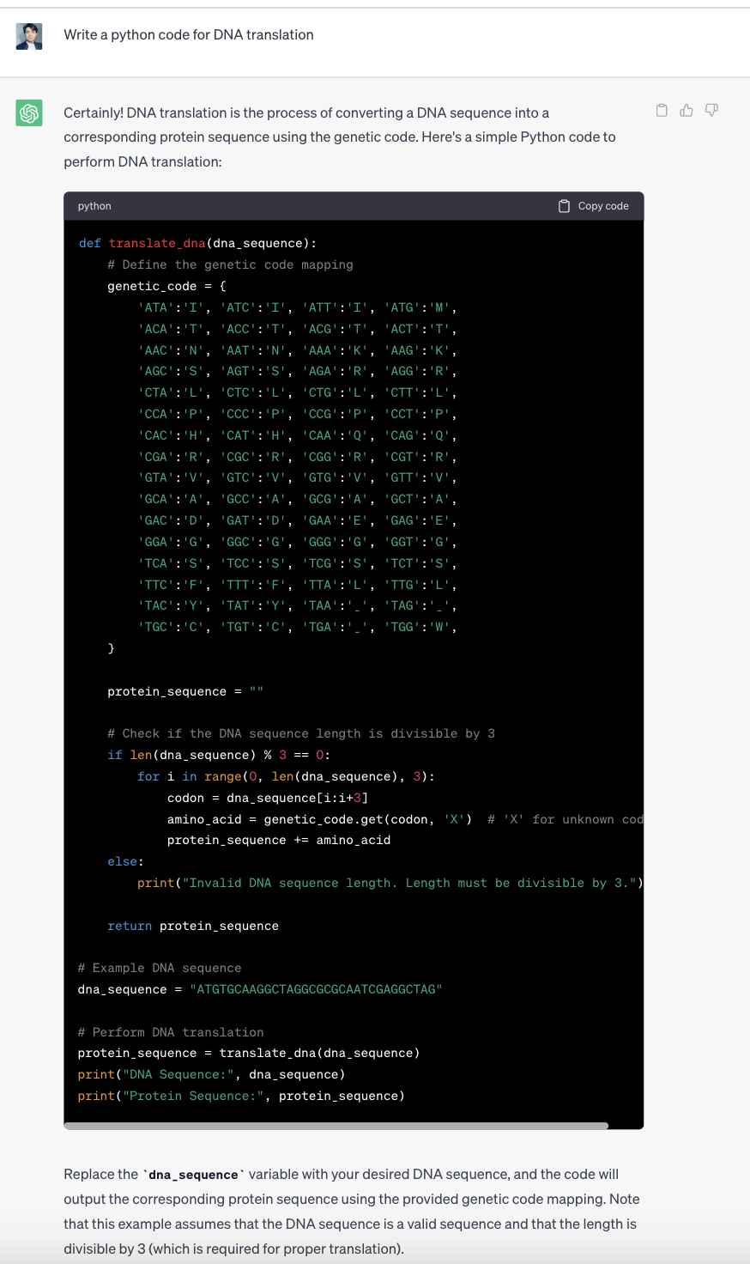
The Result

Slide 48
Check The Code
The code generated by ChatGPT looks good, but does it work?
Let’s test the code in Google Colab
Open a Colab window and paste the code into the window

Slide 49
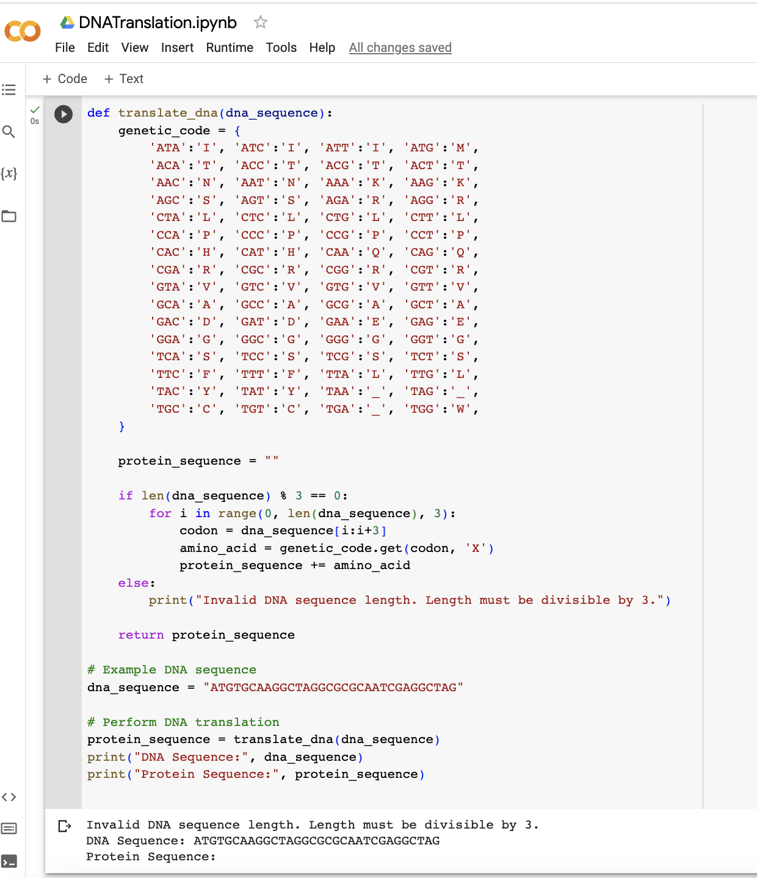
Running on Google Colab
ERROR MESSAGE

Slide 50
Check the Code
The code actually generates an error: See the error message
ChatGPT generated codes are good but are not always perfect
Often users need to optimize the code to get real results
Let’s do some code optimization by debugging the program

Slide 51
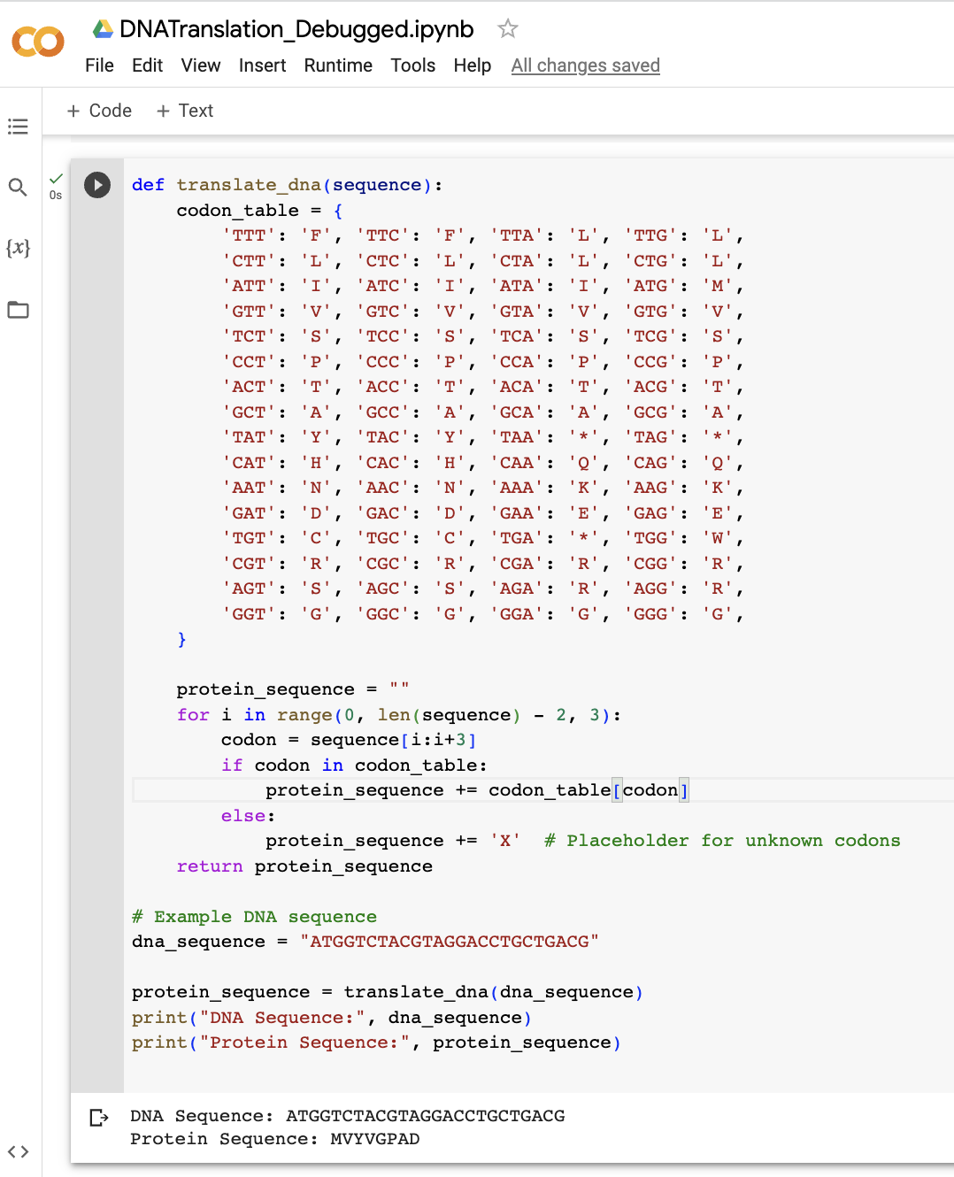
Change the
Function around
CORRECT RESULT

Slide 52
Coding With ChatGPT – Example 2
Click Here
Write a python program to find ORFs in DNA sequence

Slide 53
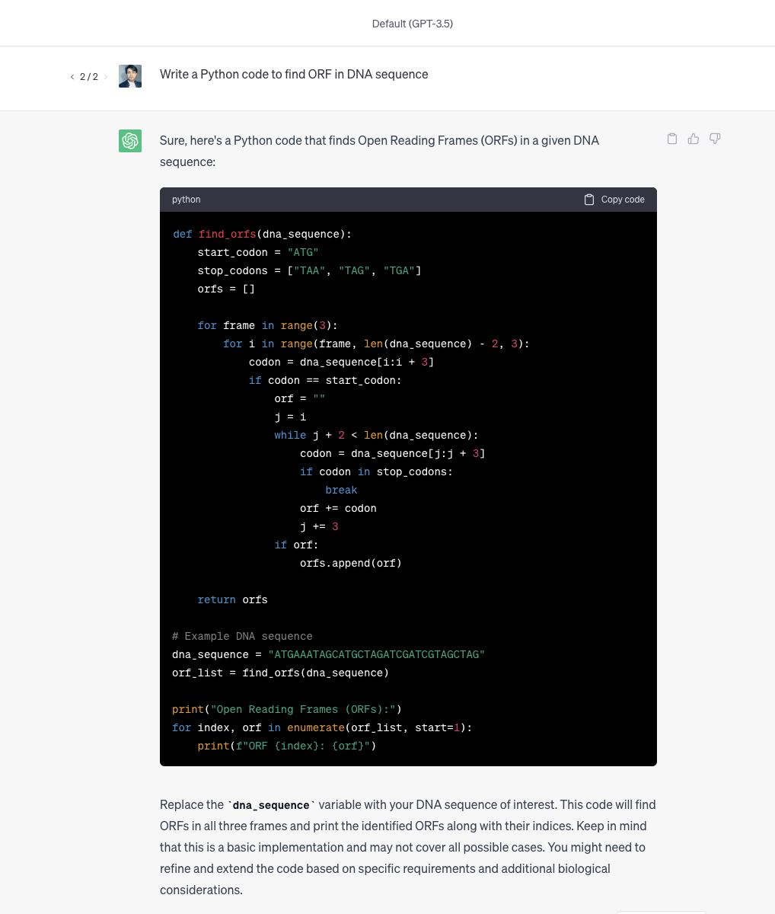
The Result

Slide 54
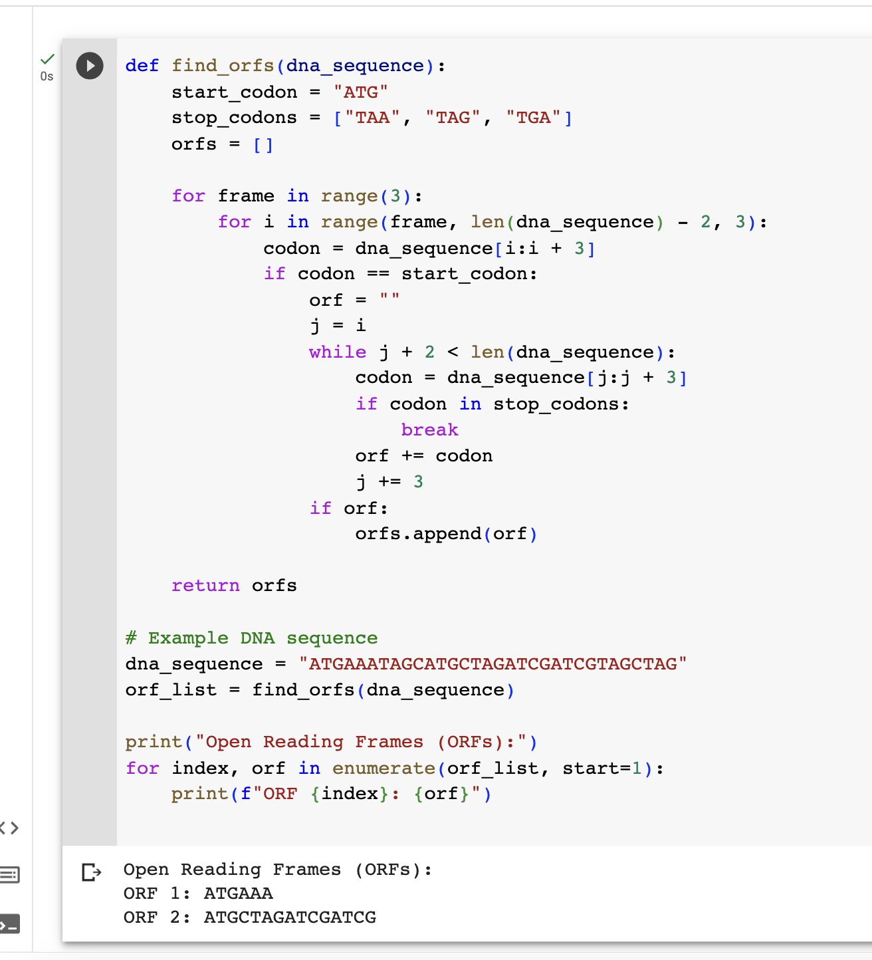
Checking on Google Colab
Accurate Results

Slide 55
Using Gemini Inline in Google Colab

Slide 56
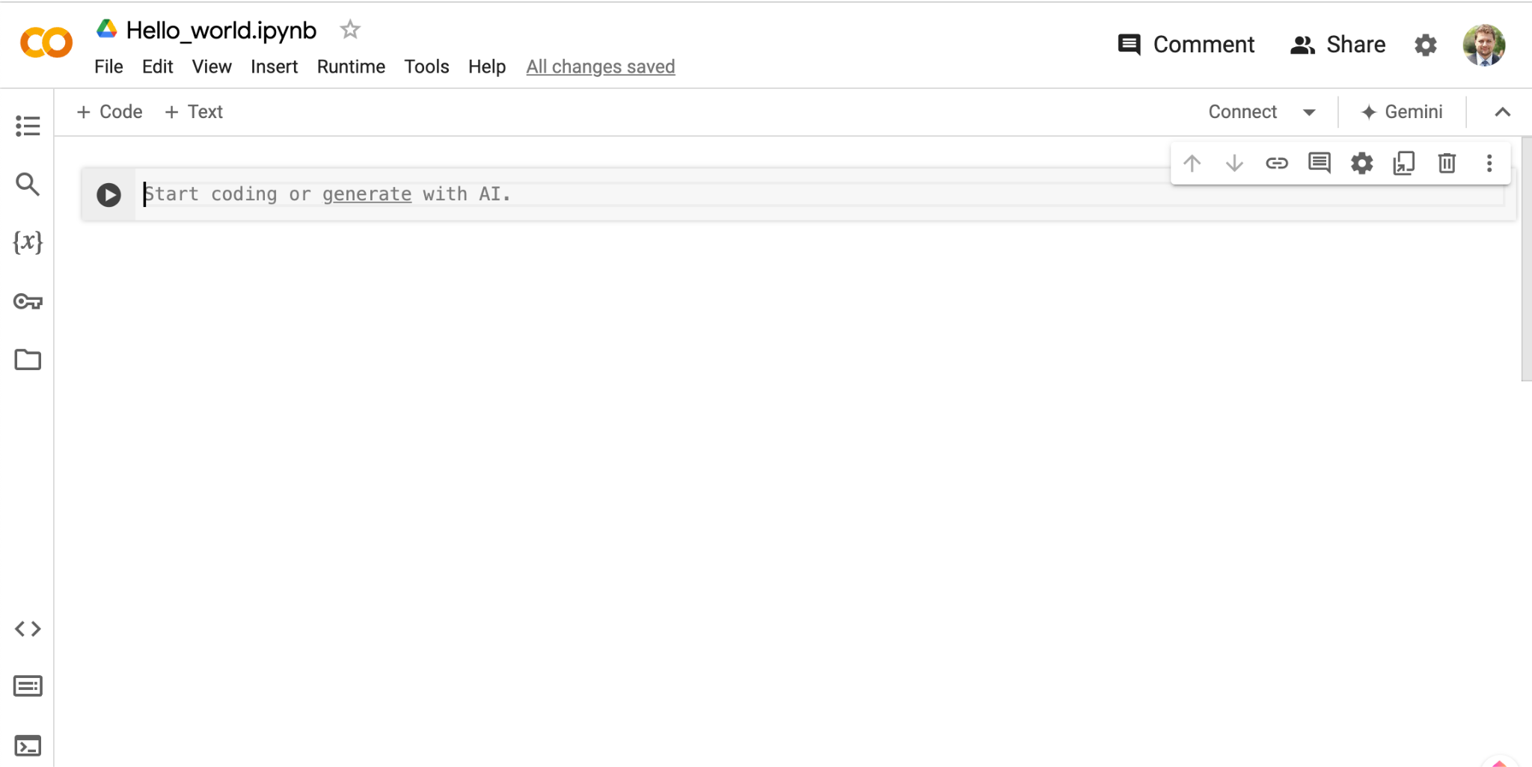
Activating Gemini in a Colab cell
Click on generate with AI after adding a new line
Click here

Slide 57
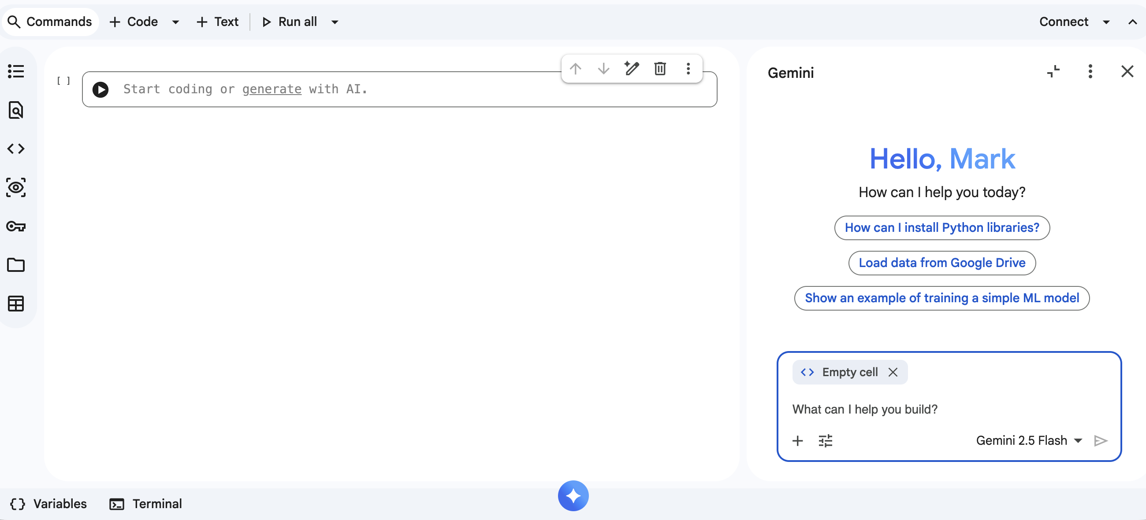
Giving prompt to Gemini Inline
Enter message in the prompt box
Enter message here, press enter

Slide 58
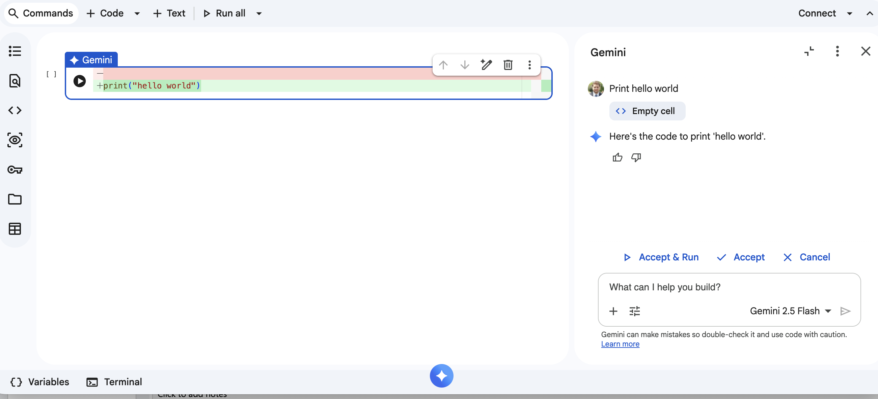
How to use Gemini AI copilot inline
Run AI-generated code
Run AI code here

Slide 59
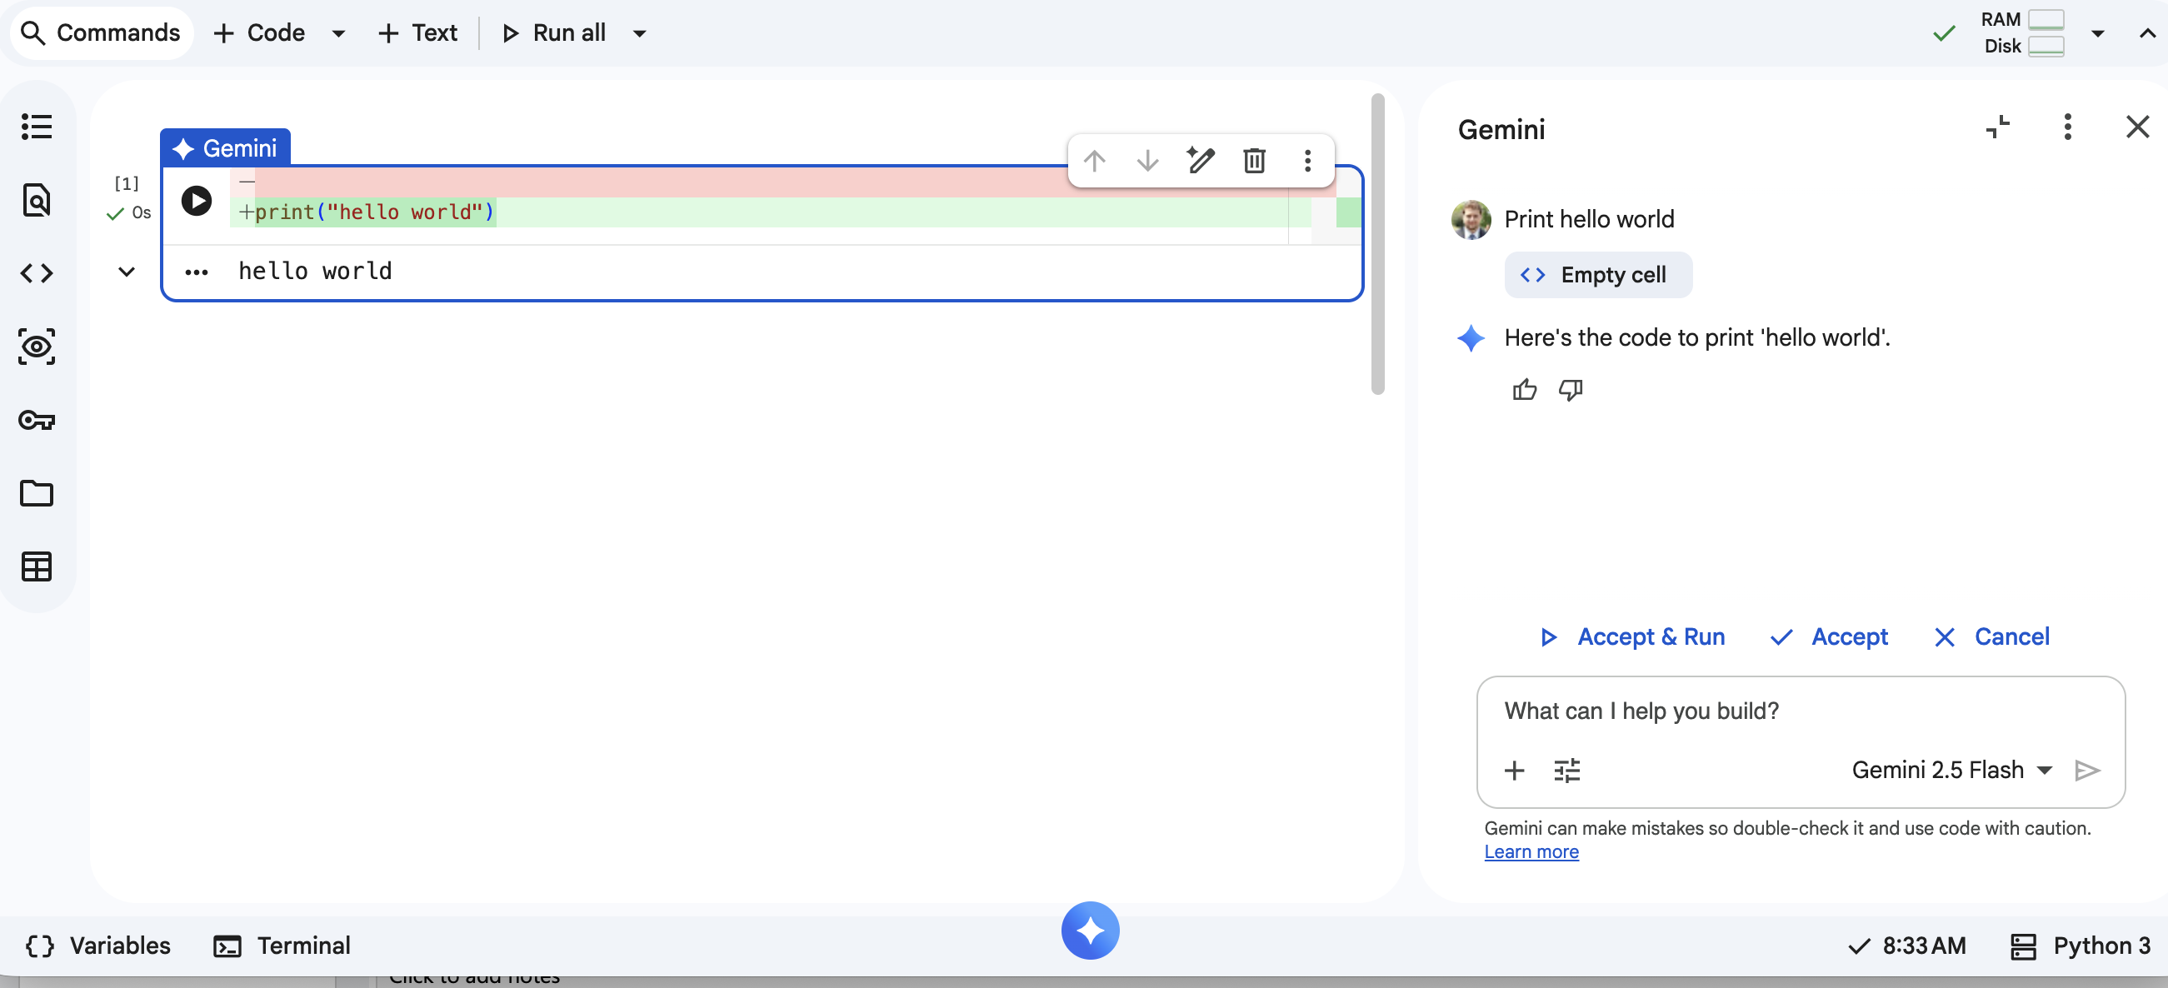
How to use Gemini AI Copilot Inline
Check output for errors

Slide 60
Agentic coding with Google Colab

Slide 61
AI agentic coding with Google Colab
What is Agentic Coding?
An AI agent autonomously writes, runs, inspects output, and iterates
Google Colab as the Agentic Environment
Colab provides a live Python kernel that AI can use to execute cells and read results
Gemini enables natural-language prompts to generate and run ML code
Key Capabilities in Practice
Generate data pipelines, and visualize results from a single prompt
Agent detects errors in output and rewrites code automatically
Supports multi-step workflows: load data → preprocess → model → evaluate → report

Slide 62
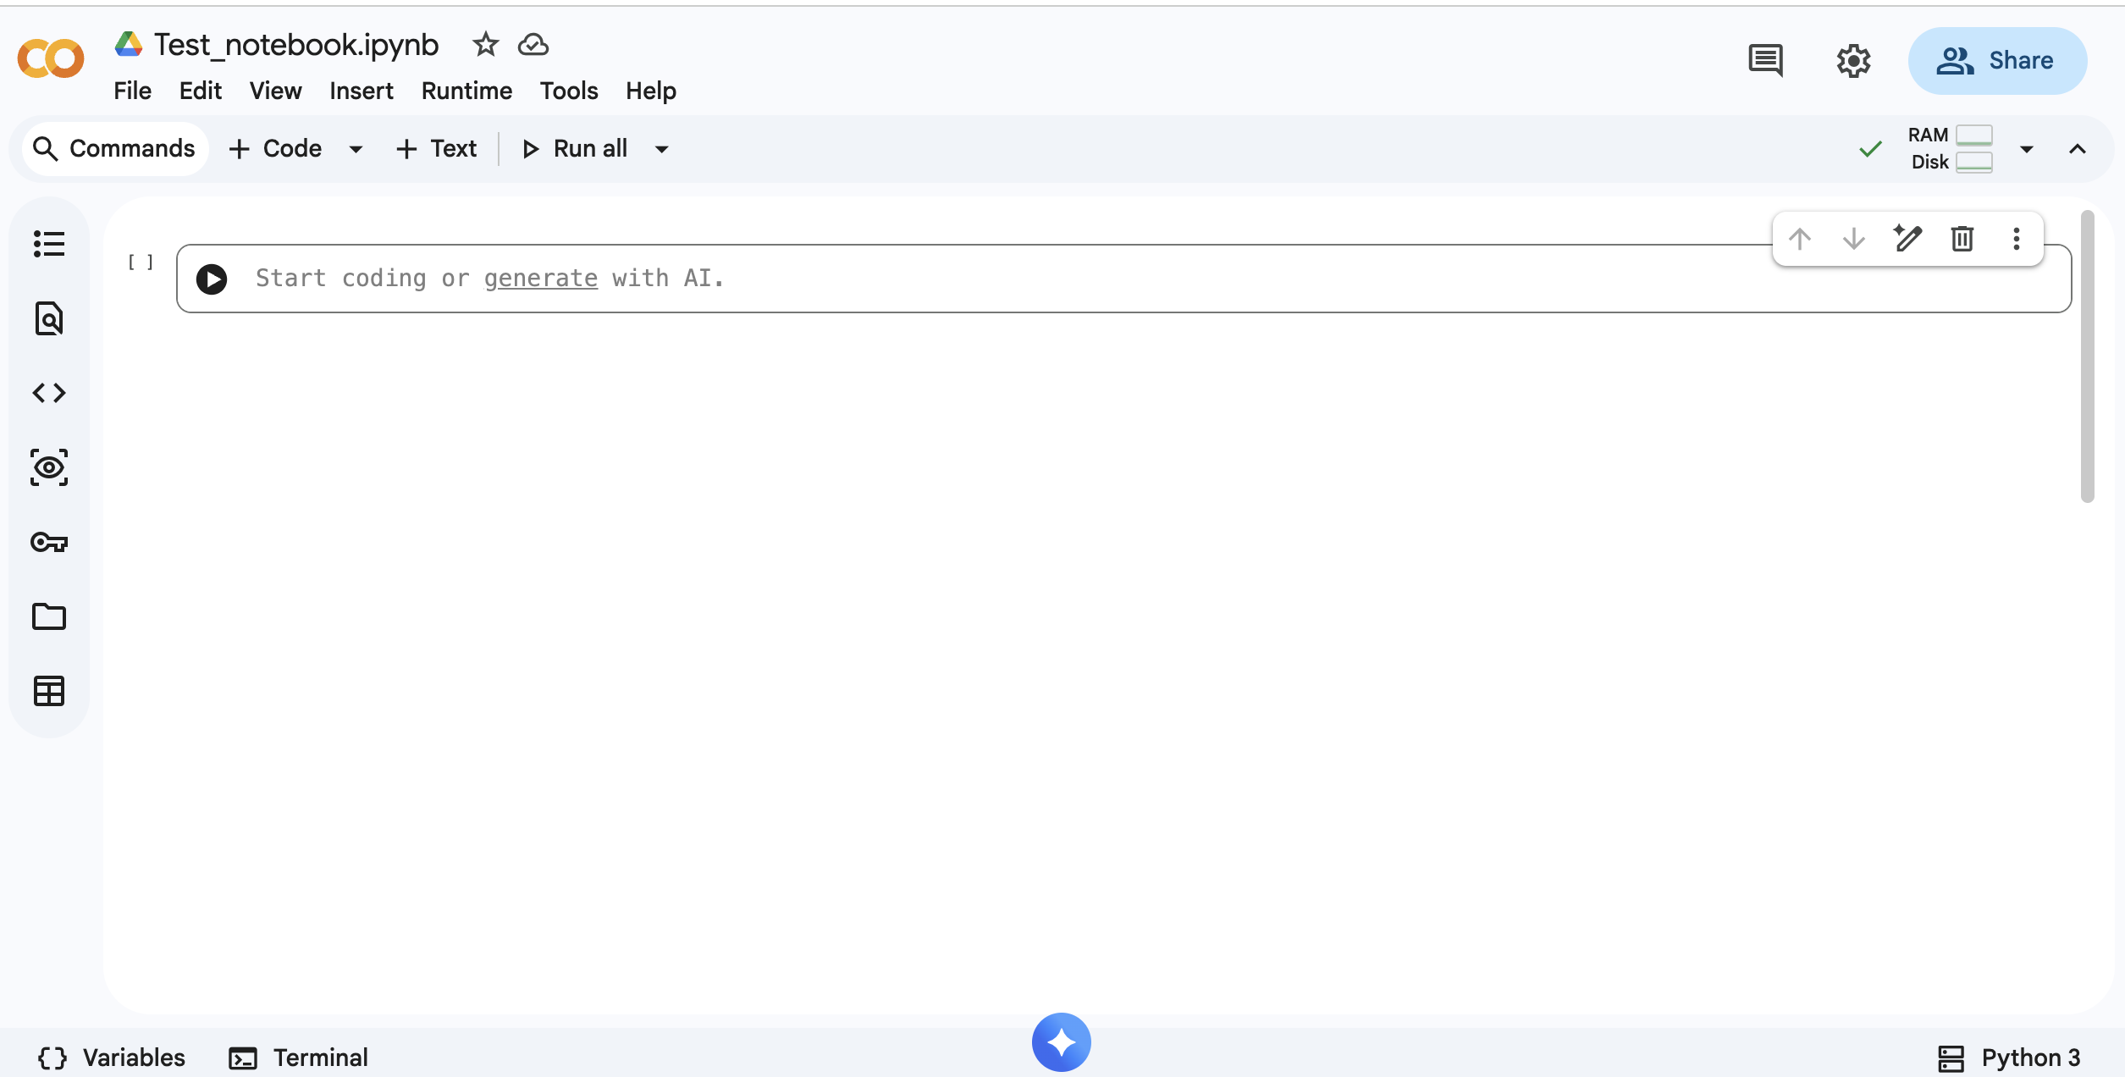
Click the Gemini Button in Google Colab to activate Gemini chat
Click here

Slide 63
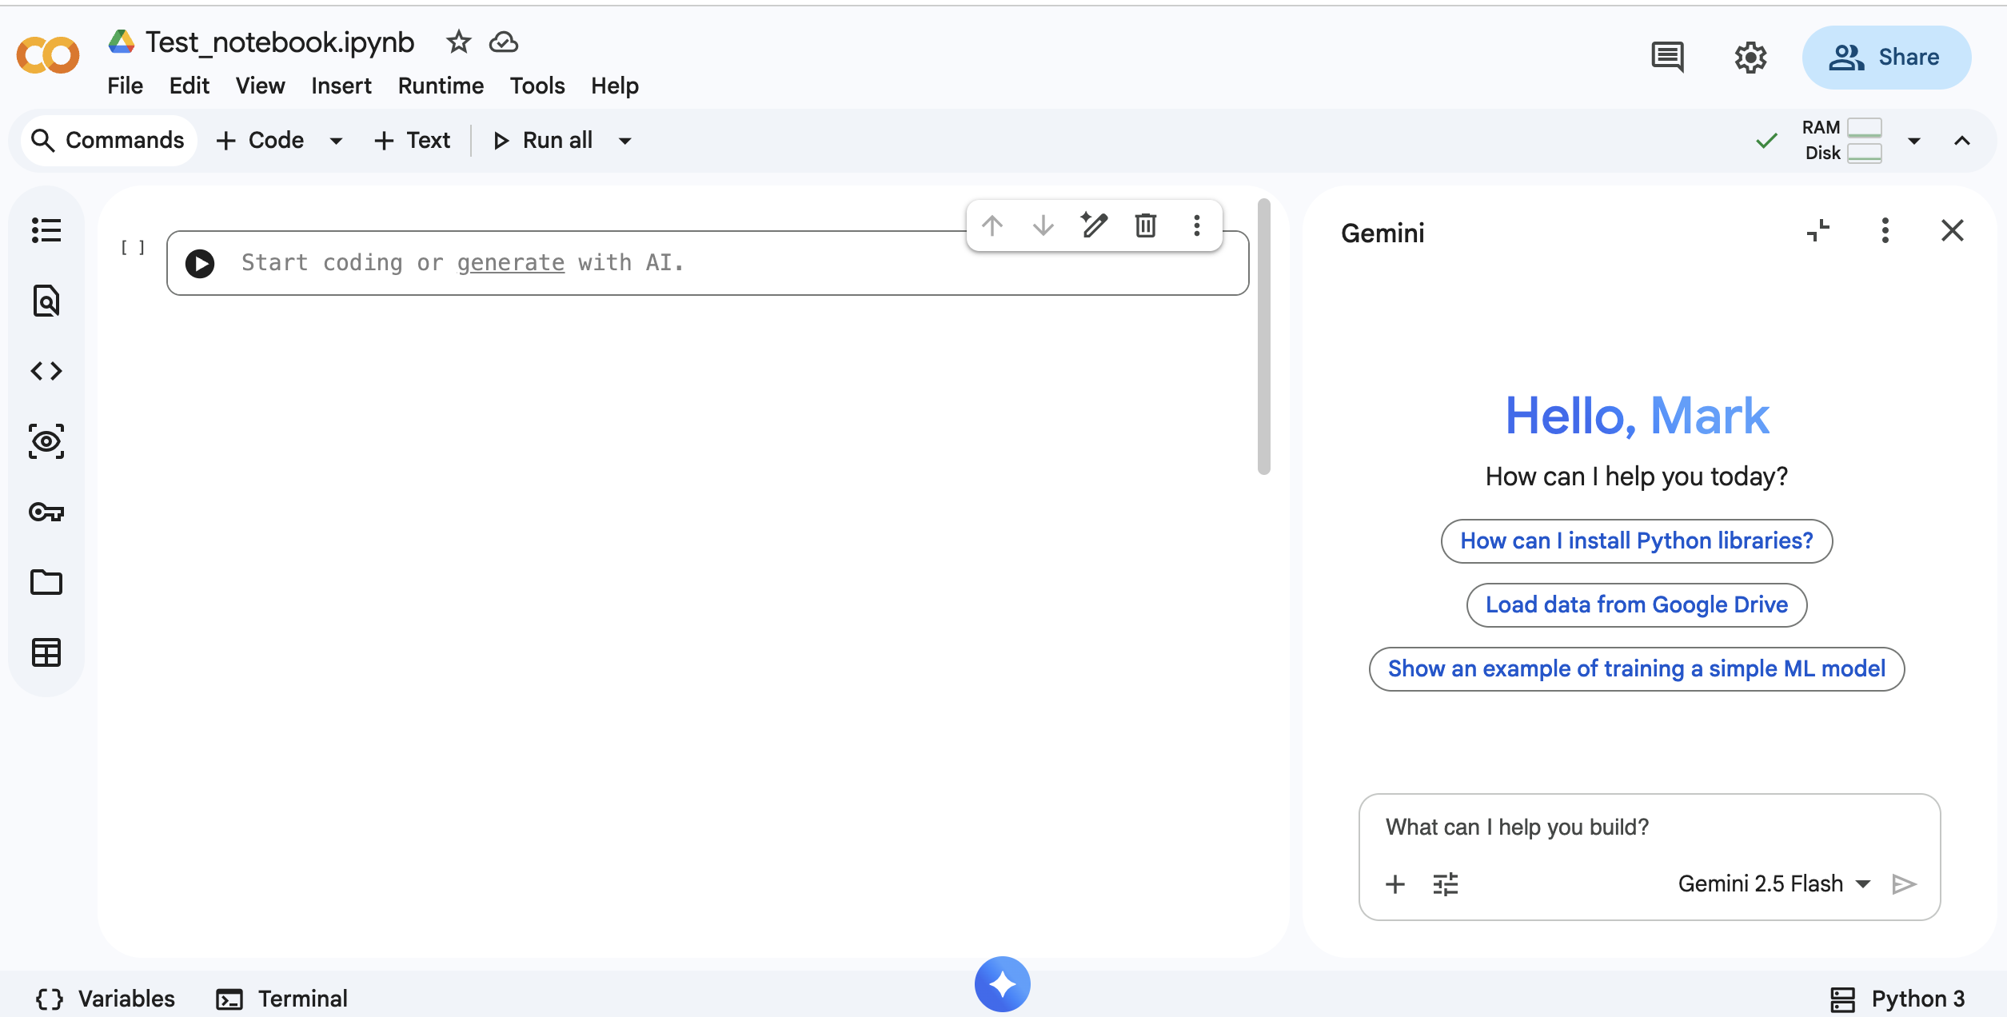
Enter a Message or/and upload data
1. Enter message here
2. Click to upload files

Slide 64
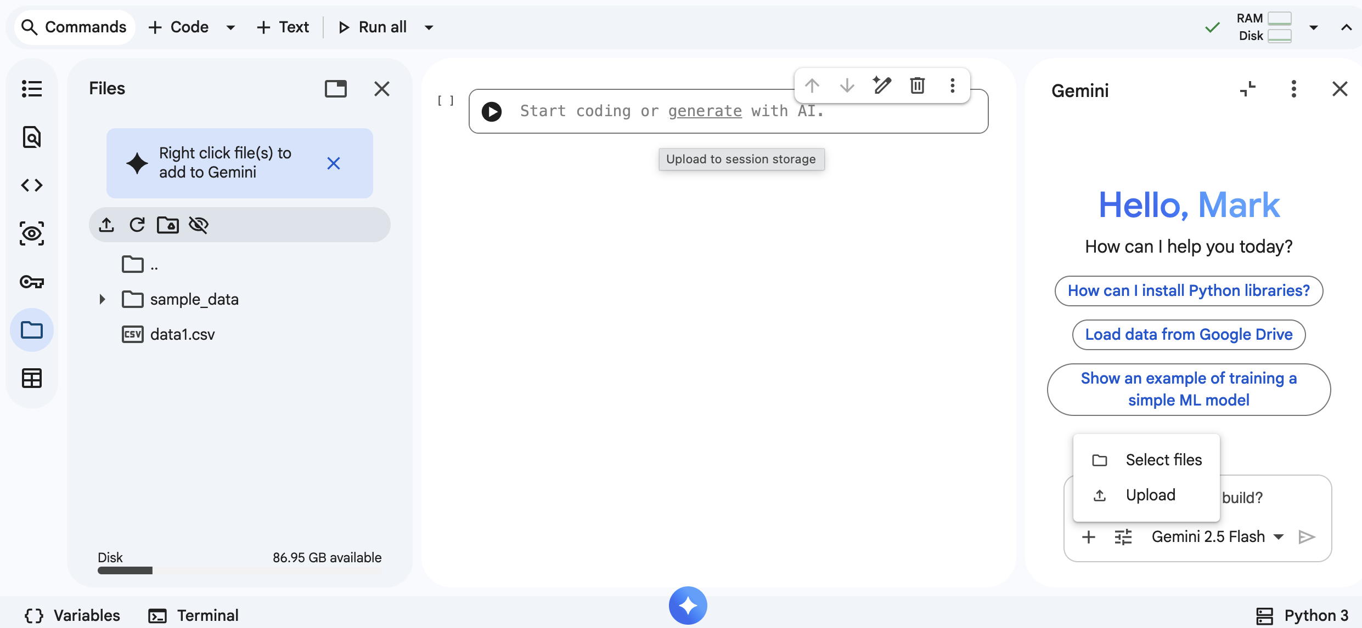
Data upload
2. You can select existing file instead of uploading a new one
1. Click to upload data or select existing one

Slide 65
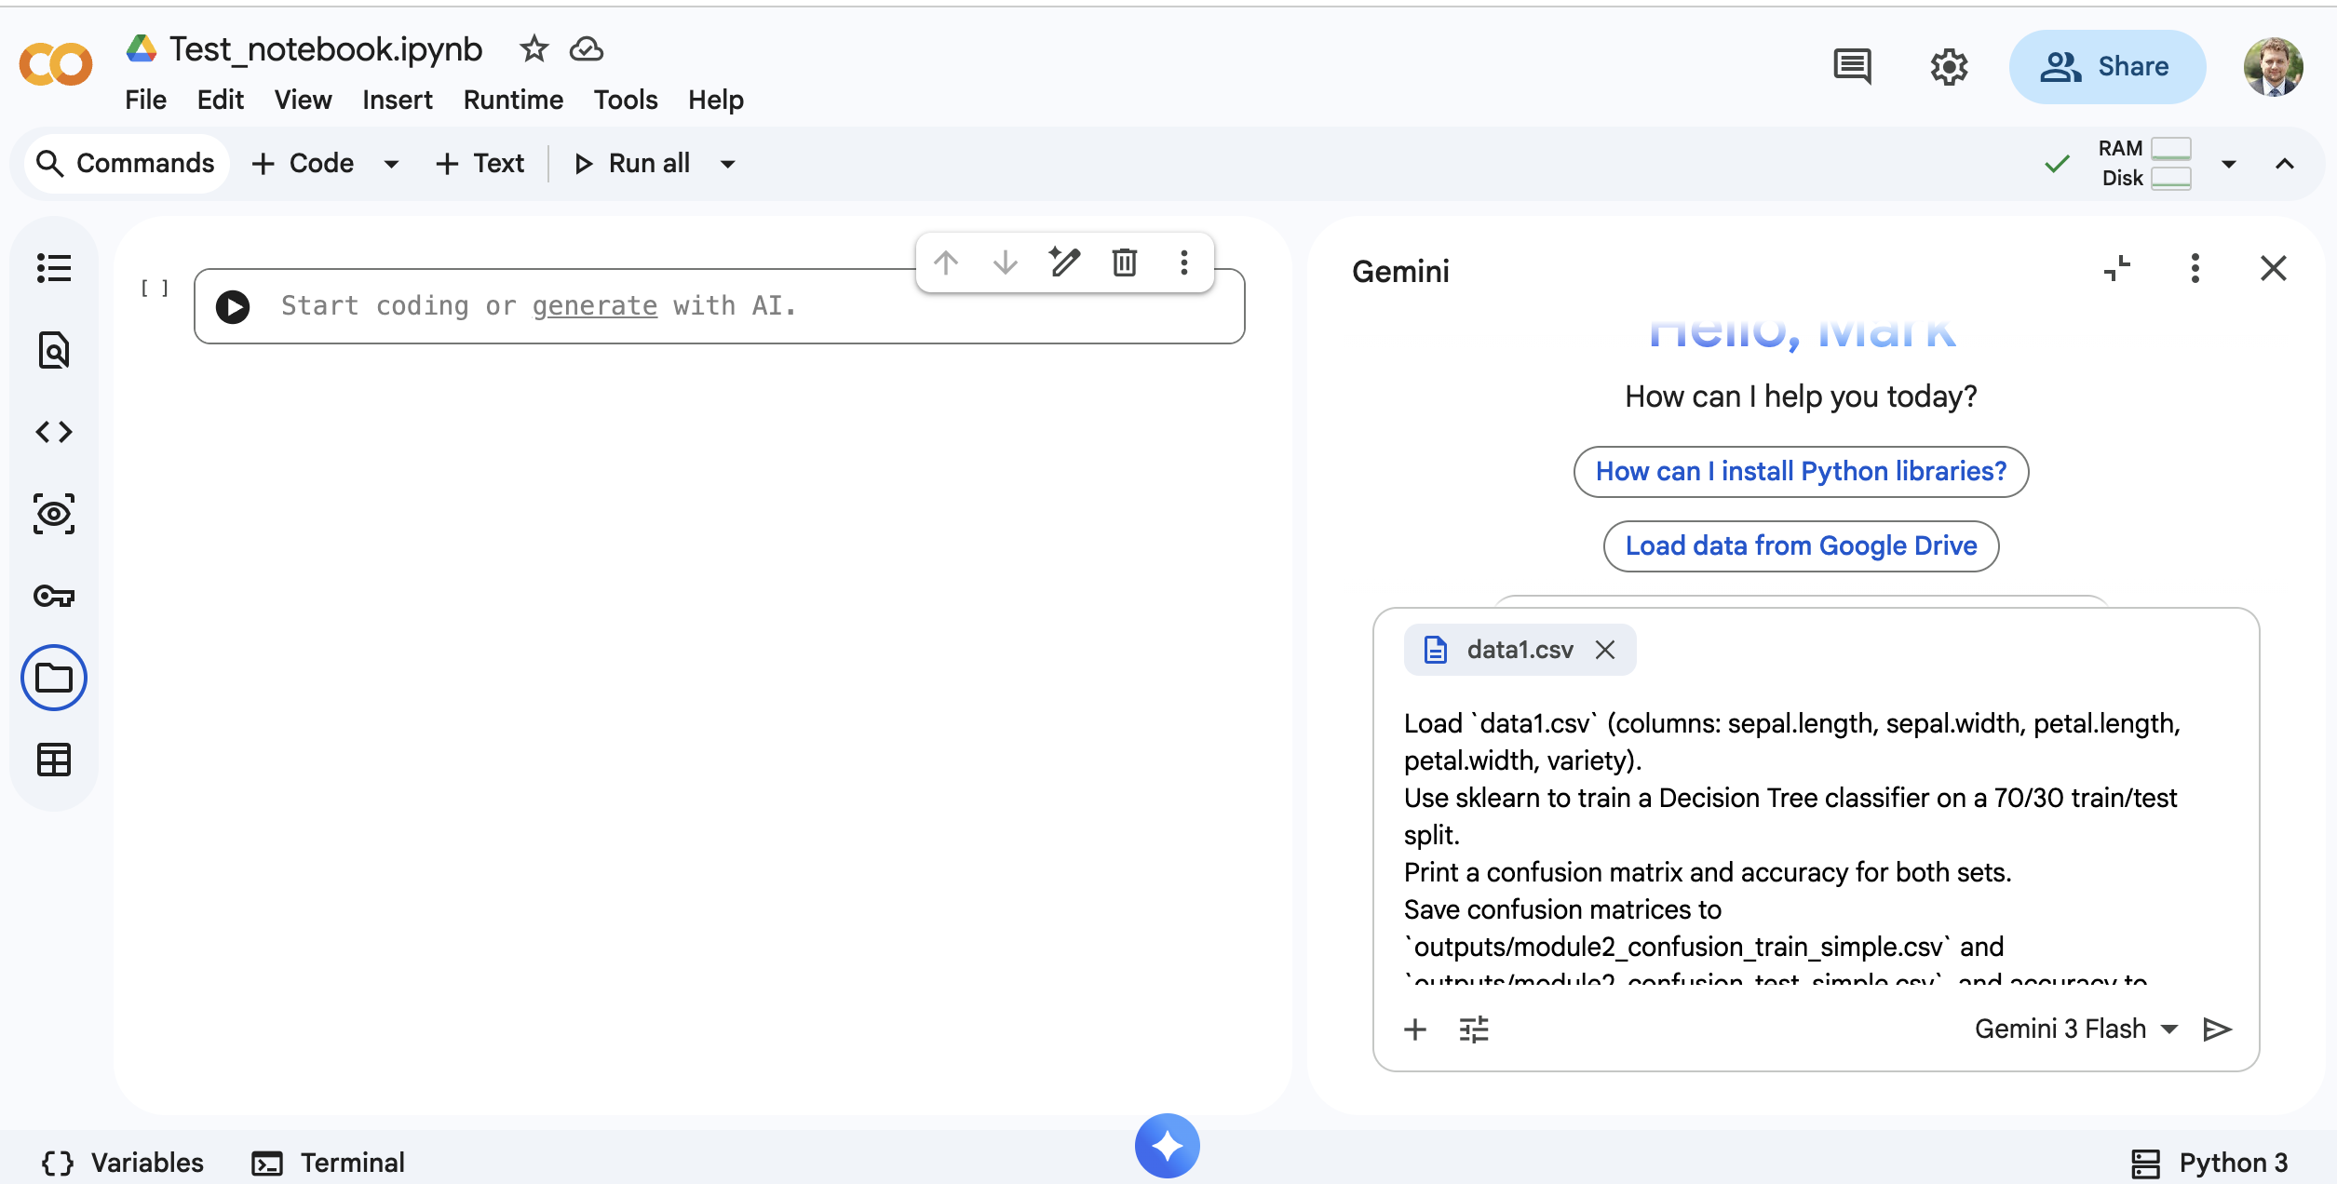
Press the Insert Button to Insert the Code into Google Colab
Press run button to start the program

Slide 66
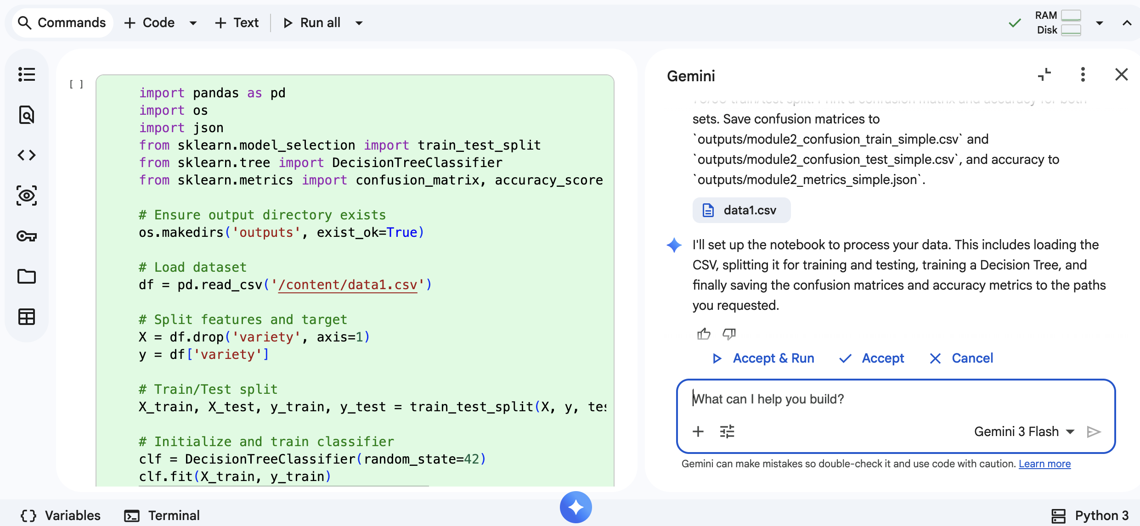
Review the Code and Press to Accept and Run
Press run button to start the program

Slide 67
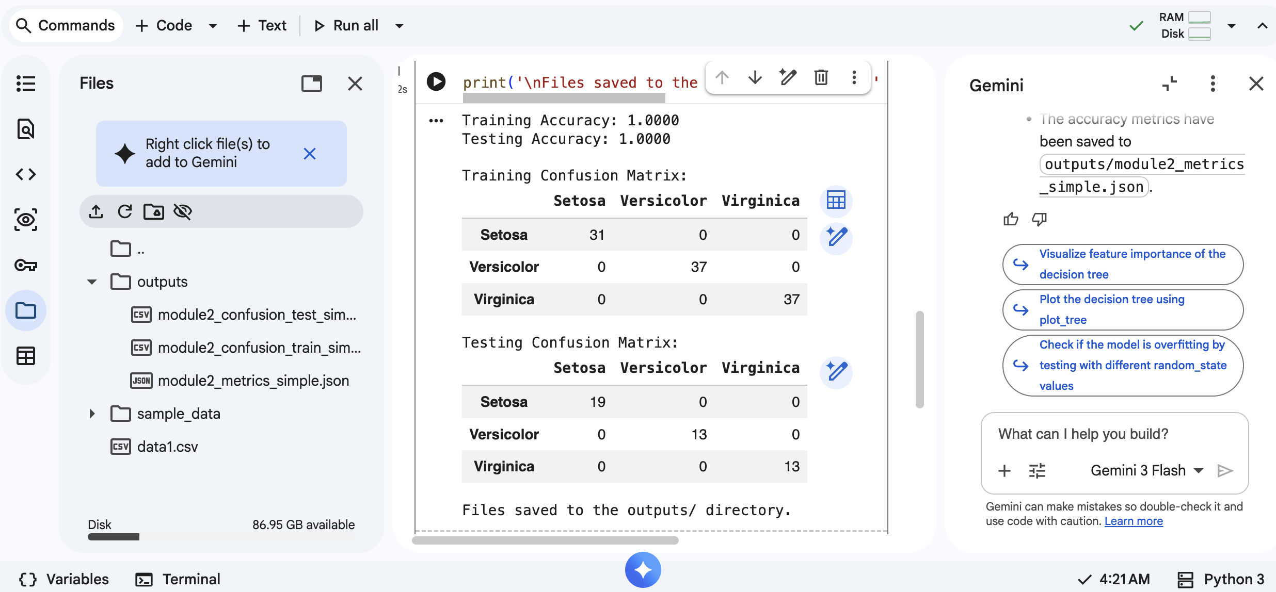
Review the Code and Press to Accept and Run
Model performance
Output files
Next steps

Slide 68
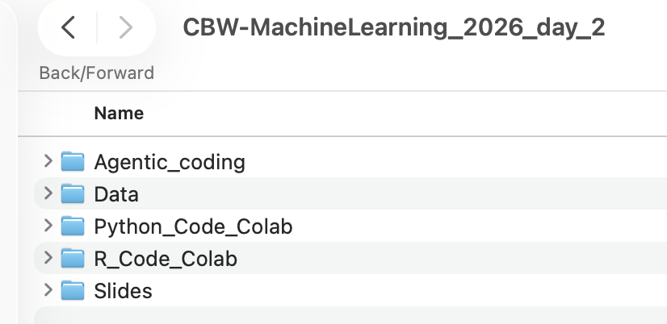
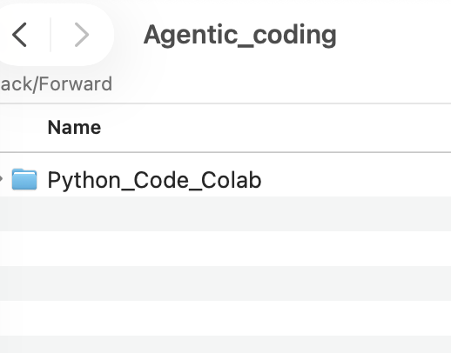
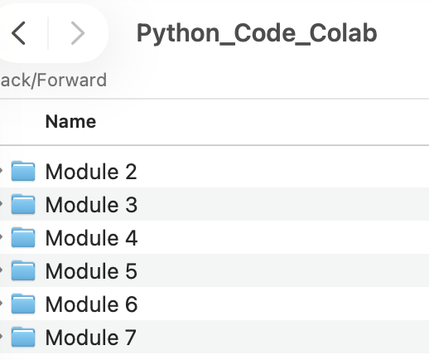
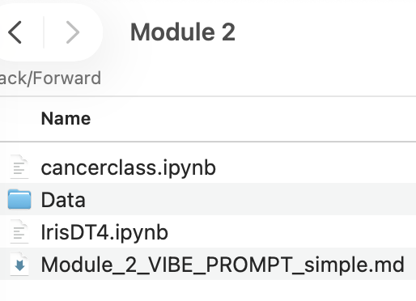
Agentic coding lab
1) Download file for module 8 labs or go to Agentic_coding folder in the download for Day2
2) Run human code, record performance, ask AI to generate code using prompt in the PROMPT file, run it, record performance, post human vs AI on Slack

Slide 69
Quick Take Aways
ChatGPT (and other copilot programs) do not always generate perfect code
The generated code usually needs testing and optimization (newer models like GPT-4o and GPT-5 produce better results than earlier versions)
Generated results from ChatGPT tend to get better with each prompt/query
ChatGPT learns from each query and tries to generate optimum results
For optimum performance, users need to provide accurate and precise prompts

Slide 70
Using ChatGPT for Information Extraction

Slide 71
Information Extraction (IE)
IE is the process by which information related to a given topic is automatically retrieved from sources of text
It is the translation of unstructured data (free text) to structured data (database)
IE depends on Named Entity Recognition tools to find and categorize target information

Slide 72
Why IE is Important in Bioinformatics
2 scientific journals in 1660
60,000 scientific journals today
500,000 medical articles/year or 1 article per minute
1,500,000 scientific articles/year
35,000,000 abstracts in PubMed derived from ~20,000 journals
50,000,000 scientific articles published since 1660

Slide 73
Keeping Up…
A researcher would have to scan 130 different journals and read 27 papers per day to follow a single disease, such as breast cancer.
Baasiri, R.A., Glasser, S.R., Steffen, D.L. & Wheeler, D.A. Oncogene 18, 7958-7965 (1999)
How do we keep up?

Slide 74
Information Extraction (IE)
First projects started in the mid 1960’s following the emergence of Natural Language Processing (NLP)
Early programs included
  1982 FRUMP by G. DeJong
  1986 ATRANS by S. Lytinen and A. Gershman
  1990 SCISOR by GE Research and Development Center
  1992 JASPER by Carnegie Group for Reuters
Notes:
History of Information Extraction https://aclanthology.org/O98-4002.pdf
FRUMP (Fast Reading Understanding and Memory Program) https://www.taylorfrancis.com/chapters/edit/10.4324/9781315802671-7/overview-frump-system-gerald-dejong?context=ubx&refId=e6f76183-e224-47bc-9d14-fba70e8e1552
ATRANS (Automatic Funds TRANSfer Telex-Reader) https://www.researchgate.net/publication/221604268_ATRANS_Automatic_Processing_of_Money_Transfer_Messages
SCISOR (System for Conceptual Information Summarization, Organization, and Retrieval) https://dl.acm.org/doi/abs/10.1145/92755.92769
JASPER (Journalist’s Assistant for Preparing Earnings Reports) https://aclanthology.org/A92-1024.pdf

Slide 75
Information Extraction (Open Source Tools)
General Architecture for Text Engineering (GATE) is bundled with a free Information Extraction system
Apache OpenNLP is a Java machine learning toolkit for natural language processing
Machine Learning for Language Toolkit (Mallet) is a Java-based package for a variety of natural language processing tasks, including information extraction
DBpedia Spotlight is an open source tool in Java/Scala (and free web service) that can be used for named entity recognition and name resolution.
Natural Language Toolkit is a suite of libraries and programs for symbolic and statistical natural language processing (NLP) for the Python programming language

Slide 76
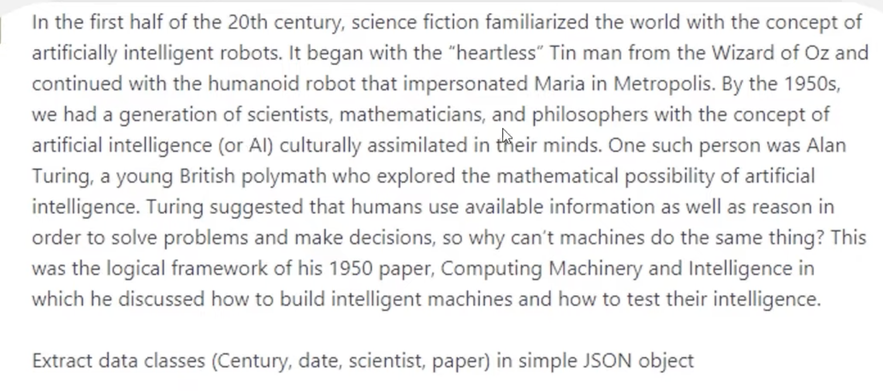
Simple IE With ChatGPT
Type or paste in text and request data extraction and format

Slide 77
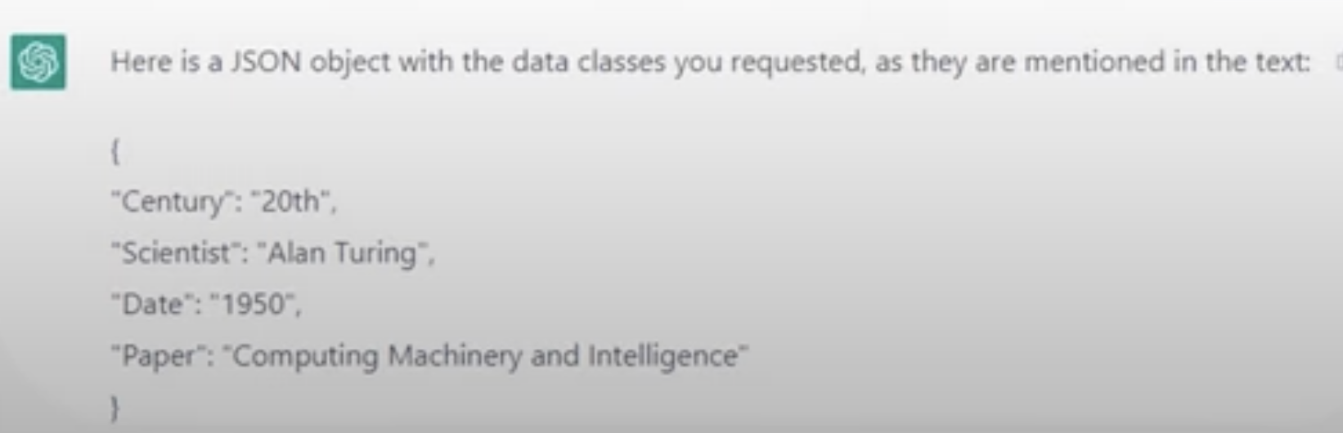
The Result
The advanced language processing of LLMs provides exceptional Named Entity Recognition with the ability to categorize and extrapolate additional context to the information

Slide 78
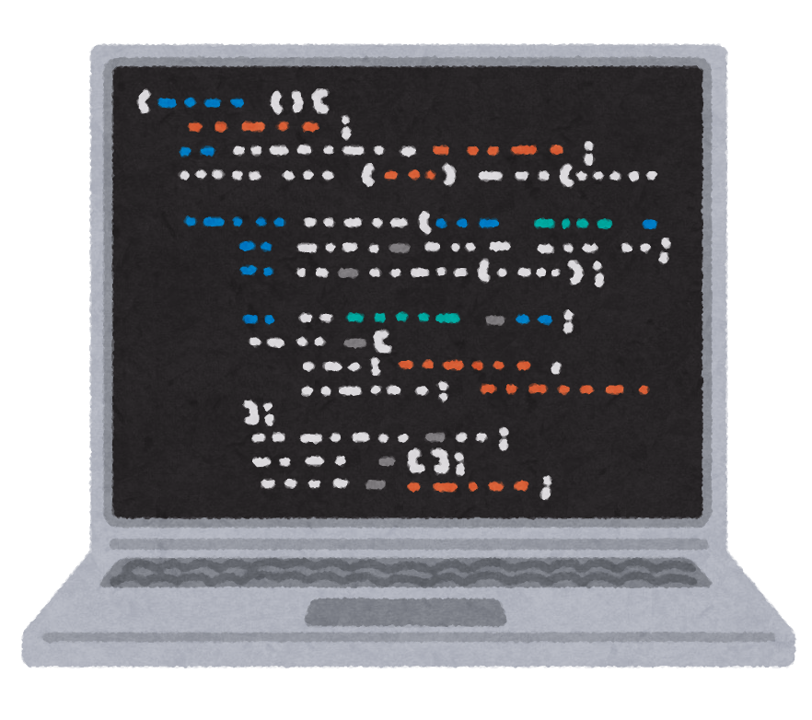



IE with Your Own RAG-Bot
What is RAG?
LLMs are experts of what they were trained on
  But what if we have specialized information outside the scope of the training?
  Retrieval Augmented Generation: augment the knowledge of an LLM with an external collection of specialized information
+

Slide 79
RAG with Custom ChatGPT
Using Custom GPTs requires an OpenAI Plus account for $20/month (pricing info)
RAG Steps:
Build a corpus of specialized knowledge
  ChatGPT vectorizes the corpus for quick retrieval
Engineer a prompt
Generate output using the augmented LLM

Slide 80
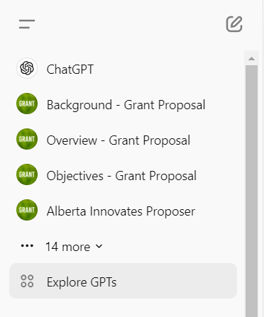
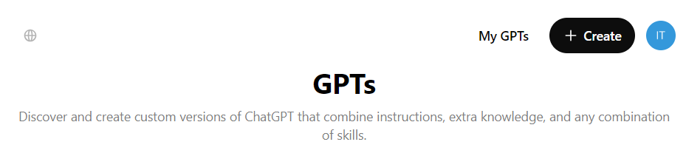
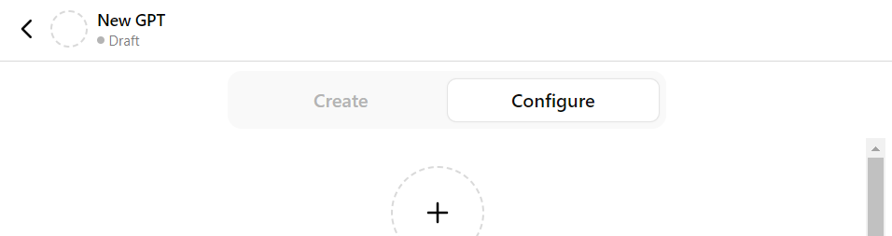
RAG with Custom ChatGPT
Log in to your ChatGPT plus account and select “Explore GPTs” in the left-hand sidebar
In the upper right-hand corner, select “Create”
Navigate to the “Configure” tab to start building
2
3
1

Slide 81
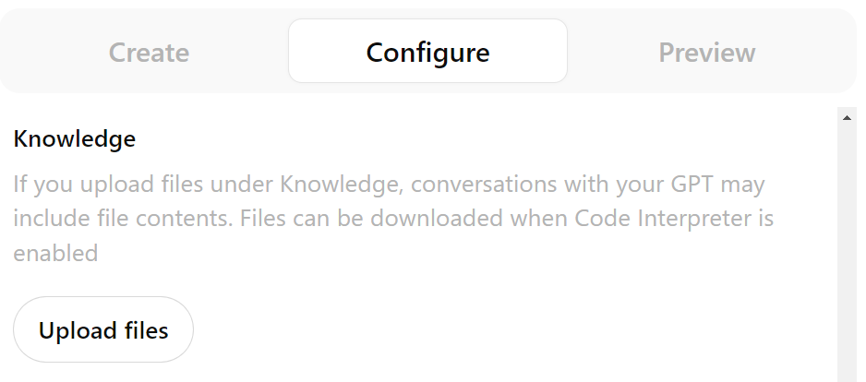
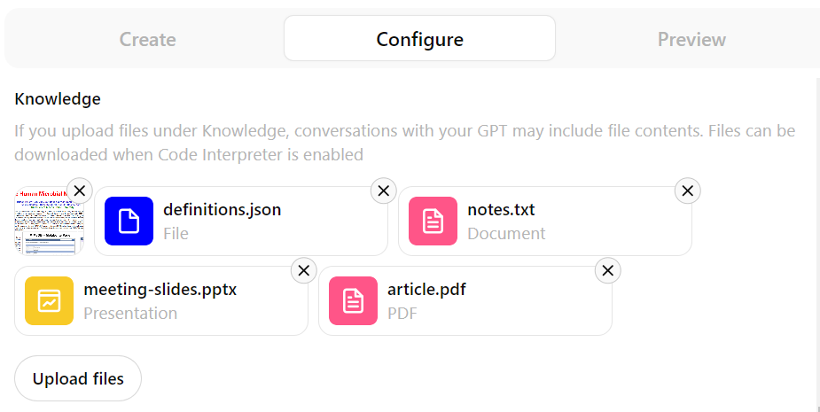
RAG with Custom ChatGPT
Build the Corpus
Collect up to 20 knowledge files containing your specialized information
Files can be plain text, documents, PDFs, images, spreadsheets and slides
Text files are limited to 2M tokens each
Images are limited to 20MB each
Notes:
Web Browsing uses Bing search
Actions can also incur additional cost

Slide 82

RAG with Custom ChatGPT
Engineer a Prompt
Name and Description
provide information for
users, not the LLM
Instructions: This is
the base prompt that
informs every response
given by the LLM
Conversation Starters: Common initial queries that you don’t want to type out repeatedly
Notes:
Web Browsing uses Bing search
Actions can also incur additional cost

Slide 83
RAG with Custom ChatGPT
Example Instructions Prompt:
You are an expert system trained to provide scientifically accurate and detailed responses to queries about diabetes. Your role is to answer queries with a strong emphasis on factual correctness and scientific detail. Your responses should:
Be Evidence-Based: Use the latest scientific research and data to support your answers.
Be Objective and Neutral: Present information factually without bias or opinion. Acknowledge areas of uncertainty or ongoing research where applicable.
Be Precise: Include specific numbers, dates, and measurements. For example, instead of "an optimal amount of glucose," specify "500mL of glucose."
Include Sources: Knowledge files MUST be referenced, by including the file name in square brackets after every fact. For example: “Familial forms of CDI usually present in childhood [PMC9516129.pdf]."

Slide 84

RAG with Custom ChatGPT
More Tools
Capabilities: Bonus functionalities including code interpretation (incurs additional cost), web browsing, and image generation
Actions: Allow interaction with external APIs
Notes:
Web Browsing uses Bing search
Actions can also incur additional cost

Slide 85


RAG with Custom ChatGPT
Finally, click “Create” in the upper right-hand corner. Now you can chat with your custom GPT.
Who do you want to share your custom GPT with?
  Is there anything confidential in your knowledge files or instruction prompts?

Slide 86
RAG Applications
A RAG-Bot to assist with grant writing
A RAG-Bot to assist with paper writing
A RAG-Bot to write newsletters
A RAG-Bot as a ”virtual assistant” that answers FAQs or simple questions about topics that are relevant to your lab, your research, you administrative functions, human resource issues, classes or student queries, SOPs

Slide 87
Conclusion
We have covered lots of material in a very short time
We have tried to give a “flavor” of different tools and their potential applications
We have tried to provide code so that you could re-use it in your own applications
We have tried to avoid “toy” problems that everyone gives but instead tried to solve real biological or real bioinformatics problems with real data

Slide 88
Conclusion
Machine learning is a difficult subject with some things (ANNs) being more difficult than others (DTs)
Trying to code everything from scratch is long and hard, but hopefully gives you an appreciation of the challenges
Using libraries and APIs such as pandas, numpy, sklearn, keras and tensorflow can make things much easier and shorter – but you still need to know how to code

Slide 89
Conclusion
There are certain groups of ML problems (classification, motif recognition, regression) that could or should probably be “webified” and delivered as servers that learn from user data and provide answers
There are other groups of ML problems (gene prediction, secondary structure prediction) that are very specialized and could never be generalized to web servers for learning (although web-based predictors exist)
Chatbots and LLMs are changing the bioinformatics and coding landscape quickly

Slide 90






Coffee Break & Networking Session
Workshop Sponsors

