Slide 1
Workshop location
G-217 Biological Sciences building
Logistic page:
https://bioinformaticsdotca.github.io/travel_logistics/edmonton/MLE_EdVan-2604

Slide 2
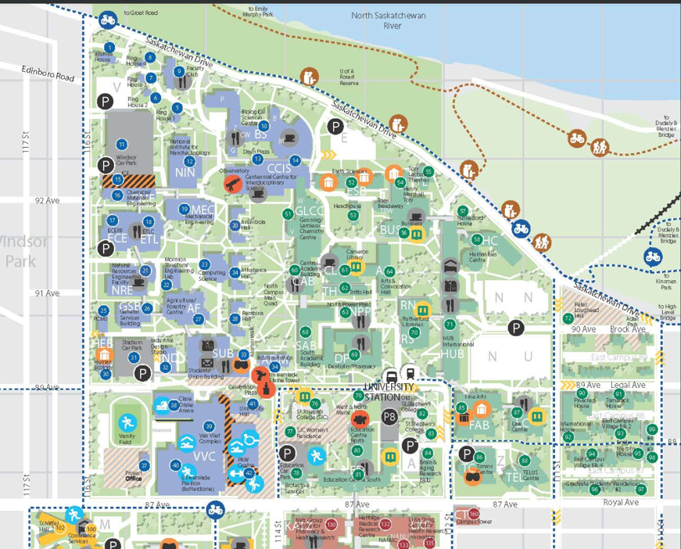
Finding G-217 (BioSci)
BioSci
Bldng
UofA
Campus Map
Park Here
LRT
Stop
Lister Centre
Hotel
Campus Suite
Hotel

Slide 3
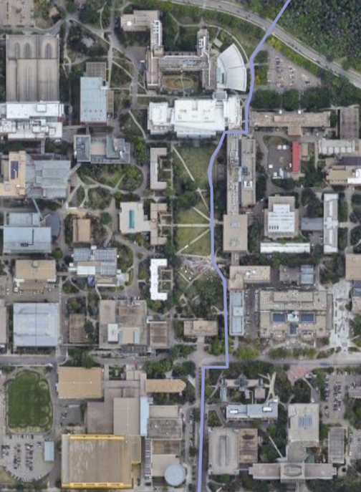
Finding G-217 (BioSci)
G-217 in
BioSci
Bio Sci
G-217 is
located on the
2nd floor of the
BioSci Building
CCIS
UofA Campus
Aerial View
Two buildings of note – BioSci and CCIS

Slide 4
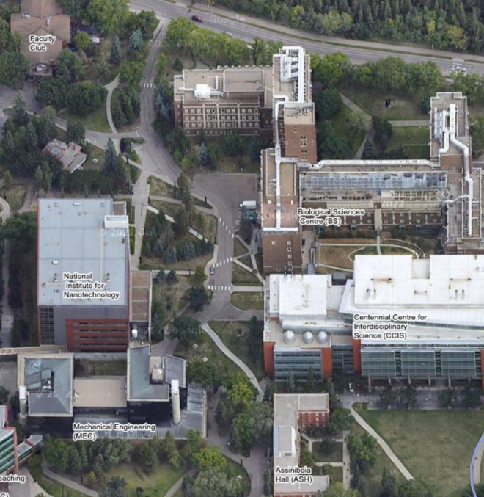
Finding G-217 (BioSci)
Faculty
Club
Saskatchewan Drive
Bio Sci. Building
Note the building
entrance marked
with the red dot
G-217 is
located on the
2nd floor of the
BioSci Building
Enter
Here
CCIS

Slide 5
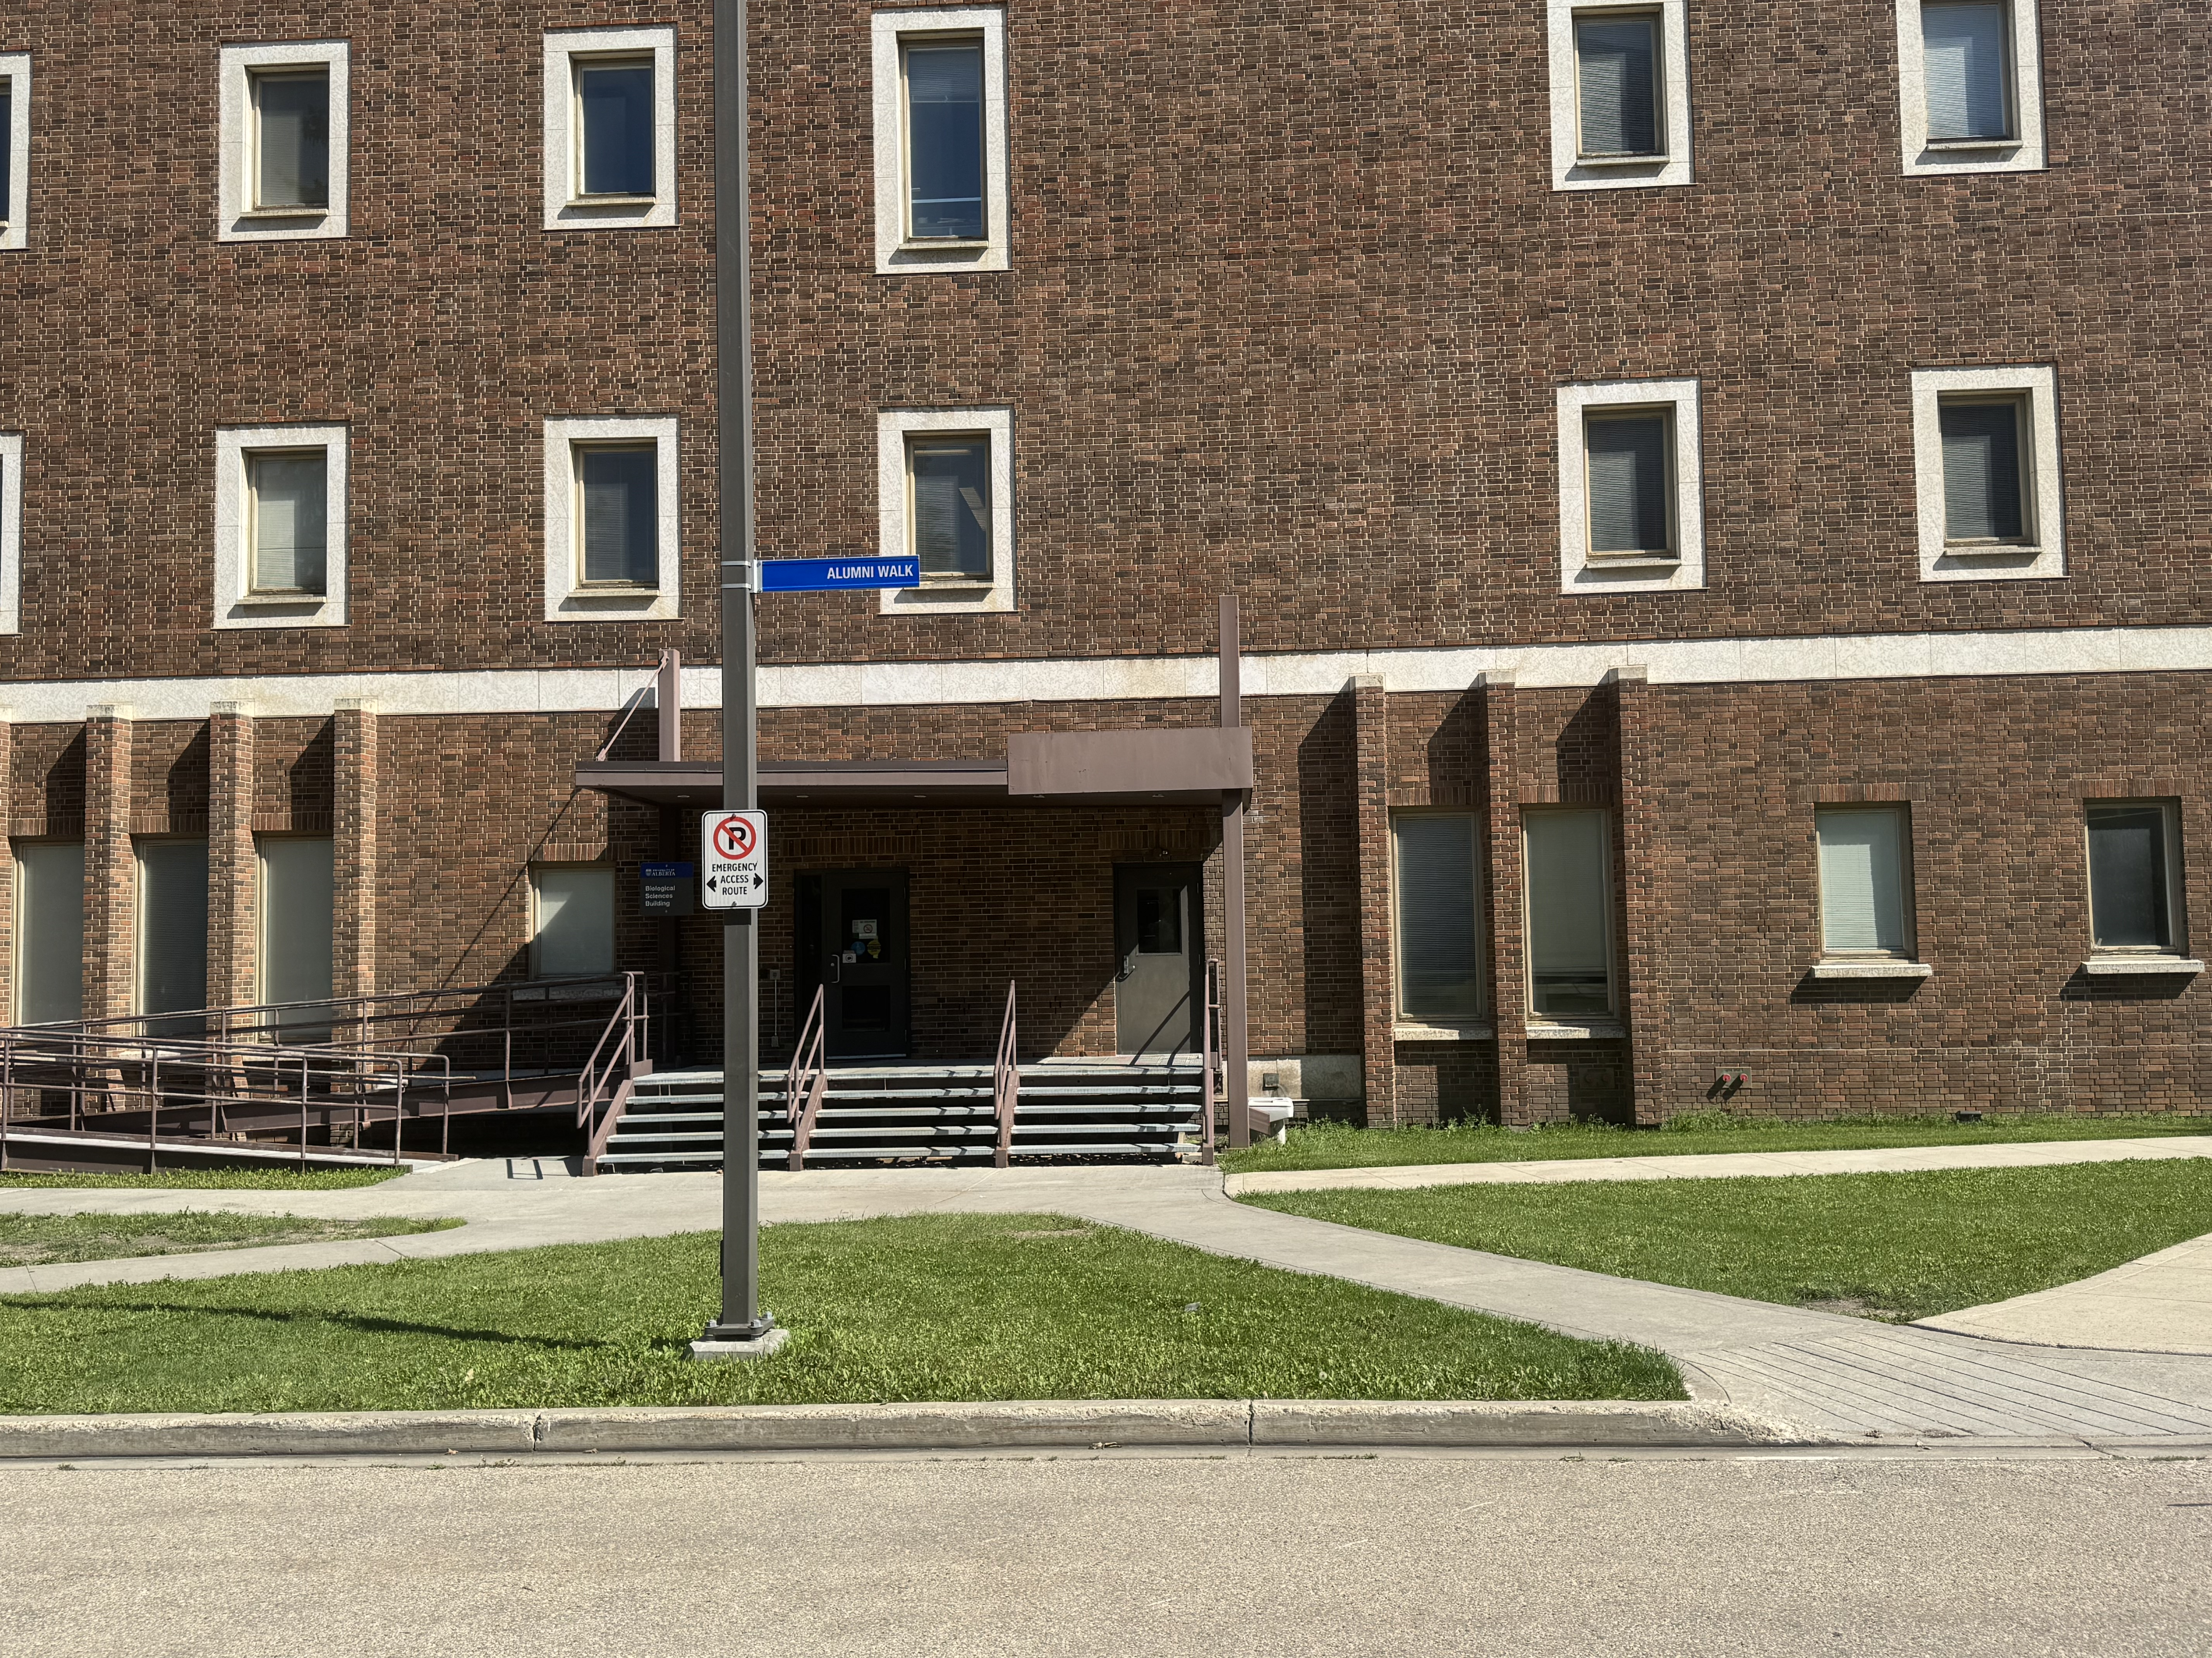
Finding G-217 -- Entrance 1
Enter Here

Slide 6
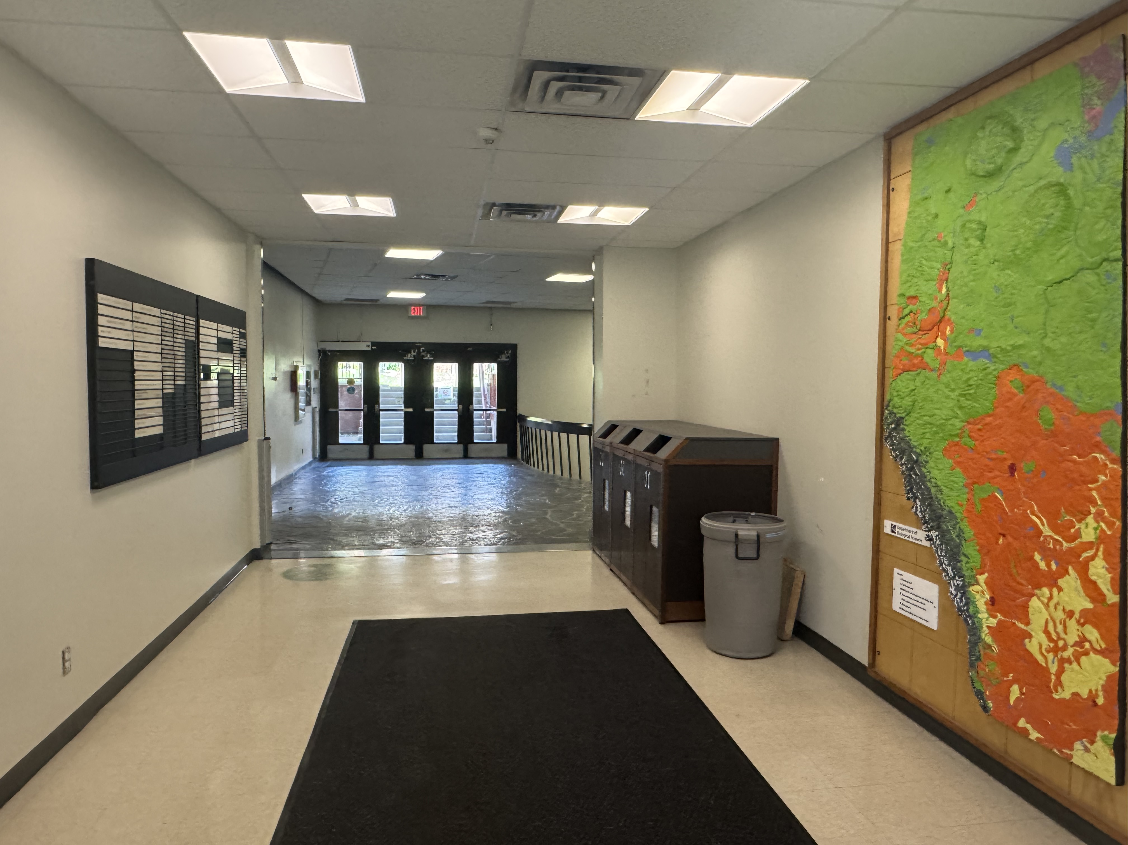
Finding G-217 – Inside Entrance 1
Enter Here
This is what you should see
when you enter, walk 10 m forward and turn right
G-217 is on the same floor as Entrance 1 and 2
Seems like it’s on
the first floor

Slide 7
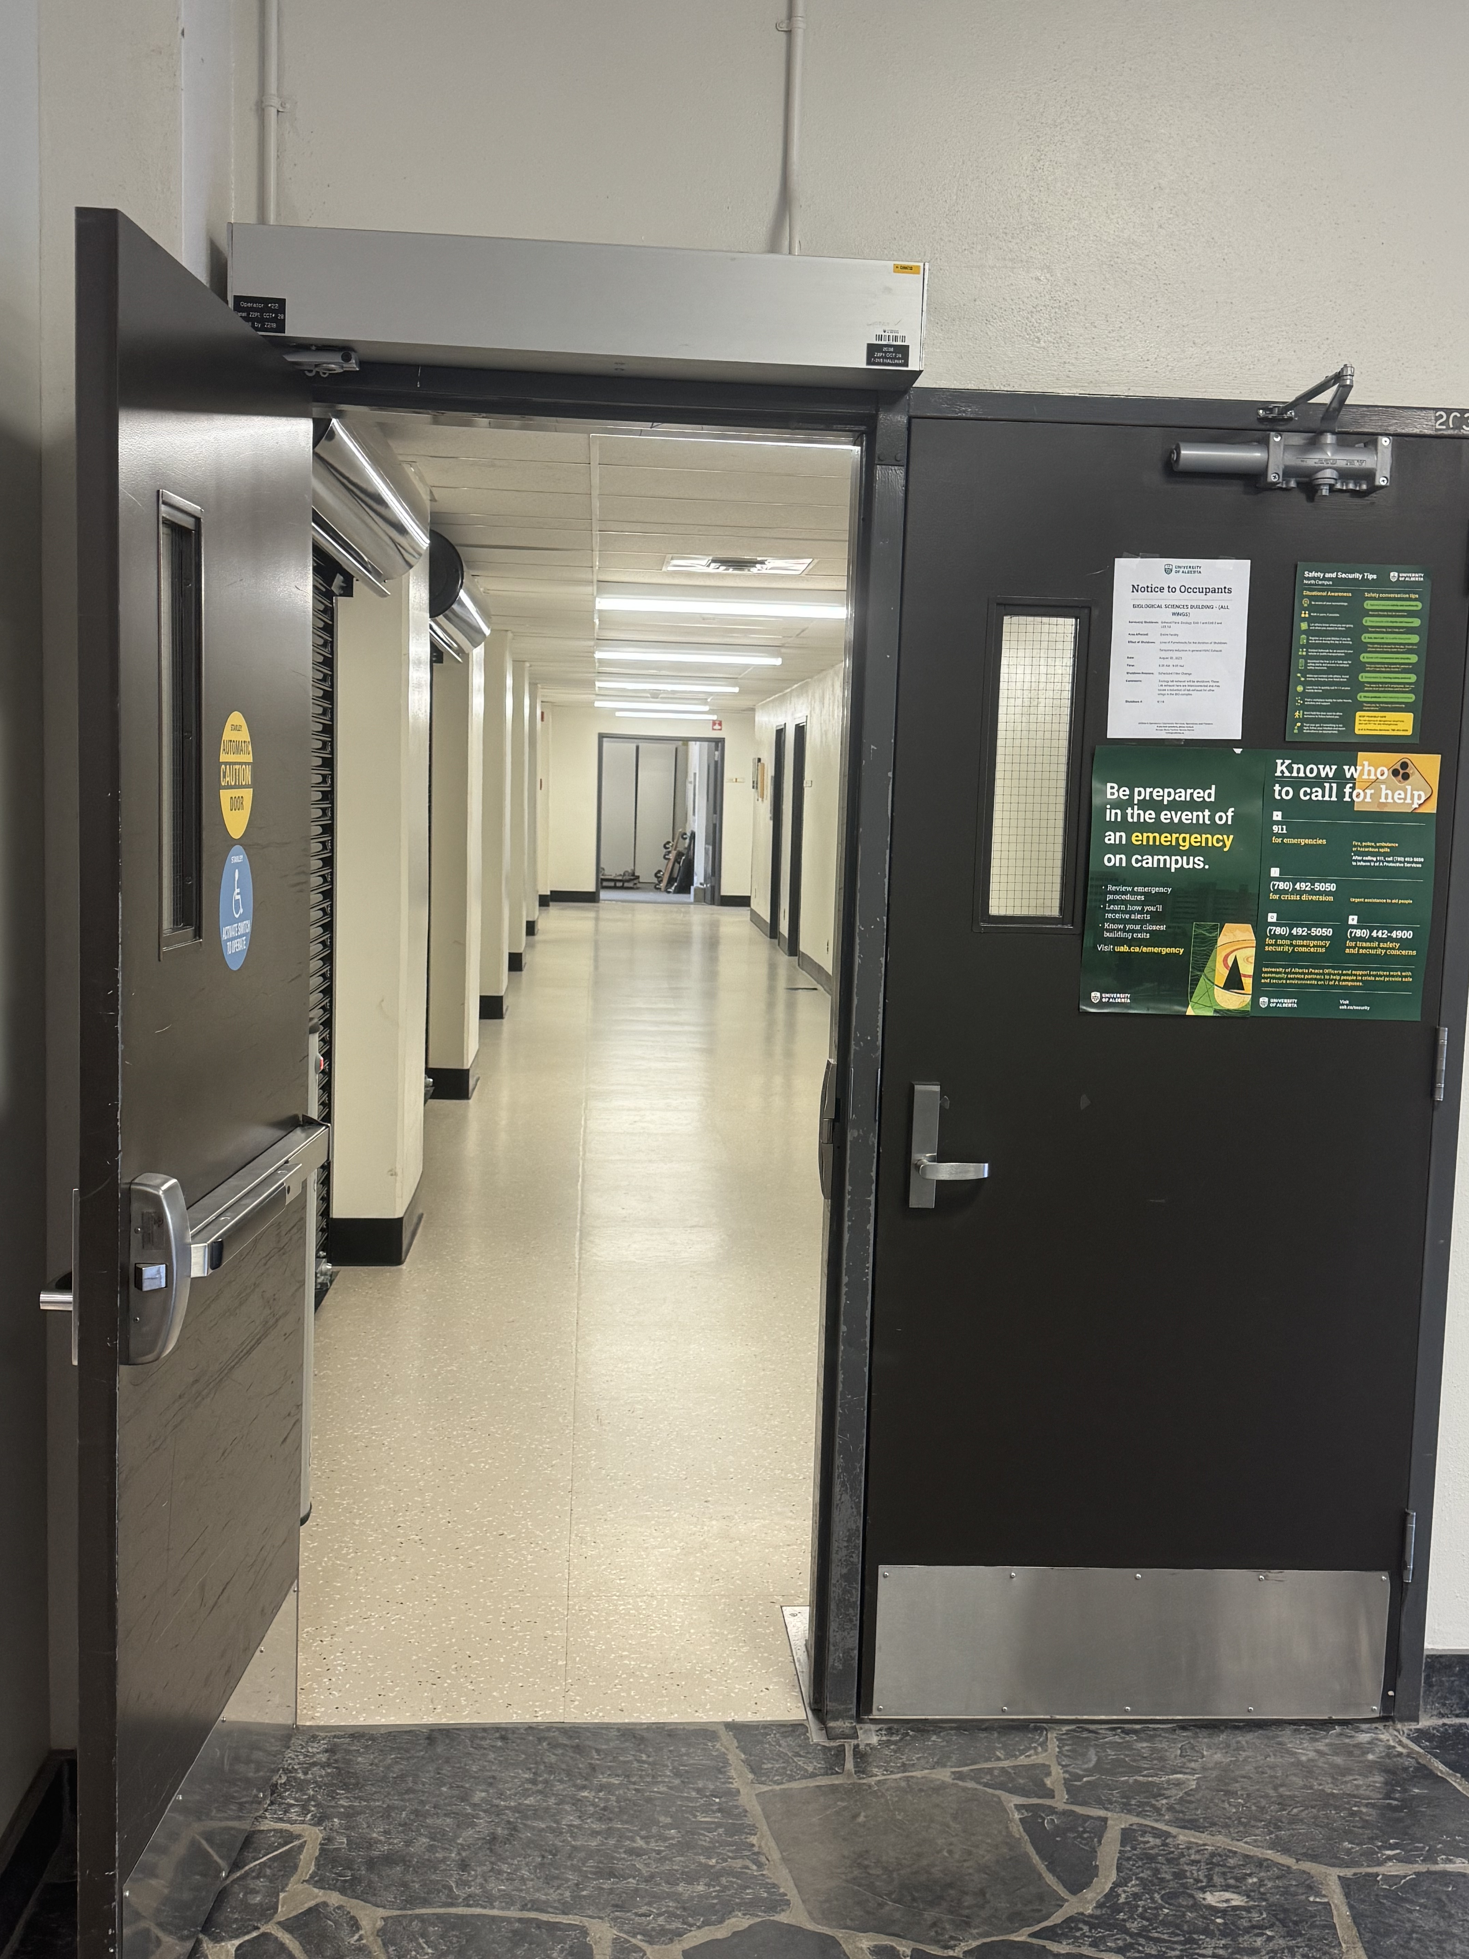
Finding Washrooms – Walk Down The Hall Through Double Doors

