Slide 1

bioinformatics.ca
bioinformaticsdotca.github.io

Slide 2
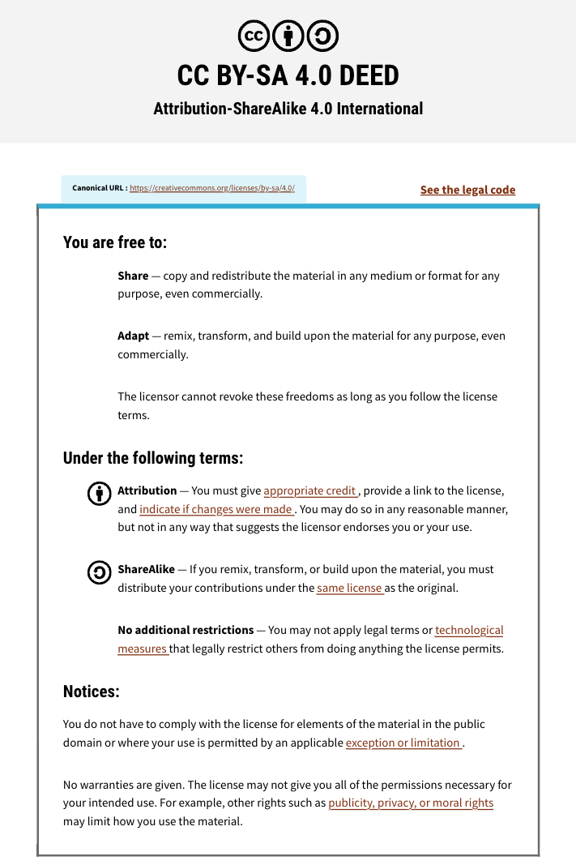

Slide 3

Module 1: Introduction
Richard LeDuc
Pathway and Network Analysis
May 12-13, 2026
Instructor affiliation logos go here

Slide 4
Learning Objectives
A little background
Meet some of the major players
Pathways vs Ontologies
Annotation Bias
Enrichment Analysis
GSEA and Empiric approaches
Hypergeometric or Fisher’s Exact
No motivation for “why” to do functional analysis. I will talk about the “whats”.

Slide 5
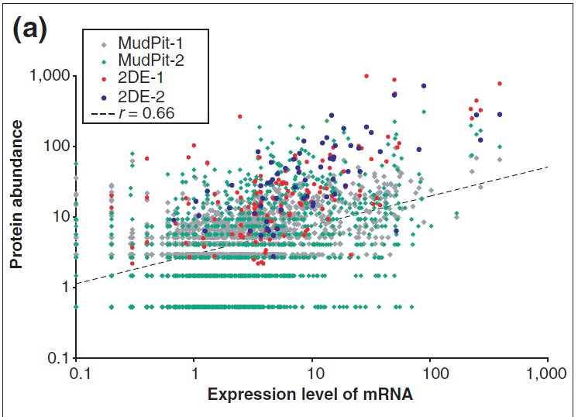
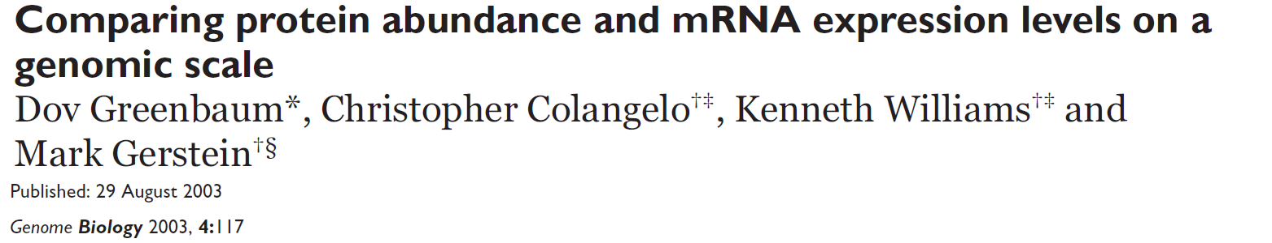
Imagine a single gene and a Case/Control design
0.66 squared = 0.43
transcriptomics
proteomics
Activity
DNA
mRNA
Protein
Gene→ Functional Annotation
Generic molecule will be a “molecular entity”.

Slide 6
High Throughput, Discovery Omics
High Throughput. Individual experiments are happening so fast, they can not all be analyzed, by hand, individually. We must automate the process.
Discovery Omics. We have not pre-determined what we are going to measure, instead we run a sample through a process and measure as many of a certain molecular entity as we can.
Examples. Bulk transcriptomics, proteomics, DNA methylation, ATAC and Cut&Run, mRNA or circRNA microarrays, and many more.
Don’t confuse process / analytic approaches with tools

Slide 7
Differential Expression and Designed Experiments
Each molecular entity is counted as a separate, small, experiment and all experiments have the same design.
We have a statistical model for each entity
Our “Universe” is defined by the molecular entities discovered.
Our “Gene List” are the Differentially Expressed molecular entities.
Our Null hypothesis is that there is no difference between factor levels.

Slide 8
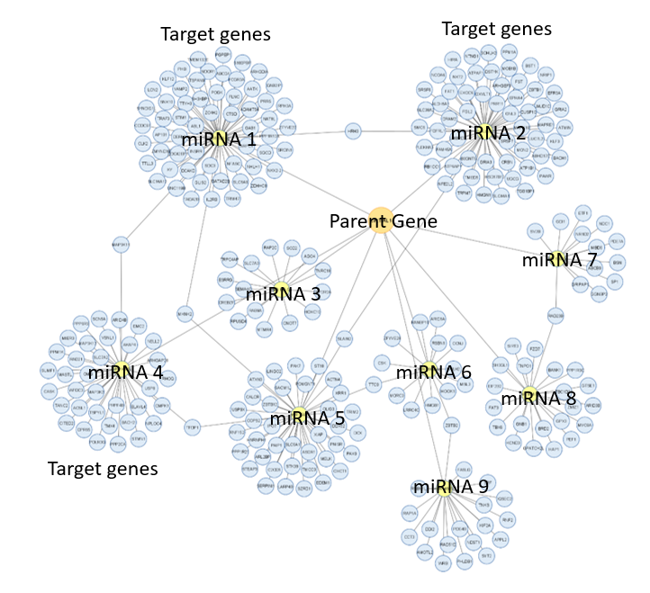
Other Approaches
Functional Analysis can be used in other contexts.
All we need is a “universe” of genes, a subset that is different (the Gene List), and a desire to find biological meaning.
Weighted Gene Co-expression Network Analysis (WGCNA).
Differential circRNA.
Figure curtesy Dr. Marietta Jank

Slide 9
Functional Analysis or What do we do with a gene list?
We start with a Controlled Vocabulary, of relevant gene sets
…and a Gene List of genes of interest…
…and we ask, “Are any of the elements of the controlled vocabulary overrepresented in the gene list?”

Slide 10
The Major Players
Reactome
KEGG
Gene Ontology

Slide 11
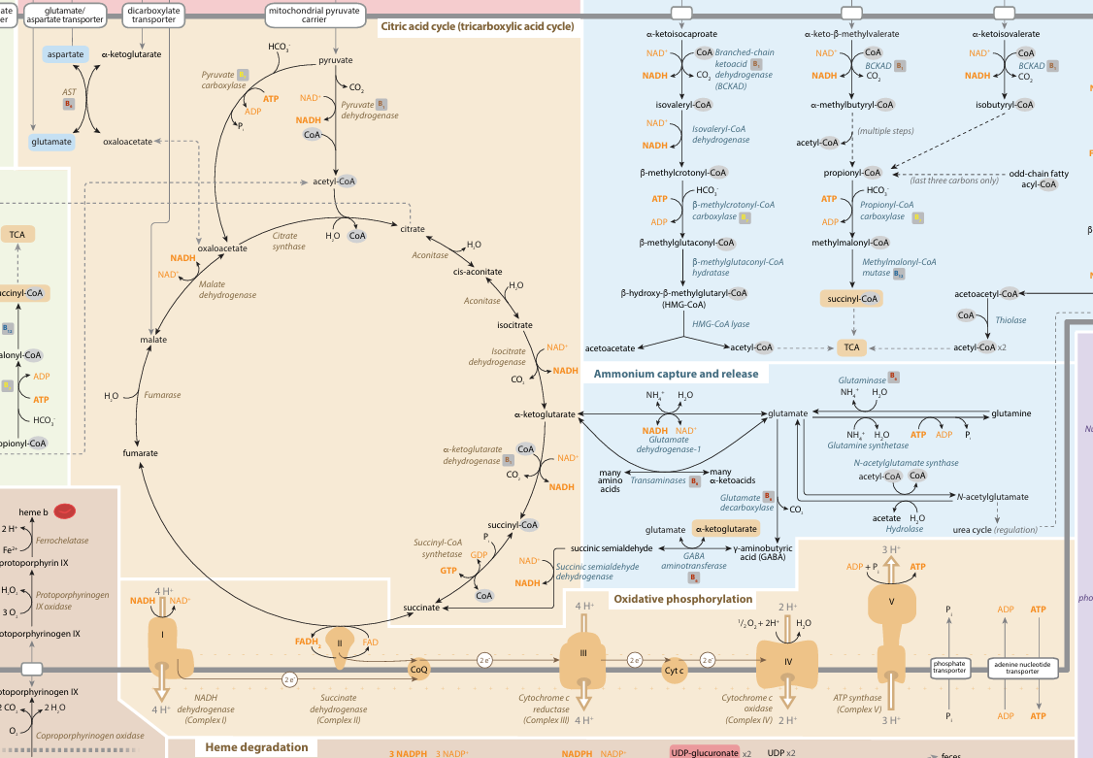
Traditional Pathway
mededucation.stanford.edu/wp-content/uploads/2024/01/FullSubwayMap_V1023_Web.pdf

Slide 12
Names of “Gene Groups”
Some use Pathways. An enzymatic or signaling series
Some use Processes. An experimentally verified group.
Some use Clusters. Computationally inferred group.
Others use Concepts. For Ontological element.
We will call them all the generic form, “Term”.

Slide 13
Introducing three Major Players
Reactome
Started in 2003
Cited over 30,000
KEGG
Kyoto Encyclopedia of Genes and Genomes
Started in 1995
Cited over 51,000 times
Gene Ontology
Started in 1998
Cited over 180,000 times.

Slide 14
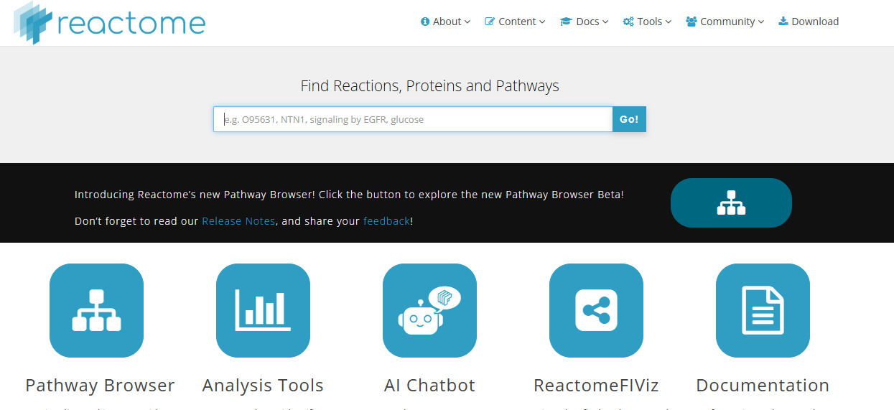
Reactome focus on “human pathways”
“The Reactome Knowledgebase is distinctive in focusing its manual annotation effort on a single species, Homo sapiens, and applying a single consistent data model across all domains of biology. Processes are systematically described in molecular detail to generate an ordered network of molecular transformations, resulting in an extended version of a classic metabolic map. ”
Jassal et al. Nucleic Acids Research 2019. 6;48(D1)

Slide 15
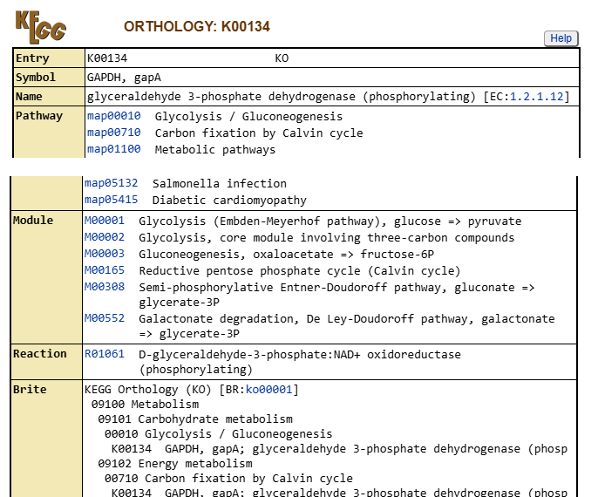
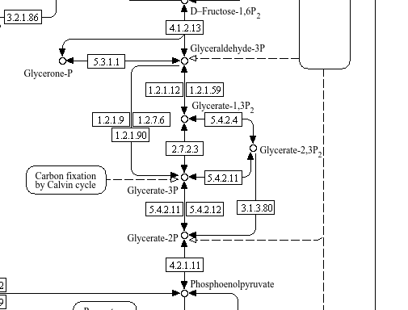
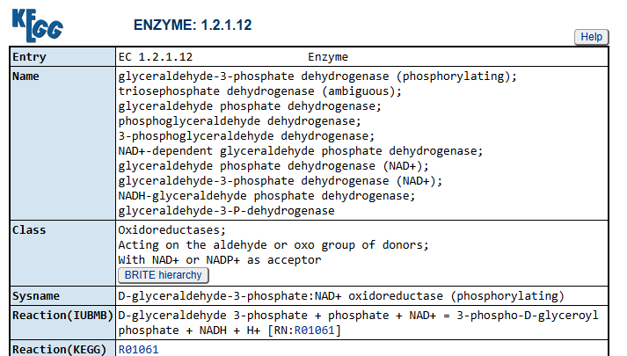
KEGG Pathways
https://www.kegg.jp/kegg-bin/show_pathway?map00010

Slide 16
Gene Ontology

Slide 17
How do we know what we know?
Epistemology. Study of the nature, origin, scope, and limits of human knowledge. It is how we know what we know.
In science it is mostly empirical observation and mathematical inference.
Metaphysics. Study of reality, existence, and being.
From metaphysics, comes our friend, the ontology. It is the study of what exists and how to categorize them. An ontology is a dictionary of everything we know to exist.
Notes:
There are many, competing definitions of these terms, this is the way I was taught them.

Slide 18
Scientific Ontologies
Scientific ontologies are an effort to organize human knowledge.
In science, an ontology has two parts, and one restriction.
The two parts are a controlled vocabulary of all items related to genes and their products and a set of relationships between the items.
Restriction. We limit scientific ontologies to a defined portion of existence. In our case, we will talk about the Gene Ontology which is restricted to biological genes and their products.

Slide 19
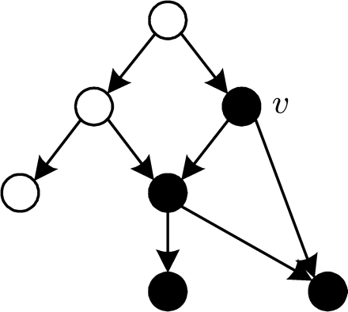
Directed Acyclic Graph
Terms are nodes
Relationships are edges
All relationships are “one way”.
No circular pathways are allowed.
A given node, v, is not independent of the nodes below it.
Trust me, this will become important later in this session!
(Image from: Bioinformatics (2007) 23 (9): 1053-1060.doi:10.1093/bioinformatics/btl673)

Slide 20
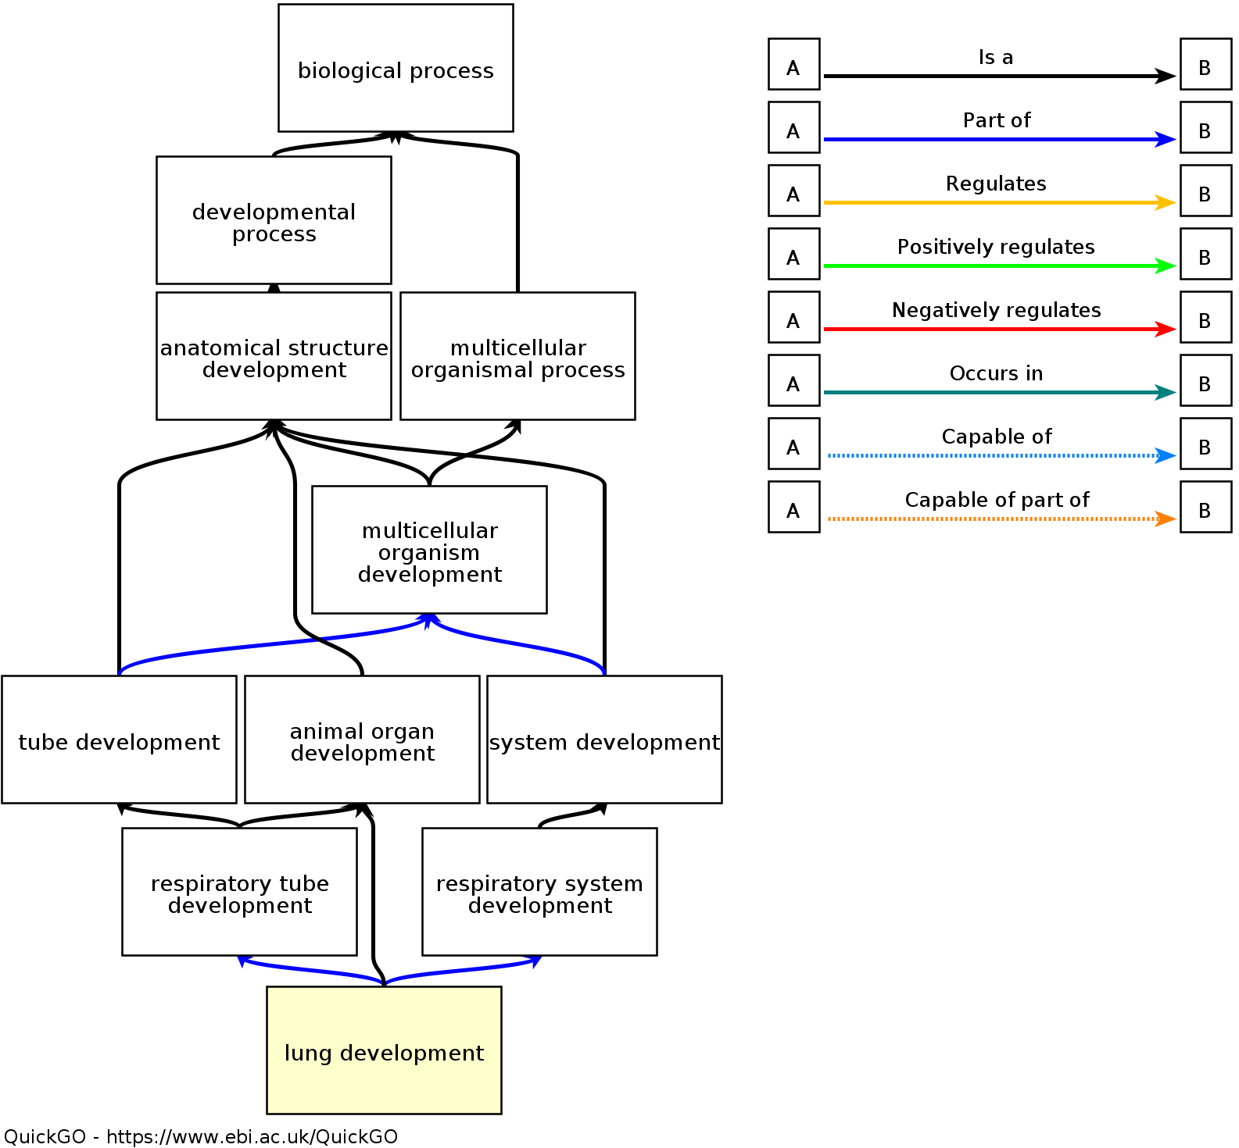
Ontology Structure
27,885 genes (across all species) map directly to lung development.
21 child terms, like lung growth
and bronchiole development
www.ebi.ac.uk/QuickGO

Slide 21
Example GO Term
id: GO:0016049 name: cell growth namespace: biological_process def: "The process in which a cell irreversibly increases in size over time by accretion and biosynthetic production of matter similar to that already present." [GOC:ai] subset: goslim_generic subset: goslim_plant subset: gosubset_prok synonym: "cell expansion" RELATED [] synonym: "cellular growth" EXACT [] synonym: "growth of cell" EXACT [] is_a: GO:0009987 ! cellular process is_a: GO:0040007 ! growth relationship: part_of GO:0008361 ! regulation of cell size

Slide 22
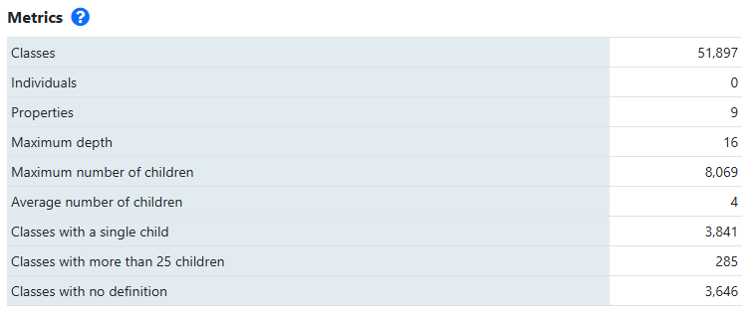
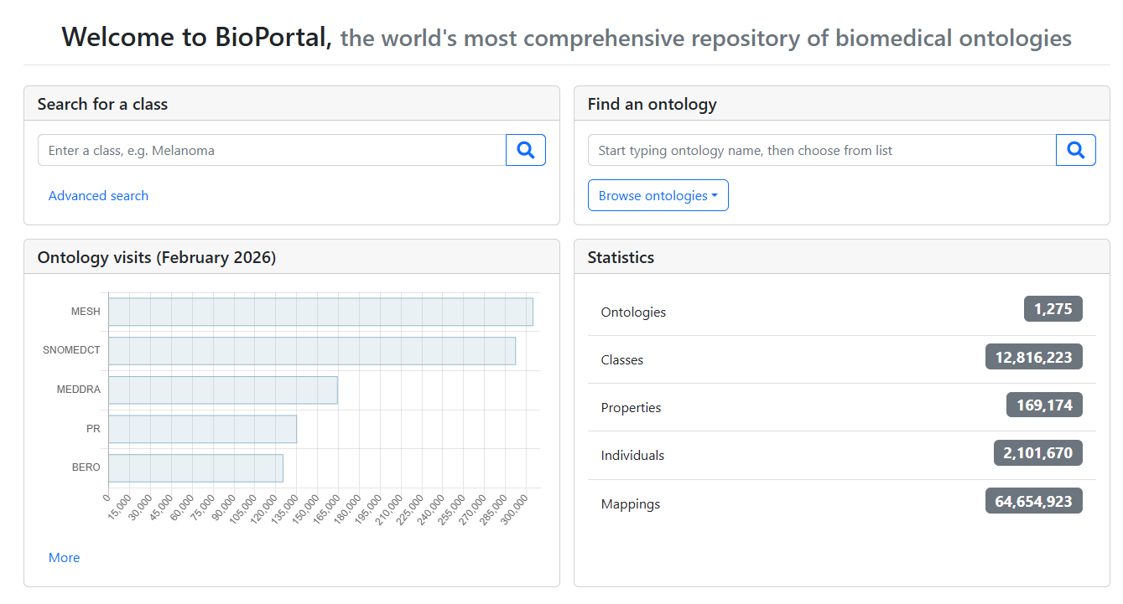
The wealth of controlled vocabularies: Bioportal.bioontology.org
Gene Ontology
Feb. 2026

Slide 23
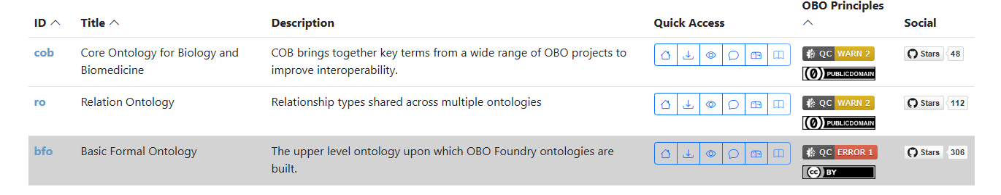
Ontology of Ontology Structure
The Ontology Foundry has ontologies for building ontologies!
https://obofoundry.org/

Slide 24
Comparing Annotational Systems

Slide 25
Annotation Bias
58% of all annotations come from 16% of human genes.
Pitarch et al. 2025, Database, 1-8
When working with data on animal models of certain surgical birth defects, we often see brain related terms—even in other organs.
So, what is going on?

Slide 26
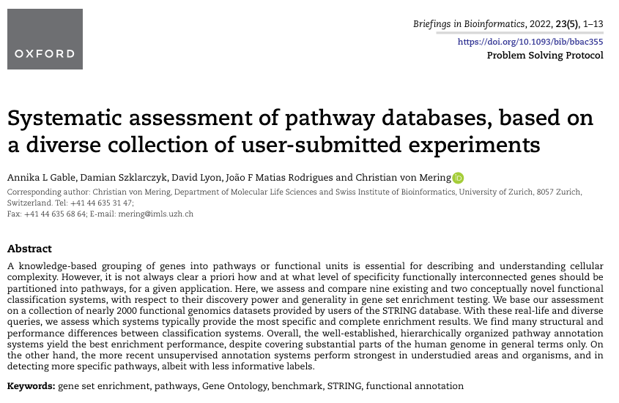

Slide 27
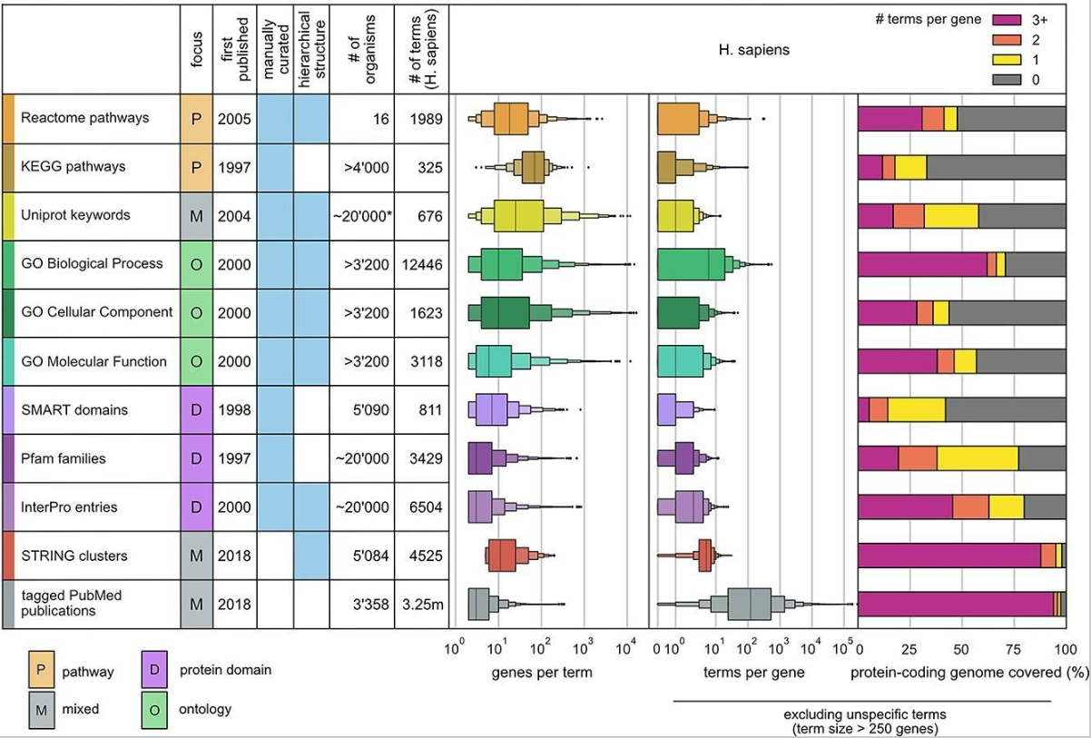
Gable et al. Brief Bioinform. 2022;23(5):bbac355. doi:10.1093/bib/bbac355

Slide 28
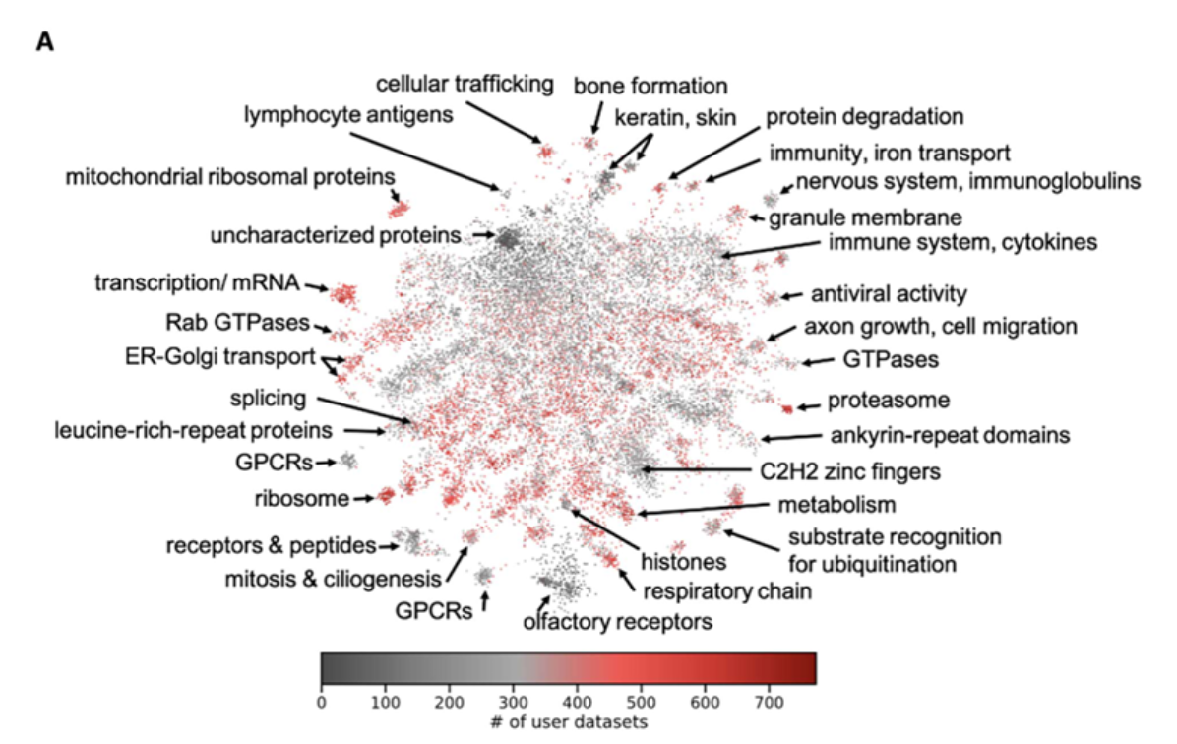
They have clustered all the protein-protein interactions in the STRING DB to form the tSNE plot. Then looked at the genes of 1959 data sets submitted to STRING.
Gable et al. Brief Bioinform. 2022;23(5):bbac355. doi:10.1093/bib/bbac355
Notes:
1959 data sets submitted to STRING for functional analysis. Of those sets, how many had a molecular entity from given gene.

Slide 29
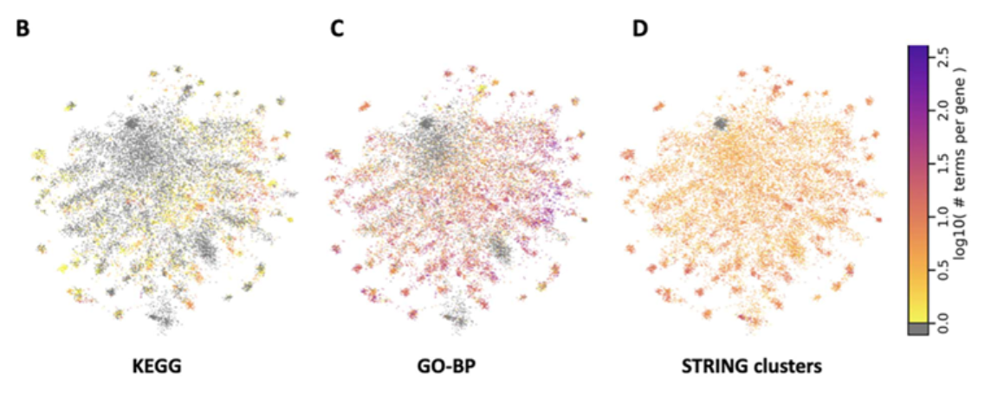
Gene Coverage by Different Approaches
Gable et al. Brief Bioinform. 2022;23(5):bbac355. doi:10.1093/bib/bbac355
Notes:
Density of terms for the given tool.

Slide 30
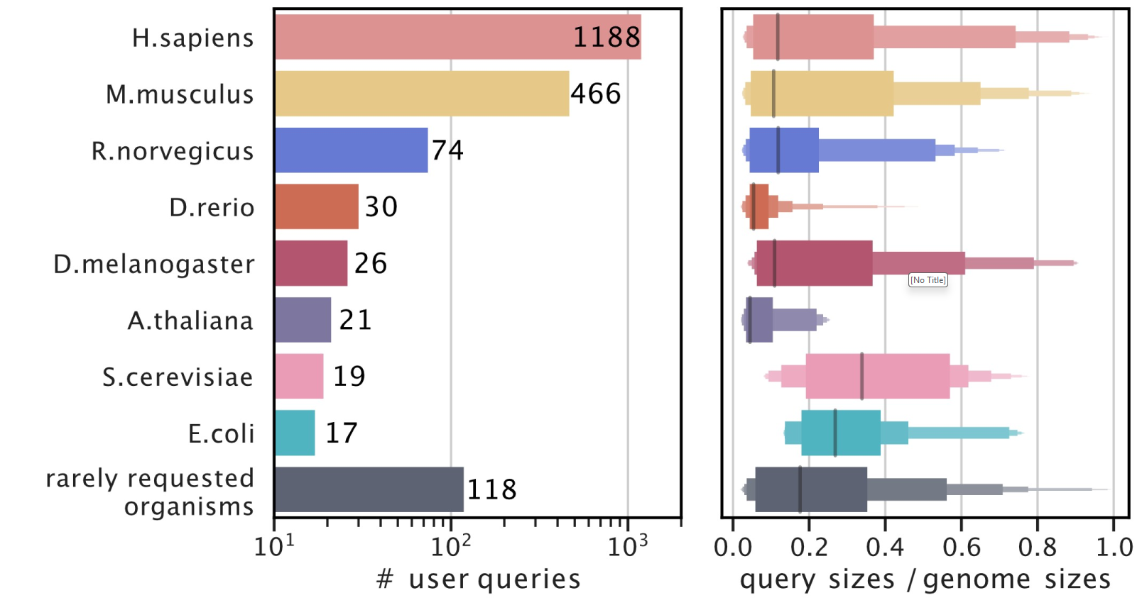
Submitted Datasets
88% are human/rat/mouse.
Gable et al. Brief Bioinform. 2022;23(5):bbac355. doi:10.1093/bib/bbac355
Notes:
1959 data sets submitted to STRING for functional analysis. Notice that most discover omics measure gene products from less than 20% of all genes.

Slide 31
Their Results
Established pathway annotation systems differ widely in the number and size of their pathways and terms.
Most of the human genome is not annotated in detail.
LeDuc’s corollary. It is worse the farther away you get from well known systems.
User datasets are biased towards universally expressed genes.
LeDuc. Most of what we measure is what kept the sample alive.
Annotation depth reflects global research interests.
LeDuc. There are more problems than researchers and there is a lot left to study.
Gable et al. Brief Bioinform. 2022;23(5):bbac355. doi:10.1093/bib/bbac355

Slide 32
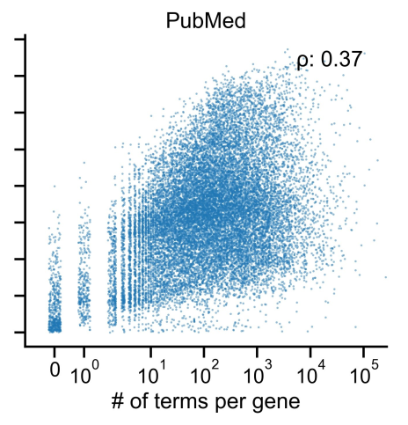
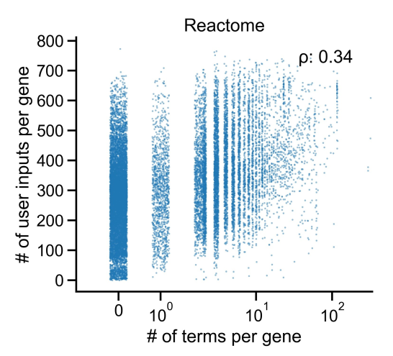
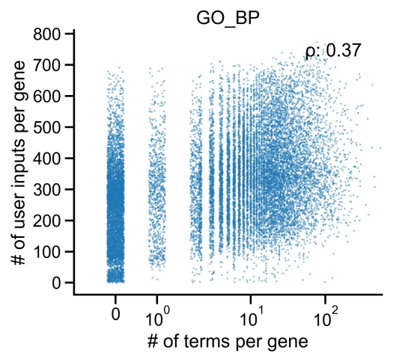
Terms per Gene for their 1959 Data Sets
Notes:
Note all the zeros. Many molecular entities don’t map into a given functional analysis system. Terms for PubMed reflect have a paper uniquely about the gene (after applying their filtering criteria).

Slide 33
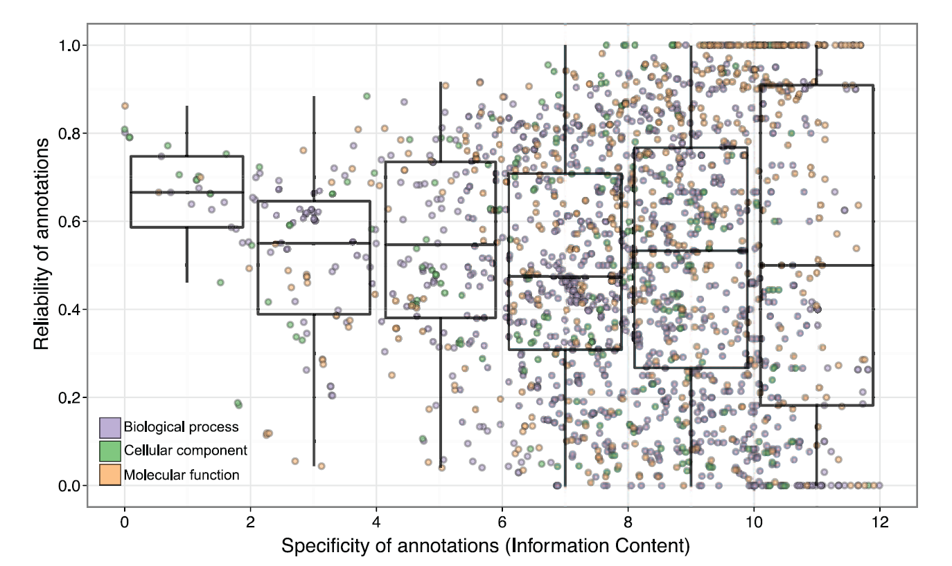
How Reliable are Automated GO Annotations?
Authors looked at the changes in GO annotations in three-year periods between 2006 and 2011. Compared early automated vs. later curated.
Most are annotations based on homology to another species.
Reliability is (#Auto Assigned Annotations) / (# later confirmed experimentally)
Skunca et al. (2012) PLOS Computational Biology 8:5, e1002533

Slide 34
Doing Functional Analysis

Slide 35
What do we need
Table of Molecular Entity Expression Levels, this defines the Gene Universe.
Experimental Design and statistical analysis usually gives the Gene List.
A Controlled Vocabulary (Usually ontology or pathway file)
Mapping file for relating Molecular Entities to Terms in the Controlled Vocabulary.
A tool to run the analysis.
Always remember to report all your version numbers

Slide 36
The Math: Big Picture
For each Term in the Controlled Vocabulary
Assign a p-value for the Term being overrepresented.
This is different from the differential expression p-value.
Correct the Term’s p-values to reflect multiple testing.
Interpret the results.
Two common approaches for assigning p-values: Hypergeometric or GSEA

Slide 37
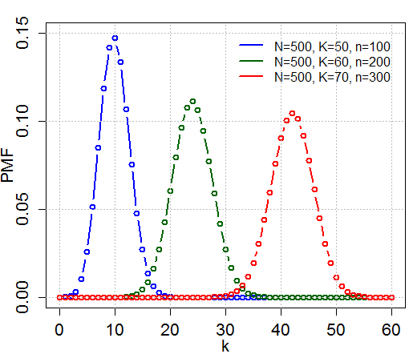
The Hypergeometric Distribution
A probability distribution used as the basis of a statistical test.
Analytic solution to sampling without replacement (more on the next slide).
Also known as Fisher’s Exact Test (for the one tailed-version, two-tailed is the sum of two one-tailed).
en.wikipedia.org/wiki/Hypergeometric_distribution

Slide 38
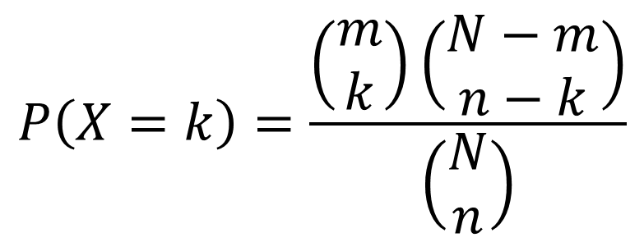
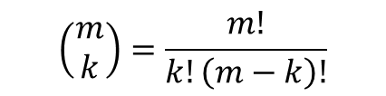
Hypergeometric
Imagine an urn with a fixed number of white and black marbles. If you draw n marbles (without looking) what is the probability that k of them will be white?
The answer is given with the hypergeometric distribution.
 | Drawn | Not Drawn | Total
White | k | m-k | m
Black | n-k | N+k-n-m | N-m
Total | n | N-n | N

Slide 39
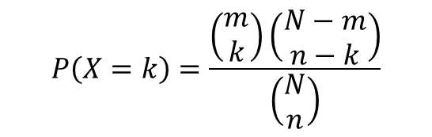
Hypergeometric
Some pre-defined set become “white marbles” (say, all genes with a given GO annotation or belonging to a pathway), and the array is the total set of all marbles.
If I have n statistically different mRNA expression levels out of N genes on the array, and k of them are in my pathway of interest (with m in the pathway on my microarray), should I be excited by this result?
 | Significant | Not Significant | On Array
In pathway | k | m-k | m
Not in pathway | n-k | N+k-n-m | N-m
Total | n | N-n | N

Slide 40
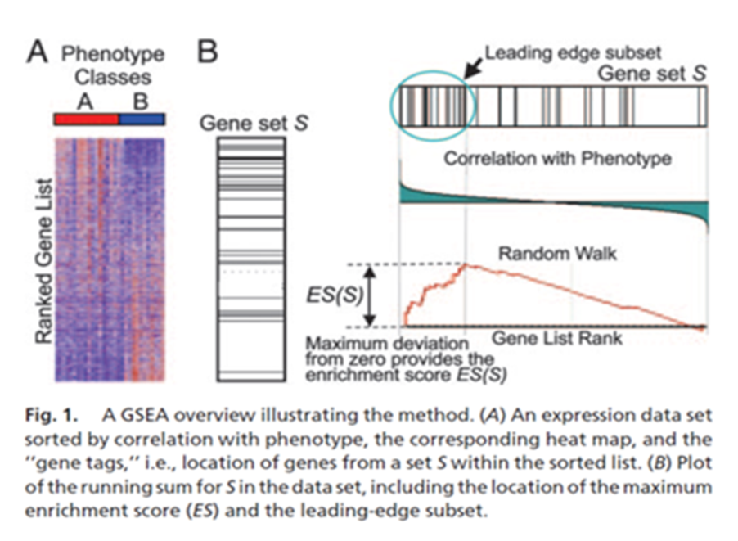
Gene Set Expression Analysis
Subramanian et al. (2005) “Gene set enrichment analysis: A knowledge-based approach for interpreting genome-wide expression profiles” PNAS 102 (43) 15545-15550.
Mootha et al. (2003) Nature Genetics 34 (3): 267-273
Three step process

Slide 41
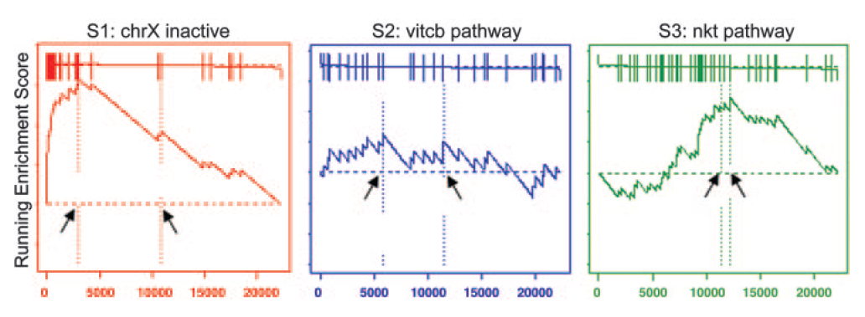
Step 1: Calculate Enrichment Score
Increase Enrichment Score as a function of the genes correlation with the phenotype each time you pass a member of the pre-defined set.
Decrease it each time you pass a gene that is not in the set.
Highest value reached is the enrichment score.

Slide 42
Step 2: Estimate the Significance Level
Take the observed sample data and randomly assign each sample to a phenotype. (Under null hypothesis, treatment doesn’t matter.)
Recalculate the ES values for this random data.
Lather, rinse, repeat #1 and #2 several times.
The distribution of random ES scores is then used to estimate the significance of our real score.

Slide 43
Step 3: Correct for Multiple Testing
They use a more modern FDR correction developed by Benjamini and others.
Benjamini, Y., Drai, D., Elmer, G., Kafkafi, N. & Golani, I. (2001) Behav. Brain Res. 125, 279–284.
Reiner, A., Yekutieli, D. & Benjamini, Y. (2003) Bioinformatics 19, 368–375.

Slide 44
Big Take-Aways
Functional analysis helps make sense out of long lists of molecular entities.
Human knowledge biases functional analysis.
But that’s okay because it is typically used for hypothesis generation.
You need to have all the correct bits and bobs to make it work, and you should report their version numbers.

Slide 45







Coffee Break & Networking Session
Workshop Sponsors

