Slide 1

Module 2b - Defined Gene Lists
Diogo Pellegrina
May 12, 2026

Slide 2
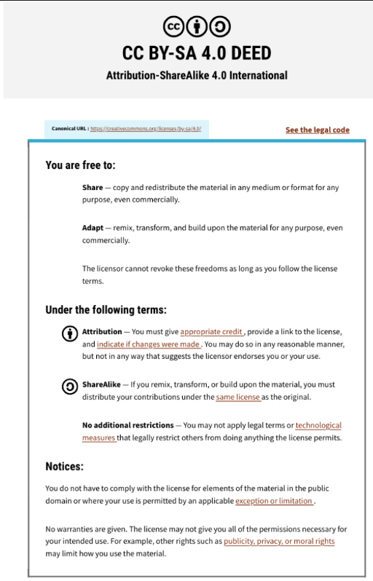
This presentation is an adaptation of 2024 lecture from Veronique Voisin

Slide 3
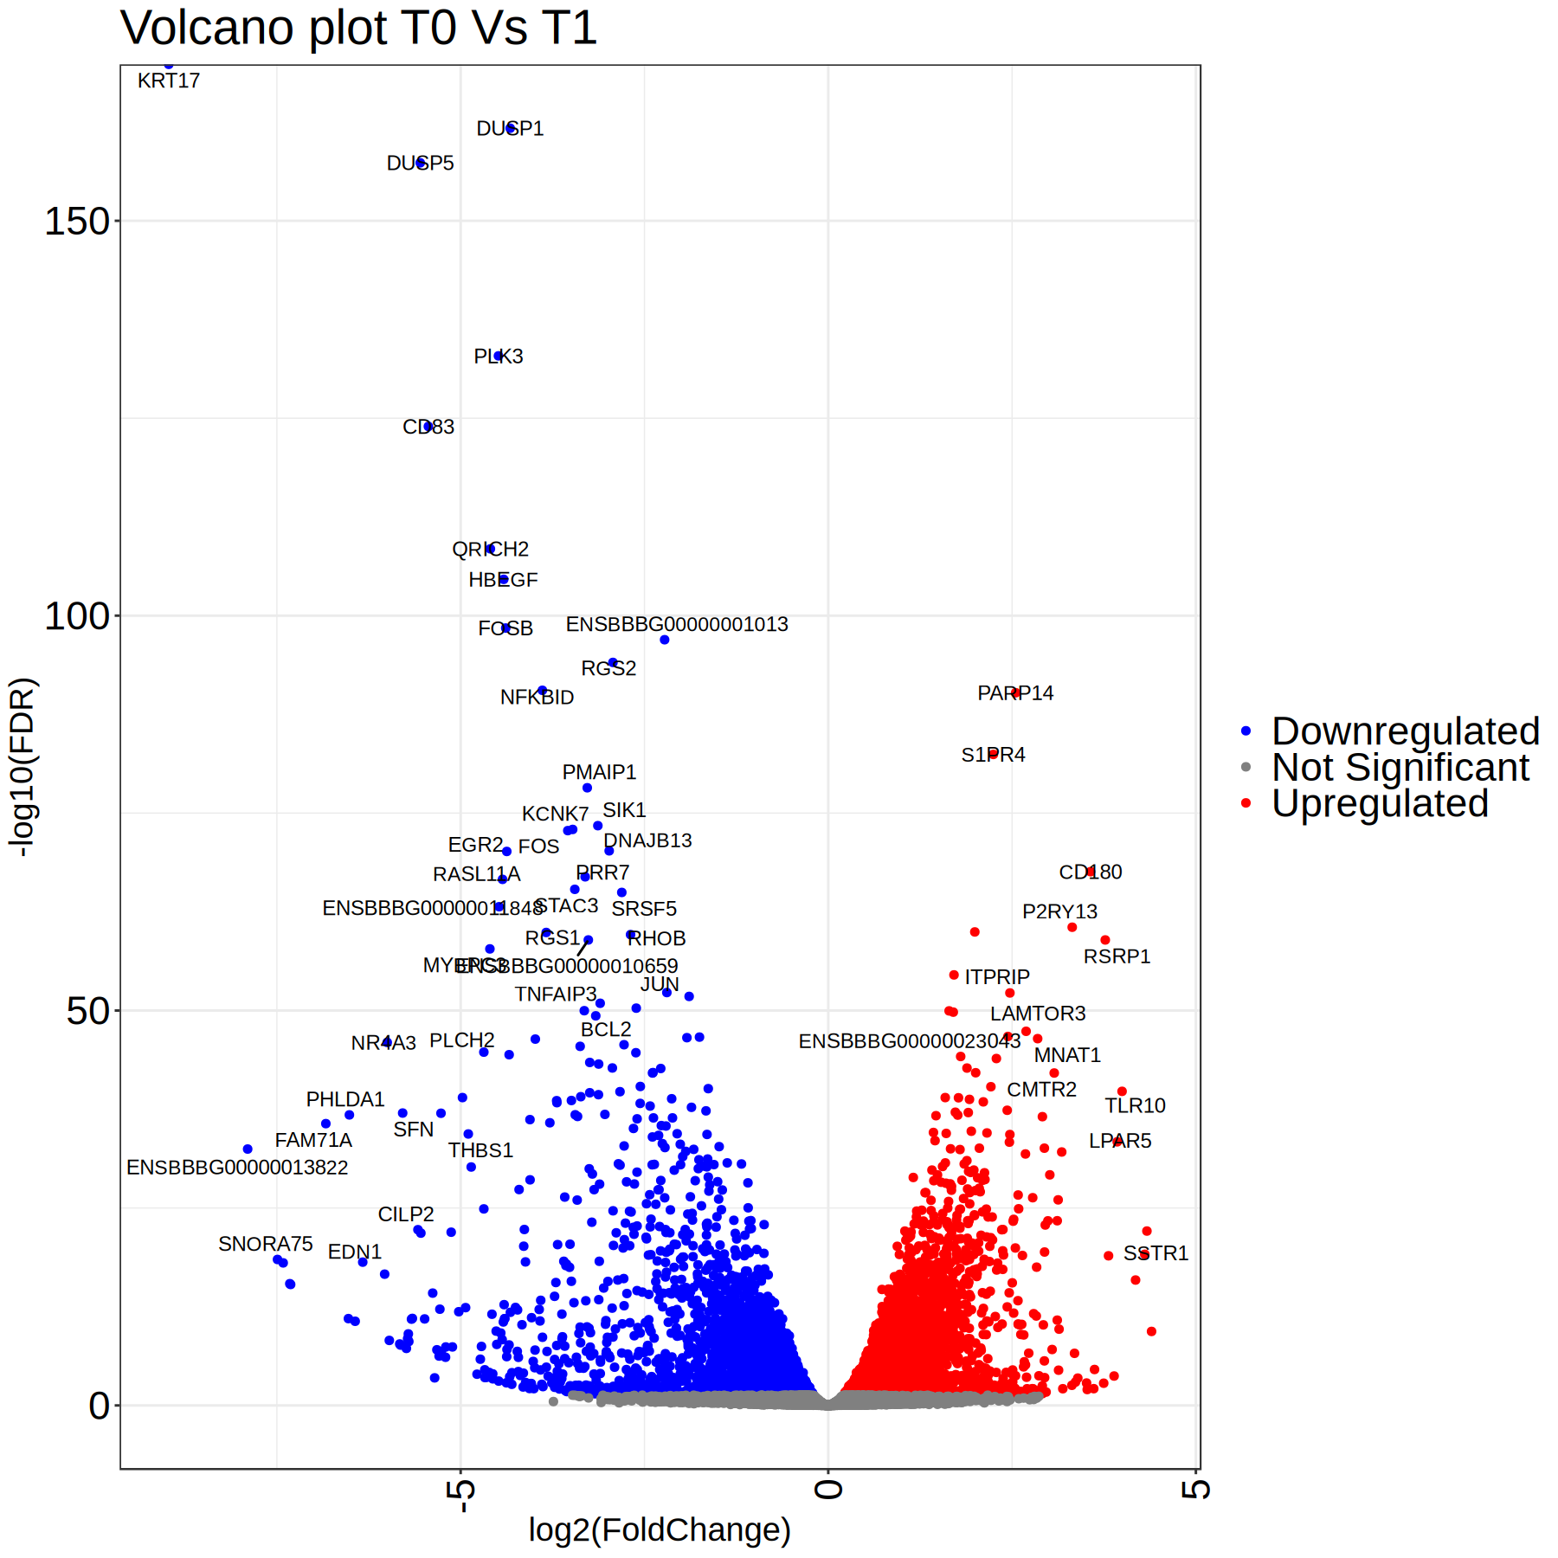
Interpreting lists of gene names
My experiment was a success, I got a list 1000+ significant genes.
What can I do when I have too much information?
?

Slide 4
Pathway enrichment analysis is done by comparing the overlap/intersection between our gene list and some curated gene lists*
pathway:
axon guidance (GO:0007411)
overlap
My gene list
LAMC2
MYPN
SEMA3G
PFKB3
SH2D2A
MDM2
RFX2
IFI30
TUBB3
SLC45A3
SIPA1L2
SEMA4A
GAB2
SLIT1
LAMA1
ARHGAP19
TMOD2
DOK4
DOK1
RELN
BDNF
STON2
SEMA7A
SEMA5B
PTPRA
EFNB1
VASP
LRPAP1
SH3PXD2A
SEMA6B
COTL1
DNM3
SQLE
BSG
EPHB3
STK17A
F2RL3
LAMA5
NFKB2
ATP6V0A1
GADD45B
NRP2
IGSF9
SPTB SRC
BDNF
TTC7B
ARPC1B
SLC20A2
EFNA
SMO
SEMA7A
KIF5C
TNR
IL21R
GFRA3
LGI1
NTRK1
LAMA2
ALCAM
DOK4
SLC20A2
PPIF
BMP2K
PIK3CB
PALLD
PTPN11
Notes:
(0.999^2000) +
((0.999^1999*0.001)*2000) +
((0.999^1998*0.001^2)*2000*1999/2) + ((0.999^1997*0.001^3)*2000*1999*1998/6) +((0.999^1996*0.001^4)*2000*1999*1998*1997/24) +((0.999^1995*0.001^5)*2000*1999*1998*1997*1996/120)

Slide 5
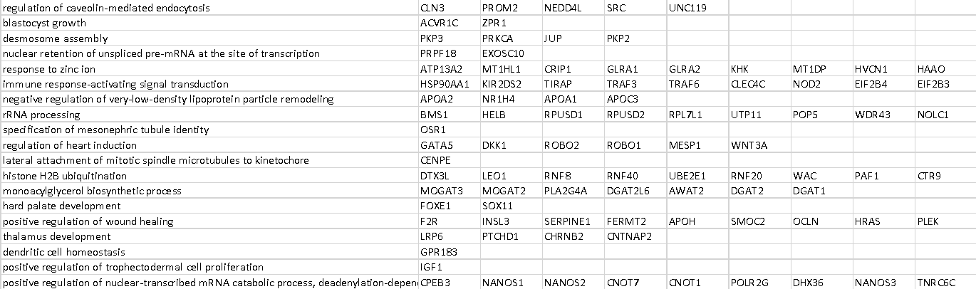
Getting curated gene lists:
There are many available sources of useful lists.
The most relevant ones are those that are open to the public and can be downloaded as .gmt files*, such as Reactome, GO (Gene Onthology), WikiPathays, and others

Slide 6
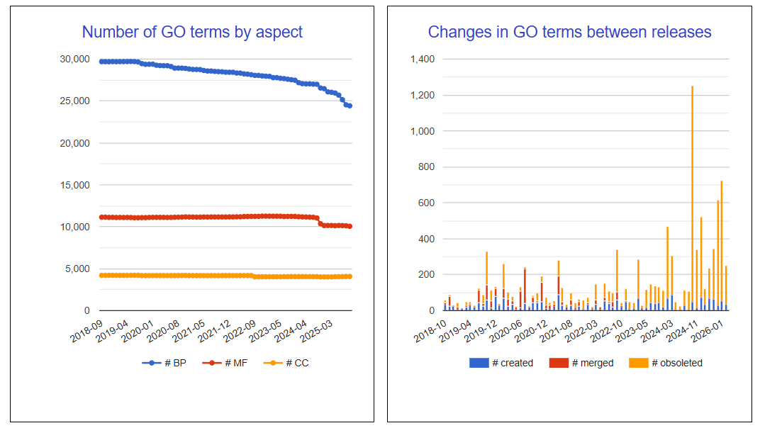
Different sources
Gene Ontology (GO) is by far the largest source. 174 species have >1k annotations. Includes various degrees of experimental validation.

Slide 7
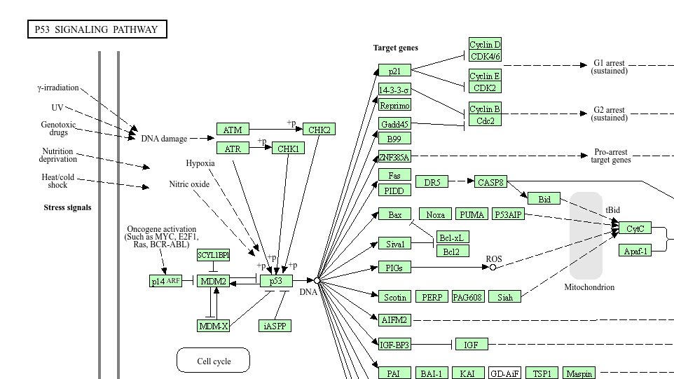
Different sources:
KEGG: High quality, manually curated pathways. But several features aren’t freely available. Diagrams like these are available with some limitations.

Slide 8
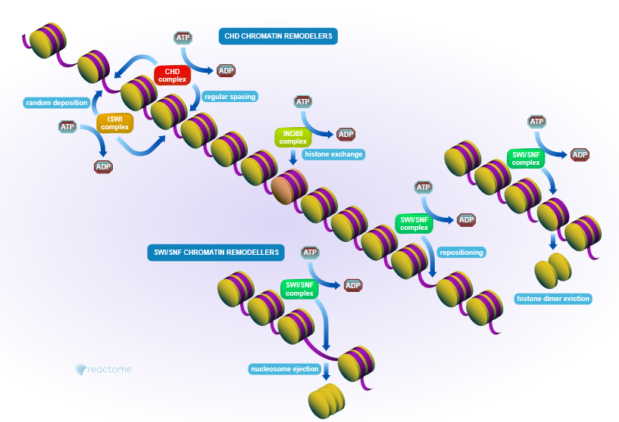
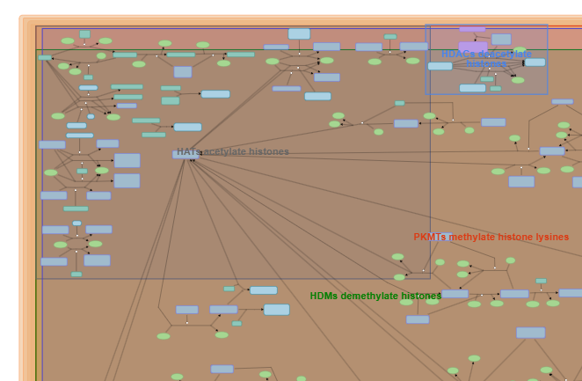
Different sources:
Reactome: ~25k pathways for 15 species. Also manually curated, 100% open-source, has summarized and full diagrams.

Slide 9
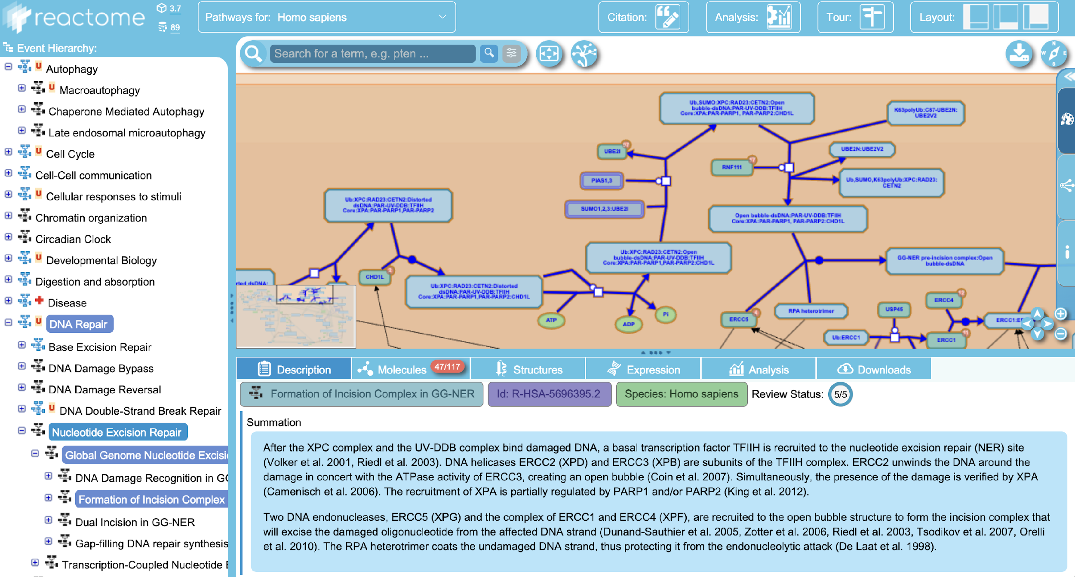
All of this data can be downloaded, but it is quite complex

Slide 10
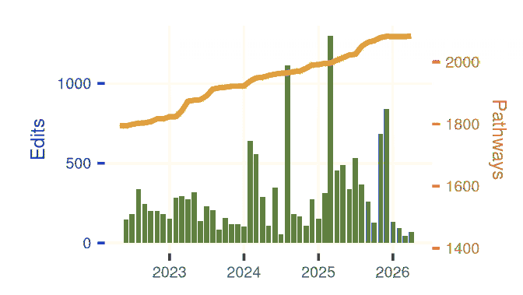
Wikipathways
Created by the community wiki-style, 670 authors so far.
Decent size and good quality overall (mostly human made).

Slide 11
Other sources
miRTarBase: terms contain the targets of micro RNAs
Transfac: terms contain the targets of transcription factors
Human Protein Atlas: terms are mostly describing the tissues where proteins are found.
Human Phenotype Ontology: terms contain genes with disease-related polymorphisms.
CORUM: Terms are protein complexes

Slide 12
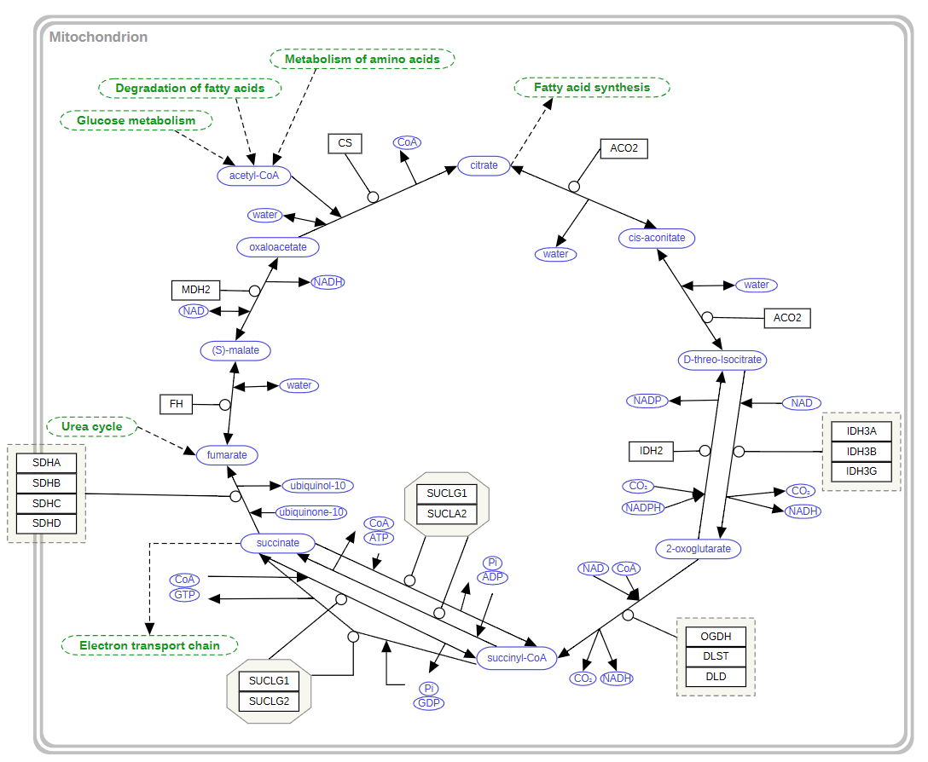
Pathway enrichment analysis will compare your list with other well known lists of genes:
There are ~20000 known genes in the human genome. Let’s suppose your list of differentially expressed genes has 2000 genes.
From WikiPathways there are ~20 genes in “WP78:Tricarboxylic acid cycle”.
If I have 3 DEGs in WP78, is this a lot?

Slide 13
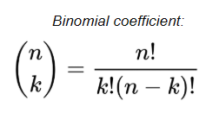
Pathway enrichment analysis will compare your list with other well known lists of genes:
20000 known genes, 20 genes in a certain pathway (0.1%).
If I “roll a 1d1000” for each DEG, what is the likelihood I get 3 (or more) hits?
1-
(0.999^2000) +
(0.999^1999*0.001)*2000 +
(0.999^1998*0.001^2)*2000*1999/2 = 0.32
Notes:
(0.999^2000) +
((0.999^1999*0.001)*2000) +
((0.999^1998*0.001^2)*2000*1999/2) + ((0.999^1997*0.001^3)*2000*1999*1998/6) +((0.999^1996*0.001^4)*2000*1999*1998*1997/24) +((0.999^1995*0.001^5)*2000*1999*1998*1997*1996/120)

Slide 14
Pathway enrichment analysis will compare your list with other well known lists of genes:
20000 known genes, 20 genes in WP78 (0.1%).
If I “roll a 1d1000” for each DEG, what is the likelihood I get 5 (or more) hits?
1-
(0.999^2000) +
((0.999^1999*0.001)*2000) +
((0.999^1998*0.001^2)*2000*1999/2) + ((0.999^1997*0.001^3)*2000*1999*1998/6) + ((0.999^1996*0.001^4)*2000*1999*1998*1997/24) + ((0.999^1995*0.001^5)*2000*1999*1998*1997*1996/120) = 0.016
Notes:
(0.999^2000) +
((0.999^1999*0.001)*2000) +
((0.999^1998*0.001^2)*2000*1999/2) + ((0.999^1997*0.001^3)*2000*1999*1998/6) +((0.999^1996*0.001^4)*2000*1999*1998*1997/24) +((0.999^1995*0.001^5)*2000*1999*1998*1997*1996/120)

Slide 15
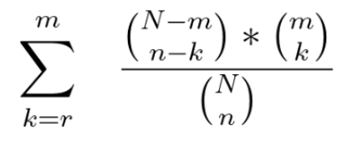
Don’t worry, there is a formula for that:
Don’t worry, you will never see this formula again:
Many tools were already implemented to do this test (sometimes with extra features) in very convenient ways.
Notes:
(0.999^2000) +
((0.999^1999*0.001)*2000) +
((0.999^1998*0.001^2)*2000*1999/2) + ((0.999^1997*0.001^3)*2000*1999*1998/6) +((0.999^1996*0.001^4)*2000*1999*1998*1997/24) +((0.999^1995*0.001^5)*2000*1999*1998*1997*1996/120)

Slide 16
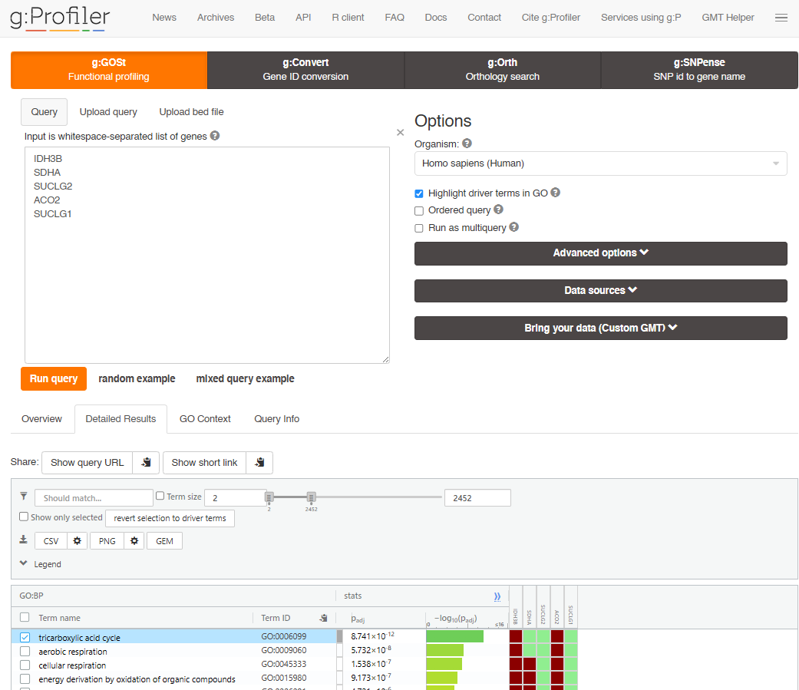
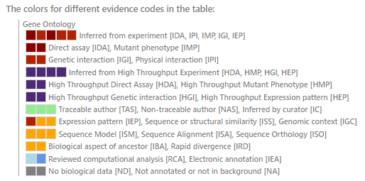

Slide 17
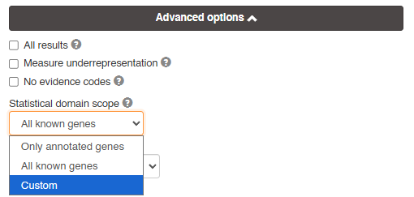
Remember to include a custom statistical domain!
The default will consider all genes found in at least one of the pathways being compared.
In most cases you will want to include a custom background list, for example, in an RNAseq you should add all genes in the gtf/gff file you used to align reads.

Slide 18
There is lots of room for creativity:
Example: Genome Wide Association Study (GWAS)
 | Cases |  |  |  |  | Controls
SNP | 1 | 2 | 3 | 4 | 5 | 6 | 7 | 8 | 9 | 10
A | 1 | 0 | 0 | 0 | 0 | 0 | 0 | 0 | 0 | 0
B | 0 | 1 | 0 | 0 | 0 | 0 | 0 | 0 | 0 | 0
C | 0 | 0 | 1 | 0 | 0 | 0 | 0 | 0 | 0 | 0
D | 0 | 0 | 0 | 1 | 0 | 0 | 0 | 0 | 0 | 0
E | 0 | 0 | 0 | 0 | 1 | 0 | 0 | 0 | 0 | 0
F | 0 | 0 | 0 | 0 | 0 | 1 | 0 | 0 | 0 | 0
Since the mutation matrix is too sparse, no gene is found mutated significantly more often in the cases than in the controls

Slide 19
There is lots of room for creativity:
Example: Genome Wide Association Study (GWAS)
 | Cases |  |  |  |  | Controls
Pathway | 1 | 2 | 3 | 4 | 5 | 6 | 7 | 8 | 9 | 10
Apoptosis | 1 | 1 | 1 | 1 | 1 | 0 | 0 | 0 | 0 | 0
But if you combine mutations found in genes of enriched pathways, you can find more rows with a more workable number of mutations.
By aggregating counts and reducing multiple testing penalties you have better statistical power
Results are easier to interpret

Slide 20
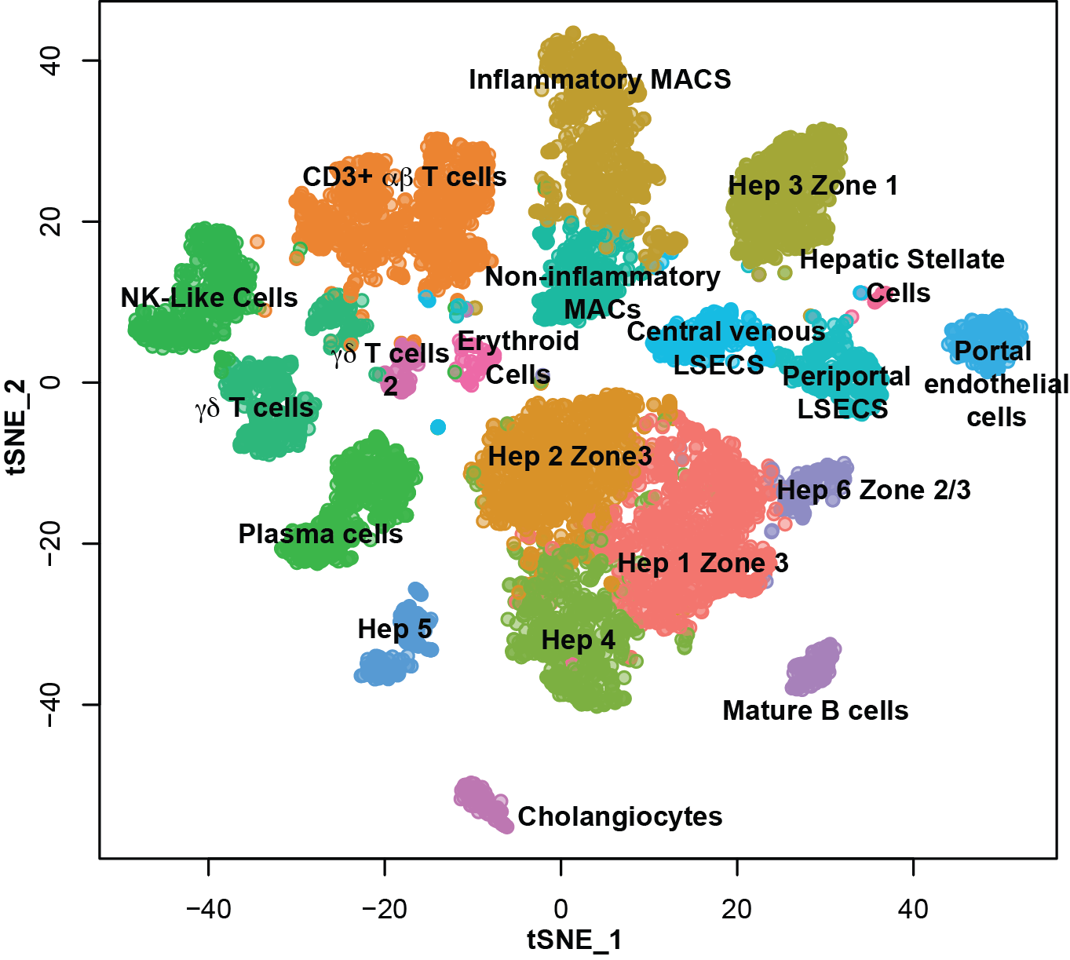

Often times you will want to do several PEAs in parallel
In this exemple cells from a scRNAseq experiment were clustered. You can run a PEA using a command line to annotate each cluster
8444 single cells from five human liver samples
Public data, contributed to
Human Cell Atlas
(https://www.humancellatlas.org)
shiny.baderlab.org/HumanLiverAtlas/
MacParland et al., Oct.22.2018, Nature Communications

Slide 21
Often times you will want to do several PEAs in parallel
If you have clusters of genes, you will need a different background list in each case.
8444 single cells from five human liver samples
Public data, contributed to
Human Cell Atlas
(https://www.humancellatlas.org)
shiny.baderlab.org/HumanLiverAtlas/
MacParland et al., Oct.22.2018, Nature Communications

Slide 22
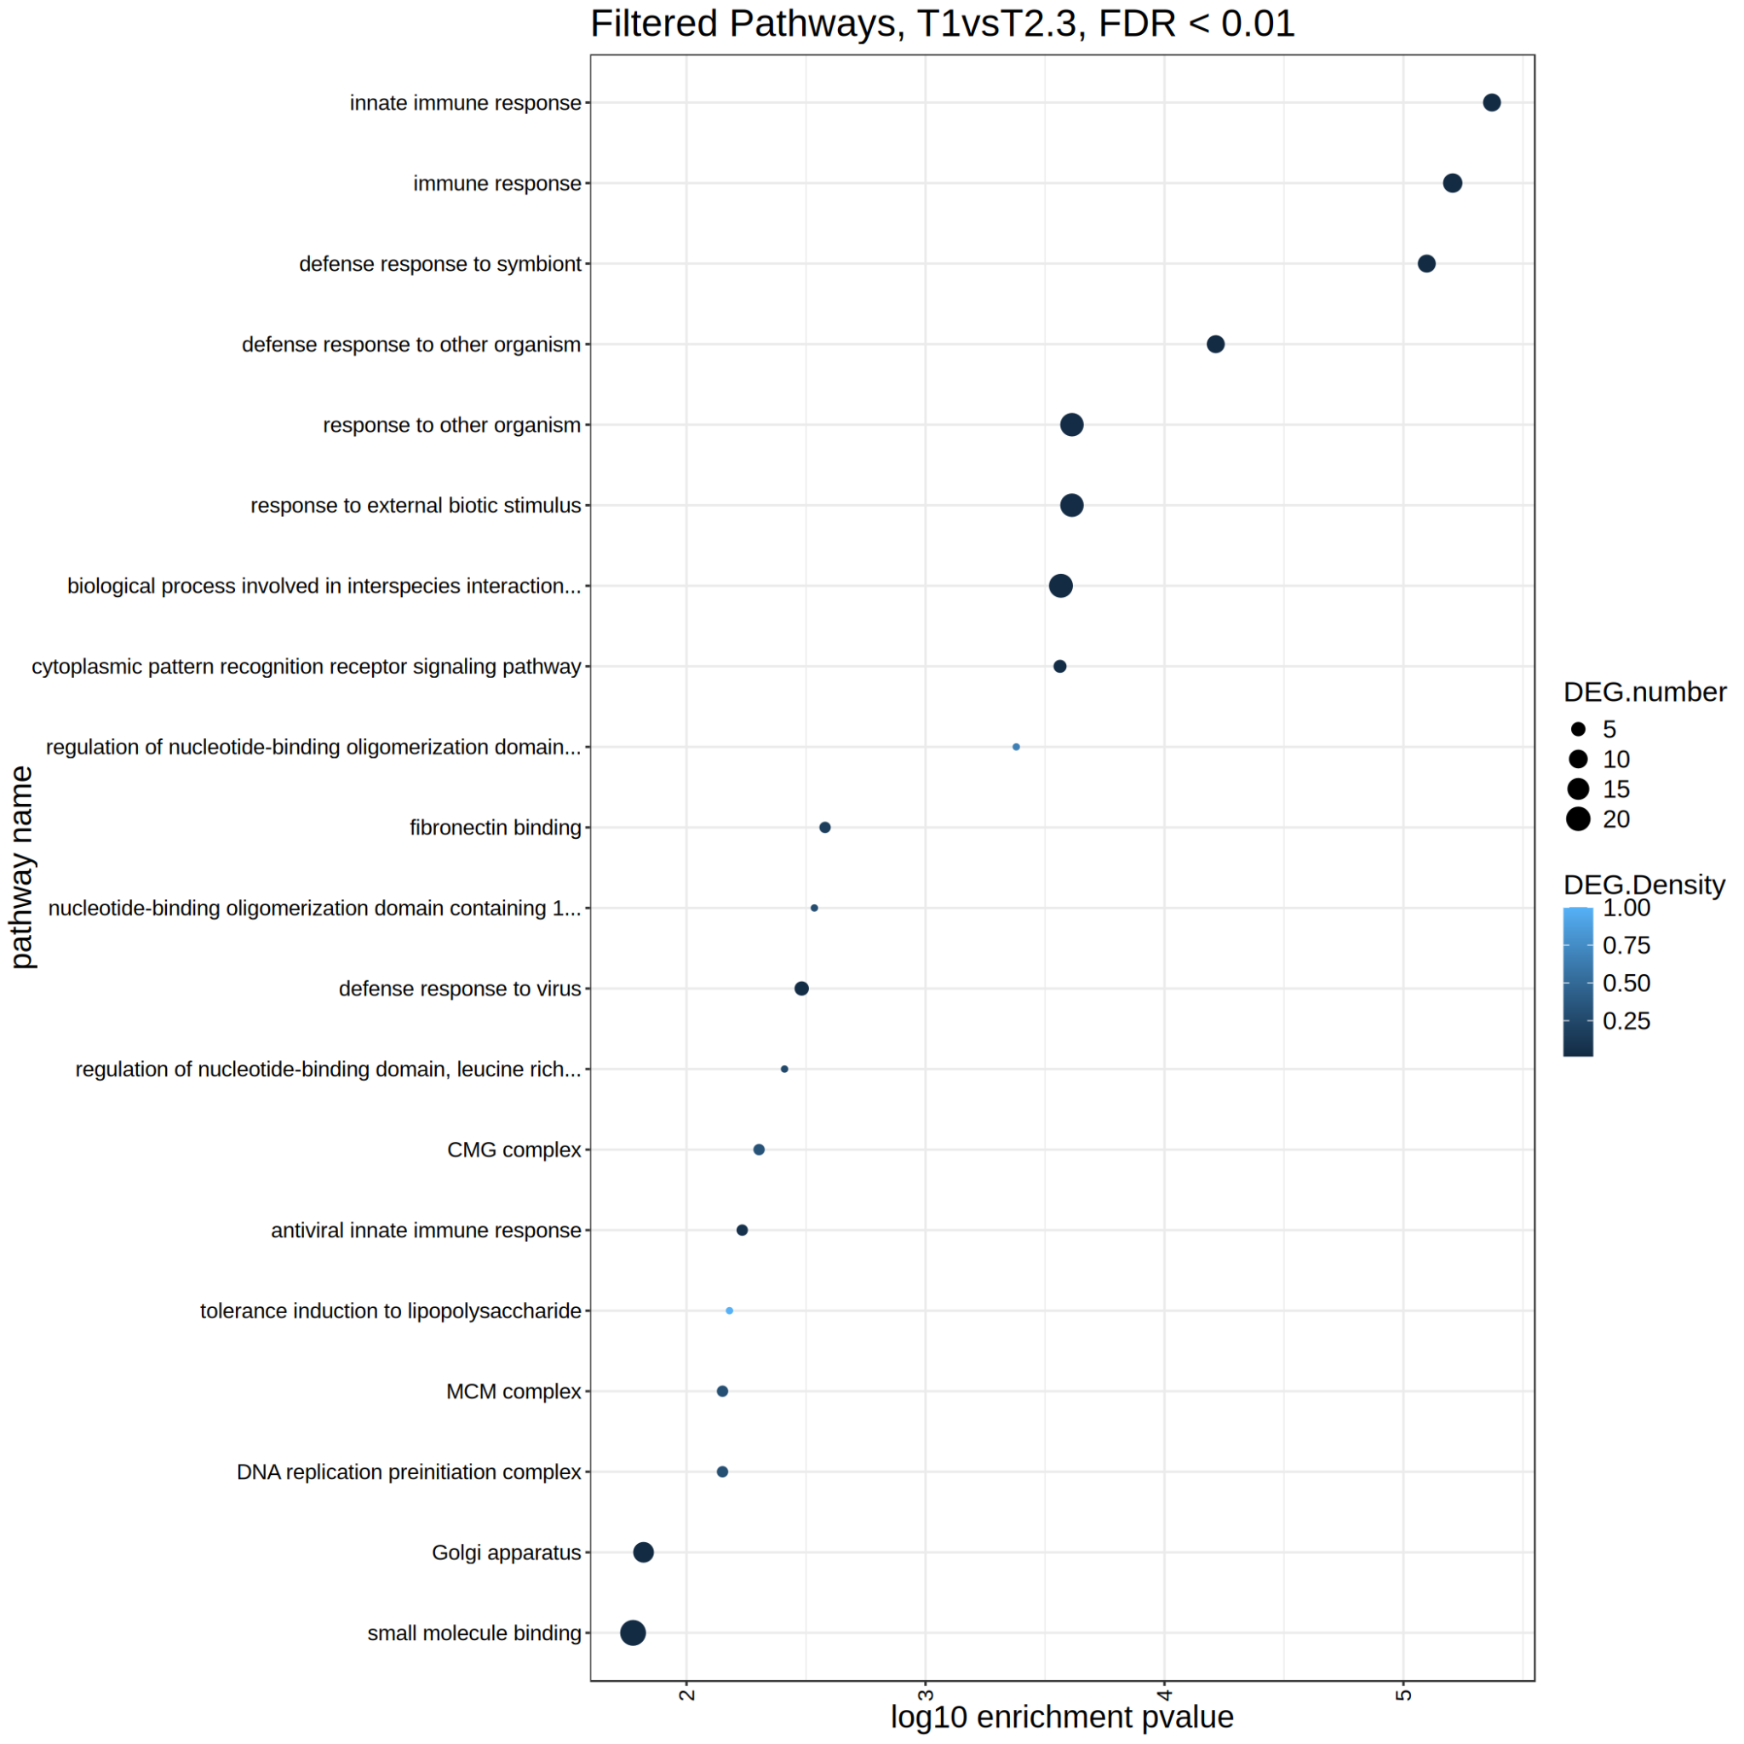
The most “classic” way of visualizing PEA:
Showing pathway name, adjusted p-value, and number of intersecting genes.
In this example Bison with tuberculosis are compared with controls.
Among the top pathways are:
innate immune response
nucleotide-binding oligomerization domain
small molecule binding

Slide 23
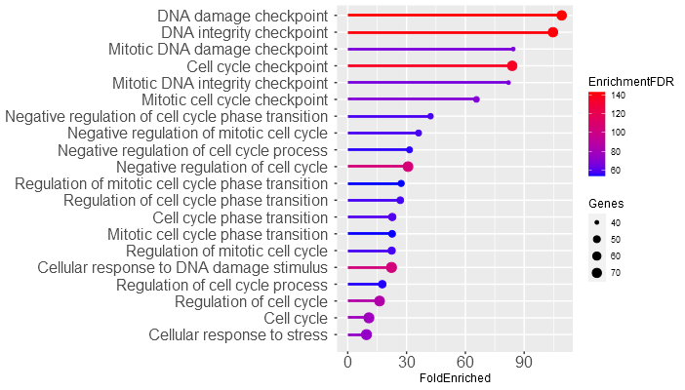
In most cases you will have hundreds of enriched pathways, all very similar to each other:

Slide 24
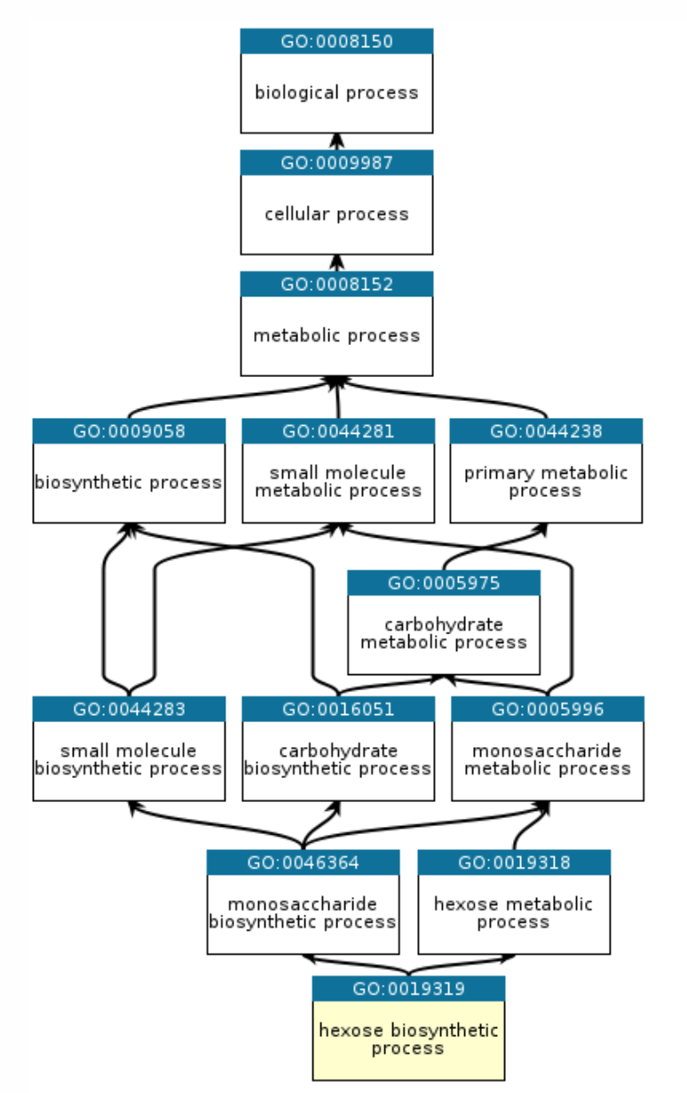
These repetitive results originate from the nested structure of reference pathways:
If a biological process affected the expression of the genes that belong to a certain pathway, it will necessarily also enrich all the supersets of that pathway.
Pathways can also be “hitchhiked” even if they locally have less DEGs.
There are several tools you can use after PEA to solve this problem, for example:
4

Slide 25
PathwayDenester tests if the genelist falls more than expected in the intersection between pathways
It takes your list of enriched pathways and uses a test similar to the hypergeometric test used in PEA.
If a pathway is, more often than expected, enriched by the genes in the intersection with a more significant pathway, it is excluded.
4

Slide 26
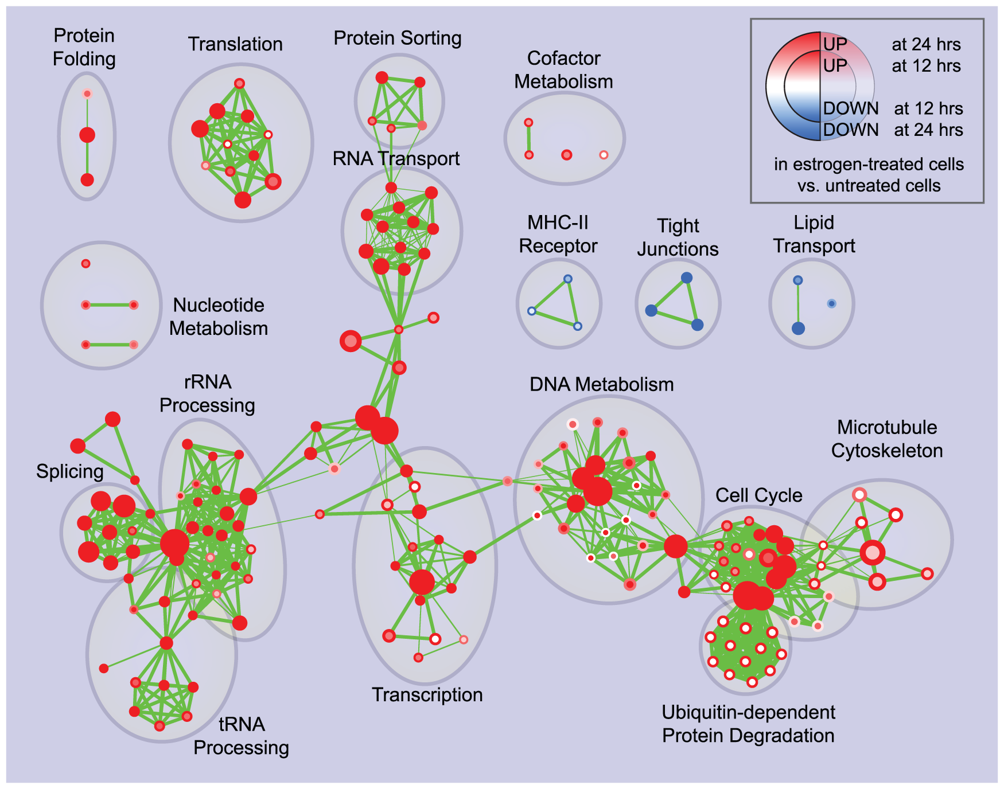
Enrichment Map will cluster similar pathways and display them in a graph:
(more about it tomorrow)

Slide 27


Slide 28
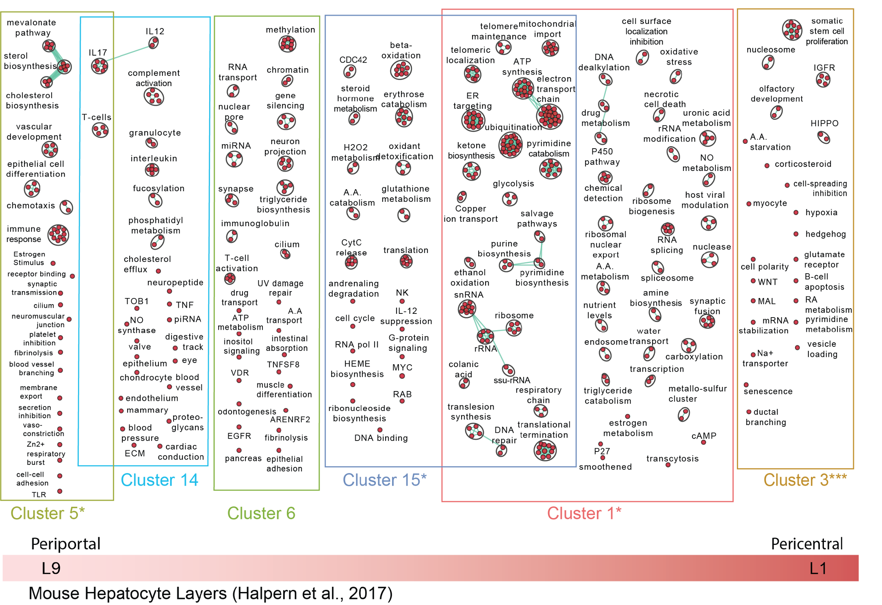
Pathway analysis identifies the division of labour among hepatocyte populations
Pathway analysis by GSVA

Slide 29
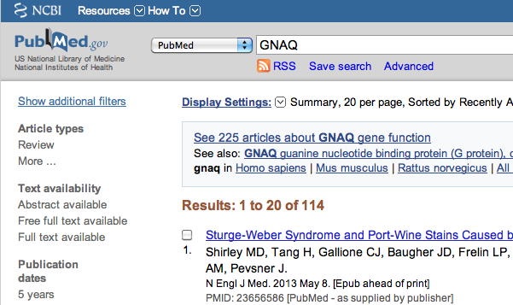
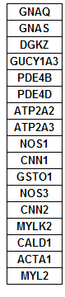

Pathway and network analysis
Save time compared to traditional approach
my favorite gene

Slide 30
Pathway and network analysis
Helps gain mechanistic insight into ‘omics data
  Identifying a master regulator, drug targets, characterizing pathways active in a sample
Any type of analysis that involves pathway or network information
Most commonly applied to help interpret lists of genes
Most popular type is pathway enrichment analysis, but many others are useful

Slide 31
Autism spectrum disorder (ASD)
Pathway analysis example 1
Genetics
  highly heritable
    monozygotic twin concordance 60-90%
    dizygotic twin concordance 0-10%
    (depending on the stringency of diagnosis)
  known genetics:
    5-15% rare single-gene disorders and chromosomal re-arrangements
    de-novo CNV previously reported in 5-10% of ASD cases
    GWA (Genome-wide Association Studies) have been able to explain only a small amount of heritability
Pinto et al. Functional impact of global rare copy number variation in autism spectrum disorders. Nature. 2010 Jun 9.

Slide 32
Rare copy number variants in ASD
Rare Copy Number Variation screening (Del, Dup)
  889 Case and 1146 Ctrl (European Ancestry)
  Illumina Infinium 1M-single SNP
  high quality rare CNV (90% PCR validation)
    identification by three algorithms required for detection
      QuantiSNP, iPattern, PennCNV
    frequency < 1%, length > 30 kb
Results
  average CNV size: 182.7 kb, median CNVs per individual: 2
  > 5.7% ASD individuals carry at least one de-novo CNV
  Top ~10 genes in CNVs associated to ASD

Slide 33
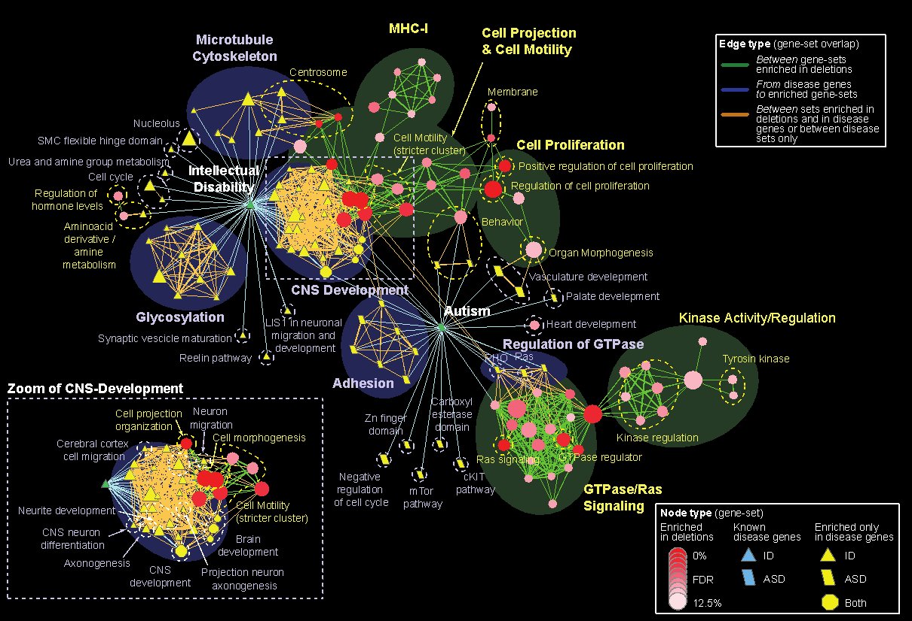
Pathways enriched in autism spectrum

Slide 34


Slide 35
Ependymoma pathway analysis
Pathway analysis example 2
Ependymoma brain cancer - most common and morbid location for childhood is the posterior fossa (PF = brainstem + cerebellum)
Two classes: PFA - young, dismal prognosis, PFB - older, excellent prognosis. Determined by gene expression clustering.
Exome sequencing (42 samples), WGS (5 samples) showed almost no mutations, however methylation arrays showed clear clustering into PFA and PFB (79 samples)
PFA more transcriptionally silenced by CpG methylation
Witt et al., Cancer Cell 2011
Nature. 2014 Feb 27;506(7489):445-50
Steve Mack, Michael Taylor, Scott Zuyderduyn

Slide 36
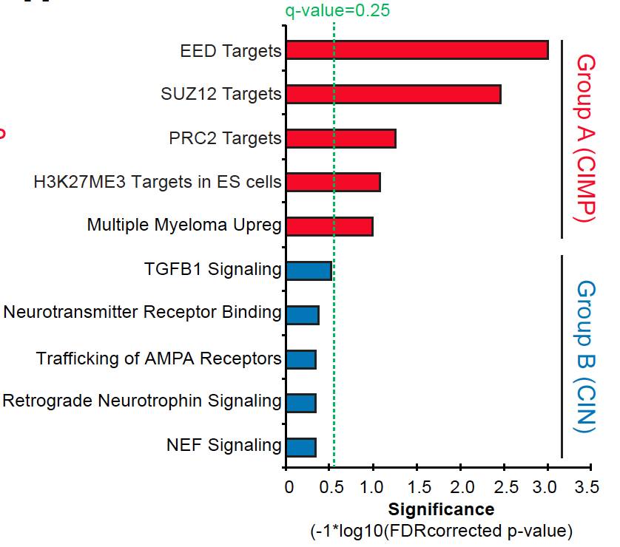
polycomb repressor complex 2 – inhibited by SAHA, DZNep, GSK343 – killed PFA cells
No known treatment. Now in clinical trial

Slide 37
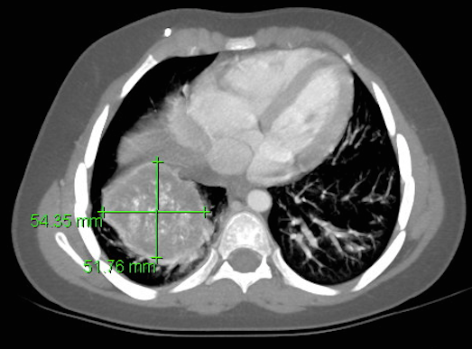
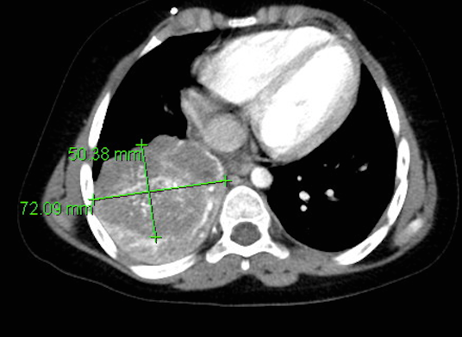
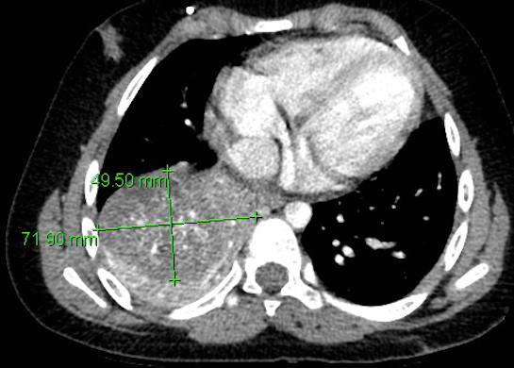
Treatment of Metastatic PF ependymoma with Vidaza
9 yo with metastatic PF ependymoma to lung treated with azacytidine
2 months
3 months
3 cycles Vidaza
Effect lasted 15 months

Slide 38
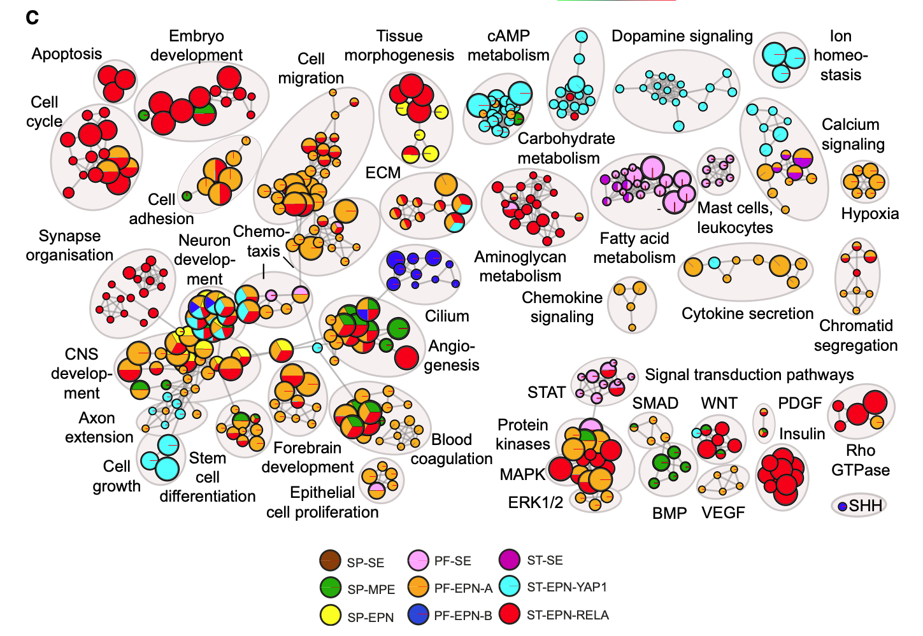
Molecular classification of ependymal tumors
Pathway analysis example 3
Pajtler et al. Cancer Cell 27, 728–743, May 11, 2015

Slide 39
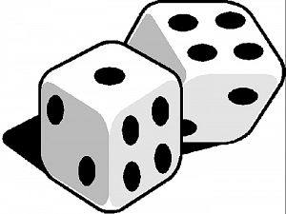
How do simple enrichment tests work?
Enrichment Table
OVERLAP BETWEEN GENE LIST AND GENE_SETS (PATHWAYS)
gene-set (pathway)
Gene-set p-value
Spindle 0.0001
Apoptosis 0.025
39
1
gene list
13
2
41
Is this overlap larger than expected by chance?
random sampling
using background genes
Background genes
Empirical pval =(#obs_overlap > random_overlap) +1) / (number of tests + 1)
Notes:
We are slowly getting in more details on how a simple enrichment test works.
Here in pink is our gene list that we have selected and in blue the pathway. The gene list has 41 genes and the pathway 39.
The brown represents all genes in the experimental background.
The first step of the enrichment test is to calculate the size of the overlap between the gene list and the pathway that we are testing
But then the next step is to calculate if we can get the same overlap size or a larger overlap by chance only using a random gene list.
So ,One way to do it is try 1000 random gene lists and compute the overlap size for each of the random list . You get a null distribution and you measure how much your observed overlap is larger compared to null distrubution.
When you do that, you are calculating an empirical pvalue and i have writtend the formula of the empirical pvalue below.
The p-value is assessing the probability that the overlap between your gene list and your pathway is observed by chance only or in other words the pvalue is assessing the probability that this pathway is enriched in our gene list by chance only.
A p value can range from 0 to 1 . if we have a p value close to 0, there is a low chance that the results are caused by random chance and we can be confident to report the pathway as enriched and if it is 1 it is likely due to random chance only, so 0 is good and 1 is bad..
The problem with this method of random permutation is that you need to do a lot of random selection to obtain a good p value precision and it can be time and resource consuming for the computer.
Luckily under some conditions, we know what the distribution of the random samples looks like and we don’t have to do all these permutations but we can directly use a statistical test instead.
For this case, the distribution for enrichment test is a hypergeometric distribution and the test that uses this distribution is the fisher's exact test.

Slide 40
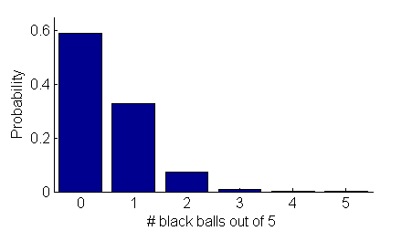






The Fisher’s exact test
a.k.a., hypergeometric test
Gene list
Null distribution
RRP6
MRD1
RRP7
RRP43
RRP42
Answer = 0.001066662
P-value
Background population:
500 black genes,
4500 red genes
1 gene-set/pathway
4.7. 10-7
0.5766
0.3516
0.06697
0.0046
0.00106
Notes:
The null distribution is modelled by the hypergeometric probability distribution
Let’s adapt this example with red and black balls to pathway enrichment analysis. We have 5000 red balls that are the genes are represent the experimental background. The 5 black balls could represent one pathway that we are testing.
Above, we have our gene list that contains 4 black balls and 1 red ball.
What is the probably than by randomly taking 5 balls from the box, we get 4 black balls and 1 red ball. We know that it is unlikely and the hypergeometric distribution can help us to calculate the probability for all of these cases (o black ball, 1 black ball, 4 black balls) and we can derive the pvalue from it.
In our case, the probability is very low and the associated pvalue is 0.001.
We can conclude that this pathway is significantly enriched in our gene list and it is probably not due to random chance only.

Slide 41

2x2 contingency table for Fisher’s Exact Test
Gene list
 | In gene list | Not in gene list
In pathway | x = 4 | 496
Not in pathway | k-x = 1 | 4499
m = 500
RRP6
MRD1
RRP7
RRP43
RRP42
t – m = 4500
k= 5
4995
t =5000
Background population:
500 black genes,
4500 red genes
Notes:
To calculate a fishers’ exact test, you can also build a 2x2 contingency table.
I show it to you in case you need to manually calculate pvalue yourself for one pathway that you are testing using the fisher's exact test formula in R for example.
So here are the numbers that you need for the formula.
k = is the size of the gene list
m = 500 is the size of the pathway
X = 4 is the number of genes in gene list and in the pathway (overlap size)
and t is the size of the background
This is why we told you that the notion of background is important because a different background size is going to give you different results.
I also wanted to show you the formule because it contains a lot of combinations that include factorials and that’s why it is using a lot of computer resources and many enrichment tools were using some approximations of the FET but nowadays computers are powerful enough and modern enrichment tools can use the exact formula rather than approximations.
-----

Slide 42
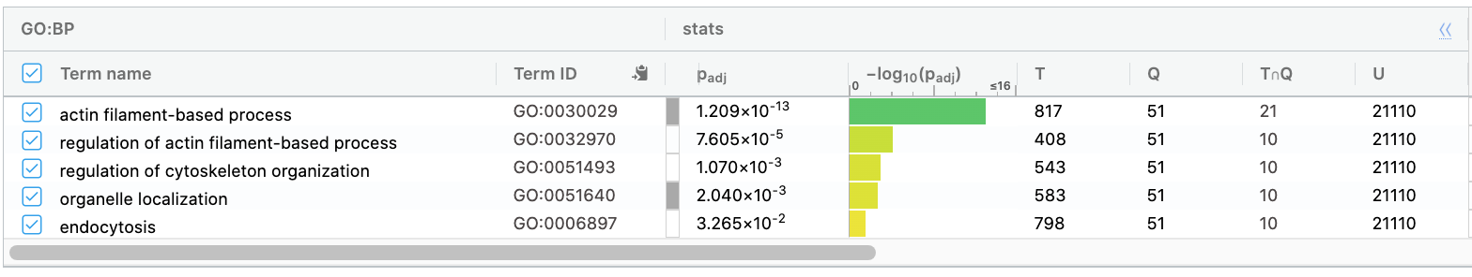
Total of GO:BP pathways tested is 349
pvalue
2.2e-16
4.9e-08
6.474e-07
1.769e-05
P value
Actin filament-based process
796
21
30
2.2e-16 (0.00000000000000022)
20263
Regulation of actin filament-based process
398
10
41
4.9e-08 (0.000000049)
20263
Regulation of cytoskeleton organization
533
10
41
6.474e-07 (0.000000647)
20263
Organelle localization
788
10
41
1.769e-05 (0.00001769)
20263
Notes:
We are seeing on this slide that not only the size of the overlap is important.
The first pathway is most significant that the 3 pathways that are down because the 88size of the overlap is larger: 21 genes and for the other pathways is 10.
Then pathway #2 is more significant than #3 because the size of the pathway is smaller. The ratio 10/398 is larger than 10/533 or 10/788.

Slide 43
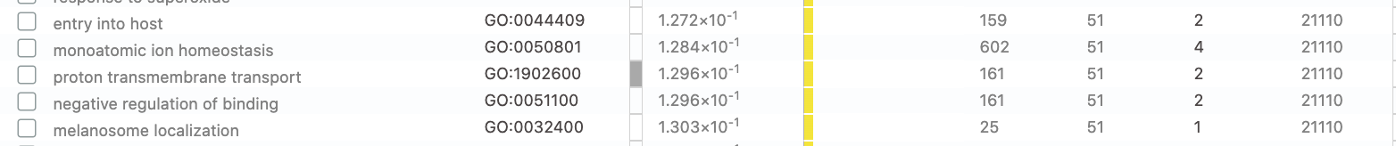
Total of GO:BP pathways tested is 349
P value
Actin filament-based process
796
21
30
2.2e-16 (0.00000000000000022)
20263
Monoatomic ion homeostasis
598
4
47
0.05875
Not significant
20461
24
1
0.06087
Not significant
Melanosome localization
50
21035
Notes:
And now we compare a pathway that is enriched with 2 non significant pathways and we see that the size of the overlap is very small 4 and 1 and this is why we got a larget pvalue.

Slide 44
The p value assesses the probability that the tested pathway is enriched in our gene list by chance only.
We are testing many pathways at the same time
correction for multiple hypothesis testing
Notes:
The pvalue assesses the probability that the tested pathway is enriched in our gene list by chance only. But we are testing many pathways at the same time therefore we need to correct for multiple hypothesis testing.

Slide 45
False discovery rate (FDR)
FDR is the expected proportion of the observed enrichments due to random chance.
Compare to Bonferroni correction which is a bound on the probability that any one of the observed enrichments could be due to random chance.
Typically FDR corrections are calculated using the Benjamini-Hochberg procedure.
FDR threshold is often called the “q-value”
Notes:
As Bonferroni is very stringent, there is another method that is widely used and it is called the false discovery rate.
The false discovery rate is the expected proportion of the observed enrichments due to random chance.
If we chose FDR 0.05, we select all the pathways is an FDR equal or less than 0.05: it means that in these pathways that we have selected under this threshold,we expect a proportion of 5% to be due to random chance.
The method to calculate the FDR is called the benjamini hochberg procedure and the result is a q value.

Slide 46
Benjamini-Hochberg example
(Nominal)
P-value
FDR /
Q-value
Rank
Category
Adjusted P-value
Actin filament-based process 2.2e-16 2.2e-16 * 349/1 = 7.678e-14. 7.678e-14
Regulation of actin filament-based process 4.9e-08 4.9e-08 * 349/2 = 1.7101e-05 1.7101e-05
Regulation of cytoskeleton organization 6.474e-07 6.474e-07 * 349/3 = 0.0002 0.0002
Organelle localization 1.769e-05 1.769e-05 * 349/4 = 0.006 0.006
… …. …. …. …. ….
347 ion homeostas 0.05870 0.05870 * 349/347 = 0.0590 0.0589
Monoatomic ion homeostasis 0.05875 0.05875 * 349/348 = 0.0589 0.0589
Melanosome localization 0.06087 0.06087 * 349/349 = 0.06 0.06
1. Sort P-values
of all tests in increasing order
2. Calculate Adjusted P-value :
P-value x [# of tests] / Rank
3. Calculate the Q-value (or FDR).
Q-value (or FDR) corresponding to a nominal P-value is the smallest adjusted P-value assigned to P-values with the same or larger ranks.
Select pathways significant at FDR < 0.05 for your analysis
Notes:
Here is the calculation of the FDR using our example.
First step is rank all pathways from smallest pvalue to largest
Then it is to multiply the nominal pavalue by the number of tested pathways and divided by the rank. By doing that we can see that most correction is done for the pvalue at the top (the smallest pvalues).
Then the q value is assigned starting by the end of the ranks . The q value is the smallest pvalue with the same or larger ranks.
It is again important to understand that the q value will always be larger than the original pvalue which is the goal that we wanted to obtain.
##########
And it is also important to understand that the more pathways we are testing, the more we are correcting and will affect the pvalues.

Slide 47
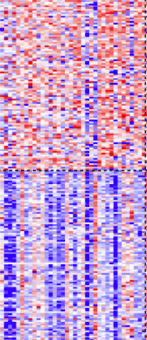
Example: Master regulator analysis
What do 1000 differentially expressed genes have in common?
Samples
Transcription factor A
Genes
Known set of targets are statistically enriched in the list of differentially expressed genes

