Slide 1

bioinformatics.ca
bioinformaticsdotca.github.io

Slide 2
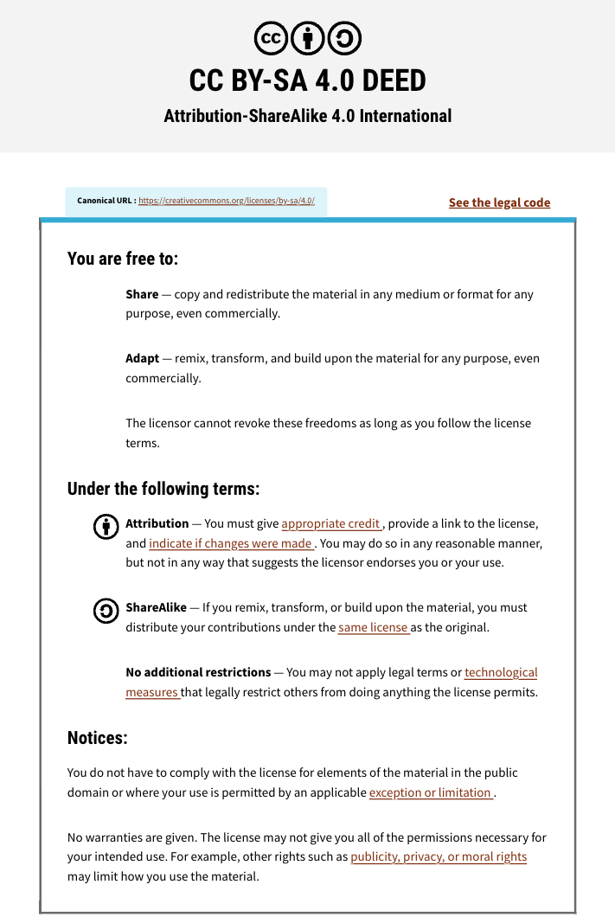

Slide 3



Module 2a Lab
Constance Li
Pathway and Network Analysis
May 12, 2026

Slide 4
Learning Objectives
Execute a differential expression analysis
Interpret its statistical outputs
Create and interpret common differential expression visualizations
Create defined gene lists and ranked gene lists for downstream anlaysis

Slide 5
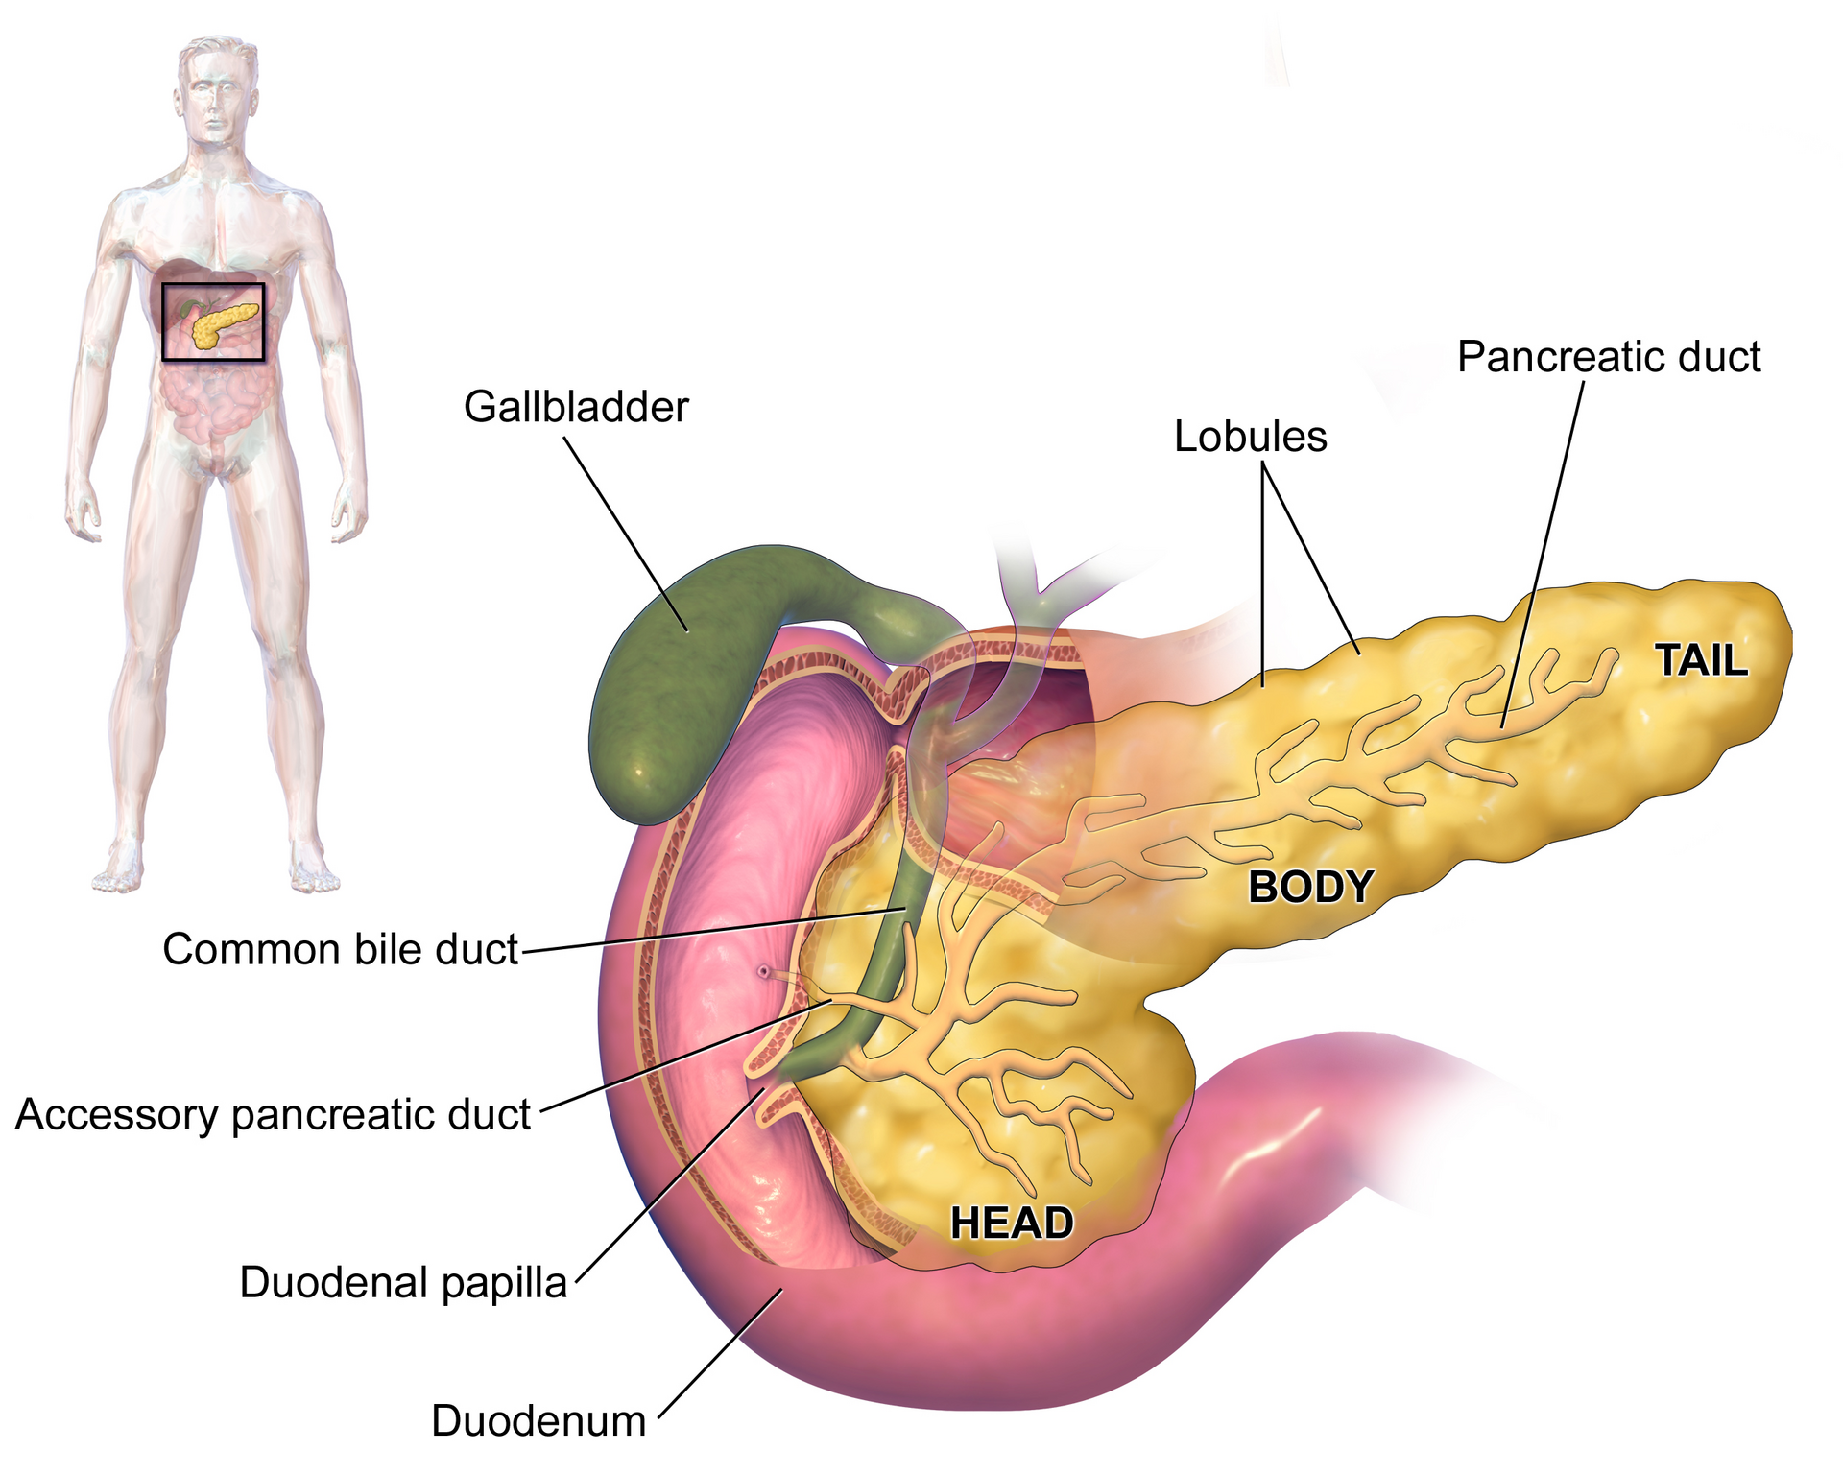
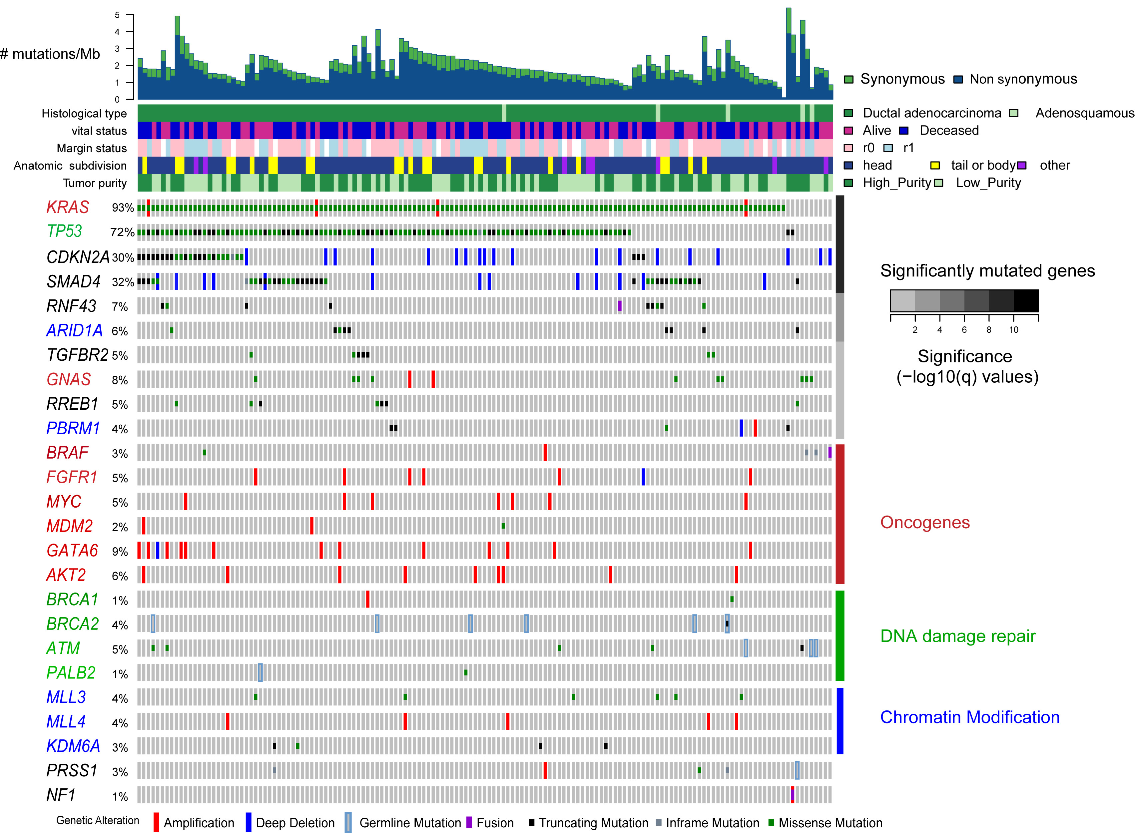
Pancreatic Ductal Carcinoma (PDAC)
Pancreatic
https://en.wikipedia.org/wiki/Pancreas

Slide 6
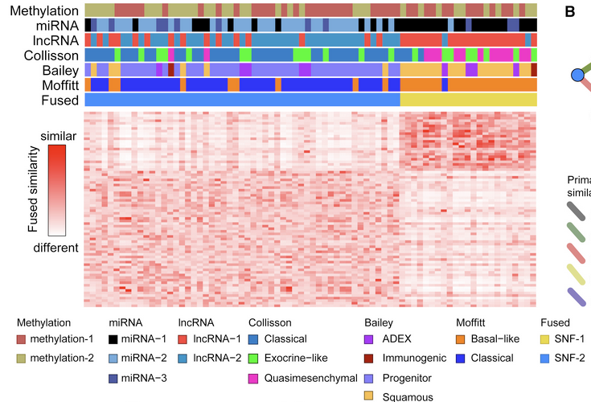
Molecular subtypes in PDAC

Slide 7
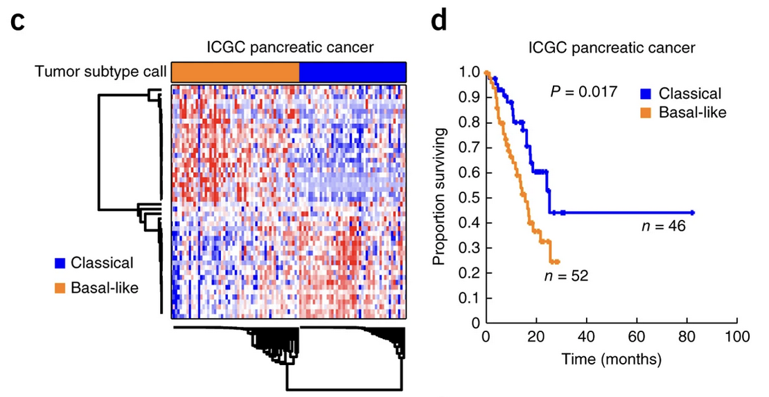
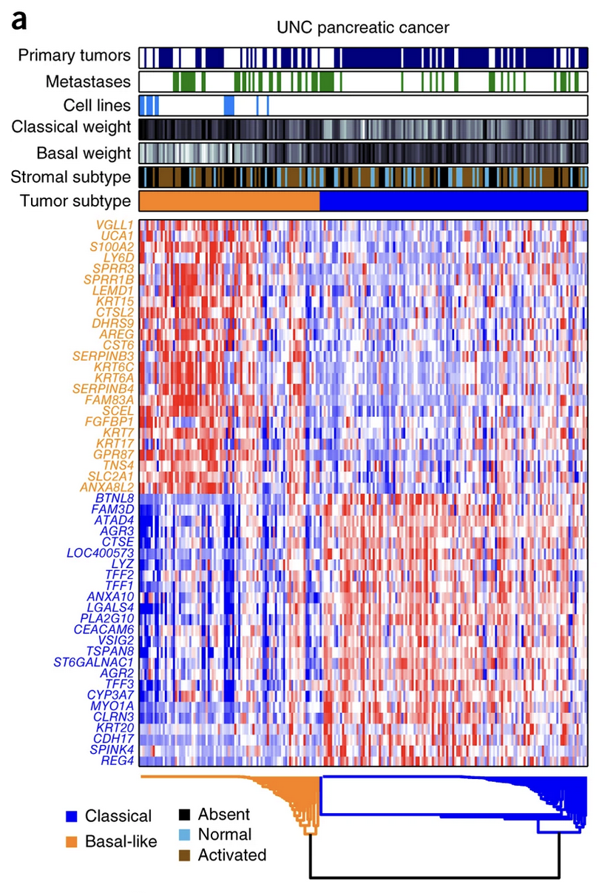
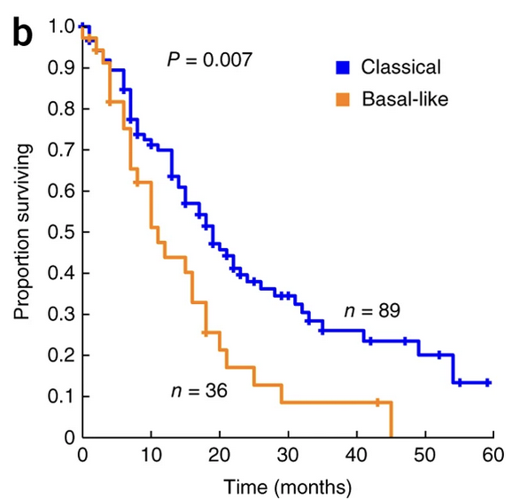
Moffitt subtyping has prognostic relevance

Slide 8
Differential (gene) expression
Condition A
Condition B
PDAC Classical Subtype
PDAC Basal-like Subtype
Control
Healthy tissue
Pre-treatment
Treatment
Tumor tissue
Post-treatment
vs
What are the transcriptional differences between the classical and basal-like subtypes?
What are our expectations?

Slide 9
Let’s get started
Download the lab materials:
https://bioinformaticsdotca.github.io/PNA_CalSask-2605/module-2.html
Module 2a: R scripts, data
Make sure R is installed
Check the required packages
Two versions: R beginners & Intermediate R users

Slide 10
Information and data sources
Moffitt subtype paper
Moffitt RA, Marayati R, Flate EL, Volmar KE, Loeza SGH, Hoadley KA, et al. Virtual microdissection identifies distinct tumor- and stroma-specific subtypes of pancreatic ductal adenocarcinoma. Nat Genet. 2015 Oct;47(10):1168–78. doi:10.1038/ng.3398
Clinical & molecular metadata
Raphael BJ, Hruban RH, Aguirre AJ, Moffitt RA, Yeh JJ, Stewart C, et al. Integrated Genomic Characterization of Pancreatic Ductal Adenocarcinoma. Cancer Cell. 2017 Aug;32(2):185-203.e13. doi:10.1016/j.ccell.2017.07.007
RNA-seq counts data
https://gdac.broadinstitute.org/

Slide 11







We’ll take lunch break after Lab 2a
Workshop Sponsors

