Slide 1

bioinformatics.ca
bioinformaticsdotca.github.io

Slide 2
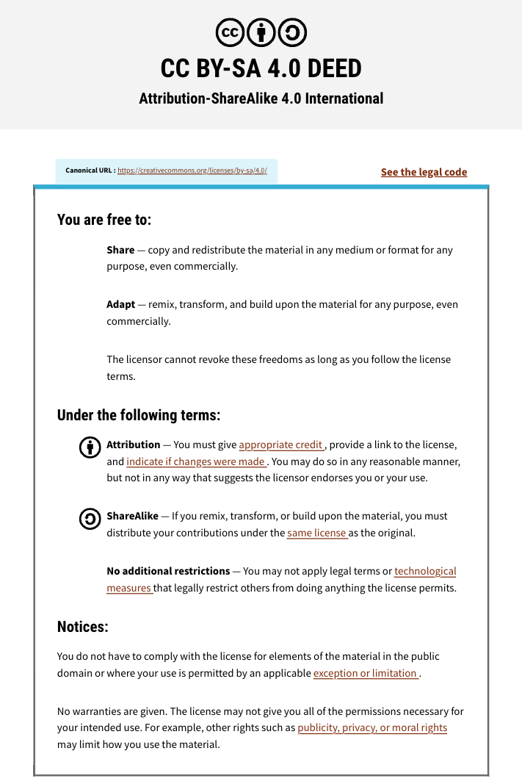

Slide 3



Module 2a: Differential Expression
Constance Li
Pathway and Network Analysis
May 12, 2026

Slide 4
Learning Objectives
Understand the fundamentals of differential expression analysis
Interpret its statistical outputs
Create and interpret common differential expression visualizations
Create defined gene lists and ranked gene lists for downstream anlaysis

Slide 5
What is differential (gene) expression?
If we have multiple conditions, we expect
Observations within the same condition to be similar
Observations between different conditions to be different
Differential expression (DE) asks how the conditions differ
Often, we interrogate the transcriptome
Condition A
Condition B
Control
Healthy tissue
Pre-treatment
Treatment
Tumor tissue
Post-treatment
vs

Slide 6
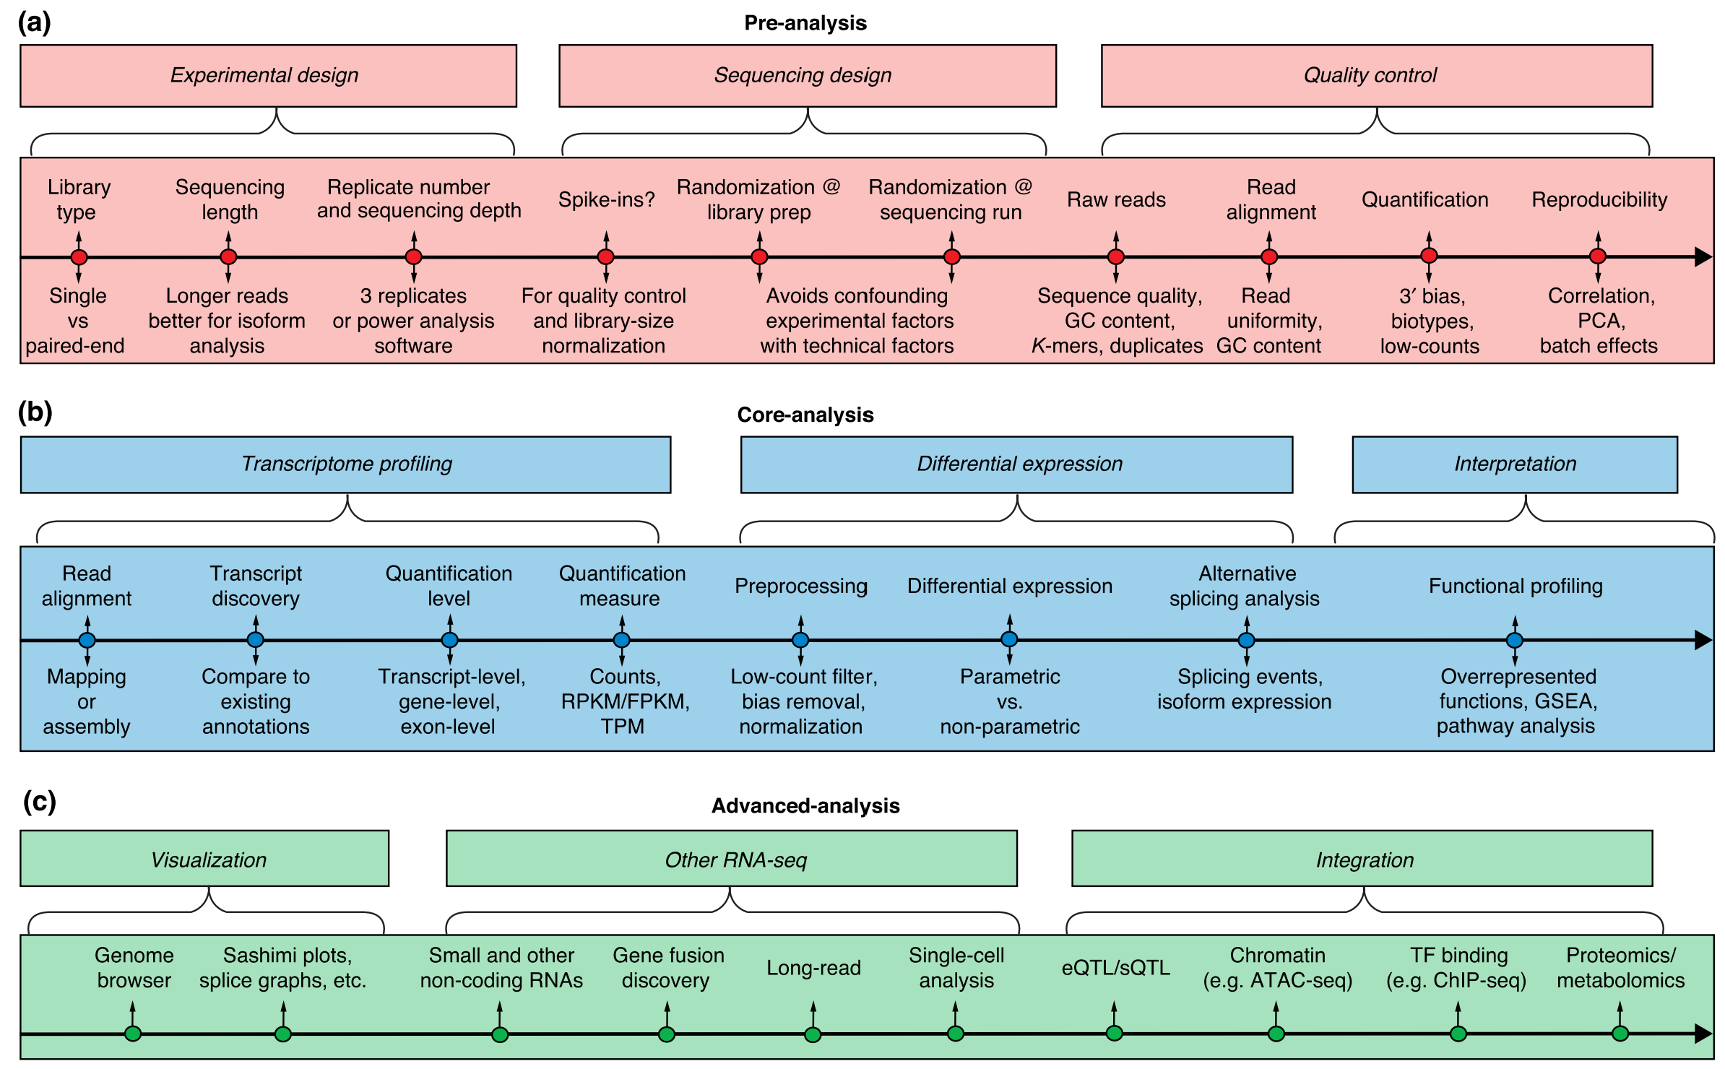
Where does DE sit?
https://genomebiology.biomedcentral.com/articles/10.1186/s13059-016-0881-8

Slide 7
Understanding variability
Biological Variability
Technical Variability
Natural differences between individuals
Differences in genetic background
Cellular heterogeneity
This is the signal we want to capture
Library preparation differences
Sequencing depth variation
Batch effects
This is noise we want to minimize
Our measurements include both types of variability
We must include biological replicates to distinguish true differential expression from noise
We often see 3 or more biological replicates
Ideally, perform a power analysis
Notes:
Considerations: statistics, cost

Slide 8
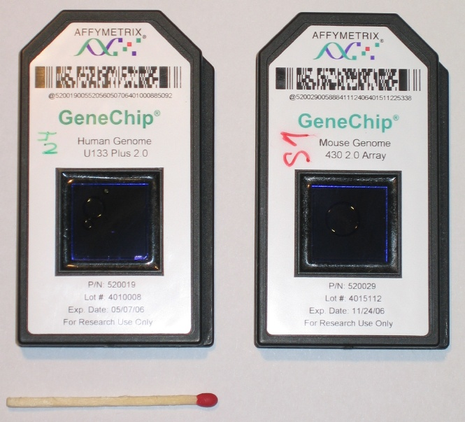
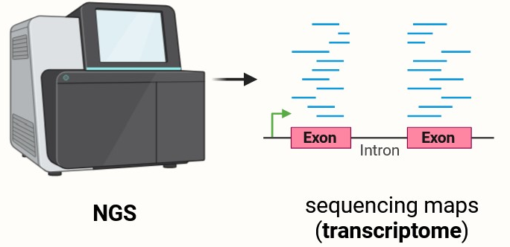
How do we profile gene expression?
Microarray and RNA-seq are high-throughput gene expression profiling technologies
Appropriate DE method depends on how data was generated
https://en.wikipedia.org/wiki/DNA_microarray
https://en.wikipedia.org/wiki/RNA-Seq

Slide 9
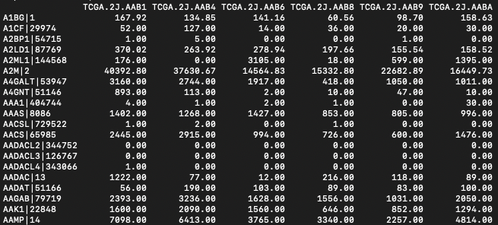
RNA-seq produces counts data
Counts data represent the number of reads aligned to each gene
Note that raw counts do not account for
Gene length
Sequencing depth
Library prep and other technical factors
Count data are also
Non-negative integers
Right-skewed
Over-dispersed
Samples
Genes
⚠ This means count data violates assumptions of standard statistical tests (t-test, ANOVA) which assume normally distributed data with constant variance.

Slide 10
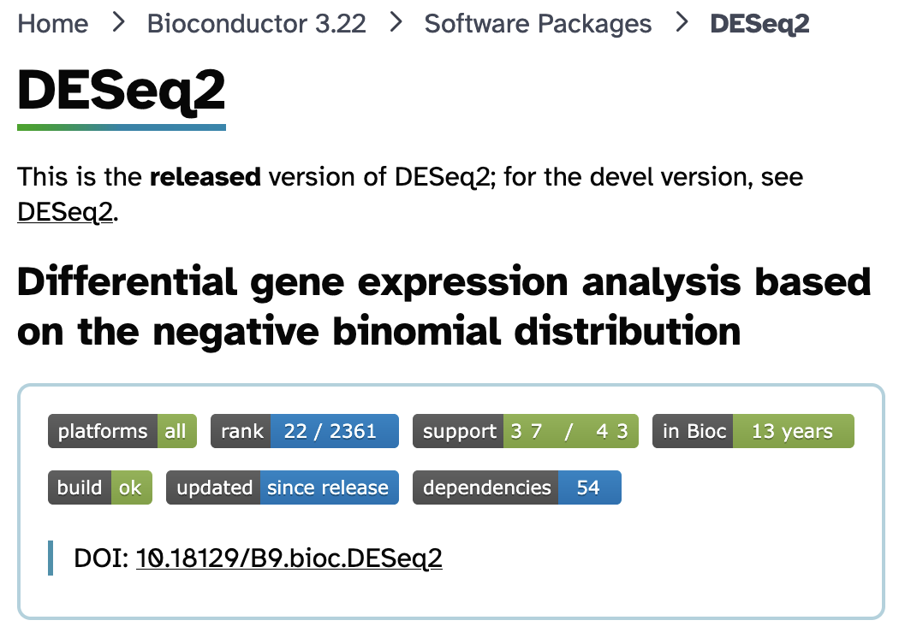
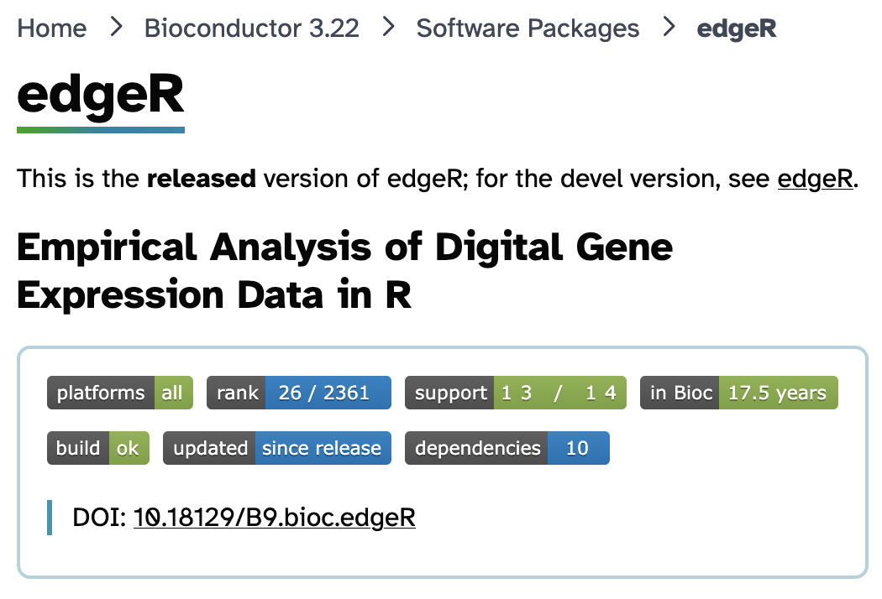
Tools for RNA-seq DE analysis
We must model RNA-seq count data appropriately
https://bioconductor.org/packages/release/bioc/html/DESeq2.html
https://bioconductor.org/packages/release/bioc/html/edgeR.html

Slide 11
Tools for RNA-seq DE analysis
We must model RNA-seq count data appropriately
DESeq2 and EdgeR
Use negative binomial distribution models
Account for dispersion
Include tools for statistical analysis and visualization
Are both frequently used, well-documented, and well-supported
We’ll use DESeq2 in Lab 2a

Slide 12
Key statistical outputs
Log2 Fold Change
P-value
Adjusted P-value
log2FC
p
FDR
Direction and magnitude of change
Probability of seeing this result by chance
P-value corrected for multiple testing
log2FC = 1 means 2× higher
log2FC = -1 means 2× lower
Tests if expression differs
from null hypothesis
Controls false discovery rate
across all genes tested
Why correct for multiple testing?

Slide 13
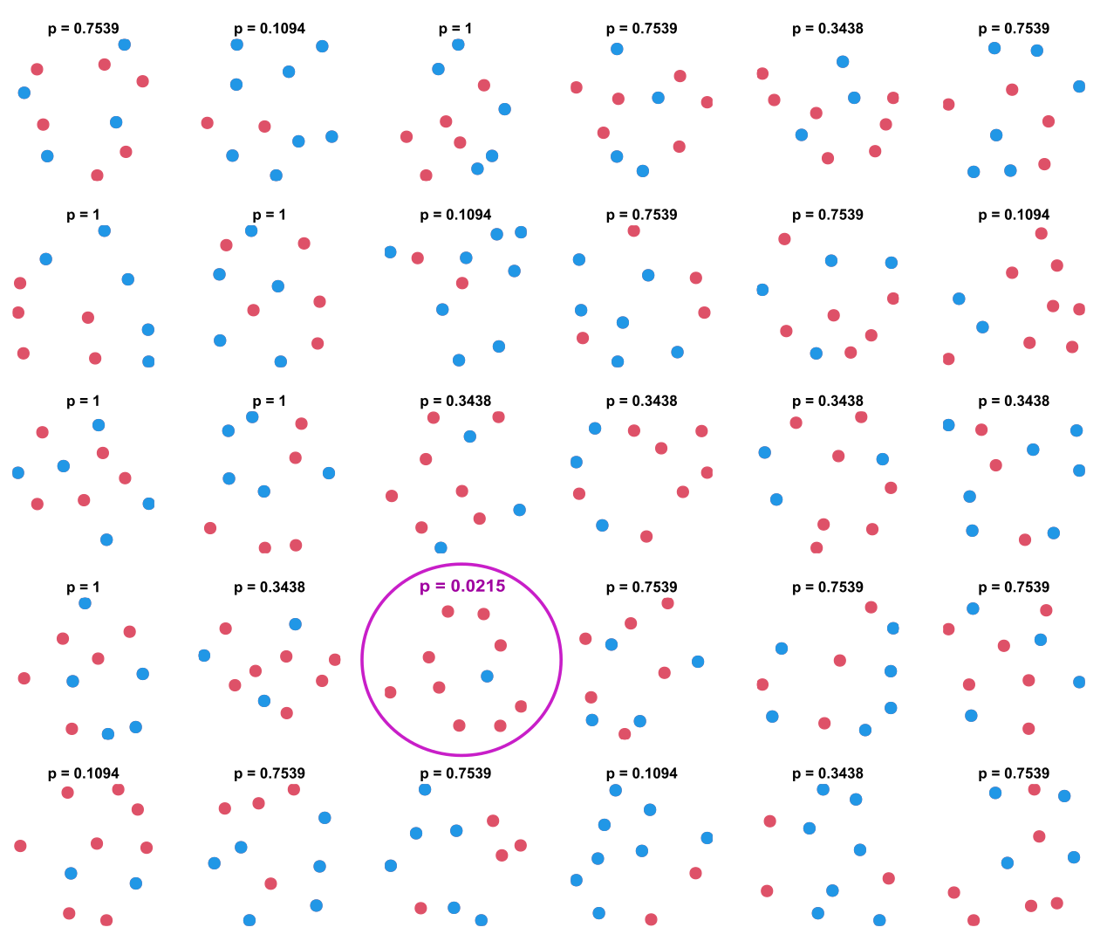
The multiple testing problem
Suppose have a population with equal numbers of blue and pink dots
We randomly sample 10 dots thirty times
We test the null hypothesis for each sample
We obtain one statistically significant result
Do we believe it?
Adapted from https://en.wikipedia.org/wiki/Multiple_comparisons_problem

Slide 14
The multiple testing problem
In bioinformatics, we often run thousands of tests and use a significance threshold (⍺) of 0.05
Problem
Testing 20,000 genes at α = 0.05 → expect 1,000 false positives by chance alone!
Solution: Multiple testing correction
Two approaches:
Family-Wise Error Rate correction is more stringent (eg. Bonferroni)
False Discovery Rate correction is less stringent (eg. Benjamini-Hochberg)
Differential expression tools report FDR-adjusted p-values

Slide 15
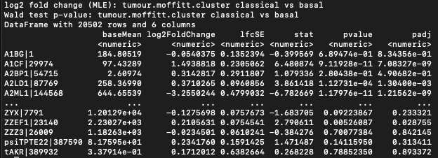

Interpreting DE results
1
Understand the comparison
3
Consider statistical significance
↑ A1CF: Significantly upregulated in classical subtype
log2FC > 0, FDR < 0.05
↓ A2ML1: Significantly downregulated in classical subtype
log2FC < 0, FDR < 0.05
2
Examine effect size in the context of the comparison
$$\log_{2}{FC}=\log_{2}{(\frac{classical}{basal})}$$

Slide 16
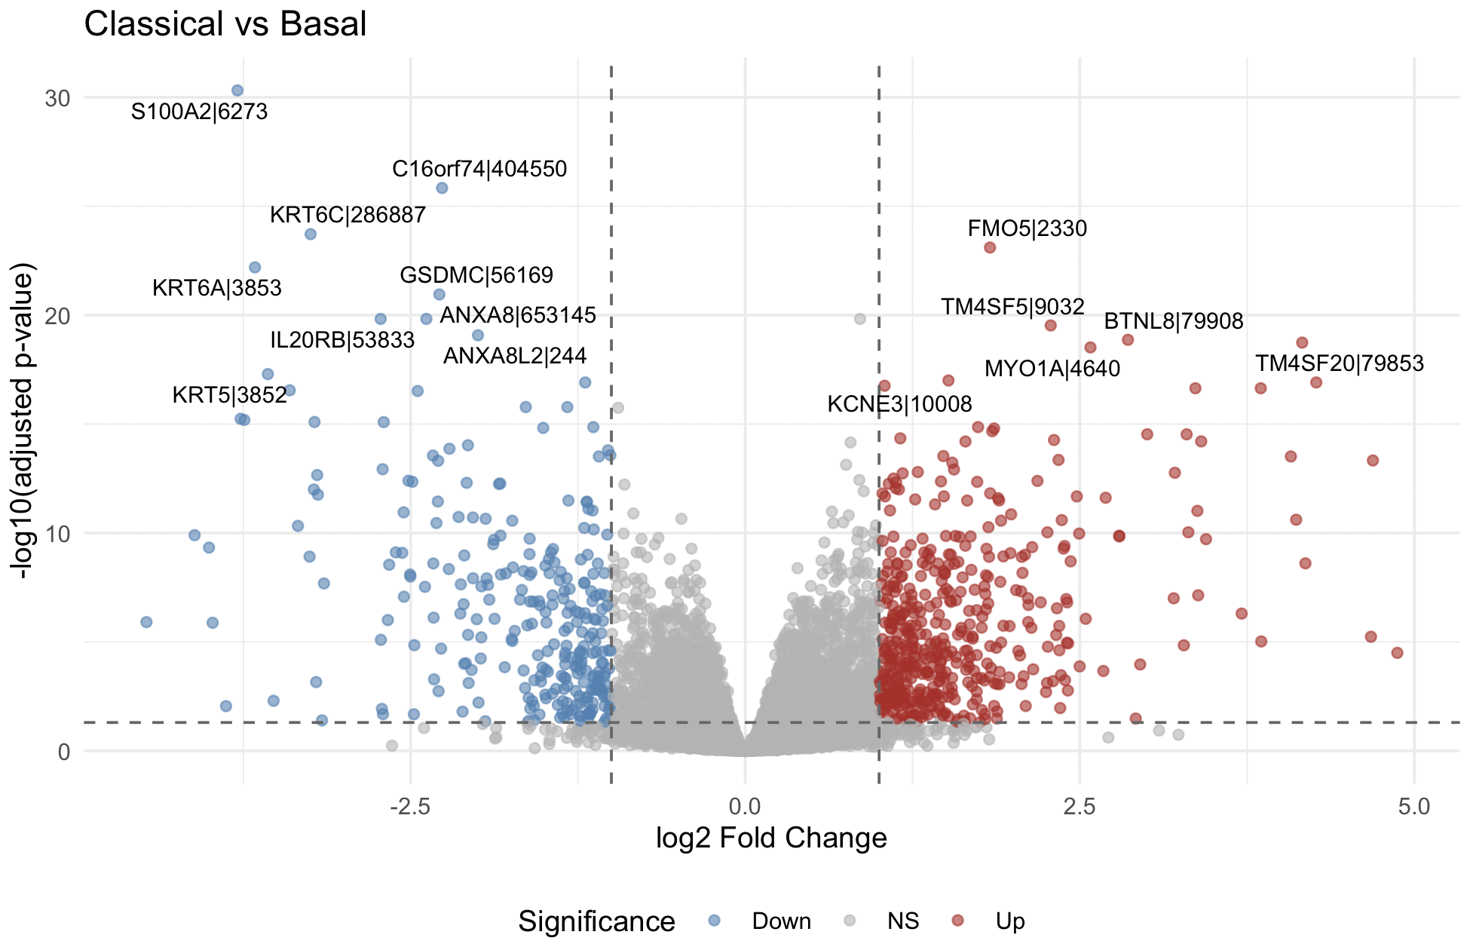
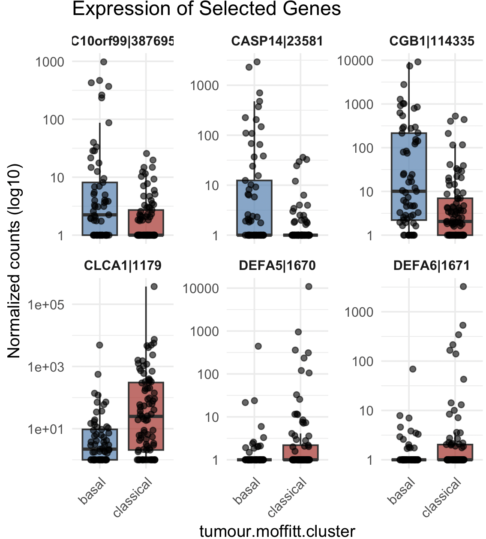
Visualize DE results to aid interpretation
CLCA1|1179
CGB1|114335
C10orf99|387695
DEFA6|1671
CASP14|23581
DEFA5|1670

Slide 17
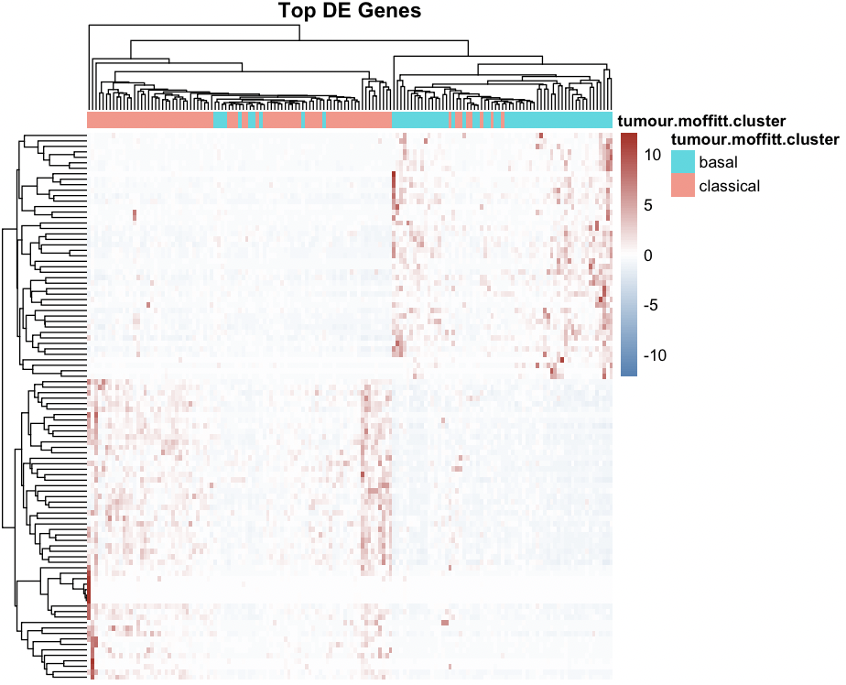
Visualizing DE results
Global view: volcano plots, heatmaps
Great results summaries
Focused view: boxplots, violin plots
Gene-level data
Great for sanity-checking your understanding

Slide 18
DE-derived gene lists
Pathway analysis tools require different inputs depending on the method
Defined Gene List
Ranked Gene List
For Over-Representation Analysis
For Gene Set Enrichment Analysis
A simple list of significant gene names
Filtered by thresholds (FDR, FC)
Unordered
Often separated: up vs down
Tool: g:Profiler
ALL genes with a numeric score
No arbitrary threshold cutoff
Ranked from most up to most down
Tool: GSEA
TP53
BRCA1
MYC
...
TP53 14.2
BRCA1 -9.8
MYC 0.5
...

Slide 19
Creating defined gene lists
Common filtering criteria:
By statistical significance: Adjusted p-value < 0.05
By biological significance: (2-fold change): |log2 Fold Change| > 1
Consider relaxing FC threshold if few genes pass (|log2FC| > 0.58 = 1.5-fold)
Ideally, consider both
Upregulated Genes
Downregulated Genes
FDR < 0.05 AND log2FC > 1
Higher in condition B vs A
FDR < 0.05 AND log2FC < -1
Lower in condition B vs A
💡 Rough rule of thumb: Aim for 100-2000 genes per list. Too few = low power; Too many = loss of specificity

Slide 20
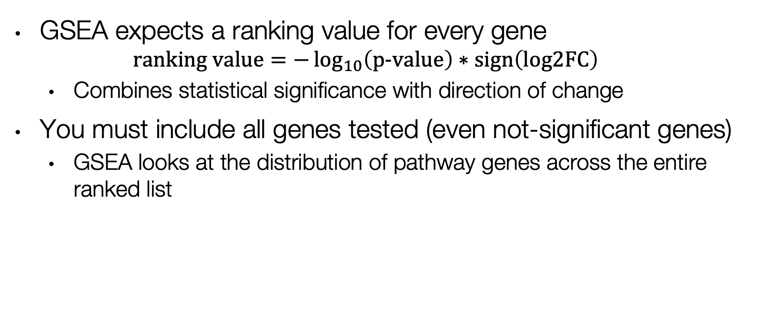
Creating ranked gene lists
GSEA expects a ranking value for every gene
$$\text{ranking} \text{value}=−\log_{10}\left(\text{p}\text{−}\text{value}\right)∗\text{sign}\left(\text{log}\text{2}\text{FC}\right)$$
Combines statistical significance with direction of change
You must include all genes tested (even not-significant genes)
GSEA looks at the distribution of pathway genes across the entire ranked list

Slide 21
The .rnk file format
GSEA requires .rnk files
Plain text file (.rnk extension)
Tab-delimited (two columns)
Column 1: Gene symbol
Column 2: Ranking score
No header row
Sorted by score (optional but helpful)
Example .rnk file
TP53 14.23
EGFR 12.87
KRAS 11.45
...
GAPDH 0.02
...
BRCA2 -8.91
BRCA1 -9.76
RB1 -11.34
⚠ Common Pitfalls:
Duplicate gene names (keep highest |score|) • NA/Inf values (remove or replace) • Wrong gene ID type (use symbols matching your GMT file)

Slide 22
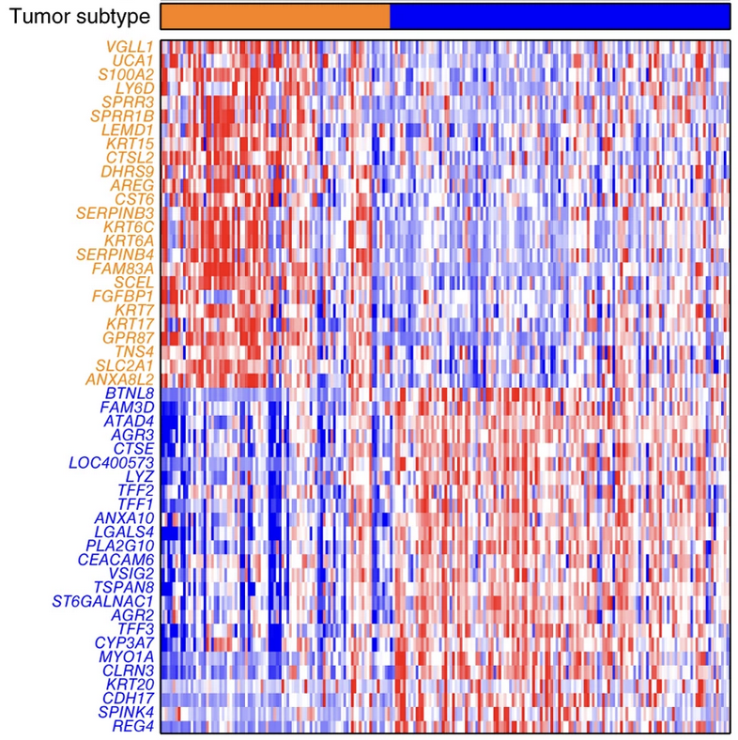
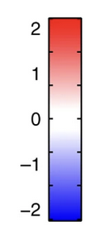

DE Lab: TCGA pancreatic cancer RNA-seq
Defined Gene List
Module 2b Lab
DESeq2
Ranked Gene List
Module 2c Lab
Module 2a Lab

Slide 23
Beyond differential expression
The same pathway analysis workflow applies to gene lists from many sources
ChIP-seq
CRISPR screens
GWAS
Peaks → nearby genes
Hits from dropout/enrichment
SNP-associated genes
Co-expression
Proteomics
Literature
Module members (WGCNA)
Differentially abundant proteins
Curated gene sets
Any gene list can be analyzed for pathway enrichment

Slide 24
Summary
DE analysis identifies genes with significant expression changes between conditions
Use appropriate tools (DESeq2, edgeR) that model count data correctly
Other tools exist for other data (eg. limma)
Always use FDR-corrected p-values
Use visualizations to strengthen your interpretation of results
Create defined gene lists (filtered) for tools like g:Profiler
Create ranked gene lists (all genes) for tools like GSEA

Slide 25
Time to try it!
Download the lab materials:
https://bioinformaticsdotca.github.io/PNA_CalSask-2605/module-2.html
Module 2a: R scripts, data
Make sure R is installed
Check the required packages

