Slide 1

bioinformatics.ca
bioinformaticsdotca.github.io

Slide 2
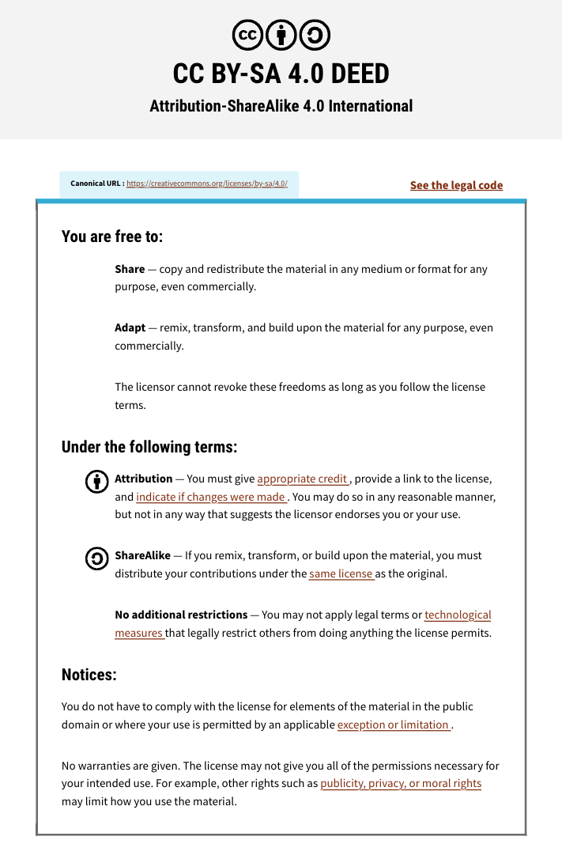

Slide 3



Module 2c: Ranked Gene Lists
Constance Li
Pathway and Network Analysis
May 12, 2026

Slide 4
Learning Objectives
List differences between ORA and FCS
Learn how GSEA calculates enrichment scores
Understand pathway databases and GMT files
Interpret GSEA results
Identify when to use GSEA vs other methods

Slide 5
DE-derived gene lists
Pathway analysis tools require different inputs depending on the method
Defined Gene List
Ranked Gene List
For Over-Representation Analysis
For Functional Class Scoring
A simple list of significant gene names
Filtered by thresholds (FDR, FC)
Unordered
Often separated: up vs down
Tool: g:Profiler
Method: Hypergeometric test (Fisher’s Exact Test)
ALL genes with a numeric score
No arbitrary threshold cutoff
Ranked from most up to most down
Tool: GSEA
Method: Running sum statistic (modified Kolmogorov-Smirnov)
TP53
BRCA1
MYC
...
TP53 14.2
BRCA1 -9.8
MYC 0.5
...
Functional Class Scoring methods test whether genes in a gene set are enriched at the extremes of a ranked gene list rather than randomly distributed

Slide 6
Why test enrichment in ranked gene list?
Possible limitations of a defined gene list approach
No “natural” value to set thresholds
Different thresholds give different results
Possible loss of statistical power due to thresholding
All significant signals are weighted the same
Weak signals are neglected
Key insight: If many pathway genes show modest, co-ordinated changes, that pathway may be dysregulated
ie: A pathway can be dysregulated even when no individual gene passes the significance threshold

Slide 7
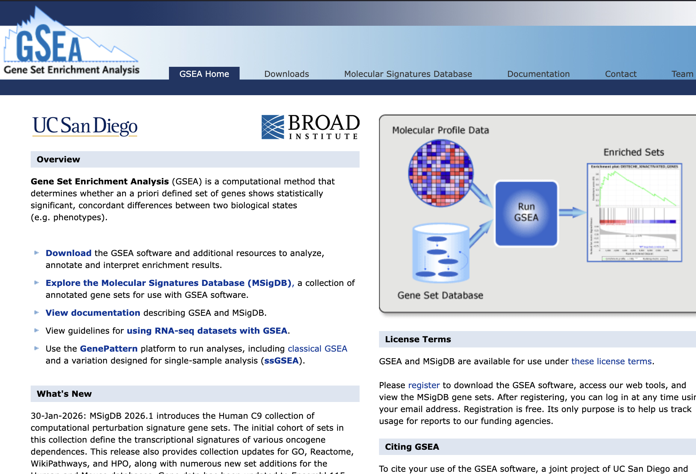
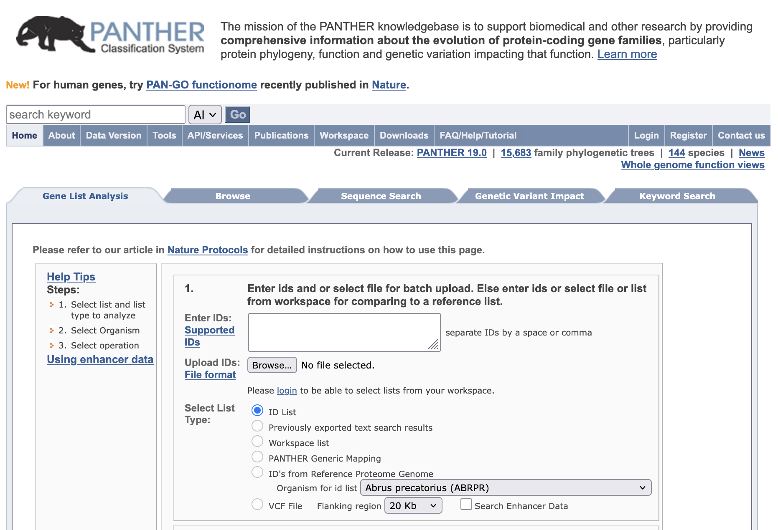
Some tools for ranked lists
GSEA is the most commonly used tool for FCS
PANTHER is primarily ORA, but can accept a ranked list

Slide 8
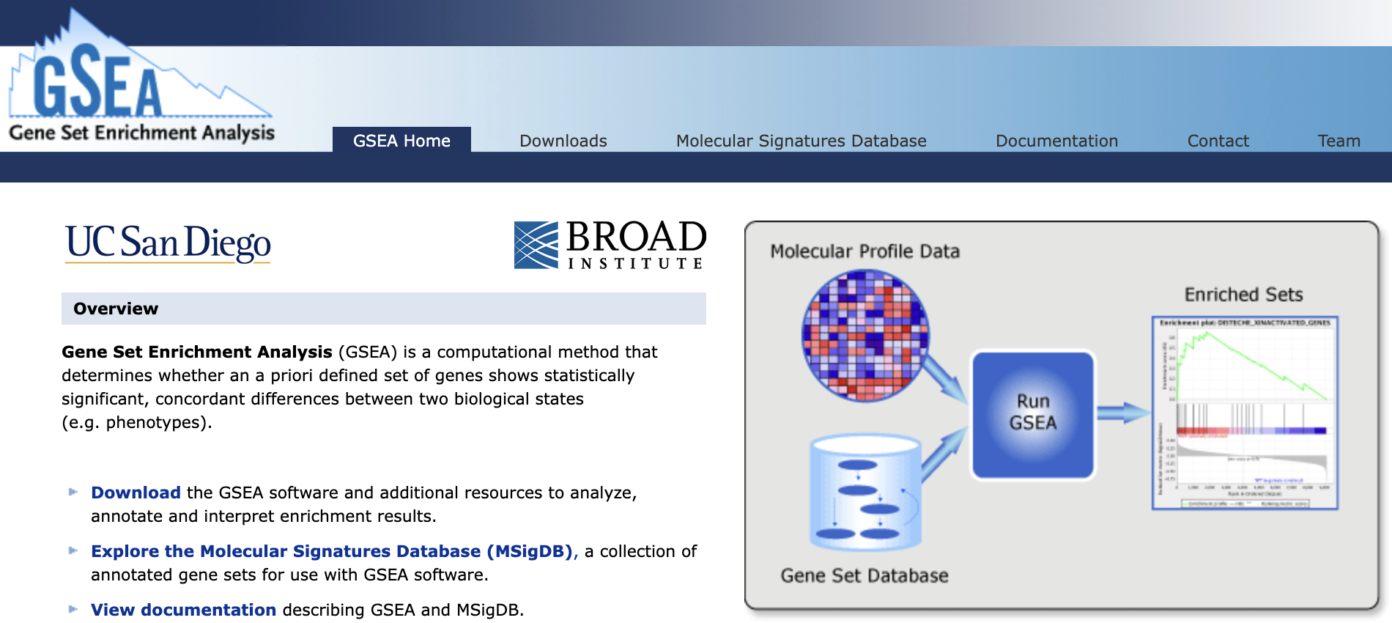
We’ll focus on GSEA
Gene Set Enrichment Analysis
https://www.gsea-msigdb.org/gsea/index.jsp

Slide 9
GSEA: The core idea
Upregulated
→ → → Ranked Gene List → → →
Downregulated
We have genes ranked from most upregulated to most downregulated
GSEA asks: Do the genes in a given pathway cluster at the top or bottom of this list more than expected by chance?
Three scenarios:
Enriched at TOP
Random distribution
Enriched at BOTTOM
Pathway upregulated
Pathway not enriched
Pathway downregulated

Slide 10
GSEA has three key steps
Calculate an enrichment score (ES)
Estimate significance level of ES
Adjust for multiple testing

Slide 11
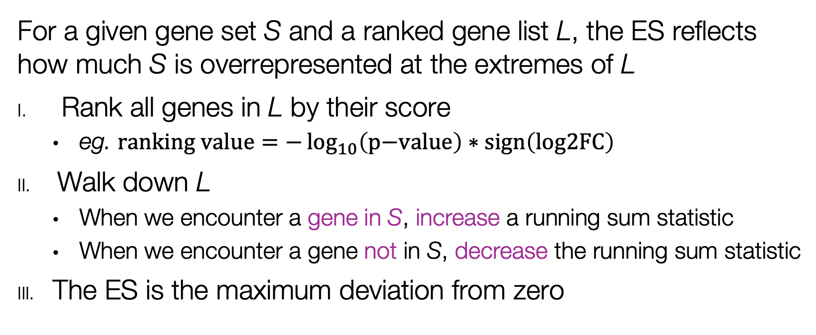
Step 1: The GSEA enrichment score
For a given gene set S and a ranked gene list L, the ES reflects how much S is overrepresented at the extremes of L
Rank all genes in L by their score
eg. $\text{ranking} \text{value}=−\log_{10}\left(\text{p}\text{−}\text{value}\right)∗\text{sign}\left(\text{log}\text{2}\text{FC}\right)$
Walk down L
When we encounter a gene in S, increase a running sum statistic
When we encounter a gene not in S, decrease the running sum statistic
The ES is the maximum deviation from zero

Slide 12

Recall the ranked gene list
Genes Ranked by
Differential Statistic
Ranking value/score =
$$−\log_{10}\left(\text{p}\text{−}\text{value}\right)∗\text{sign}\left(\text{log}\text{2}\text{FC}\right)$$
Expression Matrix
UP
UP
DOWN
DN
Class-1
Class-2
E.g.:
Fold change
Log (ratio)
t values from t-test

Slide 13
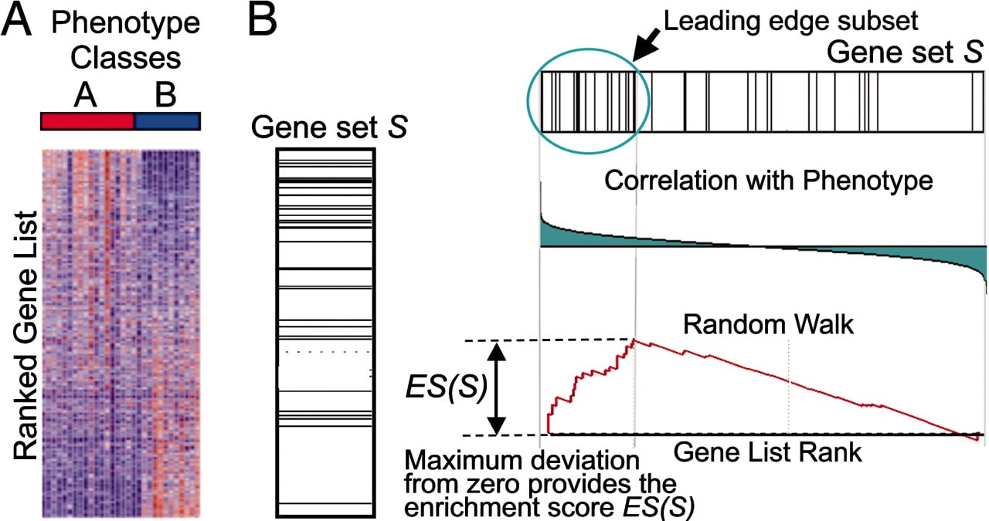
Calculating the GSEA ES
⚠ For a negative ES, the leading edge subset is the subset of members of S that appear after the peak score
Ranking score =
sign(logFC)*-log10(pvalue)
Genes in L overlapping with Gene Set S
UP in A
DN in A
Modified from https://www.pnas.org/doi/10.1073/pnas.0506580102

Slide 14
GSEA ES walkthrough example
Ranked gene list L
Gene set of interest S
UP
1
Enrichment Score
Ranked genes
2
Mark the genes in L that occur in S
Ranking value
UP
DOWN
DOWN
1. Maximum (or minimum) ES score is the final ES score for the gene set
2. Can define “leading edge subset” as all those genes ranked as least as high as the enriched set.
Notes:
Shows the running sum as GSEA walks down the ranked list. The peak (or trough) is the Enrichment Score. Positive ES = enriched in upregulated genes. Negative ES = enriched in downregulated genes.
Dense clustering at one end indicates enrichment.
Shows the distribution of gene ranking scores. Positive values on left (upregulated), negative on right (downregulated). The zero-crossing point divides up/down.
Leading Edge: The genes that contribute most to the enrichment score (appear before the peak for positive ES, after for negative ES).

Slide 15
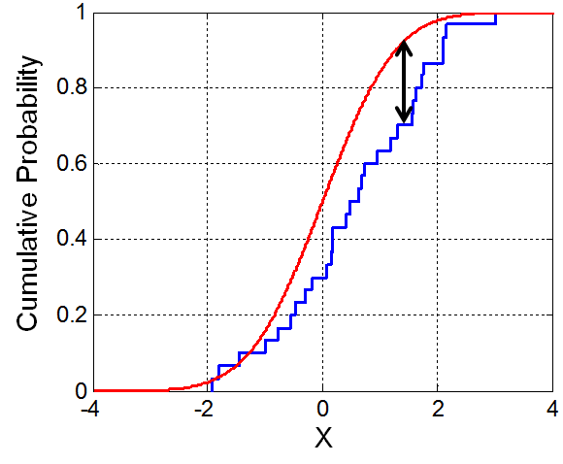
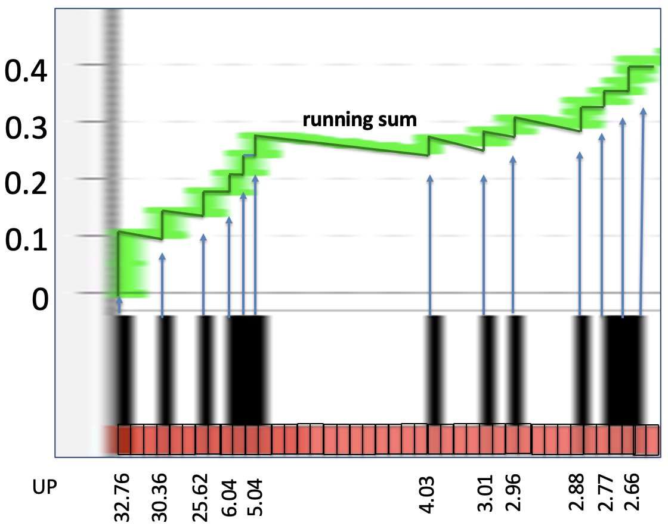
The GSEA running sum
Conceptually a modified Kolmogorov–Smirnov test
Ranked gene list L
UP
Enrichment Score
The KS test compares distributions by finding the maximum distance between two cumulative distribution functions
The GSEA score incorporates weights into the running sum
Running sum step sizes are unequal
DOWN

Slide 16
Positive and negative enrichment
Enrichment Score
Enrichment Score

Slide 17
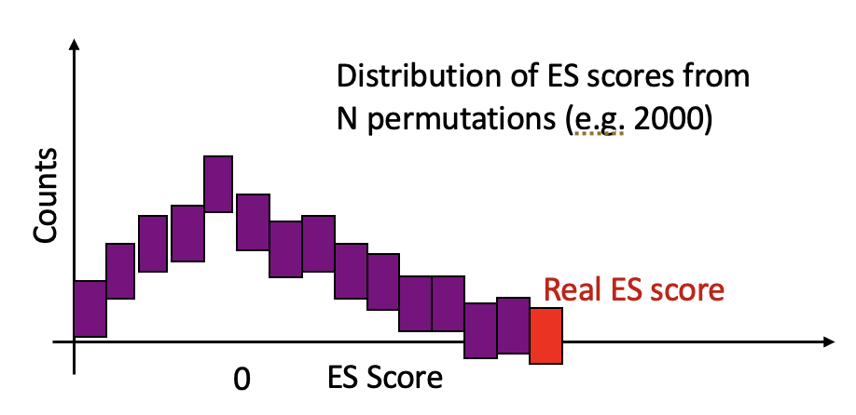
Step 2: Estimate significance level of ES
For positive ES:
p-value = (# of null ES ≥ observed ES) / (# of permutations)
= 4 / 2,000
= 0.002
GSEA determines significance by comparing observed ES to a null distribution generated by permutation
Calculate the real ES
Randomly permute phenotype labels (or gene set membership)
Recalculate ES for each permutation
Repeat 1,000+ times to build the null distribution
Compare real ES to null distribution to derive p-value
For negative ES:
p-value = (# of null ES ≤ observed ES) / (# of permutations)
= 4 / 2,000
= 0.002
Notes:
Now that we have calculated the enrichment score, we still need to estimate if that score is equal or larger than the one that we could have obtained by chance only. GSEA method is using permutation to build a null distribution and to calculate an empirical pvalue.
In the case that we are using most of the time , the permutation is done by replacing the genes in the pathway by random genes.
But there is also another permutation technique that consists of shuffling the samples before crating the rank file and baiscially creating 1000 random rank file to break gene dependency.
For each tested pathway, we have the enrichmscore for 1000 permuations that is the null distribution that you are seing on the left.it should be centered around an enrichemnt score of 0. because it is random genes. we can calculate the distance of our observed score from the mean of the null distribution. If our score is far away from the center of the null distribution, it means that this score does not occur frequenty therefore it is unlikely to happen by random chance only. We can calculate the empirical pvalue by calculating how many times the observed score was greater than the random scores.
GSEA also calculated the FDR value from the normalized enrichment scores.
We have now finished this part on GSEA and we will see in the next part examples or ranked and defined gene lists.

Slide 18
Step 3: Adjust for multiple testing
When evaluating many gene sets, remember we must account for multiple hypothesis testing!

Slide 19
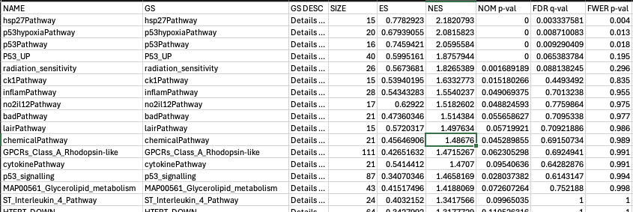

Interpreting GSEA output
Sample gene set enrichment: TP53-mut vs TP53-WT
Enrichment in TP53-WT
Normalized Enrichment Score
Family-wise Error Rate correction
NES normalizes ES by the mean of the null distribution
Allows comparison between gene sets of different sizes
$$\text{NES}\text{=}\frac{\text{observed} \text{ES}}{\text{mean}\left(\left|\text{null} \text{ES} \text{values}\right|\right)}$$

Slide 20
The leading edge
The leading edge subset contains the genes that "drive" the enrichment signal.
Leading Edge Statistics:
Tags: % of pathway genes appearing before (or after) the ES peak
List: % of ranked list genes appearing before (or after) the ES peak
Signal: Enrichment signal strength combining Tags and List
Positive ES (Upregulated)
Negative ES (Downregulated)
Leading edge = genes BEFORE the peak (at the top of the ranked list, contributing to the upward climb)
Leading edge = genes AFTER the trough (at the bottom of the ranked list, contributing to the downward dive)

Slide 21
Gene set databases
Gene sets are stored in GMT (Gene Matrix Transposed) format:
Some resources:
PATHWAY_NAME Description GENE1 GENE2 GENE3 ...
Resource | Description | Website
MSigDB | Broad Institute collection (Hallmarks, C2 curated, C5 GO, etc.) | https://www.gsea-msigdb.org/gsea/msigdb
Bader Lab | Combined GO + pathway databases, updated monthly | https://baderlab.org/GeneSets
Reactome | Curated human pathway database | https://reactome.org/
KEGG | Manually drawn pathway maps | https://www.genome.jp/kegg/pathway.html
WikiPathways | Open-source, community-curated biological pathways | https://www.wikipathways.org/

Slide 22
Gene set size considerations
The size of gene sets affects statistical power and interpretability:
Too Small (<15)
Recommended
Too Large (>500)
(15-500 genes)
• Low statistical power
• High variance in ES
• Sensitive to noise
• Good statistical power
• Interpretable pathways
• Robust ES estimates
• Overly broad terms
• Less specific biology
• Harder to interpret
GSEA Settings
Min size: Default 15, can lower to 10 for exploratory analysis
Max size: Default 500, consider 200-250 for more specific results

Slide 23
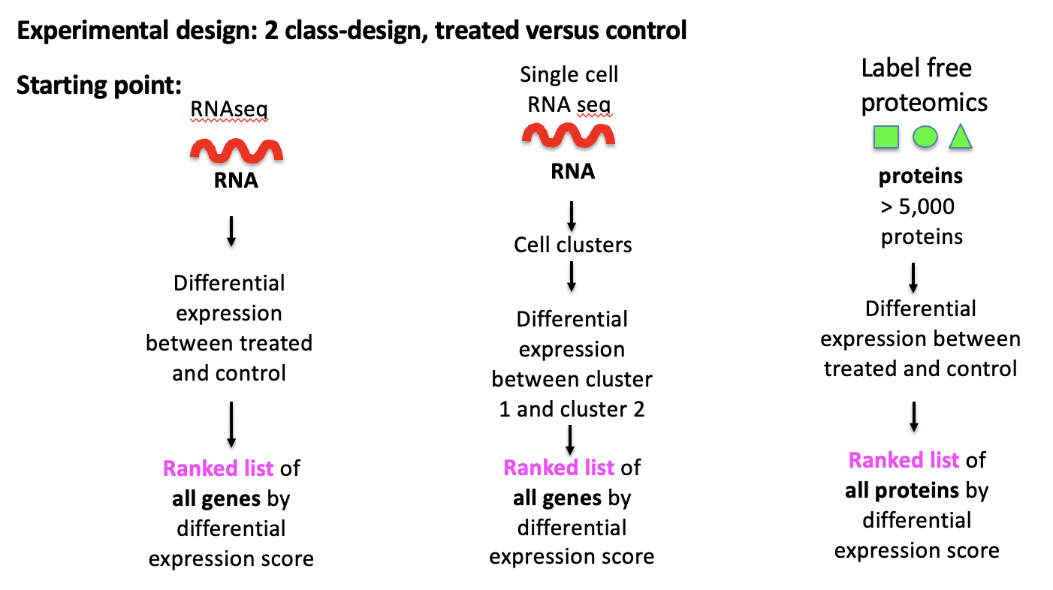
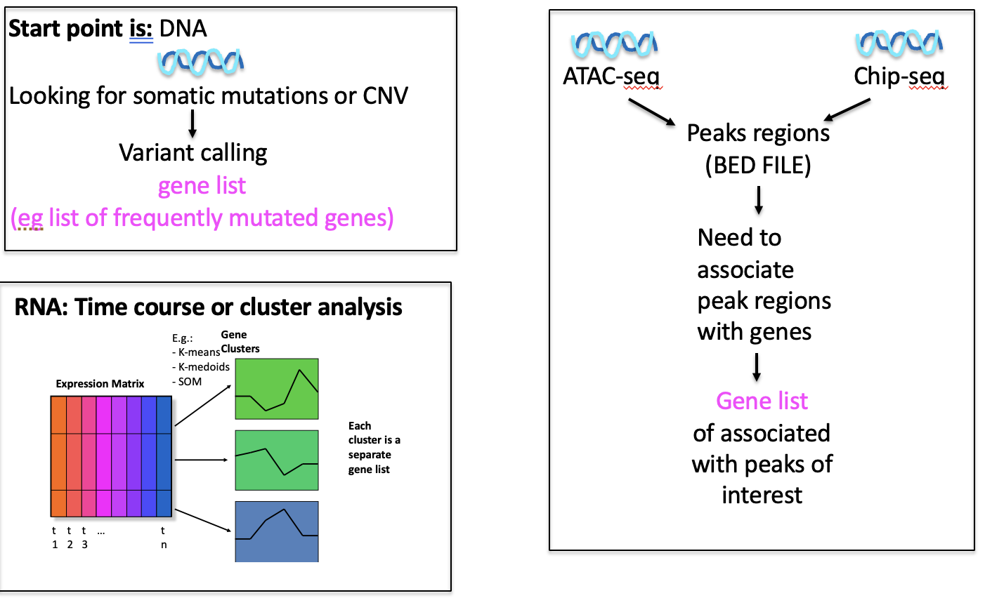
ORA or FCS?
First, consider your gene set: Is it ranked or not ranked?

Slide 24
ORA or FCS (specifically GSEA)?
Also consider characteristics of the method
 | ORA | GSEA
Input | Defined gene list (threshold-based) | Ranked gene list (all genes)
Information used | Binary (in list or not) | Continuous (ranking scores)
Threshold dependence | High - results change with cutoff | None - uses full ranking
Subtle effects | May miss coordinated changes | Detects subtle, consistent changes
Speed | Very fast | Slower (permutations)
Interpretation | Straightforward | Richer (leading edge, NES)
Suggestion: Try both! ORA for quick exploration, GSEA for deeper investigation

Slide 25
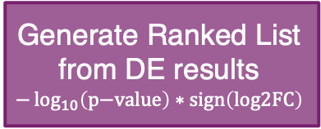
GSEA workflow summary
Generate Ranked List
from DE results
$$−\log_{10}\left(\text{p}\text{−}\text{value}\right)∗\text{sign}\left(\text{log}\text{2}\text{FC}\right)$$
Select Gene Sets
What is the biological question?
Run GSEA
Filter Results
FDR threshold?
Explore Leading Edge
What genes drive each pathway’s enrichment
Visualization

Slide 26
Summary
Functional Class Scoring methods are appropriate for ranked gene lists
Uses ALL genes, not just significant ones (no arbitrary threshold)
GSEA is the most commonly used tool
GSEA detects coordinated changes in gene sets
Enrichment Score reflects clustering at list extremes
NES allows comparison across gene sets of different sizes
Leading edge genes drive the enrichment signal

Slide 27
Some other ranked list methods
Method | Algorithm | Key features
GSAV | Gene set variation analysis | Per-sample enrichment scores; good for clustering
ssGSEA | Single-sample GSEA | Variant of GSEA that scores each sample individually
CAMERA | Correlation-adjusted mean rank | Accounts for inter-gene correlation; parametric
GAGE | Generally Applicable Gene-set Enrichment | Two-sample t-test on gene sets; directional

Slide 28
Time to try it!
Download the lab materials:
https://bioinformaticsdotca.github.io/PNA_CalSask-2605/module-2.html
Module 2c: Lab protocol pdf
You can use our input .rnk or use the one you generated in Lab 2a
You’ll need to register and download GSEA

Slide 29
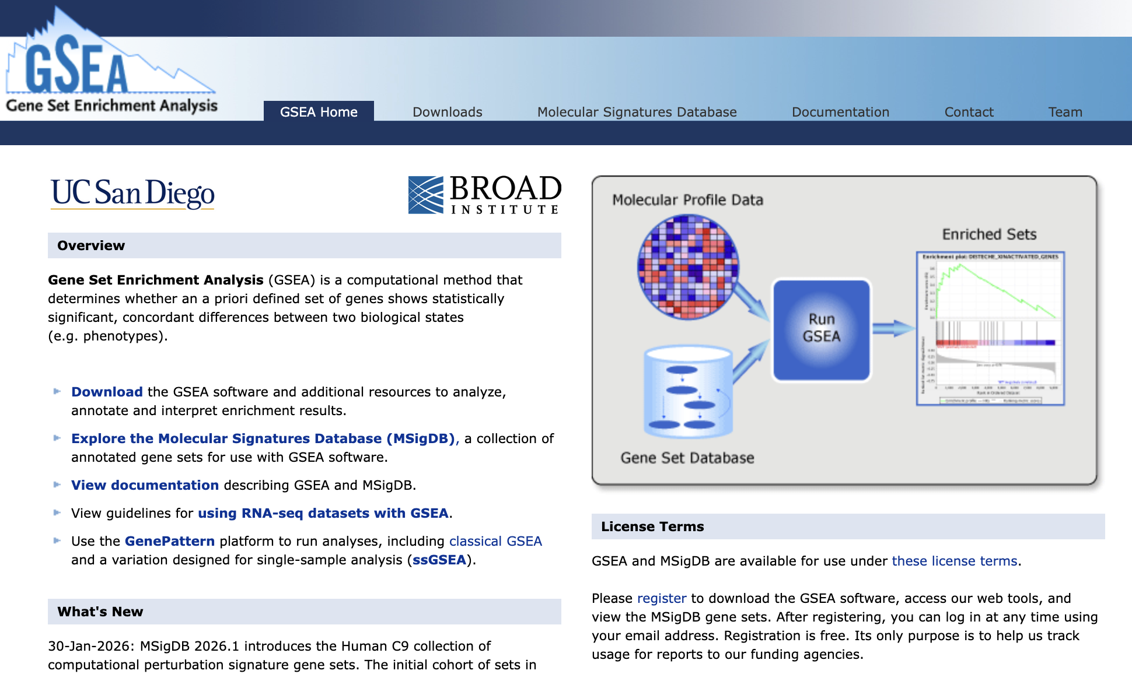
Prep for Lab
Go to https://www.gsea-msigdb.org
Register to download
Then Download
Go to https://download.baderlab.org/EM_Genesets/current_release/Human/symbol/
Download the geneset Human_GOBP_AllPathways_noPFOCR_no_GO_iea_May_01_2026_symbol.gmt

Slide 30
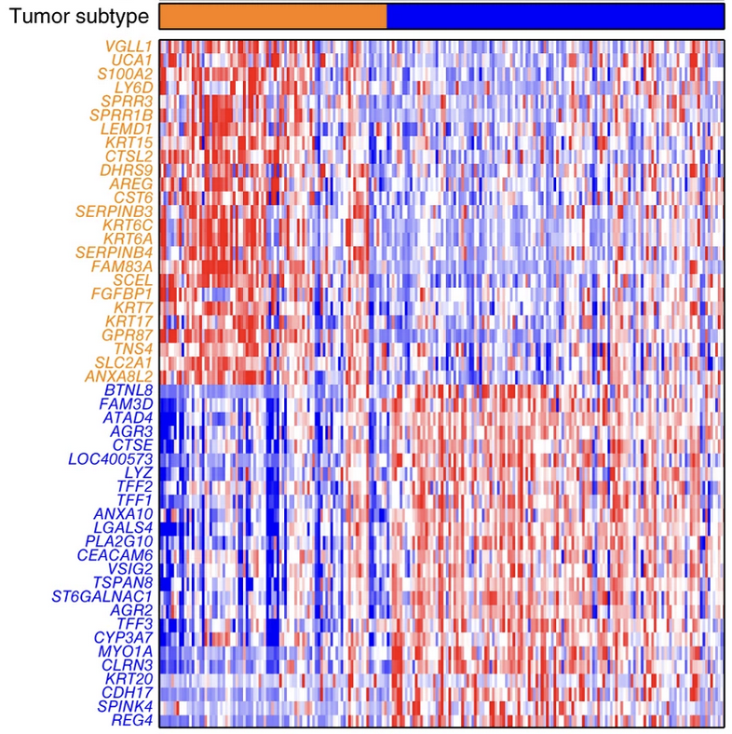
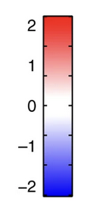

GSEA Lab: Continue our PAAD exploration
Defined Gene List
Module 2b Lab
DESeq2
Ranked Gene List
Module 2c Lab
Module 2a Lab

