Slide 1
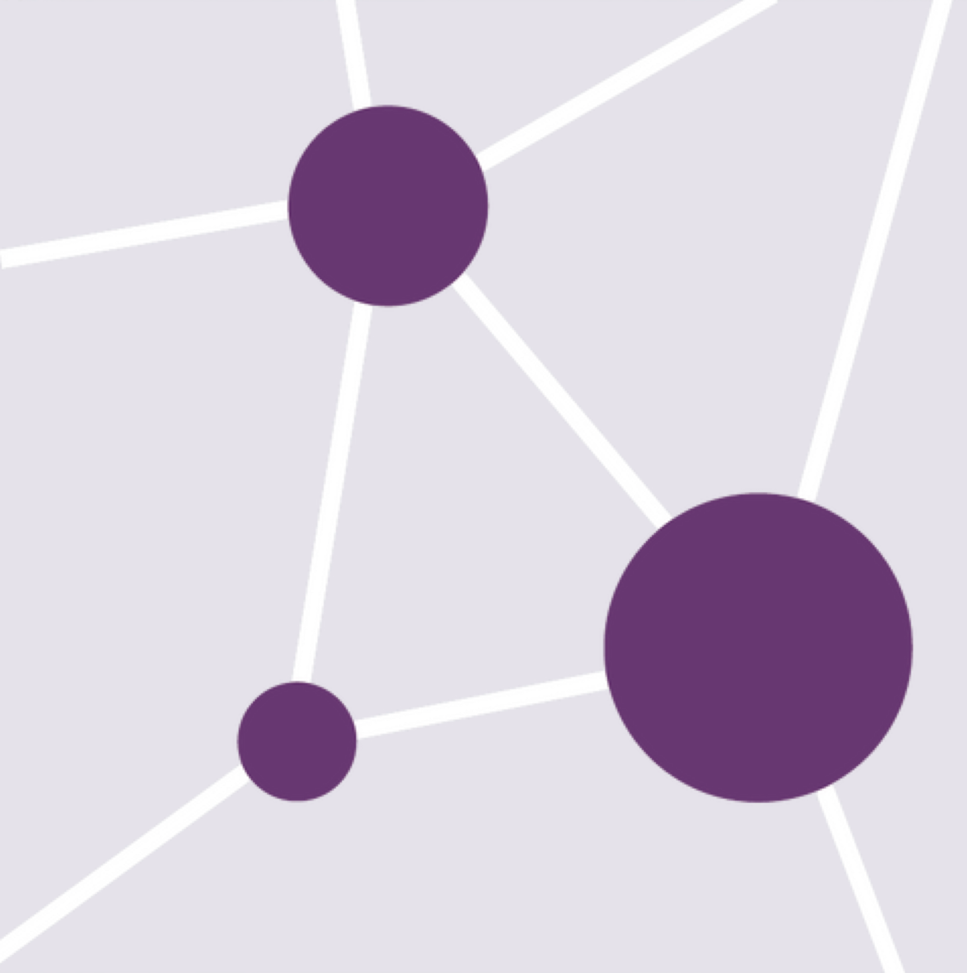
Module 3 - Cytoscape
Diogo Pellegrina
May 13, 2026

Slide 2
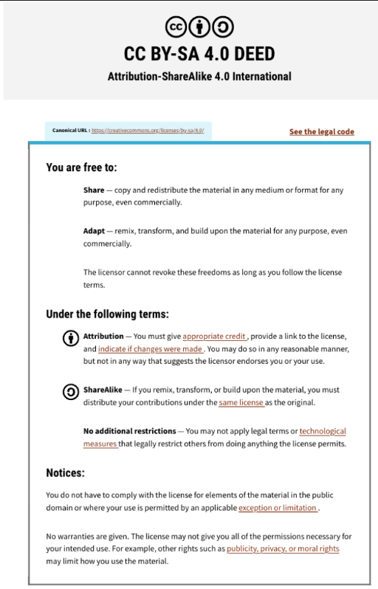
This presentation is an adaptation of Ruth Isserlin’s lecture from 2024

Slide 3
Learning Objectives
Introduction on graphs (network of nodes and edges)
Create a custom graph in Cytoscape
Adjust and personalize graph visualization
Using 3rd party Cytoscape Apps
Construct a graph of clustered terms, connected by the overlap of their contents

Slide 4
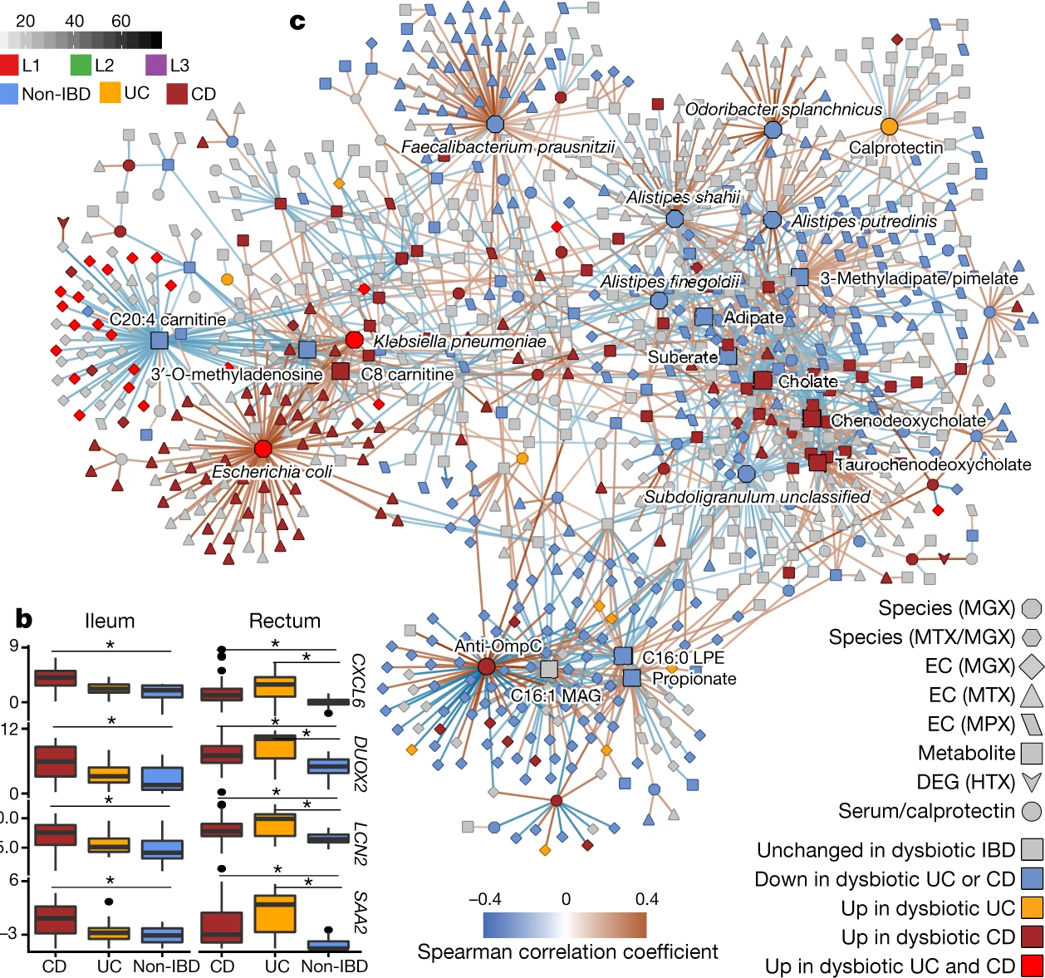
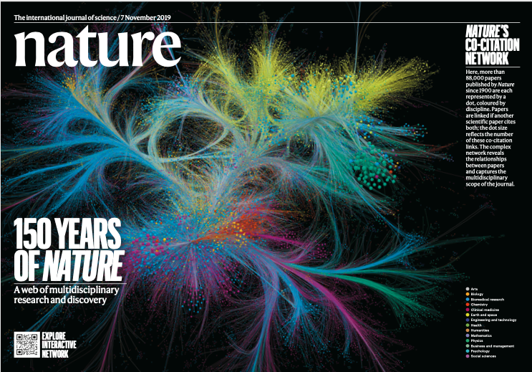
Why Networks?
Networks are everywhere….
Molecular networks
Cell-Cell Communication
Nervous systems
Bacon-Erdős degrees of separations
Lloyd-Price, J., Arze, C., Ananthakrishnan, A.N. et al. Multi-omics of the gut microbial ecosystem in inflammatory bowel diseases. Nature 569, 655–662 (2019)

Slide 5
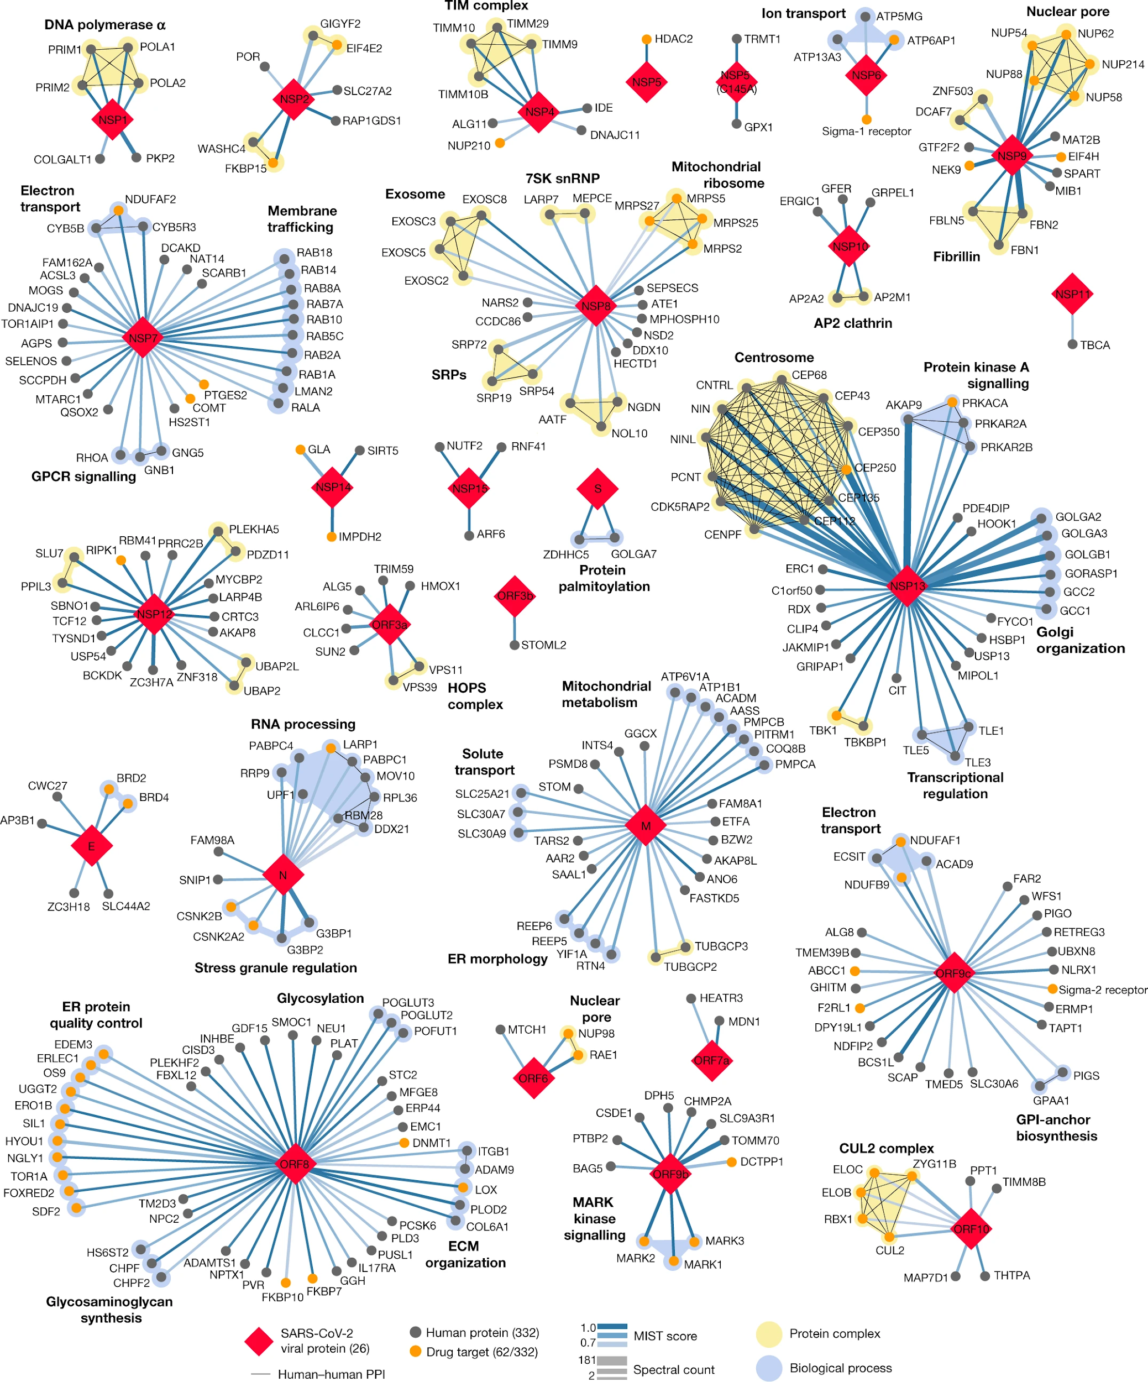
SARS=CoV-2 protein-protein interaction Network
Why Networks?
Networks are powerful tools….
Reduce complexity (if used properly)
More efficient than tables (if used properly)
Great for data integration (if used properly)
Intuitive visualization (if used properly)
Gordon, D.E., Jang, G.M., Bouhaddou, M. et al. A SARS-CoV-2 protein interaction map reveals targets for drug repurposing. Nature 583, 459–468 (2020).

Slide 6
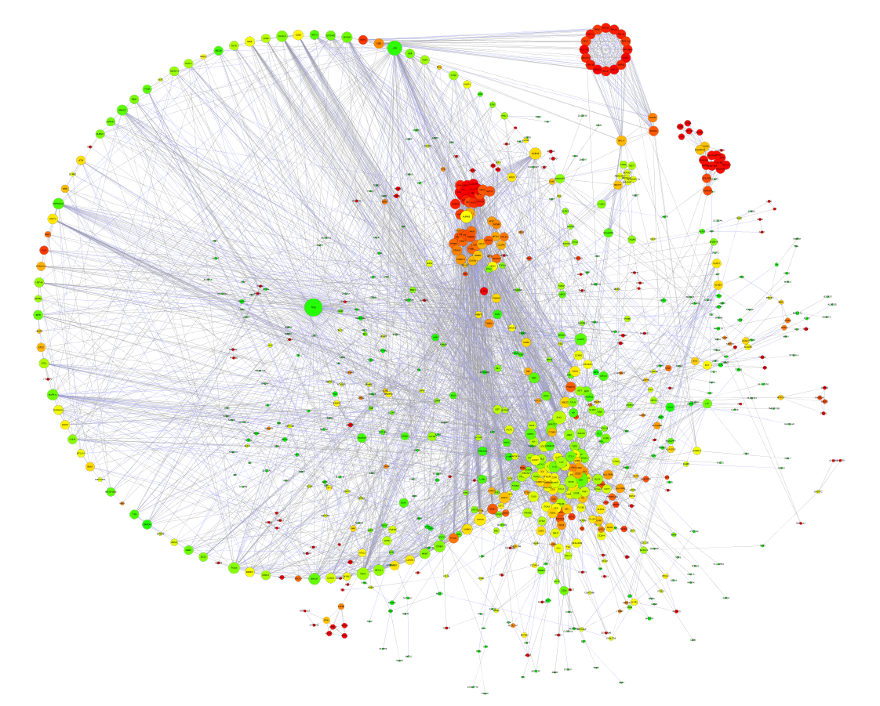
Why Networks?
Networks are powerful tools….
Reduce complexity (if used properly)
More efficient than tables (if used properly)
Great for data integration (if used properly)
Intuitive visualization (if used properly)
This is a real figure I found in the wild!

Slide 7
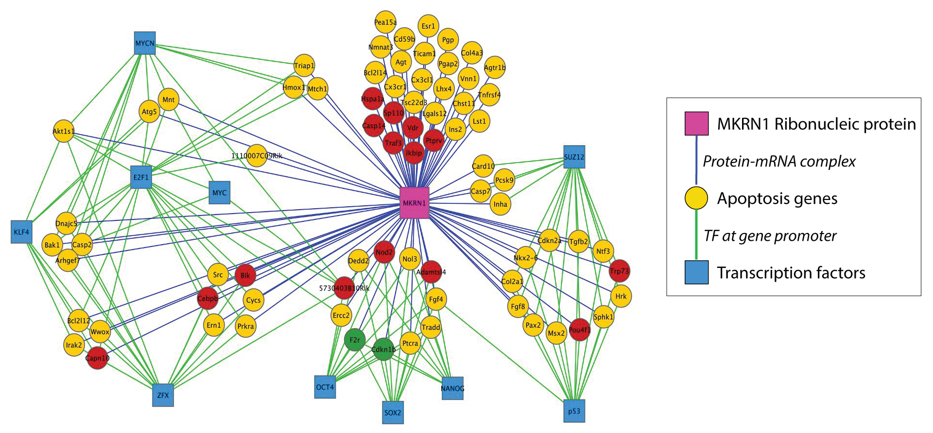
Represent relationships of biological molecules
  Physical, regulatory, genetic, functional interactions
Network analysis
  Finding clustered sub-networks with interesting properties
    Clustered groups of genes
    Genes that connect different clusters
  Finding paths between nodes
  Finding central nodes in
  network topology
  (“hub” genes)

Slide 8
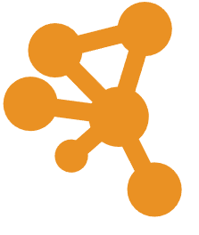
Cytoscape has an active Community:
http://www.cytoscape.org
10,000s users, >17,600 downloads/month (May 2018)
Help
  Documentation, data sets
  Mailing lists
  http://tutorials.cytoscape.org
Automatable through R or python using cyrest
Cited 2745 (google scholar), 1,843 (ISI web of Science) (June 2024)
>383 active Apps Extend Functionality (June 2024)
  Build your own, requires programming
Cline MS et al. Integration of biological networks and gene expression data using Cytoscape Nat Protoc. 2007;2(10):2366-82

Slide 9
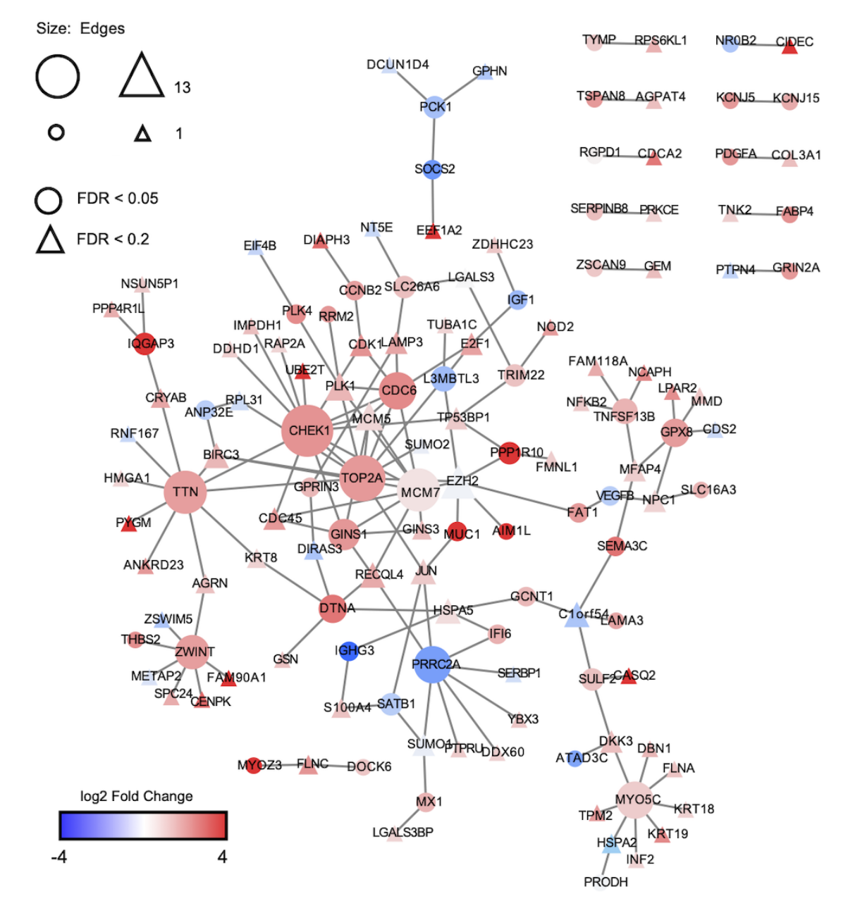
Networks of Protein-Protein Interactions:
Public databases like Biogrid host interaction data on several different species. Each interaction is curated from the literature or from high throughput experiments that record when 2 proteins are observed being in contact.
Using this dataset you can take any list of genes relevant for your project and display them is a graph, with edges displaying pairs of genes that were previously observed to interact.
In this example the color shows expression foldchange, significant genes are shown as circles.

Slide 10
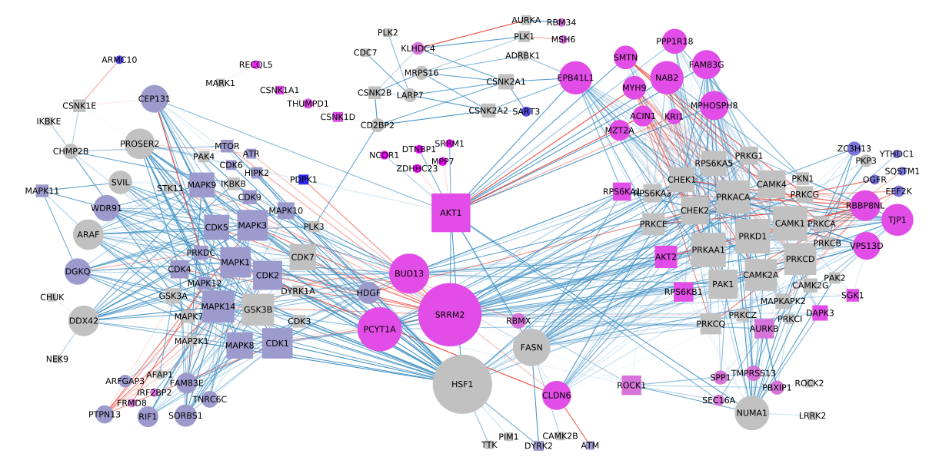
Networks of Protein-Protein Interactions:
In this other example we have a list of genes with recurrent mutations. Kinases (enzymes that phosphorylate other proteins) are shown as squares.
Only edges that represent the interaction between a kinase and proteins mutated in this dataset are shown.
The color of the nodes indicates the amino acid being mutaded, and the color of the edges indicates whether these mutations inhibit or promote phosphorylation.

Slide 11
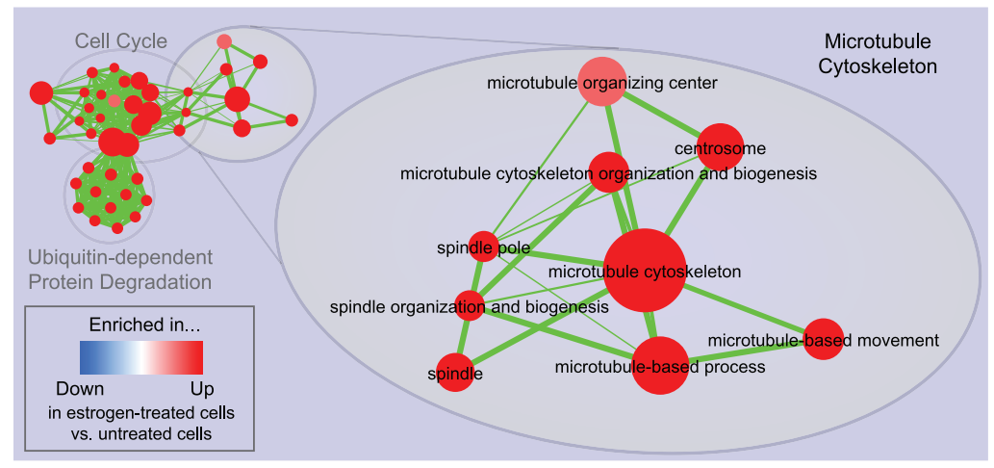
Networks of overlapping pathways:
As previously mentioned, nested pathways tend to be co-enriched and generate repetitive results. Graphs where pathways are nodes, with edges showing if they have genes in common, can be a good way to show how they cluster together in similar terms.

Slide 12
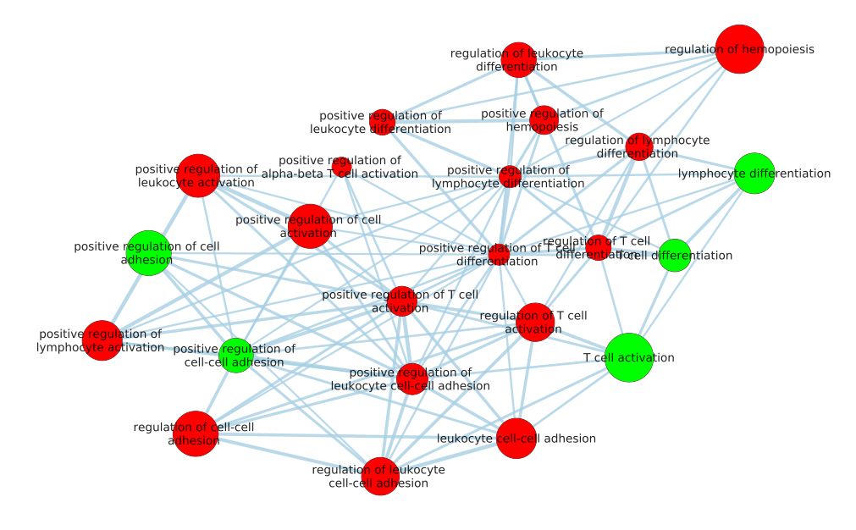
In practice there is an important caveat for this strategy:

Slide 13
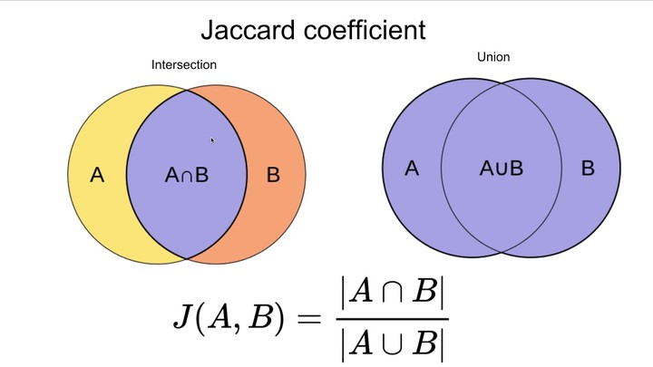
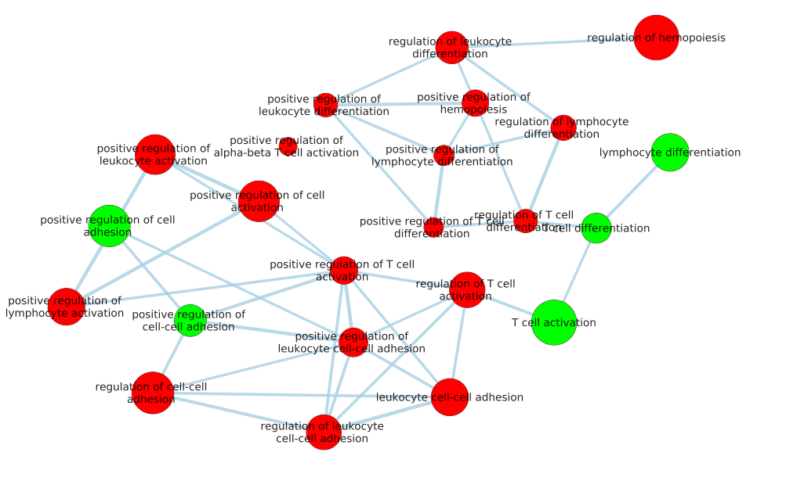
Jaccard coefficient =

Slide 14
Jaccard coefficient =

Slide 15
Then these nodes can be re-organized to make more sense

Slide 16
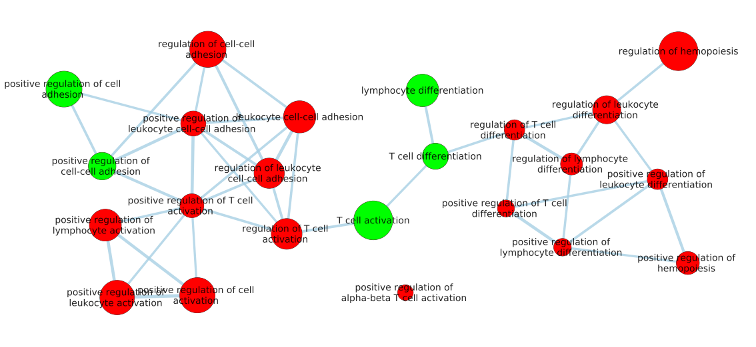
Then these nodes can be re-organized to make more sense

Slide 17
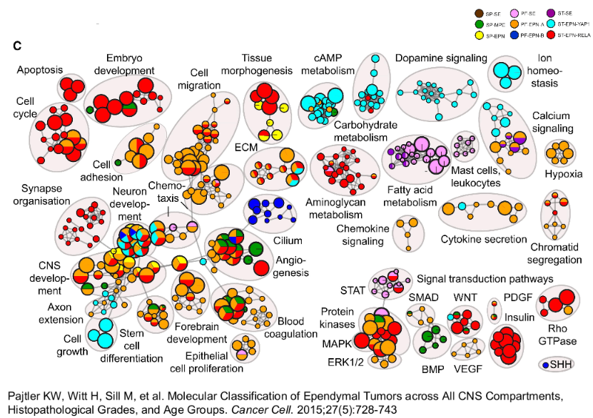
You can also use pie-charts to show pathways from multiple experiments:

Slide 18
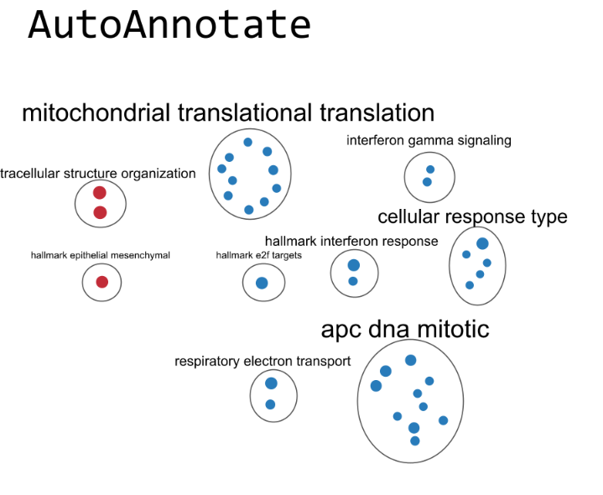

Slide 19
Lab 3, open your Cytoscapes

Slide 20
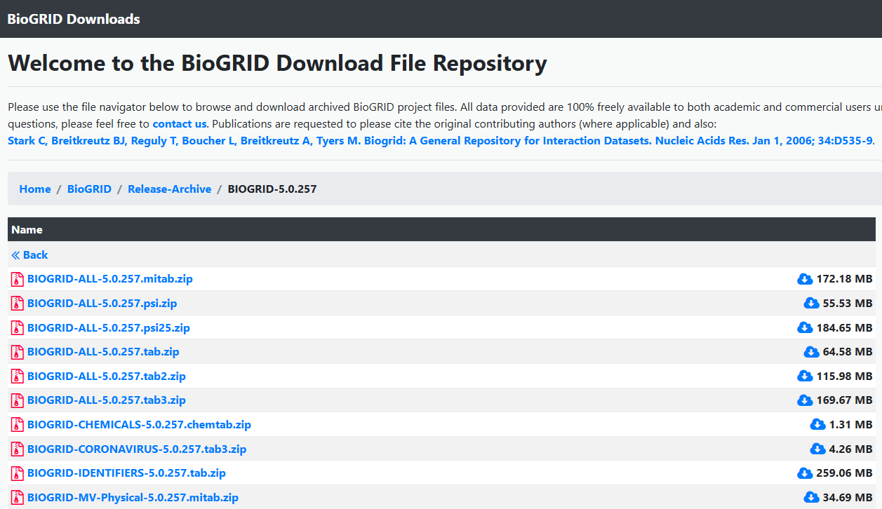
First we download a PPI from Biogrid

Slide 21
The file is very big, so we need to clean it in R
We will want to select the “from” and “to” columns. There are many repeated lines, so we will simplify it like this:
#remove self interactions
final_result <- final_result[final_result[,1] != final_result[,2],]
#sort cols A and B alphabetically
biogrid_simple <- data.frame(
'Entrez Gene Interactor A' = pmin(biogrid_file[,1], biogrid_file[,2]),
'Entrez Gene Interactor B' = pmax(biogrid_file[,1], biogrid_file[,2])
)
# Then remove duplicates
biogrid_simple <- unique(biogrid_simple)

Slide 22
But since the Biogrid file is very large we have to read/clean it by chunks.
# Open a file connection
con = file("data/BIOGRID-ORGANISM-Homo_sapiens-5.0.257.tab3.txt", "r")
“““ declare some variables, separate file header”””
while(length(chunk) != 0){
chunk = read.table(con, nrows = chunk_size, #read it in chunks
sep = "\t", header = FALSE, quote = "", comment.char = ""
)[,c(2,3)] #only 2 important columns
#get only lines with DEGs in both columns
filtered_chunk = chunk[((chunk[[1]] %in% entrez_list) & (chunk[[2]] %in% entrez_list)), ]
#save results in a list to be combined later
if(nrow(filtered_chunk) > 0) {
result_list[[chunk_num]] = filtered_chunk
chunk_num = chunk_num + 1
}
}

Slide 23
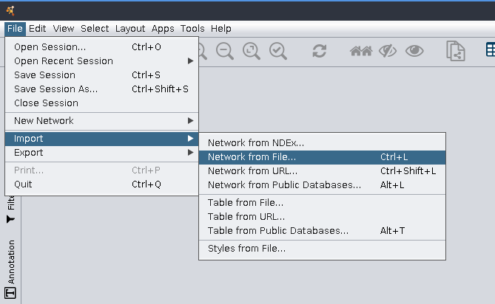

Slide 24
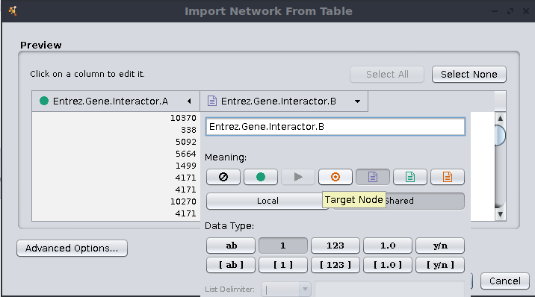
Select columns for source and target nodes

Slide 25
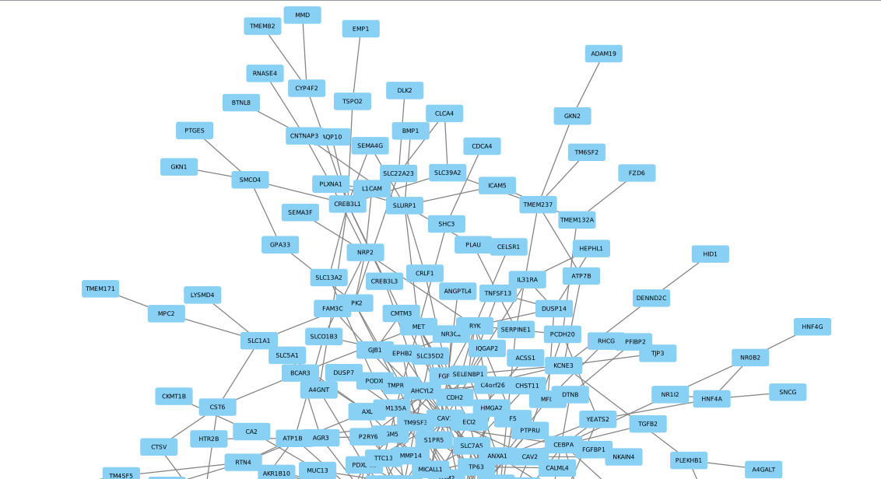
We created a monster!

Slide 26
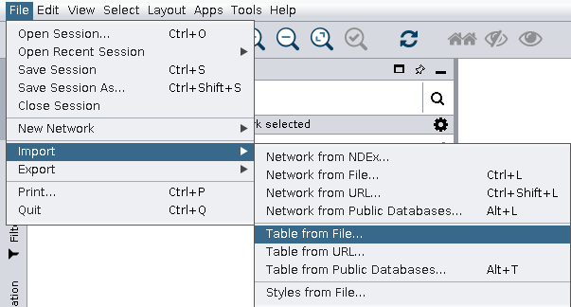
Let’s add more data to organize things

Slide 27
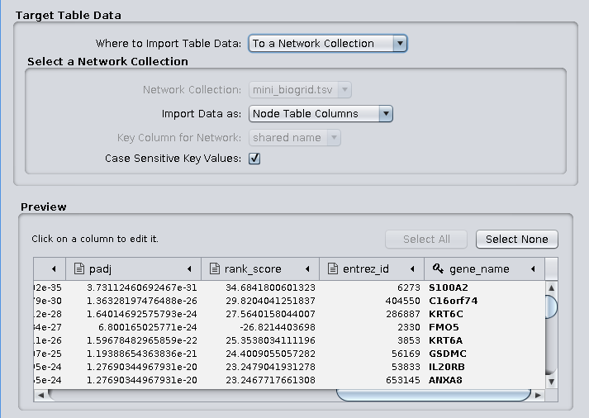
Import as NODE TABLE
Make sure gene_name is selected as a KEY

Slide 28
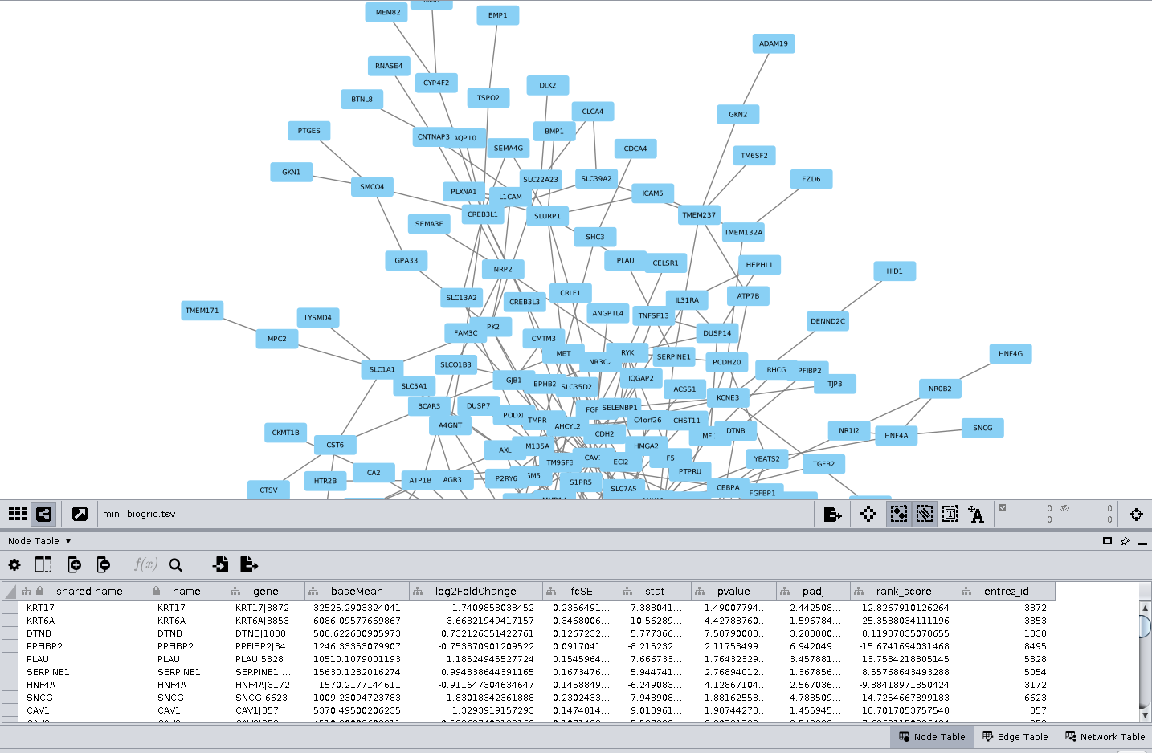
Notice in the bottom,
there are node and edge tables

Slide 29
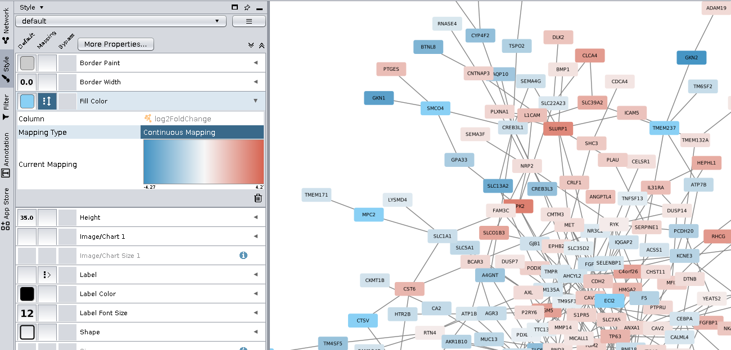
On “styles” we can give qualities to nodes based on their new columns

Slide 30
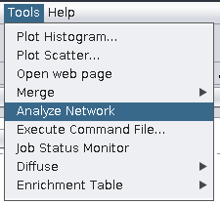
This tool will add several useful columns to those tables
Edge Betweenness
Number of Edges
Node Connectivity
Node Betweenness
Others

Slide 31
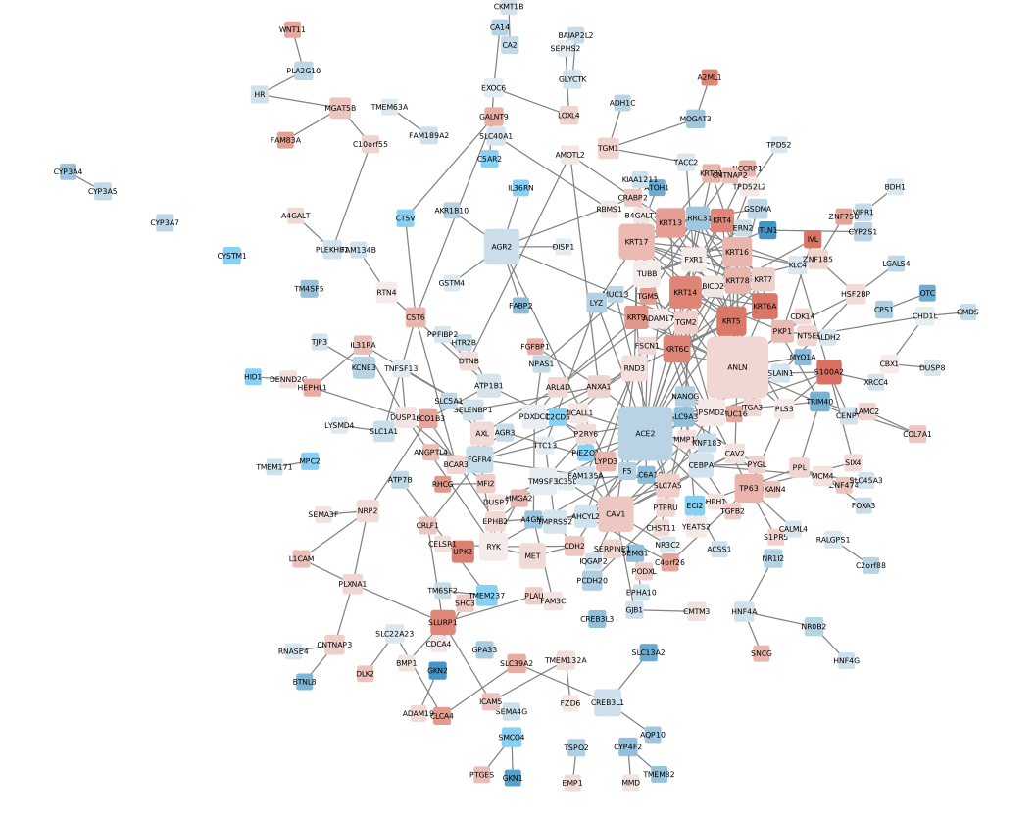
Color proportional to foldChange
Size proportional to number of edges
yFiles Organic Layout
Removed edges with low betweenness

Slide 32
In order to create an EnrichmentMap we need a custom GMT file with just our sig pathways and sig genes.
pathway_table = read.table(file.path("outputs",
"ensg_gprofiler_results_foldchange0_ordered.tsv"),
sep='\t', header = TRUE)
custom_GMT = pathway_table[, c("term_id", "term_name", "intersection")]
custom_GMT$intersection = gsub(',', '\t', custom_GMT$intersection)
write.table(custom_GMT, file=file.path("outputs","mini_gmt.gmt"),
quote=FALSE, sep='\t', row.names = FALSE)

Slide 33
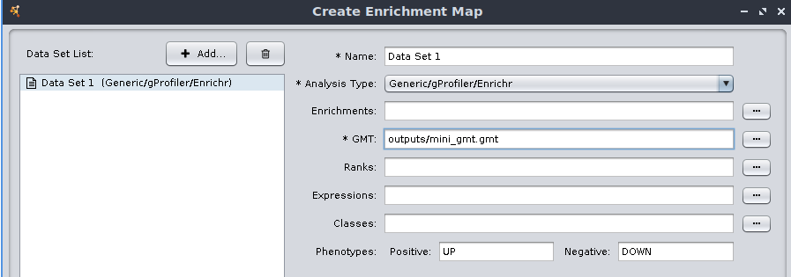
To create an enrichmentMap

Slide 34
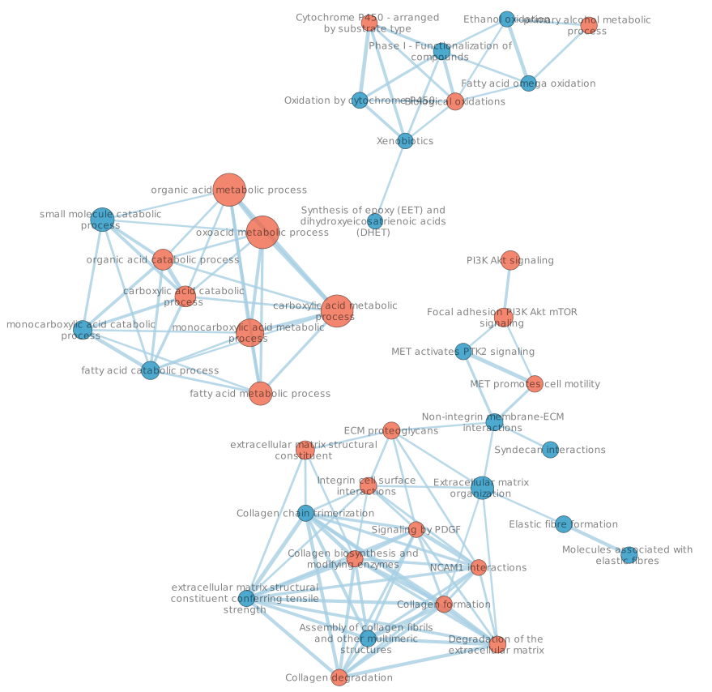
Color by pathway_denester’s “filtered”
EnrichmentMap adjustment of p-value ucutoff and Jaccard coef.
yFiles Organic Layout
Removed clusters of nodes with less than 4 members

Slide 35
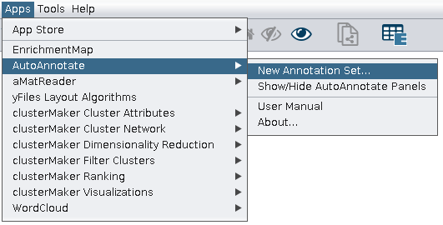
Creating cluster names with AutoAnnotate

Slide 36
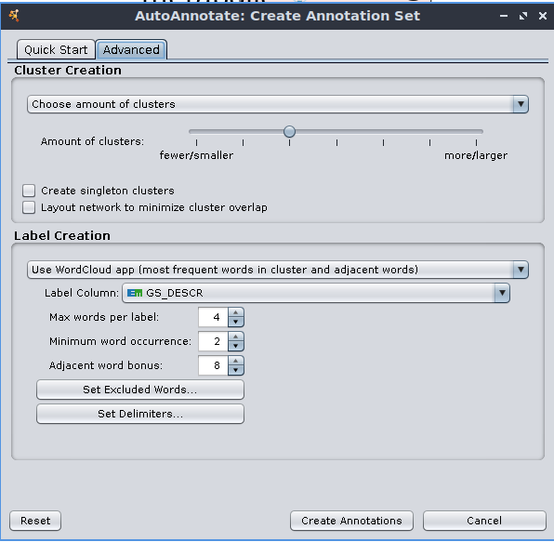
Select number of clusters, in this case, 3
Adjust Label Column to be the node column with term names
Minimum word occurrence, at least 2.
Adjusting parameters (advanced tab)

Slide 37
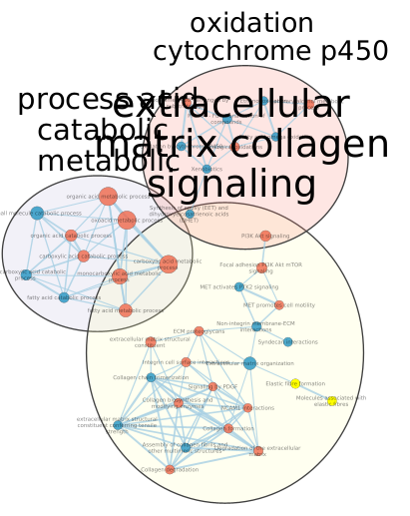
Move clusters around too be more visible

Slide 38
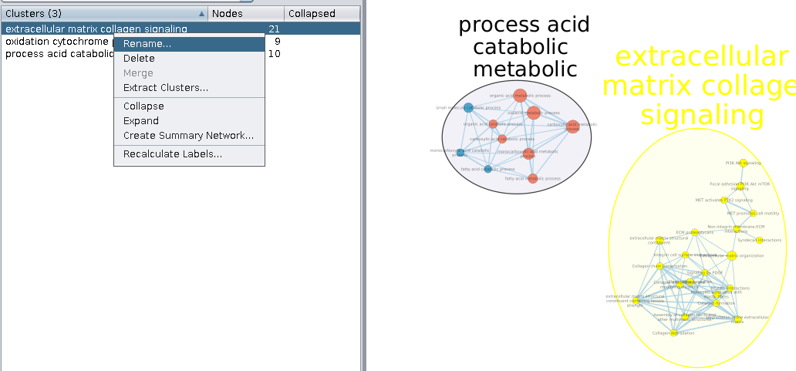
You can delete or manually rename clusters as needed

Slide 39
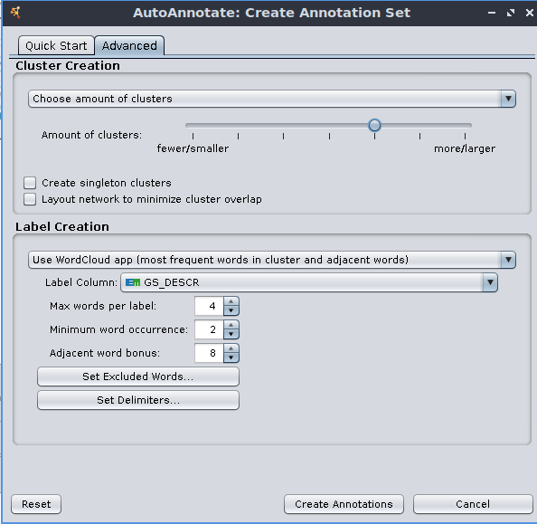
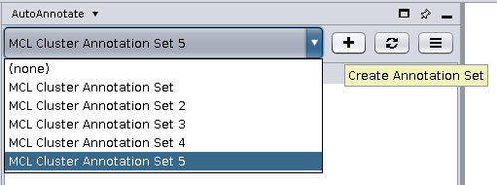
At this + button you can try creating new layers of annotation with different parameters, they will be displayed in the drop-down menu to the top left.

Slide 40
