Slide 1

bioinformatics.ca
bioinformaticsdotca.github.io

Slide 2
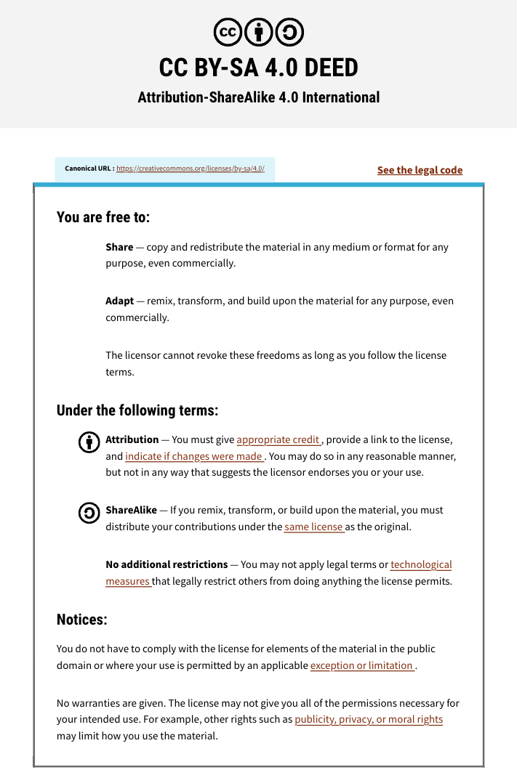

Slide 3



Module 4 Lab
Constance Li
Pathway and Network Analysis
May 13, 2026

Slide 4
Learning Objectives
Analyze mutation data using ReactomeFI
Use GeneMANIA to integrate findings across expression and mutation data types
Draw biological conclusions from multi-omics pathway analysis

Slide 5
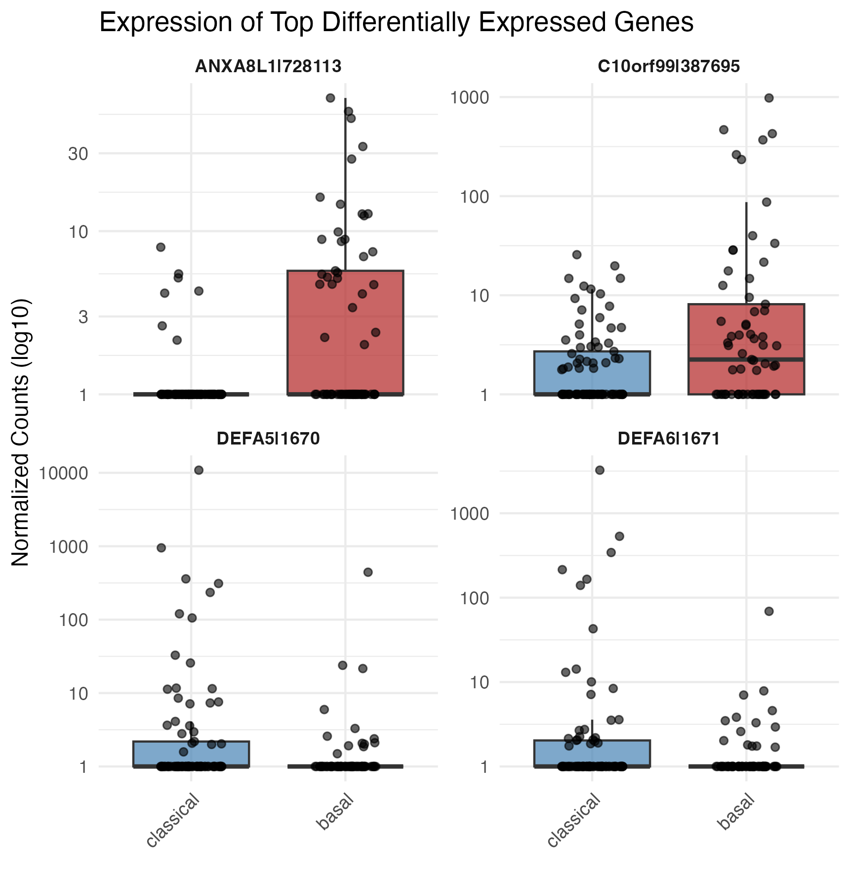
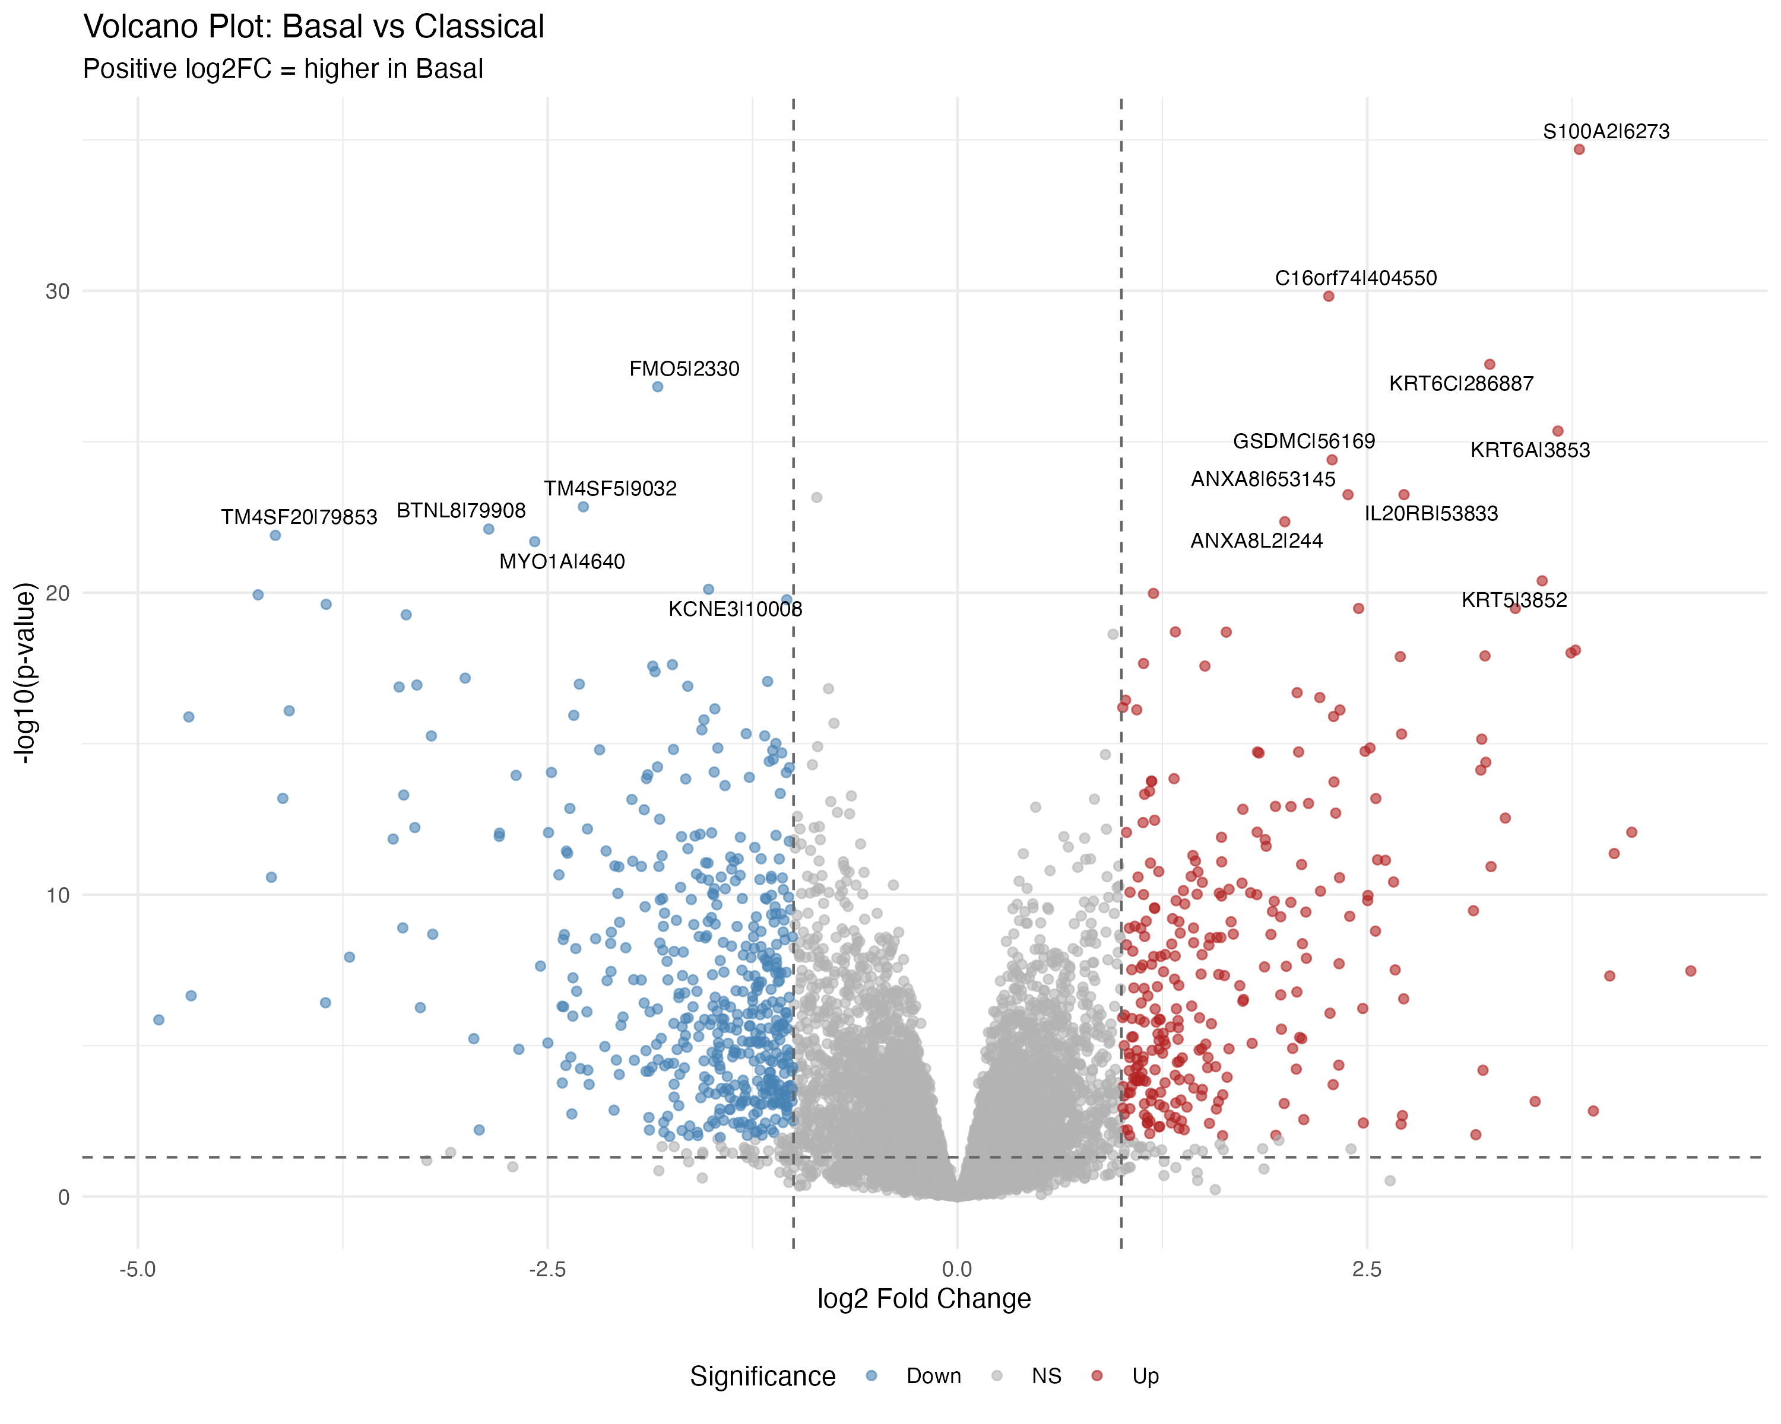
Recall Lab 2a

Slide 6
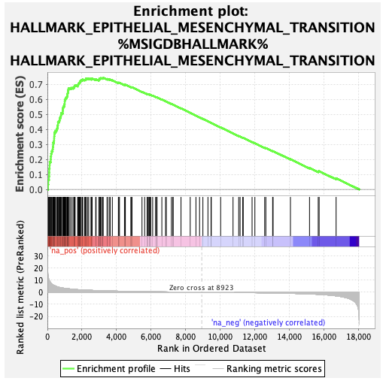
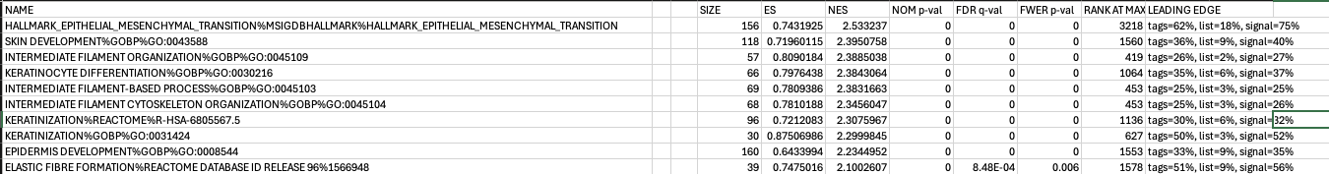
Recall Lab 2c

Slide 7
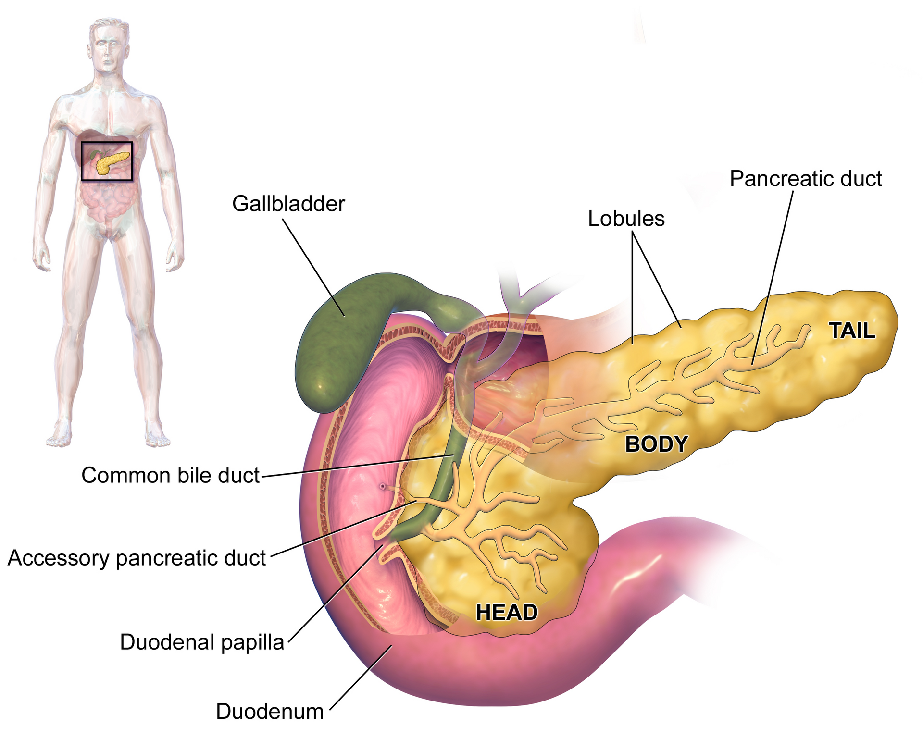
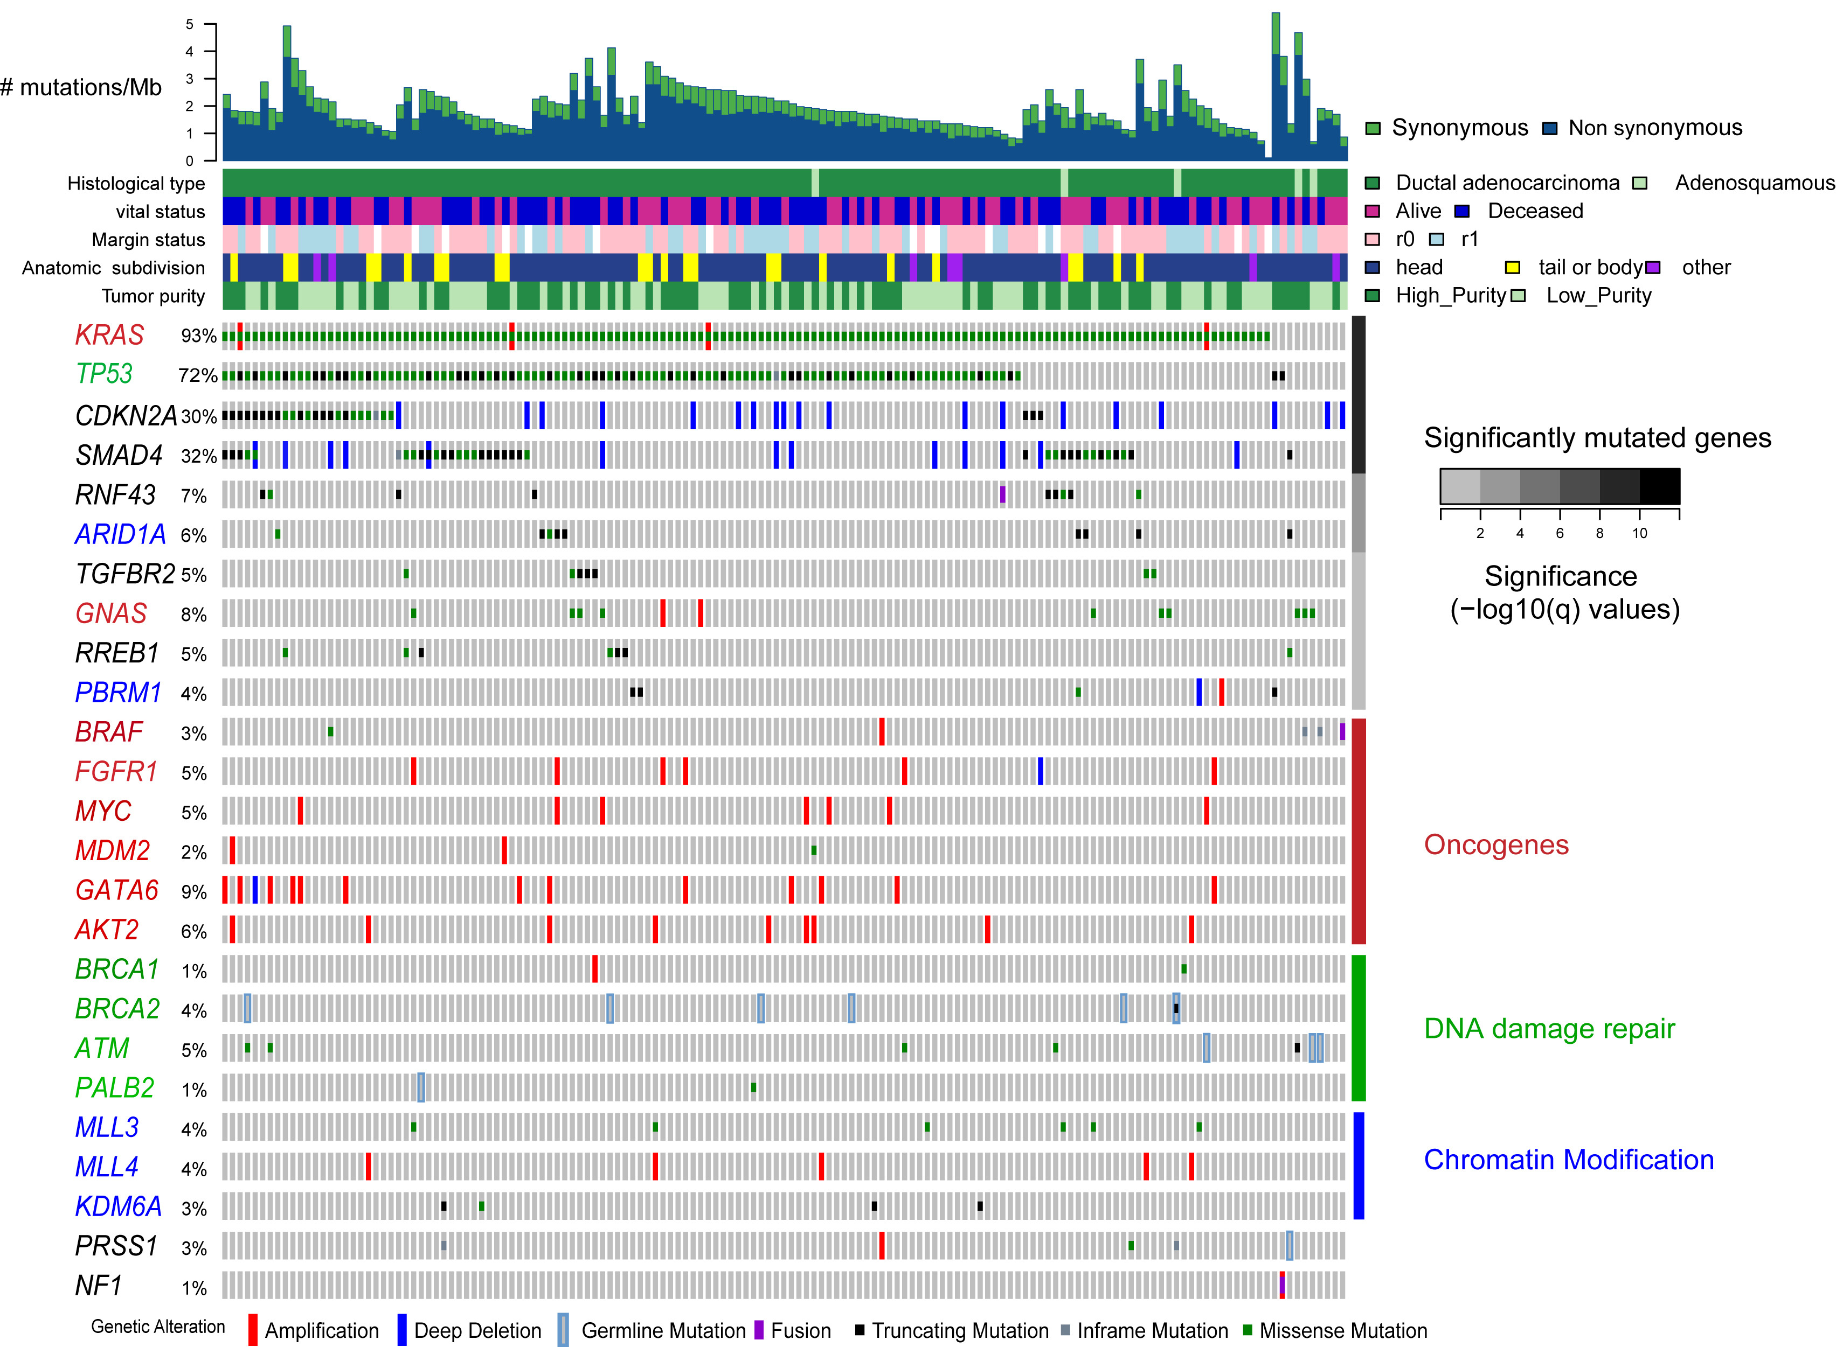
Remember PAAD?
Pancreatic
https://en.wikipedia.org/wiki/Pancreas

Slide 8
What is “integration”?
The process of combining separate parts or systems into a unified whole
Integrate different molecular profiles
Integrate a collection of networks
Integrate everything you’ve learned in this workshop

Slide 9
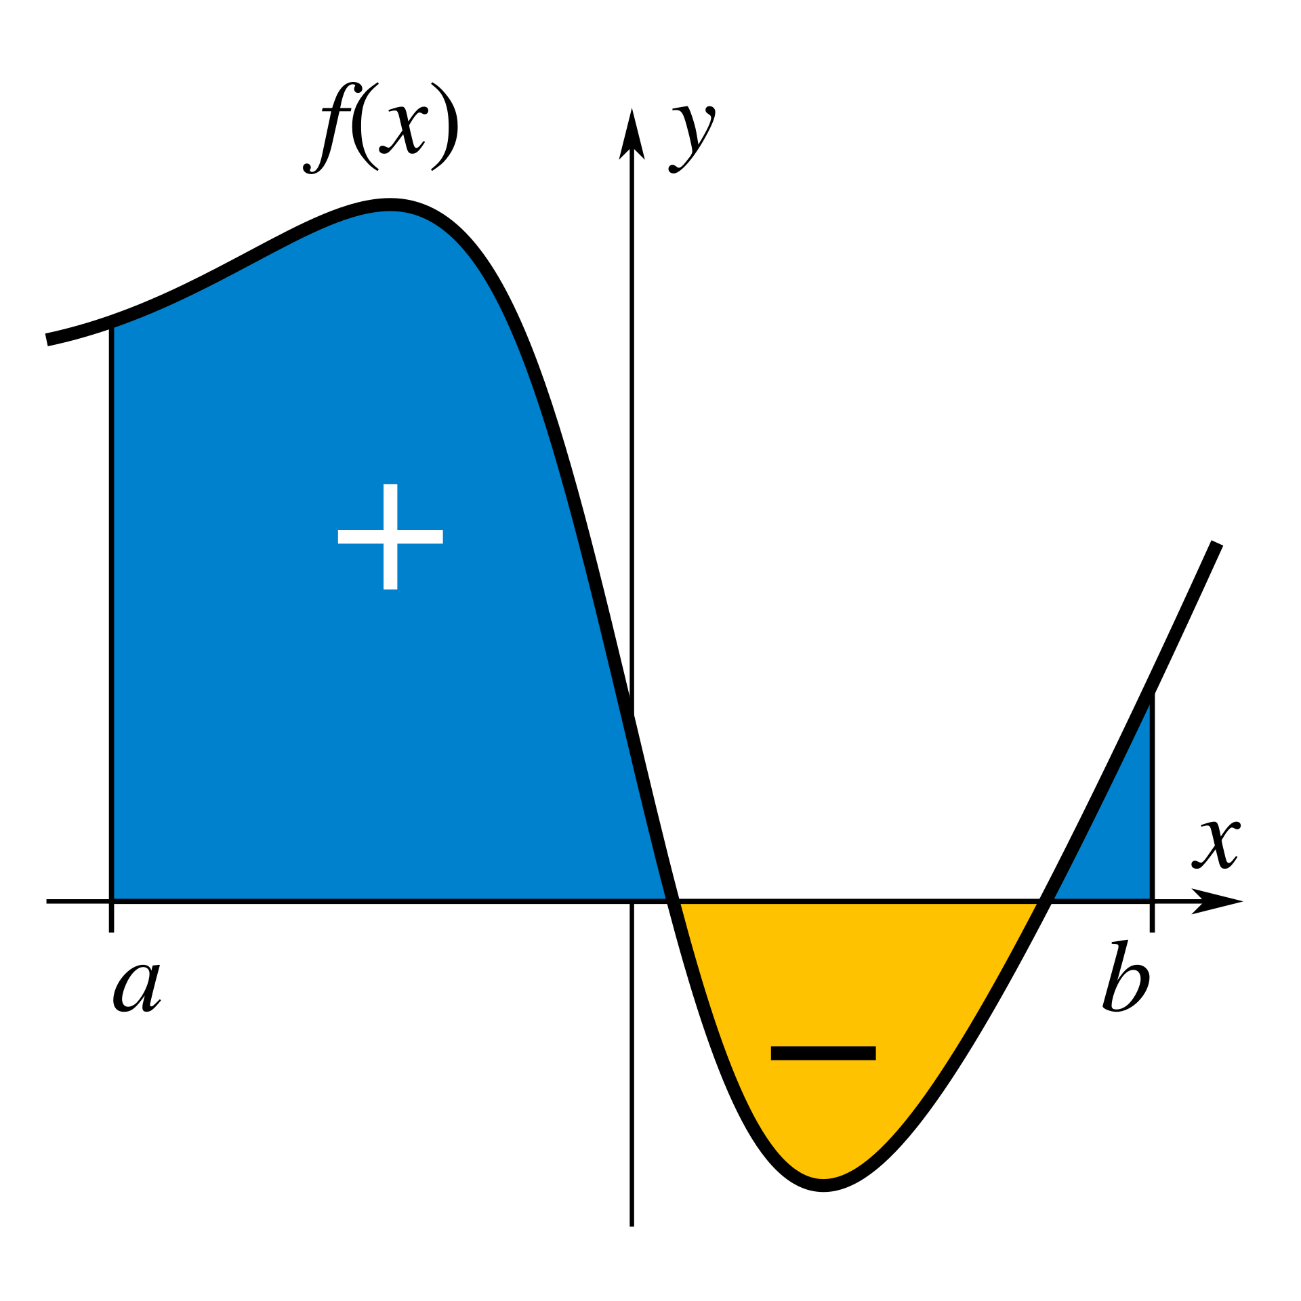
Let’s integrate
Download the lab materials:
https://bioinformaticsdotca.github.io/PNA_CalSask-2605/module-4.html
Module 4: Instructions PDF, gene list text files
Make sure Cytoscape is installed
You’ll need the ReactomeFI and GeneMANIA apps

Slide 10
Information and data sources
Moffitt subtype paper
Moffitt RA, Marayati R, Flate EL, Volmar KE, Loeza SGH, Hoadley KA, et al. Virtual microdissection identifies distinct tumor- and stroma-specific subtypes of pancreatic ductal adenocarcinoma. Nat Genet. 2015 Oct;47(10):1168–78. doi:10.1038/ng.3398
Mutations data
Raphael BJ, Hruban RH, Aguirre AJ, Moffitt RA, Yeh JJ, Stewart C, et al. Integrated Genomic Characterization of Pancreatic Ductal Adenocarcinoma. Cancer Cell. 2017 Aug;32(2):185-203.e13. doi:10.1016/j.ccell.2017.07.007
RNA-seq counts data
https://gdac.broadinstitute.org/

