Slide 1

bioinformatics.ca
bioinformaticsdotca.github.io

Slide 2
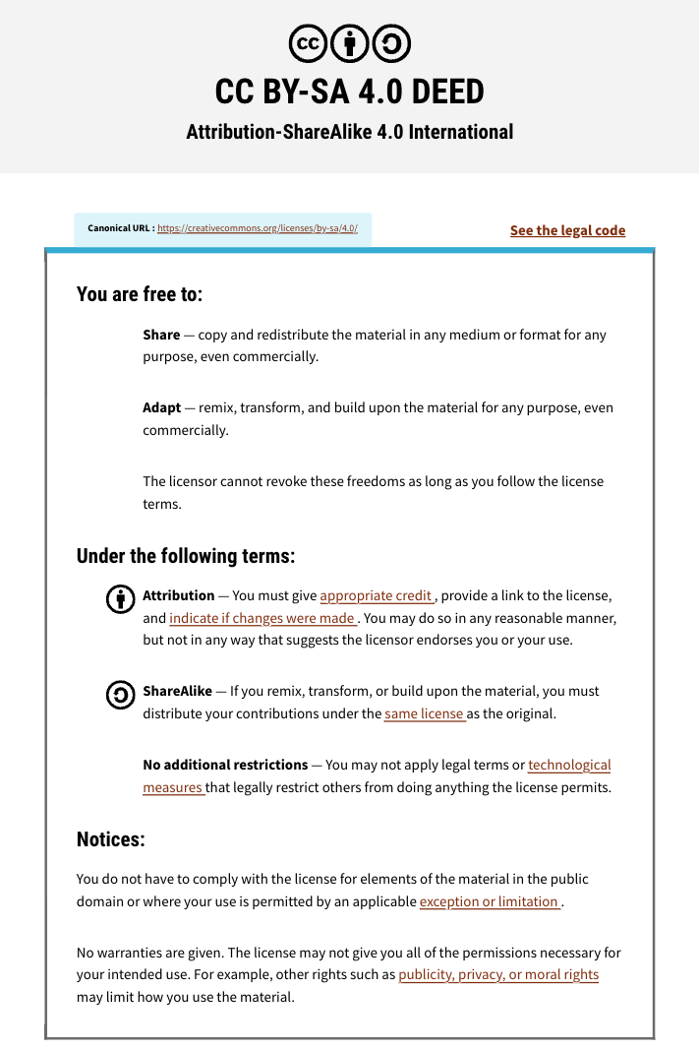

Slide 3
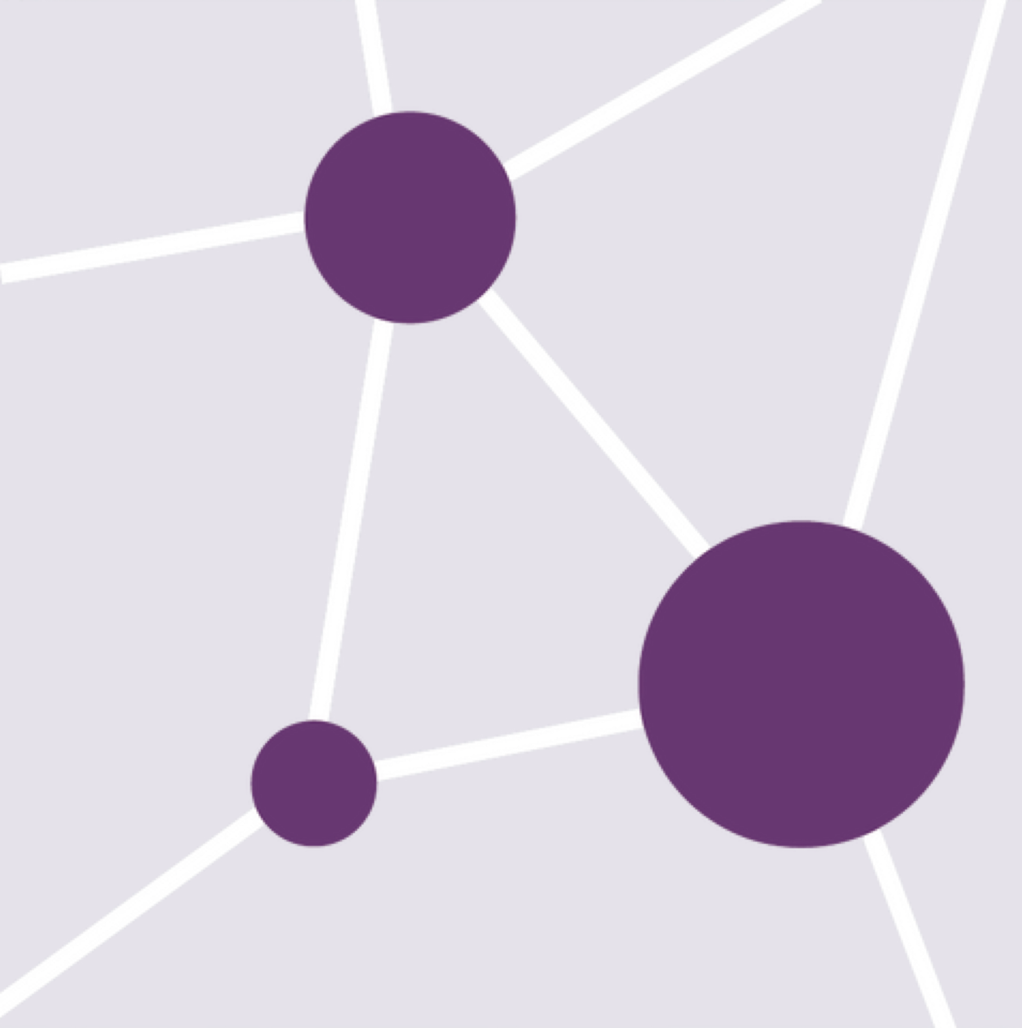


Module 4: Integrative Assignment
Constance Li
Pathway and Network Analysis
May 13, 2026

Slide 4
Learning Objectives
Describe similarities and differences between pathways and networks
Distinguish between types of pathway/network analysis and their goals
Identify and apply an appropriate method for mutations-based pathway analysis
List examples of pathway/network databases and analysis tools

Slide 5
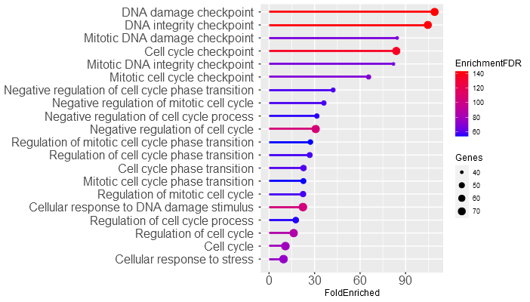
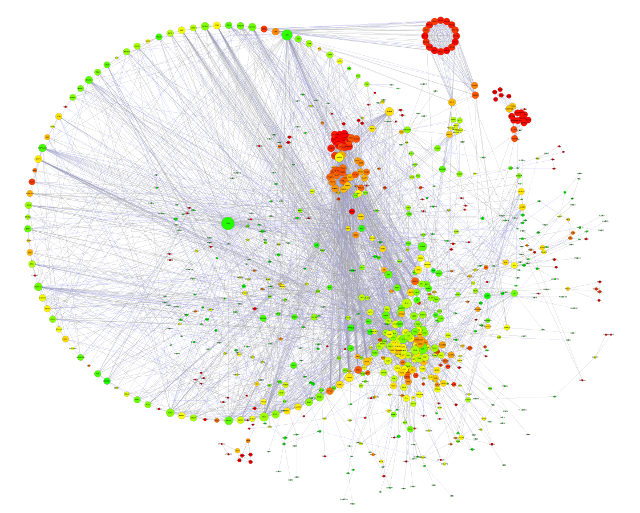
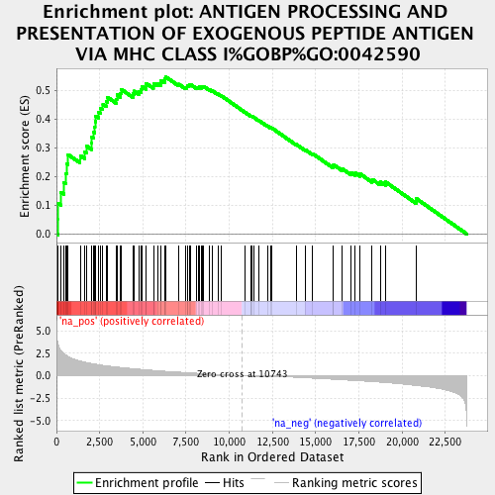
What we’ve learned so far
Condition A
Control
Healthy tissue
Pre-treatment
Module 2b
Module 2a
Defined Gene List
gProfiler
vs
DESeq2
Cytoscape
Condition B
Ranked Gene List
GSEA
Module 3
Treatment
Tumor tissue
Post-treatment
Module 2c

Slide 6
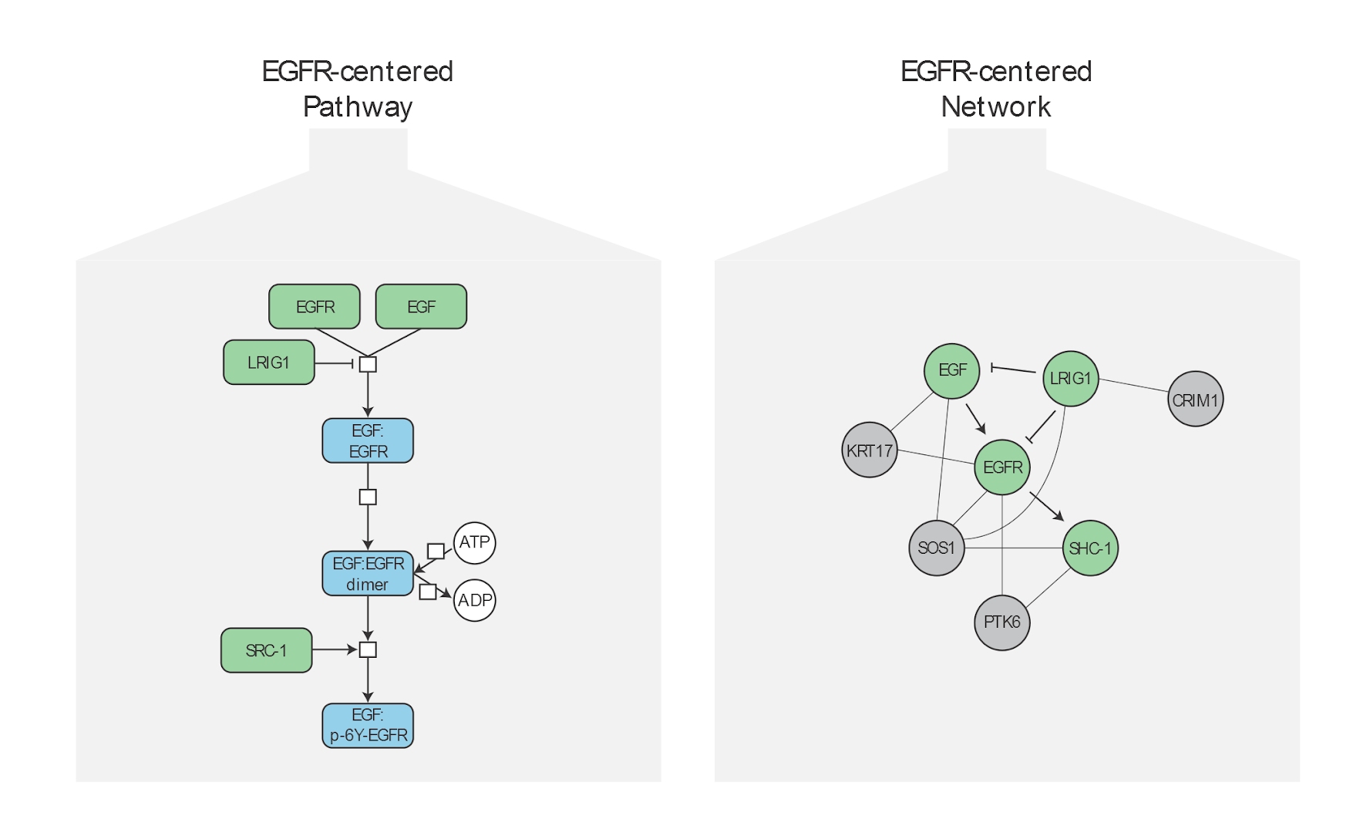
Pathways and networks
Notes:
Advantages:
Usually curated.
Biochemical view of biological processes.
Cause and effect captured.
Human-interpretable visualizations.
Disadvantages:
Sparse coverage of genome.
Different databases disagree on boundaries of pathways.
Pathways capture only the “well understood” portion of biology.
Networks cover less well understood relationships:
Genetic interactions
Physical interaction
Coexpression
GO term sharing
Adjacency in pathways

Slide 7
Pathway databases
Advantages
Usually curated
Biochemical view of biological processes
Cause and effect captured
Human-interpretable visualizations
Disadvantages
Sparse coverage of genome
Different databases disagree on boundaries of pathways

Slide 8
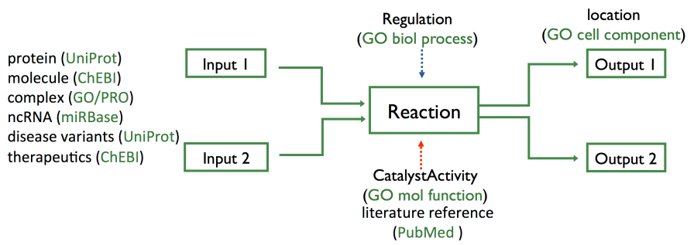
Reaction-Network databases
Reactome & KEGG
explicitly describe biological processes as a series of biochemical reactions.
represents many events and states found in biology.

Slide 9
KEGG
Kyoto Encyclopedia of Genes and Genomes(KEGG):
A vast library of information: fully sequenced genomes, genes, proteins, pathways, chemical compounds pertaining to over a hundred different species of both prokaryotes and eukaryotes.
KEGG PATHWAY is a collection of manually drawn pathway maps representing knowledge on the molecular interaction and reaction networks for Metabolism, Cellular Processes, Organismal Systems, Human Diseases and Drug Development
Subscription required for access to underlying data for analysis use

Slide 10
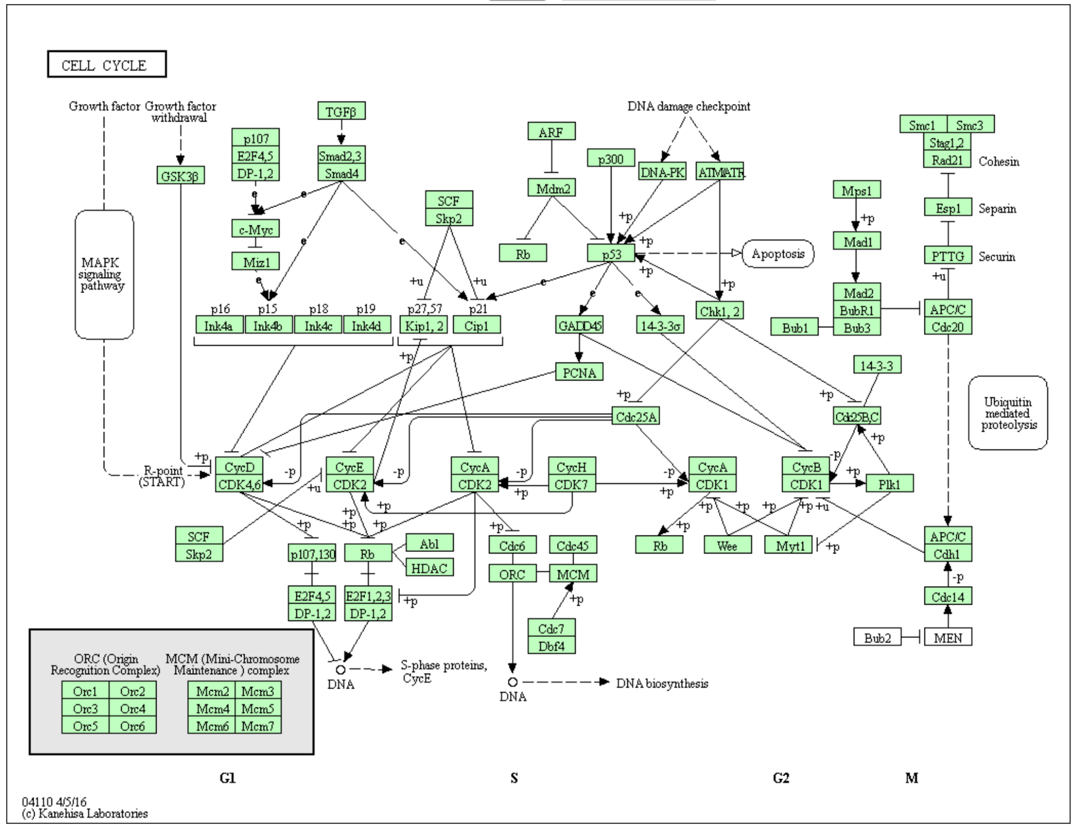
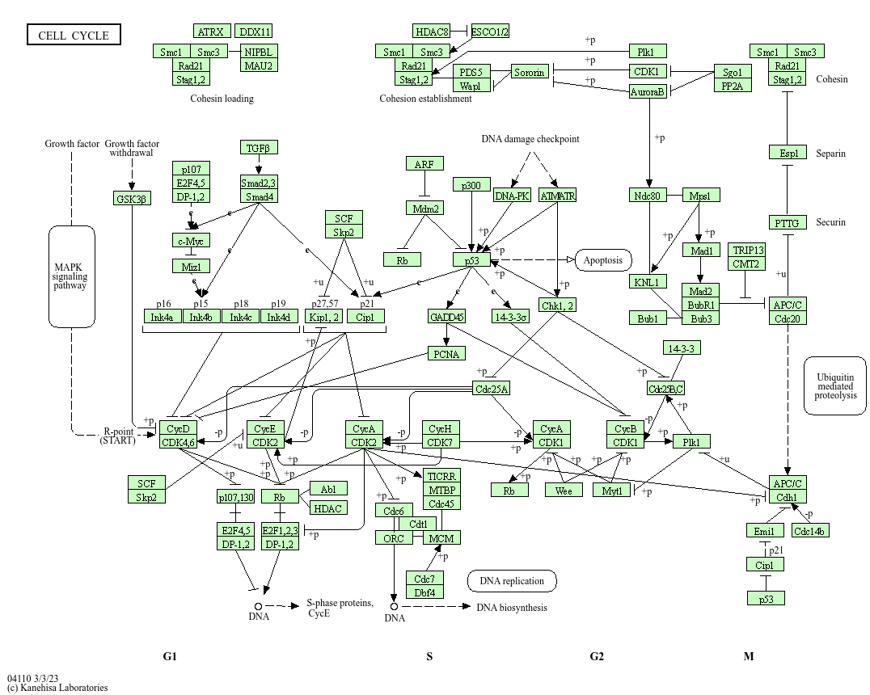
KEGG Cell Cycle

Slide 11
Reactome
Open source and open access pathway database
Curated human pathways encompassing metabolism, signaling, and other biological processes
Rigorous curation standards – every pathway is traceable to primary literature
Cross-reference to many other bioinformatics databases
Provides data visualization and analysis tools
Google-map style reaction diagrams and textbook-style illustrations with overlays
Find pathways containing your gene list
Calculate gene overrepresentation in pathways
Find corresponding pathways in other species

Slide 12
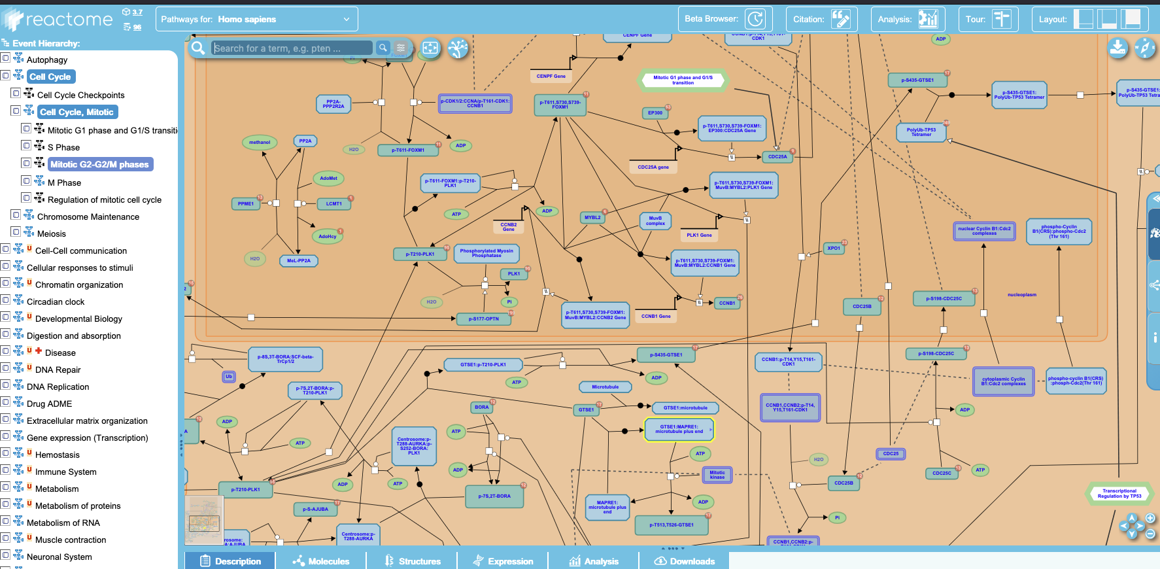
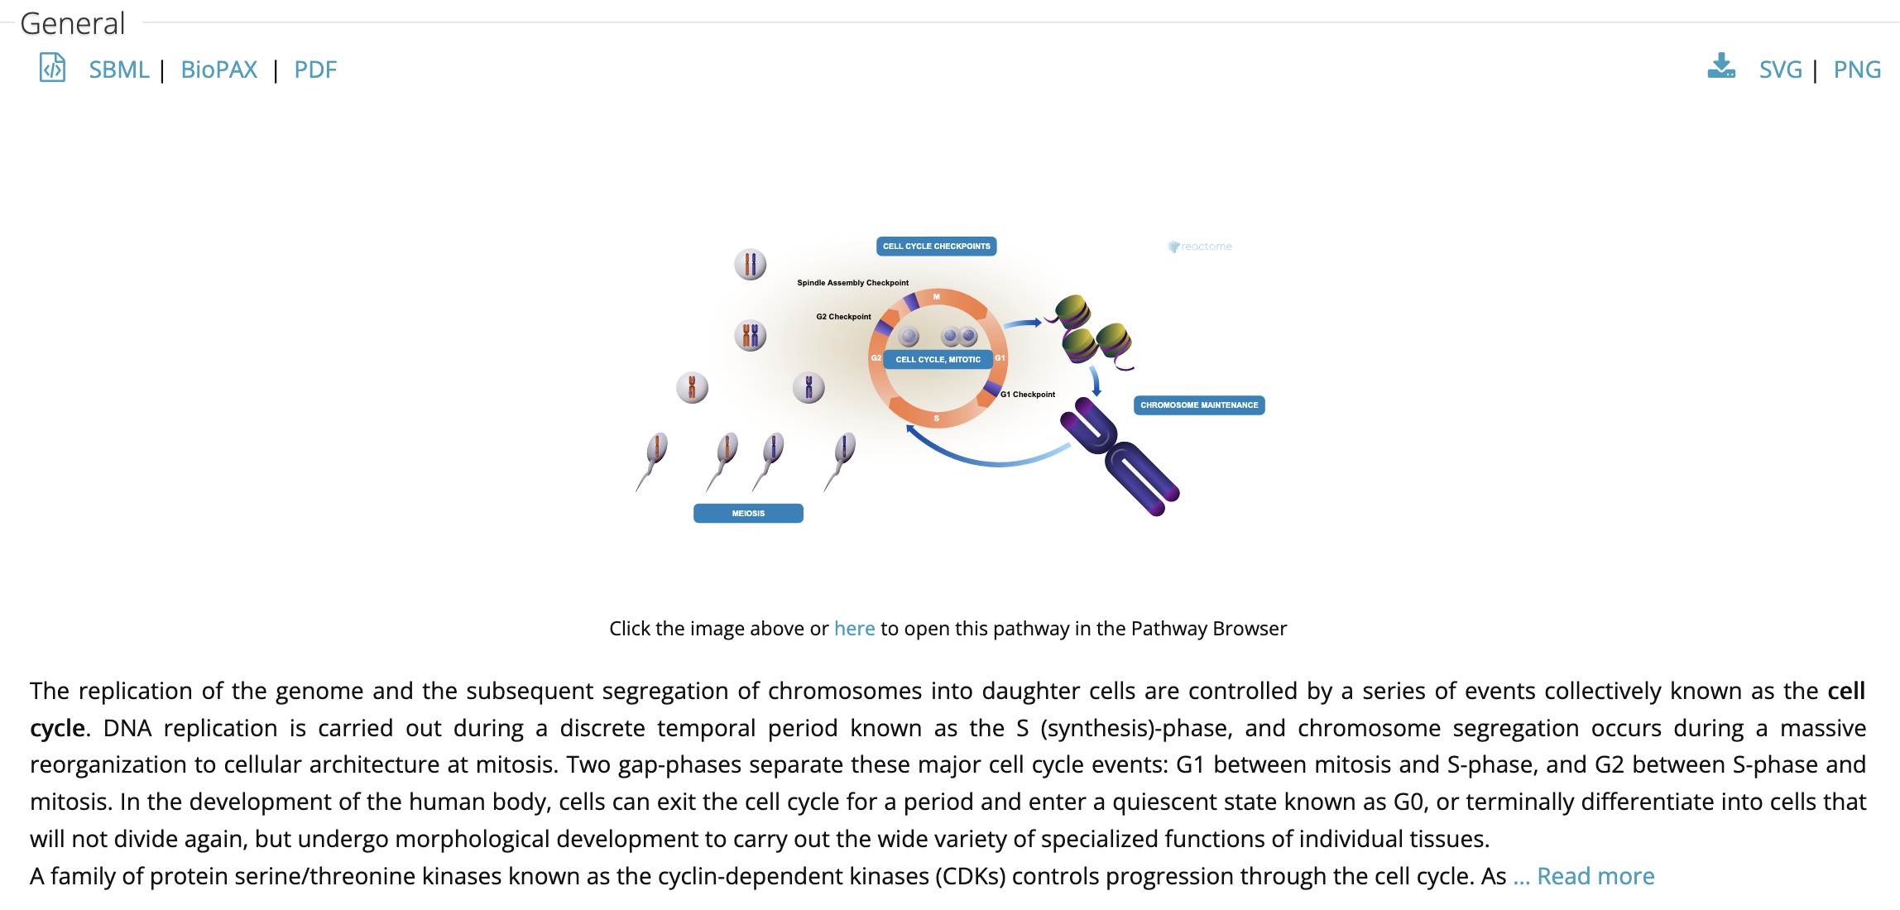
Reactome Cell Cycle
https://reactome.org/PathwayBrowser/#/R-HSA-453274&PATH=R-HSA-1640170,R-HSA-69278,R-HSA-453274

Slide 13
Pathways and networks
Notes:
Advantages:
Usually curated.
Biochemical view of biological processes.
Cause and effect captured.
Human-interpretable visualizations.
Disadvantages:
Sparse coverage of genome.
Different databases disagree on boundaries of pathways.
Pathways capture only the “well understood” portion of biology.
Networks cover less well understood relationships:
Genetic interactions
Physical interaction
Coexpression
GO term sharing
Adjacency in pathways

Slide 14
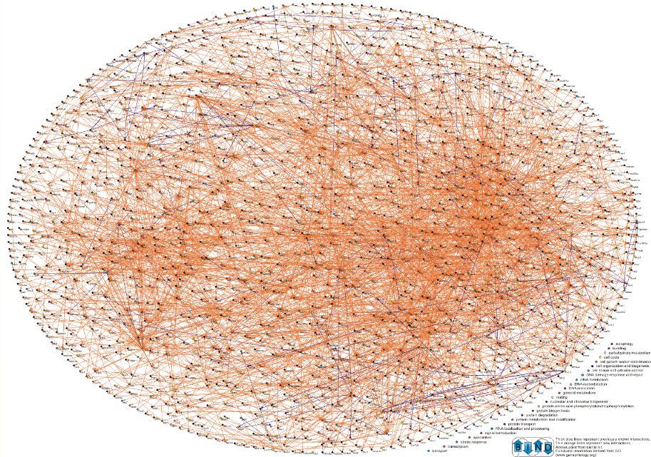
Networks
Pathways capture only the “well understood” portion of biology
Networks cover less well understood relationships:
Genetic interactions
Physical interaction
Coexpression
GO term sharing
Adjacency in pathways

Slide 15
Network Databases
Can be built automatically or via curation
More extensive coverage of biological systems
Relationships and underlying evidence more tentative
Popular sources of curated networks:
BioGRID – Curated physical and genetic interactions from literature; 89K genes & 2.1M interactions from 80 species (https://thebiogrid.org/)
IntAct – Curated interactions from literature; 143K interactors & 1.5M interactions from 9000 species. (https://www.ebi.ac.uk/intact/home)
GeneMANIA - Compendium of 2.8K gene association networks representing 167K genes and 660M interactions from 9 species

Slide 16
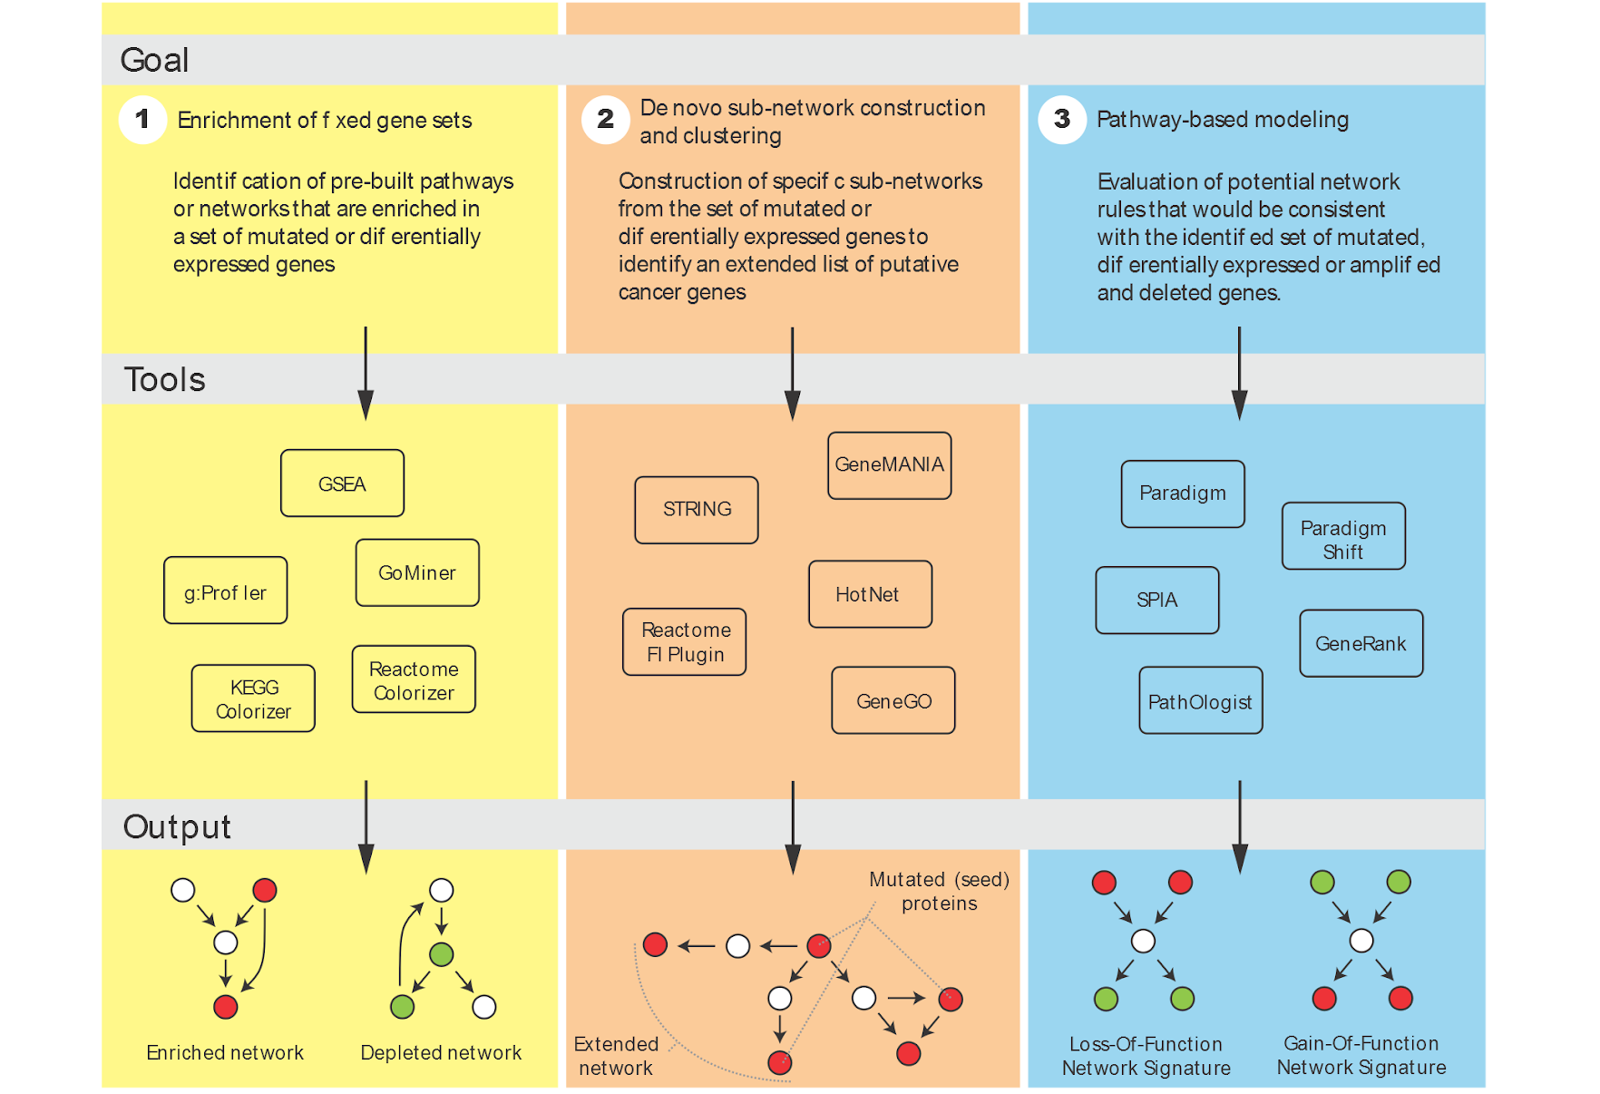
Pathway/Network Analysis
Given the pathway structure, what functional states explain my observations? Are there targetable pathways in this patient?
What biological processes are altered in this cancer?
Are new pathways altered in this cancer? Are there clinically-relevant tumour subtypes?

Slide 17
Enrichment of Fixed Gene Sets
Covered in Module 2
Most popular form of pathway/network analysis
Overrepresentation analysis vs functional class scoring
Advantages:
Easy to perform
Many good end-user tools
Statistical model well worked out
Disadvantages:
Many possible gene sets
Gene sets are heavily overlapping
“Bags of genes” obscure regulatory relationships among them
Not well-suited for mutations data
Notes:
Great for genes from differential gene expression analysis

Slide 18
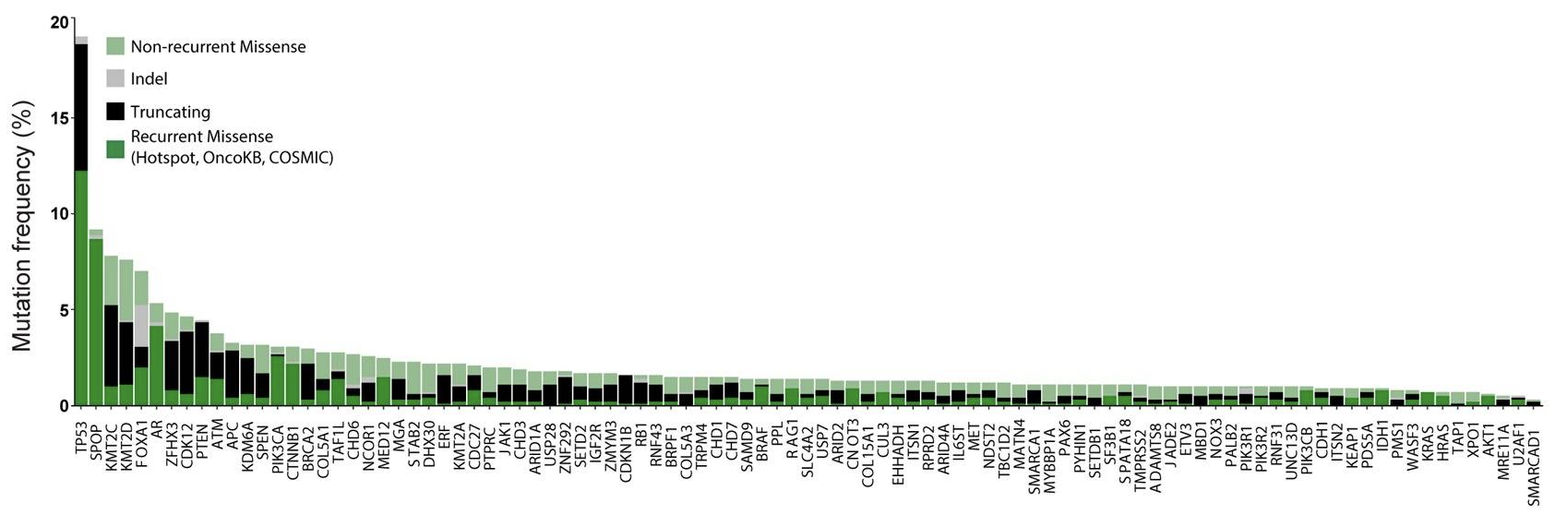
Working with mutation data
Standard pathway analysis doesn’t work well for somatic mutations
Sparseness and heterogeneity result in a ‘long tail’ of rare cancer mutations
Nat Genet. 2018 Apr 2;50(5):645–651. doi: 10.1038/s41588-018-0078-z
Notes:
Sparse data: few mutations per tumor
Heterogeneity: different tumors mutate different genes

Slide 19
Working with mutation data
Standard pathway analysis doesn’t work well for somatic mutations
Sparseness and heterogeneity result in a ‘long tail’ of rare cancer mutations
We often have small gene lists of ~20-50 significant genes
’Driver’ and ‘passenger’ mutations have different biological implications
What does this mean for ORA and GSEA?
ORA needs many genes hitting same pathway: mutations too sparse
GSEA needs ranked list: mutations aren’t naturally ranked
Both miss connections between related pathways
Neither identifies convergent mutations in the same process
Nat Genet. 2018 Apr 2;50(5):645–651. doi: 10.1038/s41588-018-0078-z
Notes:
Sparse data: few mutations per tumor
Heterogeneity: different tumors mutate different genes

Slide 20
Leverage networks to solve the sparse data problem
Key Insight
Mutated genes that are functionally connected are more likely to be drivers affecting the same biological process.

Slide 21
Pathway/Network Analysis
Given the pathway structure, what functional states explain my observations? Are there targetable pathways in this patient?
What biological processes are altered in this cancer?
Are new pathways altered in this cancer? Are there clinically-relevant tumour subtypes?
https://www.nature.com/articles/nmeth.3440

Slide 22
De Novo Subnetwork Construction & Clustering
Are new pathways altered in this cancer? Are there clinically-relevant tumour subtypes?
Apply list of altered molecular entities (genes, proteins, RNAs) to a biological network
Identify “topologically unlikely” configurations
eg. a subset of the altered genes are closer to each other on the network than you would expect by chance
Extract clusters of these unlikely configurations
Annotate the clusters

Slide 23
Finding convergence in mutations
Look for shared functional consequence in different genes
Example: RTK/RAS/PI3K Signaling Module
Patient 1
Patient 2
Patient 3
EGFR mutation
ERBB2 mutation
KRAS mutation
Same Module: RTK Signaling
Statistical Power Through Aggregation
Gene X mutated in 5% + Gene Y mutated in 3% = Not significant individually.
But if X and Y form a connected module, then 8% of tumors affect this pathway → Now statistically significant!

Slide 24
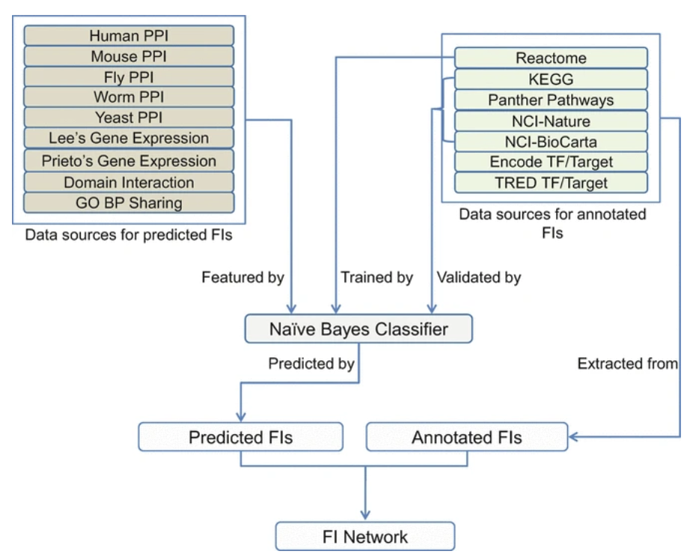
ReactomeFI
Reactome Functional Interaction allows us to analyze genes in a network context
To reveal relationships between genes
To inform our biological understanding of genes and gene products
A functional interaction is an interaction where two proteins are involved in the same reaction
Protein Bioinformatics. Methods in Molecular Biology, vol 1558. Humana Press, New York, NY. https://doi.org/10.1007/978-1-4939-6783-4_11
Notes:
Physical interaction: Proteins that directly bind (e.g., TP53 binds MDM2)
Functional interaction: Genes that work together in a pathway, even if they don't bind (e.g., TP53 activates CDKN1A transcription)

Slide 25
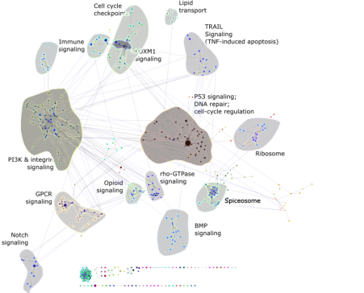
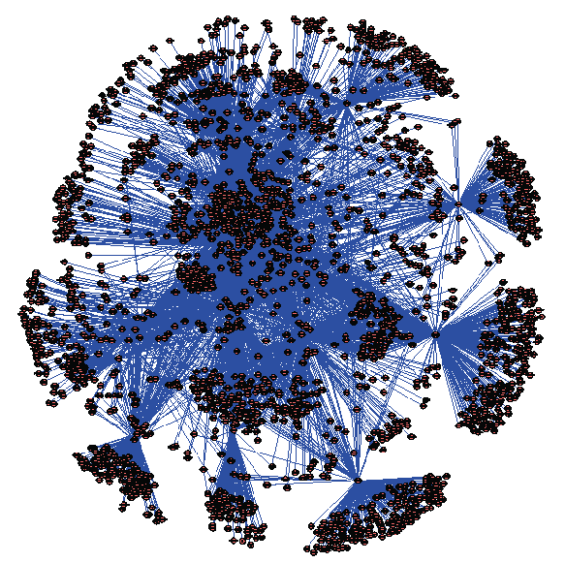
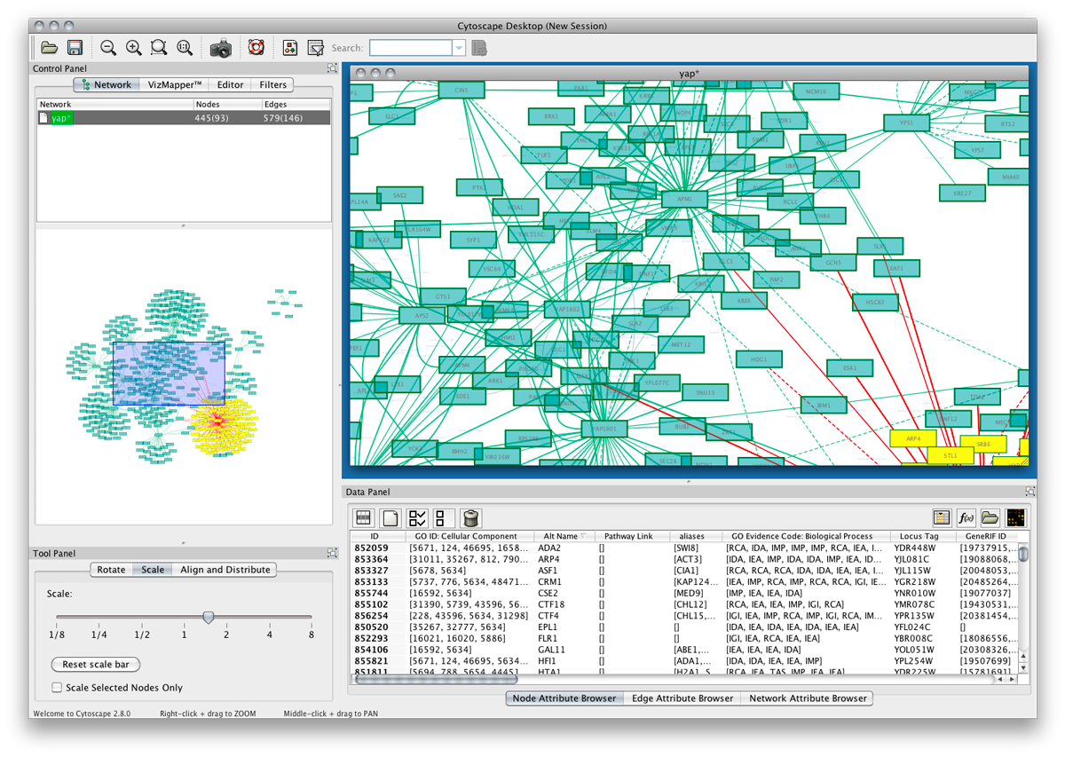
The Reactome FI Network
Extract and Cluster “Disease Genes”
+
Machine Learning
Curated
Pathway Dbs
Uncurated
Interaction
Evidence
Reactome Functional Interaction Network
(~11,000 proteins; 270,000 interactions)
Workflow available as a cytoscape plugin.
A human functional protein interaction network and its application to cancer data analysis, Wu et al. 2010 Genome Biology

Slide 26
Other network clustering algorithms
GeneMANIA
“Birds of a feather” principle.
Very useful for finding genes that are related to an experimentally defined set.
HotNet
Finds “hot” clusters based on propagation of heat across metallic lattice.
Avoids ascertainment bias on unusually well-annotated genes.
HyperModules Cytoscape App
Find network clusters that correlate with clinical characteristics.
Reactome FI Network Cytoscape App
Offers multiple clustering and correlation algorithms (including HotNet, and survival correlation analysis)

Slide 27
Pathway/Network Analysis
Given the pathway structure, what functional states explain my observations? Are there targetable pathways in this patient?
What biological processes are altered in this cancer?
Are new pathways altered in this cancer? Are there clinically-relevant tumour subtypes?
Covered in Module 2
Most popular form of pathway/network analysis.

Slide 28
Pathway-Based Modeling
Given the pathway structure, what functional states explain my observations?
Apply list of altered molecular entities (genes, proteins, RNAs) to biological pathways
Preserve detailed biological relationships
Attempt to integrate multiple molecular alterations together to yield lists of altered pathway activities
Pathway modeling shades into Systems Biology

Slide 29
Types of Pathway-Based Modeling
Partial differential equations, e.g. CellNetAnalyzer
Mostly suited for biochemical systems (metabolomics)
Network flow models, e.g. NetPhorest
Mostly suited for kinase cascades (phosphorylation info)
Transcriptional regulatory network-based reconstruction methods, e.g. ARACNe
Logic Graphs and probabilistic graph models (PGMs)
Capture the logic of a pathway without needing rate/binding constants.
Generative AI Models

Slide 30
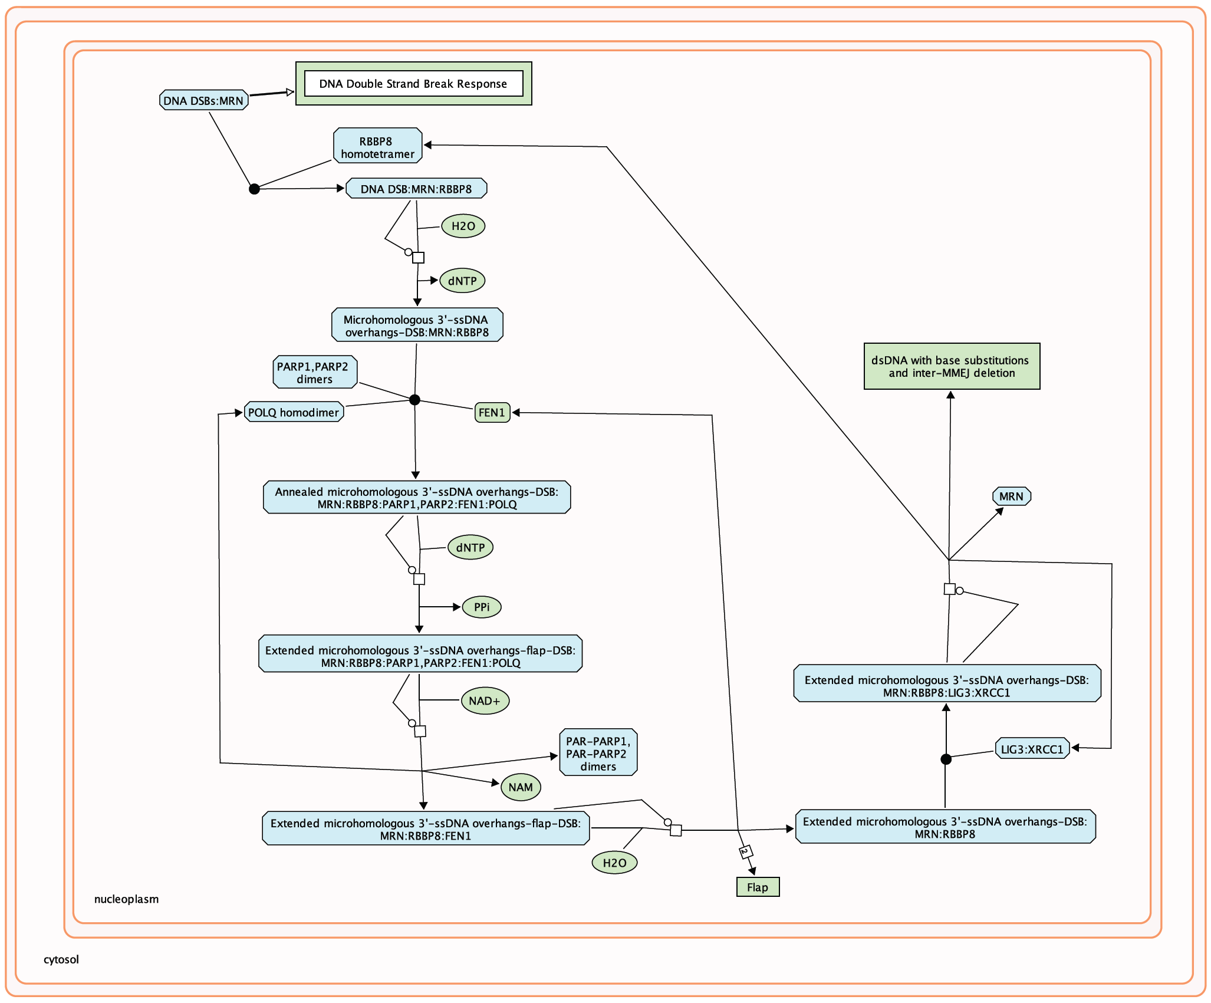
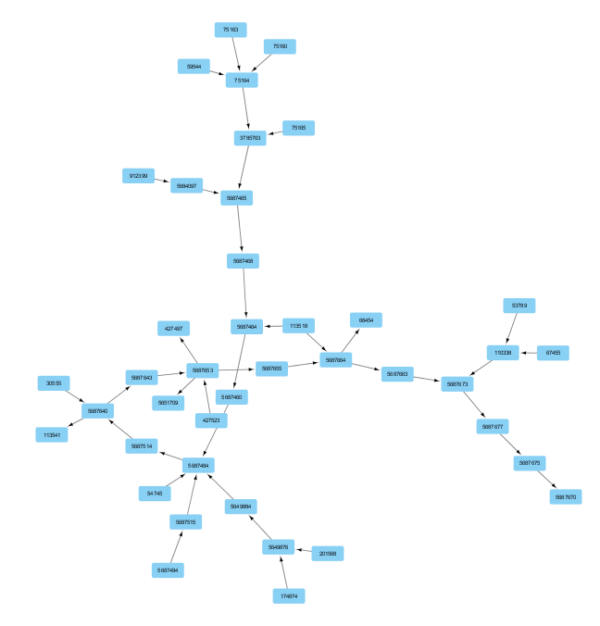
Boolean Network Inference (PARADIGM)
Pathway View
Logic Graph View
Pathway Database (Reactome/NCI-PID/KEGG) → Convert to Graph → Overlay Patient Data (CNA + Expression) → Belief Propagation (inference) → Inferred Pathway Levels per node per patient
Notes:
Left: Pathway View (Reactome-style)
This is the DNA Double Strand Break Response pathway as you'd see it in Reactome or similar databases. It shows:
Proteins/complexes (blue rounded boxes): RBBP8 homotetramer, MRN, PARP1/PARP2 dimers, LIG3:XRCC1, POLQ homodimer, FEN1
Small molecules (green ovals): H₂O, dNTP, NAD+, NAM
DNA intermediates (blue boxes): Various states of DNA repair (microhomologous overhangs, extended structures, annealed complexes)
Reactions (arrows with black squares): Biochemical transformations
Protein complexes (long teal boxes): Multi-protein assemblies like "Annealed microhomologous 3'-ssDNA overhangs-DSB: MRN:RBBP8:PARP1:PARP2:FEN1:POLQ"
This is a mechanistic view — it shows the actual biochemistry of how double-strand breaks are repaired via microhomology-mediated end joining (MMEJ).
Right: Logic Graph View (Factor Graph)
This is PARADIGM's computational representation of the same pathway. Each node (blue box with a number) represents a pathway entity that PARADIGM will infer an activity state for.
Key features:
Nodes become variables: Each protein, complex, and process gets a node ID (the numbers like 9007405, 427457, etc.)
Edges encode relationships: Arrows show regulatory/causal dependencies
Directionality preserved: The flow of information (inputs → outputs) is maintained
Hierarchical structure: Notice how nodes fan out from top to bottom, representing the cascade of events
The red "?" in the middle highlights a key concept: PARADIGM will infer the activity state of this node based on:
The observed data (CNA, expression) at measured nodes
The states of connected nodes
The probabilistic relationships encoded in the edges
The factor graph structure allows PARADIGM to propagate evidence through the network. If a node at the top is deleted (observed via CNA), and nodes at the bottom are lowly expressed (observed via RNA-seq), PARADIGM can infer that the intermediate nodes (like the one with "?") are likely inactive — even if we don't have direct measurements for them.

Slide 31
Generative AI Network Models
Large Language Models (GPT-3) are trained to predict masked text:
The quick brown fox jumped over the lazy dog.
Generative pathway models are trained to predict gene network perturbations:
?
FOXM1
AIMP2
AP1G1
ARL4A
AURKA
CIT
ZNF785
?
…

Slide 32
How to choose a tool?
What is your biological question?
Will the tool work for your model?
Does the tool include reasonable gene sets (pathway databases)?
Are the pathway databases up to date?
Is the statistical output sufficient?
Do you like the output style? Will it work for downstream analysis?
Can you connect it with network visualization tools like Cytoscape?

Slide 33
Some tips for good PNA and beyond
Name files clearly
Record parameters
Include analysis type and data source
Document FDR, gene set sizes, databases
Start stringent
Look for convergence
Begin at FDR 0.01, relax if needed
Same pathways across methods = confidence
Think biologically
Identify hubs
Do results fit disease mechanism?
Genes connecting data types may be drivers

Slide 34
Summary
Pathway/network analysis is an active and changing field
There are three major goals for pathway analysis
Enrichment of fixed gene sets (Module 2)
De novo sub-network construction and clustering (Module 4 lab)
Pathway-based modeling (Module 4 lab Extra content)
The appropriate method depends on your goal and data

Slide 35
Resources
BioGRID
http:// www.thebiogrid.org
IntAct
http://www.ebi.ac.uk/intact/
KEGG
http:// www.genome.jp/kegg
Reactome
http:// www.reactome.org
GeneMANIA
http://www.genemania.org
HotNet
http://compbio.cs.brown.edu/projects/hotnet/
HyperModules
http://apps.cytoscape.org/apps/hypermodules
Reactome Cytoscape FIViz App
http://apps.cytoscape.org/apps/reactomefis
CellNetAnalyzer
http://www.ebi.ac.uk/research/saez-rodriguez/software
NetPhorest/NetworKIN
http://netphorest.info, http://networkin.info
ARACNe
http://wiki.c2b2.columbia.edu/califanolab/index.php/Software/ARACNE
Pathway Prediction Evaluation Paper
https://www.ncbi.nlm.nih.gov/pmc/articles/PMC9216552/

Slide 36
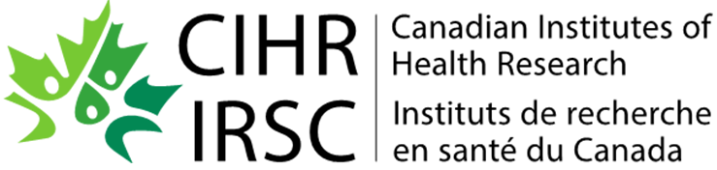






Let’s Take a Break
Workshop Sponsors

